Slide 1
Efficient Multi-GPU Shared Memory via Automatic Optimization of Fine-Grained Transfers
Inter-GPU communication via bulk DMA-based transfers exposes data transfer latency on the GPU’s critical execution path because these large transfers are logically interleaved between compute kernels. fine-grained peer-to-peer memory accesses during kernel execution lead to memory stalls that can exceed the GPUs’ ability to cover these operations via multi-threading.

Slide 2
Efficient Multi-GPU Shared Memory via Automatic Optimization of Fine-Grained Transfers
PROACT
a system enabling remote memory transfers with the programmability and pipeline advantages of peer-to-peer stores, while achieving interconnect efficiency that rivals bulk DMA transfers. enables interconnect-friendly data transfers while hiding the transfer latency via pipelining during kernel execution.

Slide 3
Efficient Multi-GPU Shared Memory via Automatic Optimization of Fine-Grained Transfers
To efficiently parallelize applications across a multi-GPU system, developers typically distribute an application’s data structures across each GPU’s physical memory. interconnects sit idle during computation phases, and compute units sit idle during communication phases.

Slide 4
Efficient Multi-GPU Shared Memory via Automatic Optimization of Fine-Grained Transfers
Efficiently overlapping GPU computation with communication phases, leading to system resource under-utilization
DMA transfer: The DMA transfer occurs between the producer and consumer kernels on the GPUs, exposing the data transfer latency.
Fine-grained peer-to-peer (P2P) transfer: enable GPU compute units to issue loads and stores directly to the physical memory of remote GPUs. P2P transfers are inefficient on current GPU interconnects.

Slide 5
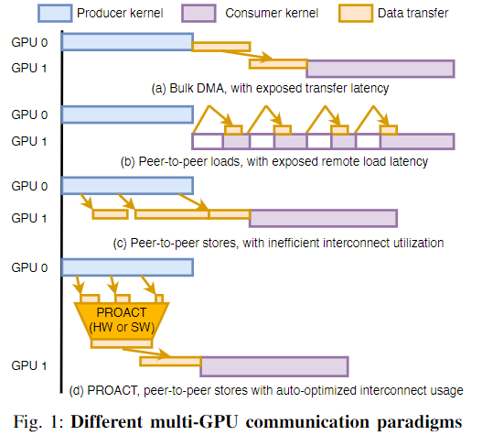
Efficient Multi-GPU Shared Memory via Automatic Optimization of Fine-Grained Transfers
Fine-grained peer-to-peer (P2P) transfer
P2P loads often result in the consumer kernel stalling while waiting for remote loads to complete, due to interconnect latency, negatively impacting performance.
As shown in Figure 1(c),P2P stores between GPUs are often generated at sub-cacheline granularity with sporadic access patterns.

Slide 6
Efficient Multi-GPU Shared Memory via Automatic Optimization of Fine-Grained Transfers
Fine-grained peer-to-peer (P2P) transfer
Although some store latency is hidden, due to protocol packetization overheads, these stores do not use the GPU-interconnect efficiently

Slide 7
Efficient Multi-GPU Shared Memory via Automatic Optimization of Fine-Grained Transfers
PROACT exposes an easy-to-use P2P-store programming model to developers but leverages profiling and GPU-runtime support to track data generation, perform transfer coalescing, and dynamically issue transfers over the interconnect to achieve high utilization.
Provides efficient overlap of per-GPU computation and inter-GPU data transfer by performing the transfers proactively soon after data generation and can be supported with either dedicated hardware or software.

Slide 8
Efficient Multi-GPU Shared Memory via Automatic Optimization of Fine-Grained Transfers
Background
CUDA Programming Model
Inter-GPU Communication Mechanisms
Inter-GPU Interconnect Efficiency

Slide 9
Efficient Multi-GPU Shared Memory via Automatic Optimization of Fine-Grained Transfers
Inter-GPU Communication Mechanisms
DMA-based bulk transfers
Peer-to-peer (P2P) GPU accesses
Programmatic communication libraries

Slide 10
Efficient Multi-GPU Shared Memory via Automatic Optimization of Fine-Grained Transfers
DMA-based bulk transfers
When using bulk DMA-based transfers between GPUs, data transfer is typically explicitly invoked from the host program executing on the CPU via cudaMemcpy(). The cudaMemcpy() call invokes the GPU’s hardware DMA engine to transfer data directly between the GPUs’ memories without the need for the transfer to reflect off of the CPU’s memory system.
However, this method is not suitable for small (several cachelines) or medium (several KB) sized transfers due to the high initialization and synchronization overhead of returning to the host program and then programming the DMA engine.

Slide 11
Efficient Multi-GPU Shared Memory via Automatic Optimization of Fine-Grained Transfers
Peer-to-peer (P2P) GPU accesses
individual GPUs are capable of directly reading and writing the physical memory of peer GPUs without GPU runtime intervention or host CPU synchronization.
However, when loads are performed from remote memory, these P2P loads often stall thread execution beyond the GPUs’ ability to hide the load latency with multi-threading due to the longer latency of the inter-GPU interconnect as compared to local memory. P2P writes almost never stall the issuing thread because there is no implicit dependence within program execution.

Slide 12
Efficient Multi-GPU Shared Memory via Automatic Optimization of Fine-Grained Transfers
Programmatic communication libraries
MPI, NVIDIA’s NCCL, NVIDIA’s NVSHMEM provide universal inter-GPU communication and synchronization patterns, irrespective of the interconnect technology and topologies on which the code runs. These libraries may selectively use bulk DMA transfers or P2P accesses under the hood, combined with the library-controlled memory management to optimize communication between GPUs.
there is little they can do to avoid DMA initiation overhead when performing large transfers.

Slide 13
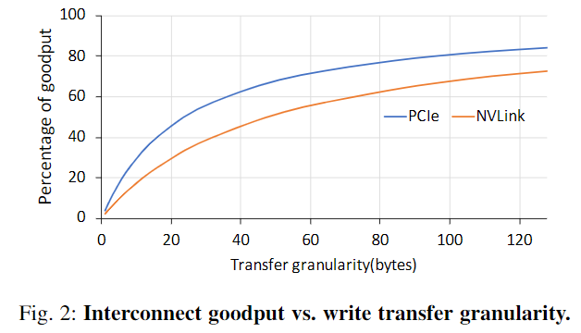
Efficient Multi-GPU Shared Memory via Automatic Optimization of Fine-Grained Transfers
Inter-GPU Interconnect Efficiency
Figure 2 shows the percentage of goodput achieved on the inter connect, i.e., the percentage of useful data delivered over
PCIe and NVLink interconnects for varying
store granularities.

Slide 14
Efficient Multi-GPU Shared Memory via Automatic Optimization of Fine-Grained Transfers
Inter-GPU Interconnect Efficiency
Interconnect efficiency decreases at these
smaller granularities because protocol packetization overheads dominate the
effective goodput.

Slide 15
Efficient Multi-GPU Shared Memory via Automatic Optimization of Fine-Grained Transfers
Inter-GPU Interconnect Efficiency
Therefore, while P2P writes may
fundamentally be the most efficient way to transfer data from a latency-hiding
perspective, dramatic improvements in
interconnect efficiency must be achieved
to improve overall multi-GPU performance.

Slide 16
Efficient Multi-GPU Shared Memory via Automatic Optimization of Fine-Grained Transfers
PROACT
bridge the benefits of DMA-based bulk copies and peer-to-peer accesses in multi-GPU systems.
provide the interconnect efficiency of large transfers with the non-blocking semantics of SM initiated peer-to-peer stores.

Slide 17
Efficient Multi-GPU Shared Memory via Automatic Optimization of Fine-Grained Transfers
PROACT
balancing the overlap of data transfers with GPU computation
maximizing the opportunity for write coalescing
smoothing interconnect utilization over time to ensure no bandwidth is wasted
increasing interconnect efficiency by ensuring communication occurs at sufficiently large granularities

Slide 18
Efficient Multi-GPU Shared Memory via Automatic Optimization of Fine-Grained Transfers
PROACT
a compile-time profiler to determine the different PROACT parameters required to achieve optimized transfer efficiency
a tracking unit to monitor data readiness
a data transfer mechanism that initiates optimized transfers

Slide 19
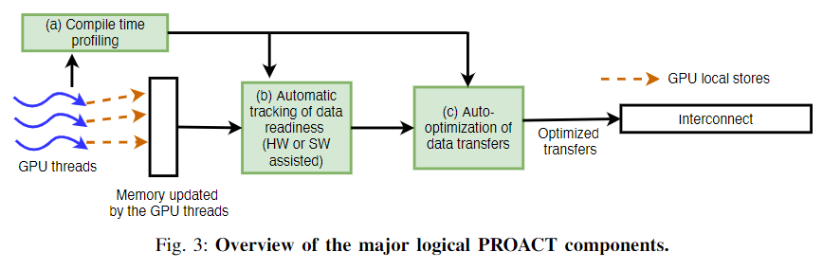
Efficient Multi-GPU Shared Memory via Automatic Optimization of Fine-Grained Transfers
PROACT

Slide 20
Efficient Multi-GPU Shared Memory via Automatic Optimization of Fine-Grained Transfers
Optimizing Transfer Efficiency via Profiling
If the granularity of P2P stores is too small, they offer poor interconnect efficiency. If a sufficient number of writes are not in flight on the interconnect at any given time, bandwidth will go underutilized.

Slide 21
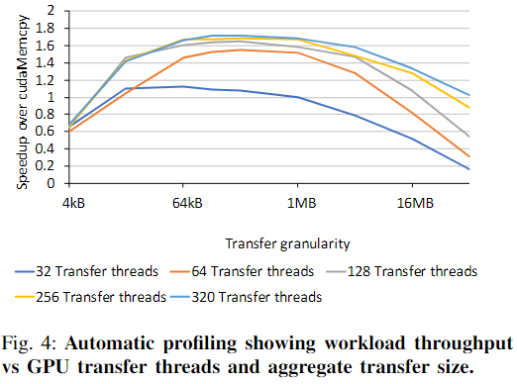
Efficient Multi-GPU Shared Memory via Automatic Optimization of Fine-Grained Transfers
Optimizing Transfer Efficiency via Profiling
Notes:
In this case, the best application throughput is obtained for transfer granularities between 64kB and 1MB when the number of threads used for the transfers is more than 128

Slide 22
Efficient Multi-GPU Shared Memory via Automatic Optimization of Fine-Grained Transfers
Optimizing Transfer Efficiency via Profiling
Each GPU generation and interconnect type has a specific number of GPU threads needed to saturate the interconnect bandwidth. By examining these profiles, PROACT can choose the number of transfer threads for a given system to maximize interconnect bandwidth while minimizing how many GPU execution lanes are used for data transfer.

Slide 23
Efficient Multi-GPU Shared Memory via Automatic Optimization of Fine-Grained Transfers
Optimizing Transfer Efficiency via Profiling
The PROACT profiler performs a parameter sweep and analyzes application performance across PROACT’s different transfer mechanisms, varying the transfer chunk size and transfer thread count, to identify the configuration that achieves the best application runtime for a given application and system. It then configures the application compilation to emit code that is most efficient according to the profiling results.

Slide 24
Efficient Multi-GPU Shared Memory via Automatic Optimization of Fine-Grained Transfers
Tracking Local Data Transfer Readiness
transmit data over the interconnect at fine granularity leads to poor interconnect efficiency.
remote GPU transfers be decoupled from each thread’s writes by aggregating these writes into local GPU memory before being transferred to remote GPUs

Slide 25
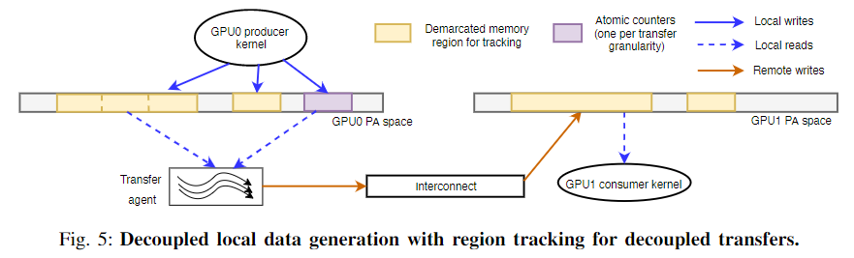
Efficient Multi-GPU Shared Memory via Automatic Optimization of Fine-Grained Transfers
Tracking Local Data Transfer Readiness

Slide 26
Efficient Multi-GPU Shared Memory via Automatic Optimization of Fine-Grained Transfers
Tracking Local Data Transfer Readiness
PROACT provides a mechanism whereby GPU threads individually write to local memory indicated by the programmer as a PROACT-enabled region. This locally written data is then propagated to remote GPUs by an asynchronously operating transfer agent.

Slide 27
Efficient Multi-GPU Shared Memory via Automatic Optimization of Fine-Grained Transfers
Tracking Local Data Transfer Readiness
The NVIDIA GPU memory model only requires weak writes and strong writes with cta and gpu scopes to be visible at remote GPUs no later than the succeeding global synchronization barrier.

Slide 28
Efficient Multi-GPU Shared Memory via Automatic Optimization of Fine-Grained Transfers
Tracking Local Data Transfer Readiness
PROACT exploits this slack by aggregating data in local memory until all writes to a transfer chunk complete, only then pushing out data to keep the interconnect saturated with high-efficiency transfers.

Slide 29
Efficient Multi-GPU Shared Memory via Automatic Optimization of Fine-Grained Transfers
Tracking Local Data Transfer Readiness
Atomic counters to track data generation
PROACT employs a set of atomic counters (one per chunk within the determined transfer granularity) to track data generation and begin the transfers.

Slide 30
Efficient Multi-GPU Shared Memory via Automatic Optimization of Fine-Grained Transfers
Tracking Local Data Transfer Readiness
Atomic counters to track data generation
Each atomic counter is initialized with a value equal to the number of Compute Thread Arrays (CTAs) that issue writes to its corresponding chunk, as determined by the compiler.

Slide 31
Efficient Multi-GPU Shared Memory via Automatic Optimization of Fine-Grained Transfers
Tracking Local Data Transfer Readiness
Atomic counters to track data generation
During execution, the counter decrements with every CTA that writes to a chunk and triggers the transfer agent to begin copying data when the counter reaches zero. PROACT requires applications to issue a deterministic number of stores for it to identify the completion of data generation on a per chunk basis and perform the transfers.

Slide 32
Efficient Multi-GPU Shared Memory via Automatic Optimization of Fine-Grained Transfers
Tracking Local Data Transfer Readiness
Notes:
As the producer kernel produces data, it also updates the atomic counters, maintained at a different location in memory. The transfer agent polls these counters, and when the expected value is observed, the transfer starts.

Slide 33
Efficient Multi-GPU Shared Memory via Automatic Optimization of Fine-Grained Transfers
Choosing the Decoupled Data Transfer Mechanism
Polling: a small configurable number of GPU warps are specialized to perform data transfers at a given granularity. Auto-generated and managed entirely by the PROACT runtime. this independently launched long-lived kernel polls the structured data-ready atomic counters that are updated by the application’s producer kernels.

Slide 34
Efficient Multi-GPU Shared Memory via Automatic Optimization of Fine-Grained Transfers
Choosing the Decoupled Data Transfer Mechanism
Polling: When ready, the transfer threads read a chunk from the local staging array and perform remote writes to the target GPU(s). these threads and the polling of the counters (in a software implementation) compete with the compute kernel(s) for execution throughput.

Slide 35
Efficient Multi-GPU Shared Memory via Automatic Optimization of Fine-Grained Transfers
Choosing the Decoupled Data Transfer Mechanism
Dynamic Kernel Launches: CUDA Dynamic Parallelism (CDP) presents another transfer agent mechanism by allowing a parent kernel to launch child kernels as needed. The tradeoff is that CDP kernel launch has a higher initiation latency than polling, though still lower than DMA-based transfers.

Slide 36
Efficient Multi-GPU Shared Memory via Automatic Optimization of Fine-Grained Transfers
Choosing the Decoupled Data Transfer Mechanism
Direct Inline Stores: native P2P stores issue remote writes to distribute data to remote GPUs as data are produced. Direct inline stores have the advantage that they spread remote writes over the course of the producer kernel without the tracking overhead of decoupled transfers, smoothing interconnect utilization as long as remote writes are evenly distributed within the kernel execution.

Slide 37
Efficient Multi-GPU Shared Memory via Automatic Optimization of Fine-Grained Transfers
Evaluated Design Alternatives
cudaMemcpy
Unified Memory: port our workload implementations to use UM by replacing conventional memory allocations with UM allocations, removing explicit data transfers, and adding the required inter-GPU synchronization
PROACT-inline: remote stores are injected directly into the source kernel to push data to remote GPUs

Slide 38
Efficient Multi-GPU Shared Memory via Automatic Optimization of Fine-Grained Transfers
Evaluated Design Alternatives
PROACT-decoupled: uses the full flexibility of the PROACT mechanisms, using the profiling tools to select the best data transfer method and other transfer parameters for each platform and application
Infinite Interconnect BW: represents the maximum speedup that applications can attain from optimizing data movement

Slide 39
Efficient Multi-GPU Shared Memory via Automatic Optimization of Fine-Grained Transfers
Microbenchmarks: consist of a syn-thetic compute kernel running on a source GPU and generating data needed in its entirety by the destination GPUs for the next phase.
MBIR X-ray CT
Page Rank
Single Source Shortest Path
Alternating Least Squares
Jacobi Solver

Slide 40
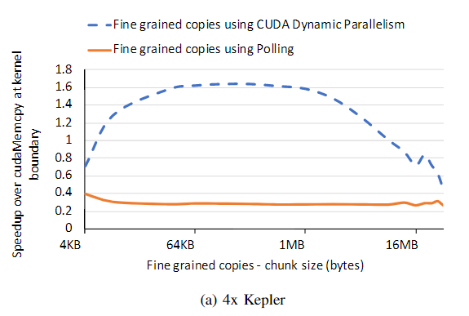
Efficient Multi-GPU Shared Memory via Automatic Optimization of Fine-Grained Transfers
Notes:
Figure 6 shows the performance of the microbenchmark when varying the granularity for decoupled transfers from 4KB to 256MB, where each source thread block generates 4KB of data

Slide 41
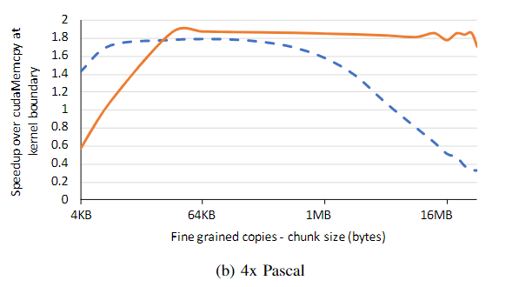
Efficient Multi-GPU Shared Memory via Automatic Optimization of Fine-Grained Transfers

Slide 42
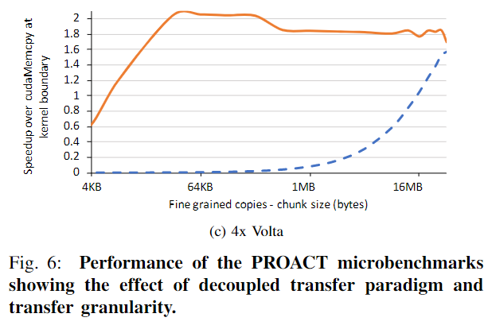
Efficient Multi-GPU Shared Memory via Automatic Optimization of Fine-Grained Transfers
Notes:
the degree the data transfer kernel interferes with the parent computation depends on the number of warps in the data transfer kernel and again varies across GPU platforms. Thus, per GPU platform, the highest-performing data transfer mechanism varies across transfer granularity, transfer mechanism (DMA vs. fine-grained), and transfer agent type (polling vs. CUDA dynamic parallelism)

Slide 43
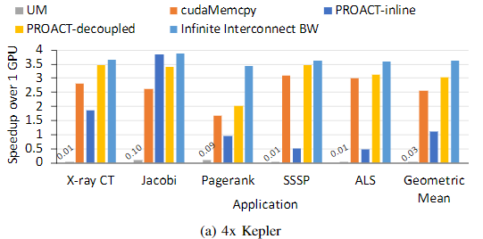
Efficient Multi-GPU Shared Memory via Automatic Optimization of Fine-Grained Transfers
Notes:
Figure 7 shows the speedups achievable on a 4-GPU system over a single GPU across three different GPU generations

Slide 44
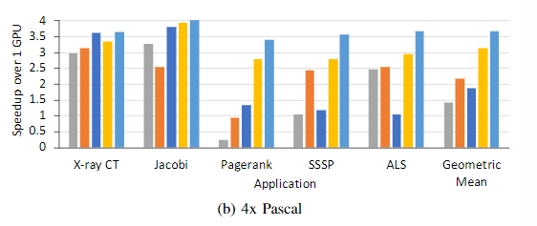
Efficient Multi-GPU Shared Memory via Automatic Optimization of Fine-Grained Transfers
Notes:
Figure 7 shows the speedups achievable on a 4-GPU system over a single GPU across three different GPU generations

Slide 45
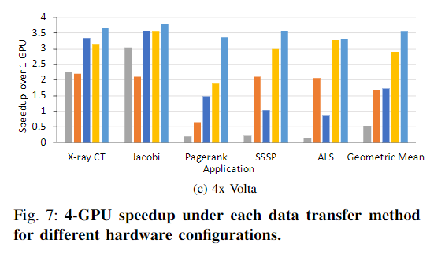
Efficient Multi-GPU Shared Memory via Automatic Optimization of Fine-Grained Transfers
Notes:
even with programmer-directed hints, traditional fault-based UM can not be relied upon to achieve peak performance. Thus, compared with different communication paradigms, the benefits of PROACT (both inline and decoupled) over cudaMemcpy come from its ability to overlap compute and communication, and the benefits over UM come from avoiding expensive page faulting and migration. PROACT-decoupled performs better than PROACT-inline when the higher interconnect efficiency achieved by decoupling outweighs the overheads on the compute kernel and vice-versa

Slide 46
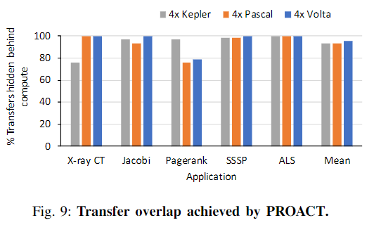
Efficient Multi-GPU Shared Memory via Automatic Optimization of Fine-Grained Transfers
Notes:
The difference between the runtime with and without the data transfer operations reveals the portion of transfer time that is not overlapped. We then determine the fraction of overlap by comparing the non-overlapped transfer time to the baseline duplication time with cudaMemcpy, reported in Figure 9.

Slide 47
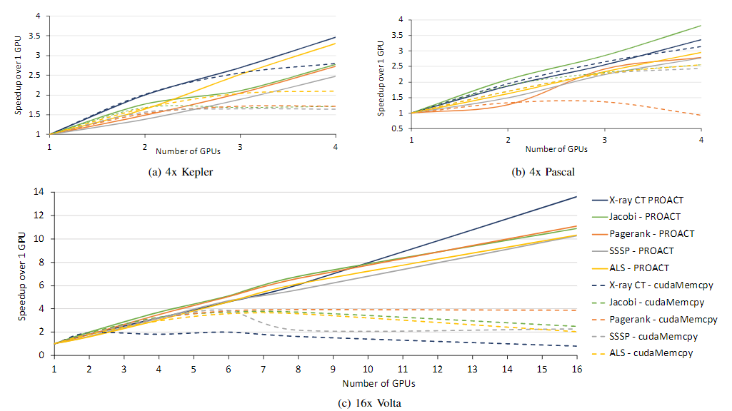
Efficient Multi-GPU Shared Memory via Automatic Optimization of Fine-Grained Transfers
Notes:
Figure 10 shows the absolute speedup that PROACT achieves on Kepler, Pascal, and Volta for systems with up to 4, 4, and 16 GPUs, respectively.

Slide 48
Efficient Multi-GPU Shared Memory via Automatic Optimization of Fine-Grained Transfers
Notes:
as the number of GPUs increases to four (on the Kepler- and Pascal-based systems), and five-sixon the Volta-based system, performance with cudaMemcpy flattens and even begins decreasing

Slide 49
Efficient Multi-GPU Shared Memory via Automatic Optimization of Fine-Grained Transfers
Conditions benefit from PROACT:
Strong scaling performance is limited by inter-GPU communication
the write access pattern of the application is deterministic in nature
programmers use structured programming

