Slide 1
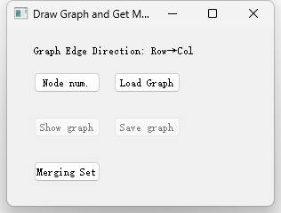

Slide 2
TSG→MS
Algorithm
This Repository
Our APP
API
TSG
MS
Testing Examples

Slide 3
TSG→MS
Algorithm
This Repository
Our APP
API
TSG
MS
Testing Examples
Experiment Codes

