Slide 1
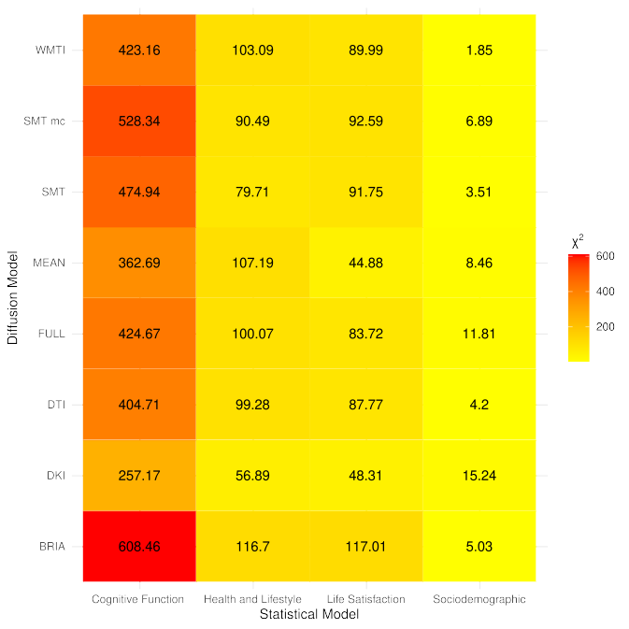
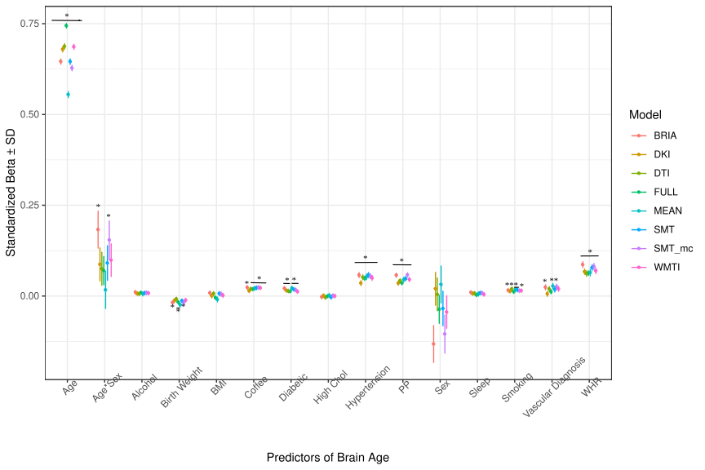
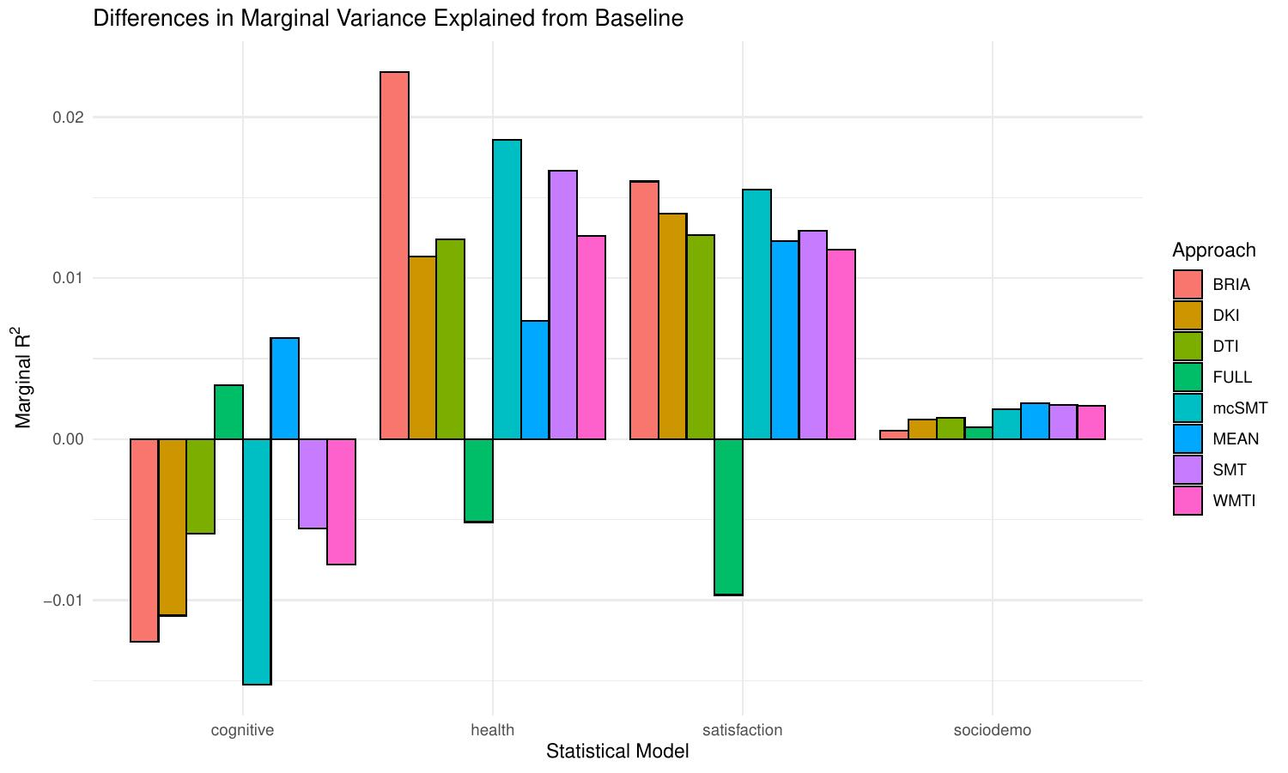




Brain age estimates from different white matter microstructure features associate concordantly with bio-psycho-social factors.
Bio-psycho-social factors’ associations with brain age: a large-scale UK Biobank diffusion study of 35,749 participants
Background: Brain age (BA) has previously been described as a general health marker. Yet, BA’s associations with various bio-psycho-social factors have not been layed out in a structured way.
Method: BAs of UK Biobank participants (N = 35,749, 44.6–82.8 years of age) estimated from white matter microstructure features were associated with bio-psycho-social variables within the domains of sociodemographic, cognitive, life-satisfaction, as well as health and lifestyle.
v
v
Result 1: Adding blocks of cognitive function, health and lifestyle, life satisfaction, and socio-demographic variables to a baseline model changed BA variance explained significantly.
Result 3: While bio-psycho-social variables were limited in adding explained variance to the baseline BA models, we identified various concordantly significant predictors across diffusion approaches (with the exception of socio-demographics).
Single health and lifestyle factors were most predictive of BA, with waist-to-hip-ratio, diabetes, hypertension and related diagnoses, smoking status, coffee consumption being indicative of a higher BA. An inverse relationship was found between BA and birth weight. Finally, higher health satisfaction, self-rated health, and digit substitution scores were indicative of lower brain ages.
WMTI = white matter tract integrity, SMT mc = multi-compartment spherical mean technique, SMT = spherical mean technique, MEAN = whole brain average brain age, FULL = all diffusion features combined, DTI = diffusion tensor imaging, DKI = diffusion kurtosis imaging, BRIA = Bayesian rotationally invariant approach.
v
Result 2: Yet, these changes were relatively small: R²<3%.
Conclusion: As previously assumed, our results indicate BA as a general marker of health. Moreover, associations of white matter BA with bio-psycho-social factors are robust to different microsructure modelling assumptions. A potentially fruitful guiding principal for future brain age associations research could be to focus on measures which are directly or indirectly related to or reflect pathology.
v
Max Korbmacher (makor@hvl.no), Tiril P. Gurholt, Ann-Marie G. de Lange, Dennis van der Meer, Dani Beck, Eli Eikefjord, Arvid Lundervold, Ole A. Andreassen, Lars T. Westlye, Ivan I. Maximov
To the paper

