Slide 1
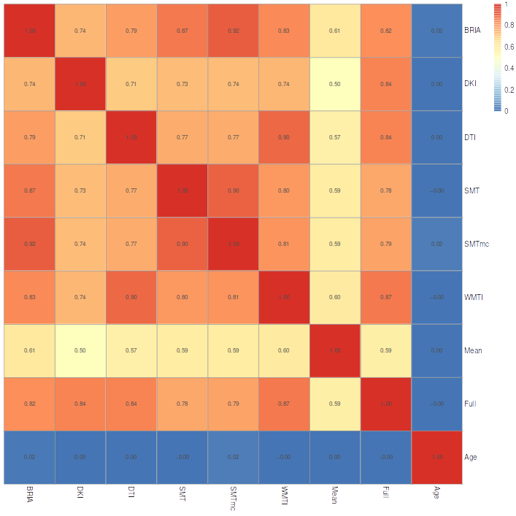
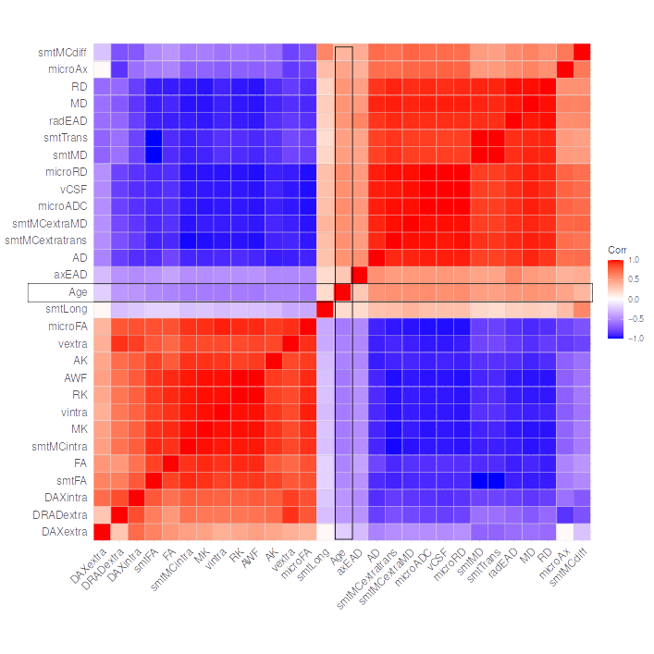
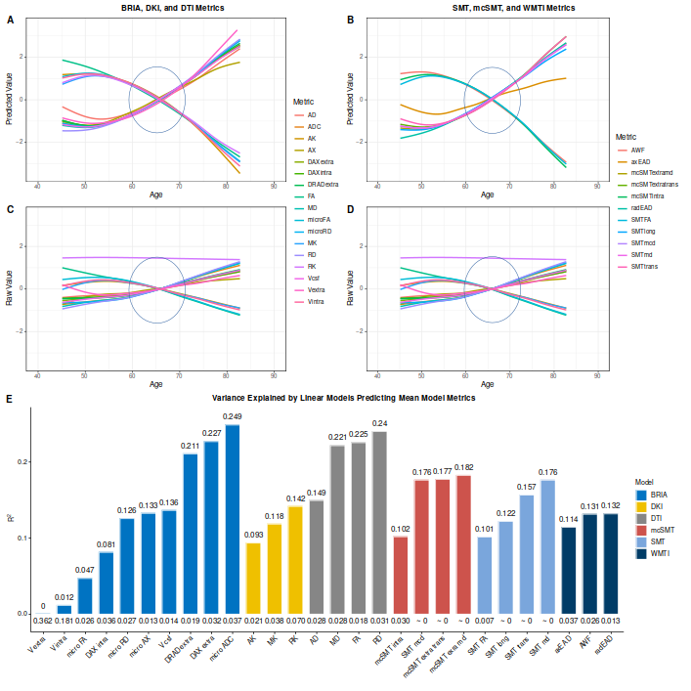
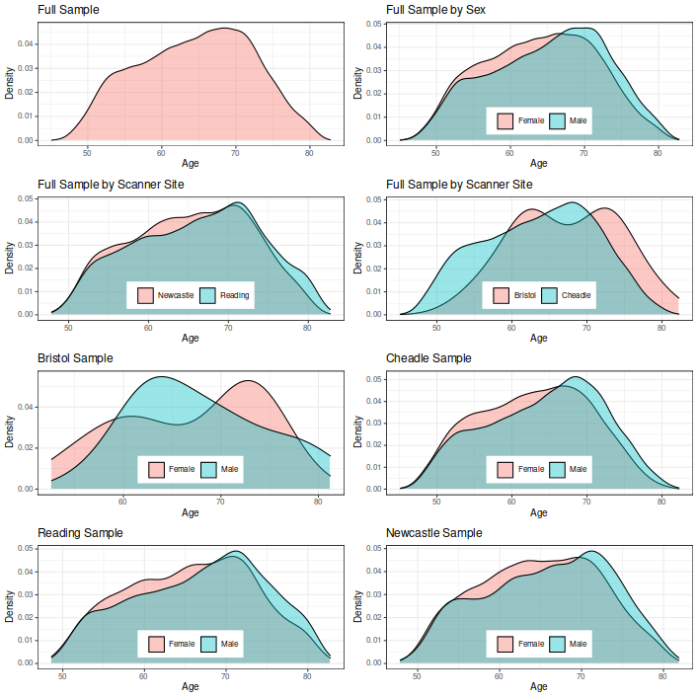
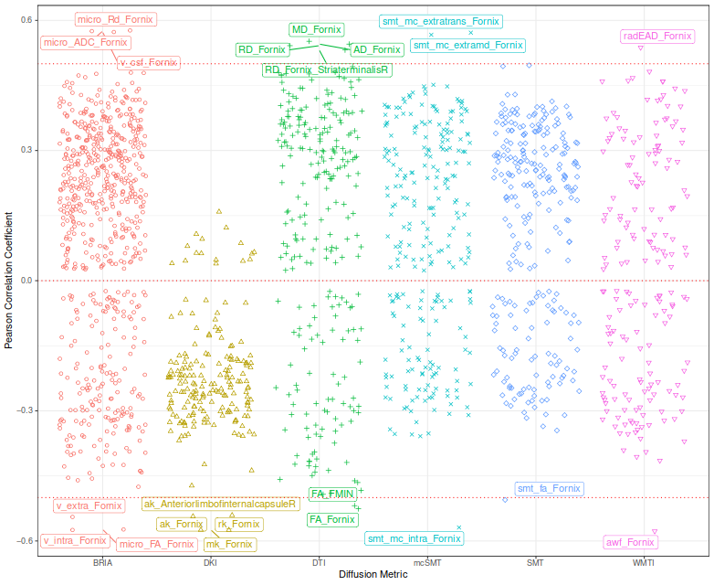
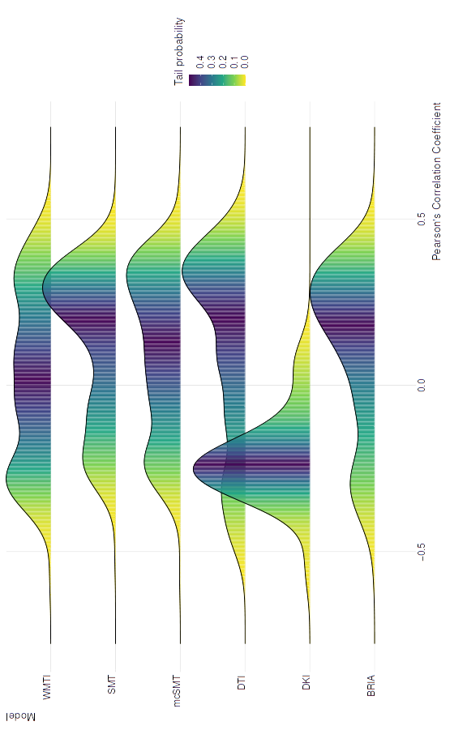

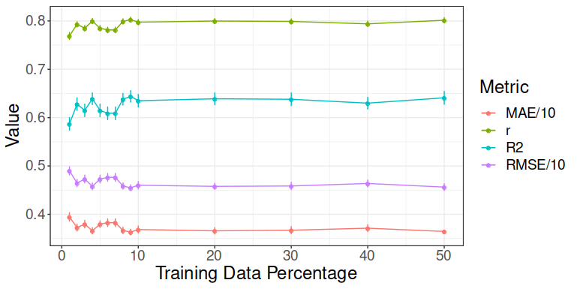


Brain-wide associations between white matter and age: fornix microstructure drives brain age
Max Korbmacher¹, Ann Marie de Lange^{2,5,6}, Eli Eikefjord^{1,9}, Dennis van der Meer^{2,10}, Arvid Lundervold^{1,7,8,9}, Ole A. Andreassen², Lars T. Westlye^{2,3,4}, Ivan I. Maximov¹
Purpose
Results
Fig. 5. Correlation matrix for fornix diffusion metrics and chronological age
Fig. 3. Corrected brain age gap correlations across models and age
An extensive comparison between diffusion approaches based on brain age predictions and the identification of the driving white matter (WM) regions in human ageing is still lacking.
This study was performed to close this knowledge gap by mapping WM features across the lifespan and identifying regions driving global estimates of brain age.
Differences in correlations between predicted and chronological age across diffusion approaches were small for corrected (r ≤ 0.02) and uncorrected age predictions (r < 0.05).
Global fornix features are highly correlated in clearly distinguishable clusters (Fig. 5).
Predicting global diffusion features from age, sex and scanner site produces clear curvilinear trends across approaches (Fig. 6).
Key finding: Fornix is the driving region of cross-sectional white matter brain ageing which can be assessed using different diffusion approaches.
Fig. 6A-B: predicted scores
Fig. 6C-D: raw scores
Fig. 6E: R² (bars) and SE (below bars) for 6A-B
Methods
Brain age gaps (BAG) were strongly correlated across models, with r > 0.7 (Fig. 3).
Tract-based spatial statistics were use to extract region-wise (John Hopkins University atlas) and global diffusion metrics for six different diffusion approaches¹ using UK Biobank diffusion-weighted MRI data N=35,749, 44.57 to 82.75 years (Figure 1).
Of all white matter regions, fornix features were strongest correlated with age (Fig. 4), and having the highest feature gain in brain age predictions (Table 1).
Fig. 6. Raw and predicted whole-brain WM diffusion metrics by chronological age
Fig. 1. Age density by sex and site
Fig. 4. Distribution of age-WM feature correlations for different diffusion approaches
After testing for optimal train-test splits (Fig.2) brain age was predicted on 90% of the original sample using the gradient boosting algorithm XGBoost.
Additionally, associations and age trajectories were examined for brain age predictions from different diffusion models as well as diffusion parameters and age.
¹ 1) diffusion tensor imaging (DTI); 2) diffusion kurtosis imaging (DKI); 3) kurtosis derived supplement / white matter tract integrity (WMTI); 4) spherical mean technique (SMT); 5) multi-compartment spherical mean technique (mcSMT); 6) Bayesian rotationally invariant approach (BRIA)
Table 1. Top five diffusion metrics ranked by gain in age prediction accuracy
Conclusion
Fig. 2.Model performance for different train-test splits
BRIA | DKI | DTI | SMT | mcSMT | WMTI | Multimodal
Micro FA fornix (54957) | MK fornix (39662) | MD fornix (50535) | MD fornix (43563) | Intra fornix (38043) | AWF fornix (52531) | Micro FA Fornix (67749)
Micro RD right external capsule (22860) | RK fornix (26954) | RD FMIN (18386) | MD right anterior corona radiata (24675) | Extra trans Fornix (35799) | RadEAD ATRL (12328) | RD Fornix right Striaterminalis (17664)
Micro FA FMIN (10081) | AK right anterior limb of internal capsule (16340) | RD fornix right stria terminalis (15431) | MD SLFR (19451) | Extratrans right external capsule (15369) | RadEAD right anterior corona radiata | AK anterior right limb of internalcapsule (17664)
Micro FA fornix right stria terminlis (9853) | AK fornix | AD fornix (9637) | MD FMIN (13527) | Extra MD anterior left limb of internal capsule (6254) | RadEAD IFOFR (9828) | RadEAD right anterior corona radiata (17375)
Micro RD Fornix right stria terminalis (9812) | AK left superior frontooccipital fasciculus | FA fornix left striaterminalis (9283) | FA fornix (12011) | Extra trans anterior right limb of internal capsule (6126) | RadEAD right external capsule (9793) | RadEAD SLFR (15840)
Conventional and advanced diffusion models perform concordant with each other on brain age predictions, with fornix being the key region for these predictions.
Fornix features were not only strongest correlated with age, but formed also a unique, strong correlation structure across diffusion approaches indicating similarities in metrics of different diffusion approaches.
Age curves of global WM features showed similarities in slopes for features of different approaches, indicating that advanced diffusion approaches can be useful in addition to convential DTI when examining age-WM associations.
1 Western Norway University of Applied Sciences, Bergen, Norway, 2 NORMENT Centre for Psychosis Research, Division of Mental Health and Addiction, University of Oslo and Oslo University Hospital, Oslo, Norway, 3 Department of Psychology, University of Oslo, Oslo, Norway, 4 KG Jebsen Centre for Neurodevelopmental Disorders, University of Oslo, Oslo, Norway, 5 LREN, Centre for Research in Neuroscience
This research has been conducted using the U.K. Biobank under Application 27412. This work was performed on the TSD (Tjeneste for Sensitive Data) facilities, owned by the University of Oslo, operated and developed by the TSD service group at the University of Oslo, IT-Department (USIT). Computations were also performed on resources provided by UNINETT Sigma2—the National Infrastructure for High Performance Computing and Data Storage in Norway.
Max.Korbmacher@hvl.no

