Slide 1
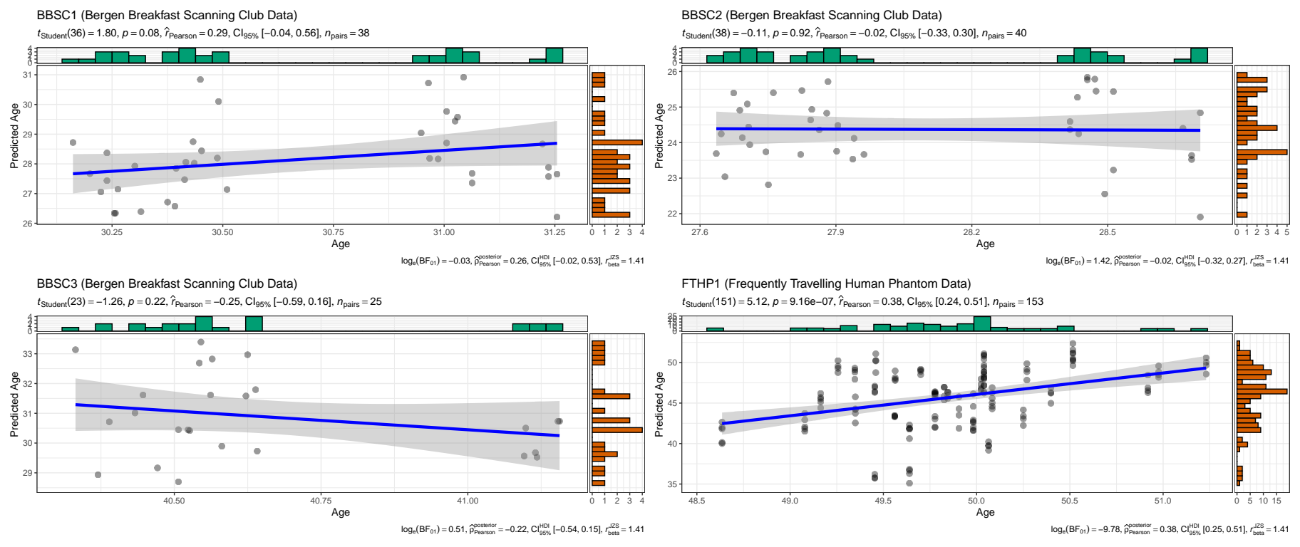
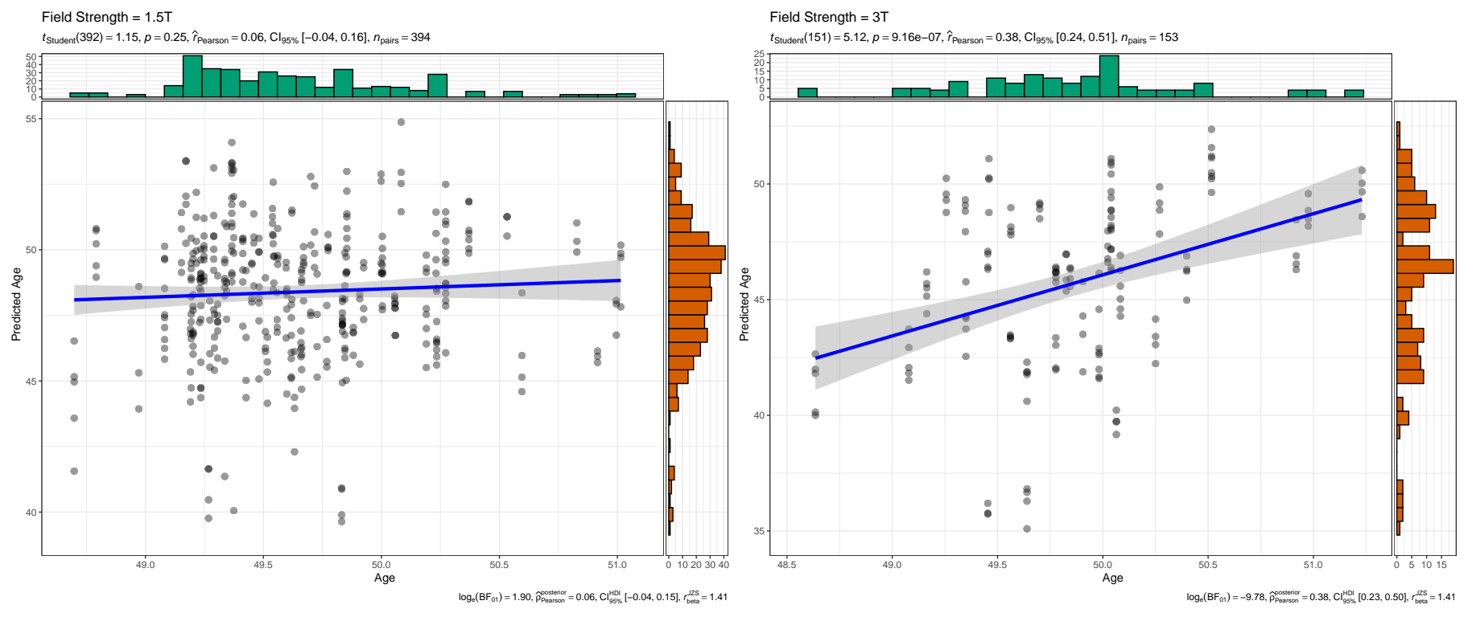




Field strength and potentially scan quality influence brain age estimates
Considerations on brain age predictions from repeatedly sampled data across time
Background: Brain age is a promising biomarker of brain or general health. However, to extend the metric’s clinical applications, the large intra-individual varibility in age predictions needs adressing.
Method: We used the pre-trained deep neural network pyment to predict brain ages from densly sampled T1-weighted magnetic resonance imaging data from three individuals (BBSC1-3) scanned in total NBBSC = 103 times over a one-year interval, and an independent data set including one individual (FTHP1) scanned NFTHP = 557 times over a three-year interval.
v
Result 1: Crude within-subject correlations between age and brain age revealed differing directionalities of slopes across subjects, with the correlation being only statistically significant in FTHP1.
v
v
Result 2: Field strength was revealed as only significant effect on brain age in FTHP1 in a random intercept model (β = -1.141, pHolm < .001).
Result 3: Quality control (QC) measures entropy-focus criterion (EFC, βstd = -0.489, pHolm < .001) and the foreground-background energy ratio (FBER, βstd = 0.456, pHolm < .001) were significant predictors of brain age in BBSC1-3 in a random intercept model at the participant level. No QC measures were associated with FTHP1’s brain age.
Conclusion: Brain age estimates are potentially influenced by acquisition parameters and scan quality. An avenue for future brain age modelling could be to employ multiple, more specific models, tuned to developmental and individual differences and acquision parameters.
v
Max Korbmacher (makor@hvl.no), Meng-Yun Wang, Rune Eikeland, Ralph Buchert, Ole A. Andreassen, Thomas Espeseth, Esten Leonardsen, Lars T. Westlye, Ivan I. Maximov, Karsten Specht
For more info see the preprint

