Slide 1
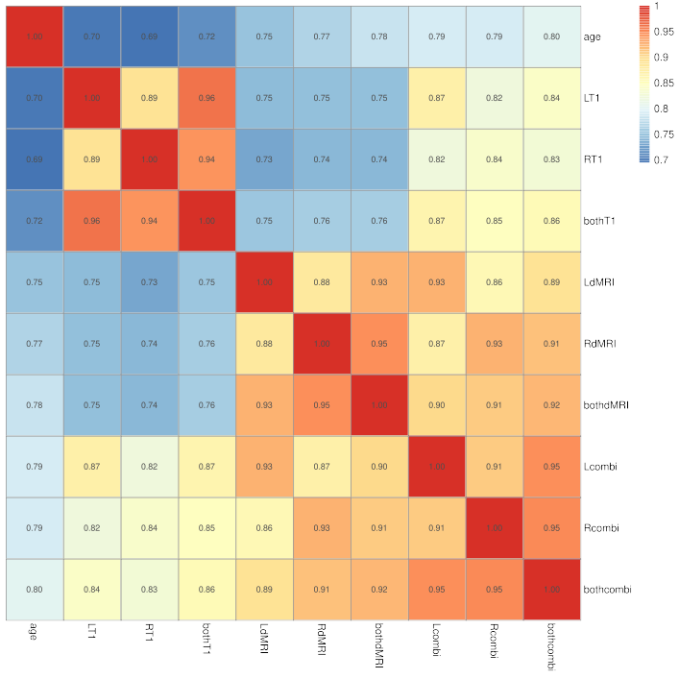
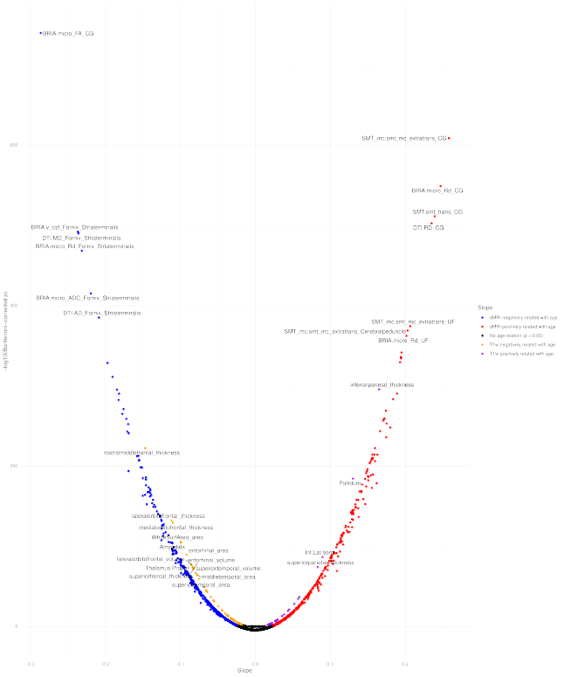
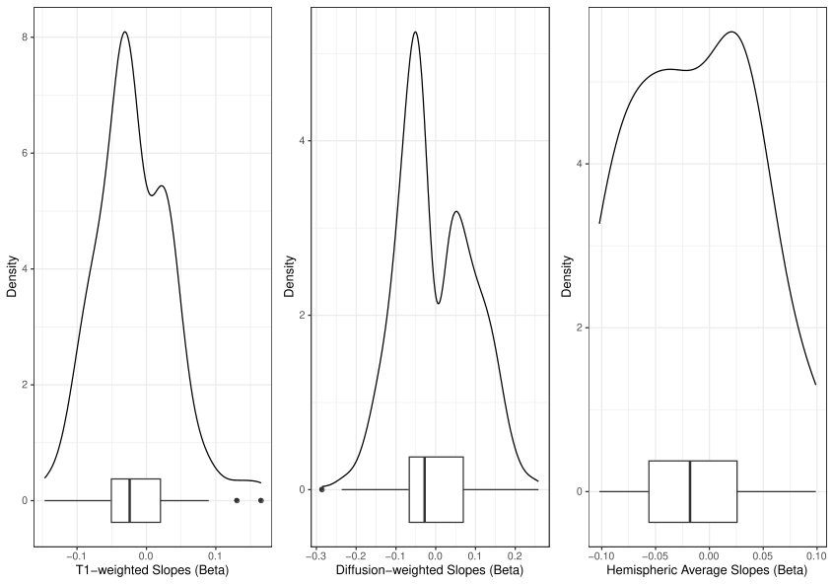




“While the brain ages asymmetrically, left/right brain age is very similar to whole-brain age estimates”
Brain asymmetries from midlife to old adulthood
Background: The brain demonstrates various age-sensitive asymmetries. Yet, a systematic mapping of grey and white matter asymmetries from midlife to old adulthood is still missing.
Method: We hence present brain asymmetries from multimodal magnetic resonance imaging (MRI) UK Biobank (N > 39,500) data using the laterality index. We furthermore present how to leverage such asymmetries by estimating brain age from the left/right hemispere instead of the whole brain.
v
v
Result 1: Left, right, and whole-brain age predictions are strongly correlated across modalities and show similar prediction errors.
Result 3: Fornix microstructure and frontal grey matter thickness asymmetry decrease strongest and cingulate and microstructure and inferiorparital thickness increase strongest at higher ages.
Left (L), Right (R), T1-weighted MRI (T1), diffusion MRI (dMRI), multimodal MRI (combi)
Model | Features | Variance explained | Mean Abs Error | Root Mean Sqrd Error | Pearson’s r
Left T1w | 117 | 0.504 (0.010) | 4.389 (0.054) | 5.472 (0.061) | 0.708 [0.703, 0.712]
Right T1w | 117 | 0.492 (0.008) | 4.439 (0.049) | 5.529 (0.051) | 0.705 [0.700, 0.709]
T1w | 234 | 0.526 (0.011) | 4.294 (0.050) | 5.356 (0.062) | 0.725 [0.721, 0.730]
Left dMRI | 840 | 0.568 (0.014) | 4.000 (0.047) | 4.990 (0.067) | 0.757 [0.753, 0.762]
Right dMRI | 840 | 0.582 (0.013) | 3.960 (0.052) | 4.967 (0.079) | 0.766 [0.762, 0.771]
dMRI | 1680 | 0.605 (0.010) | 3.867 (0.059) | 4.821 (0.094) | 0.781 [0.777, 0.785]
Left multimodal | 957 | 0.630 (0.009) | 3.757 (0.046) | 4.673 (0.047) | 0.794 [0.790, 0.797]
Right multimodal | 957 | 0.634 (0.014) | 3.723 (0.073) | 4.673 (0.092) | 0.794 [0.791, 0.798]
Multimodal | 1914 | 0.628 (0.017) | 3.663 (0.055) | 4.563 (0.077) | 0.793 [0.789, 0.797]
v
Result 2:
Conclusion: Our findings emphasise age-dependencies in regional and whole-brain asymmetries. The laterality index of brain age and the majority of brain features decreases with higher ages, indicating an overall decrease in brain asymmetry at higher ages.
v
Max Korbmacher (makor@hvl.no), Ann-Marie de Lange, Dennis van der Meer, Dani Beck, Eli Eikefjord, Arvid Lundervold, Ole A. Andreassen, Lars T. Westlye, Ivan I. Maximov
For more info see the preprint

