Slide 1

https://lukasroeseler.github.io/replicationresearch_mockup/about.html

Slide 2
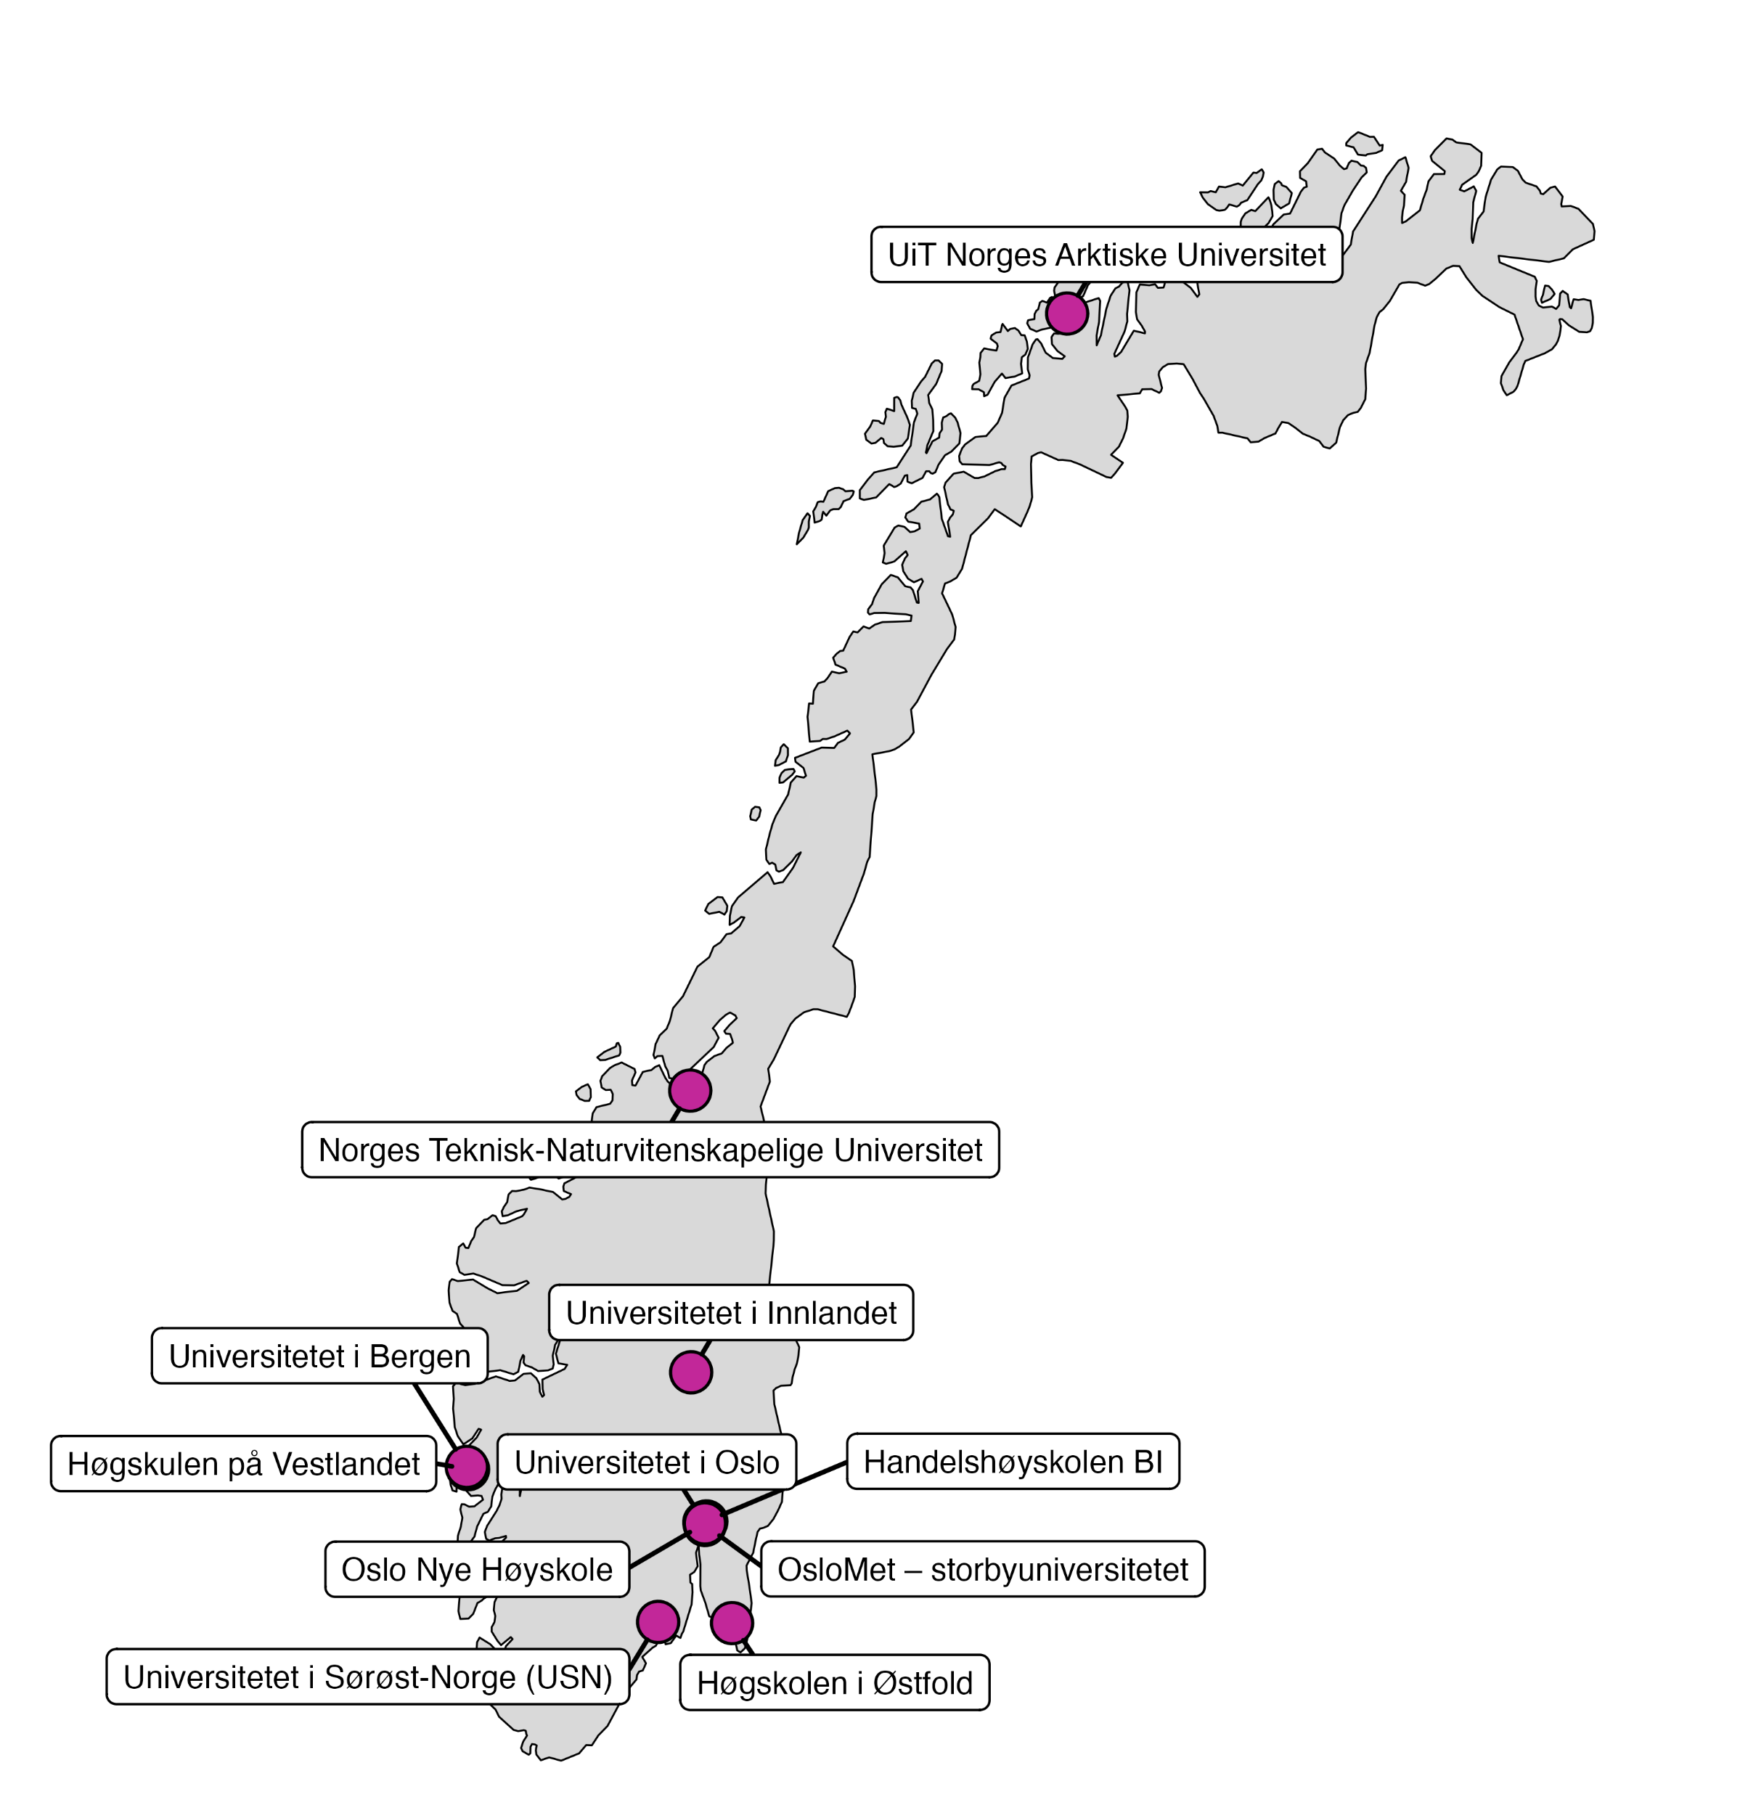

https://www.norrn.no/

Slide 3
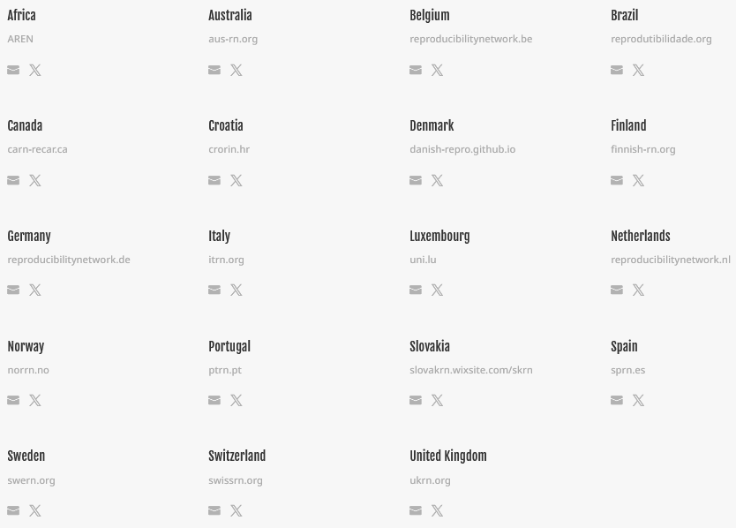
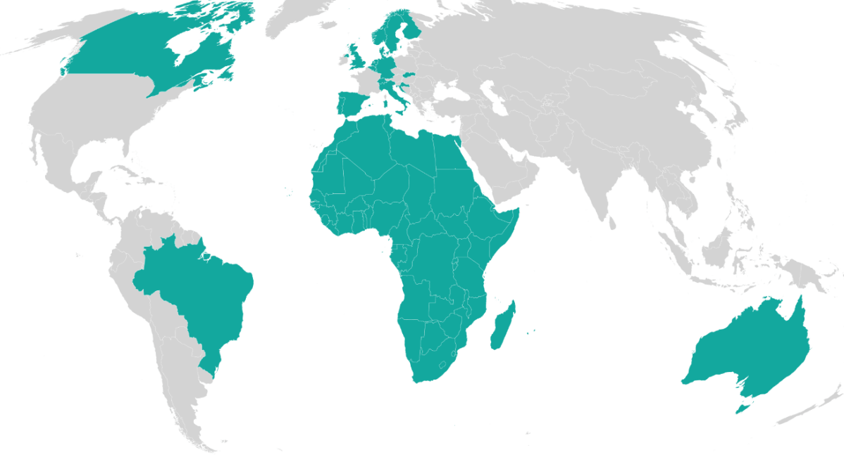
International Reproducibility Networks
https://www.ukrn.org/international-networks/
Notes:
Reproducibility Networks as a reaction and a part of the mechanism of this credibility revolution or this opportunity that we have gotten now to improve research reproducibility and replicability globally

Slide 4
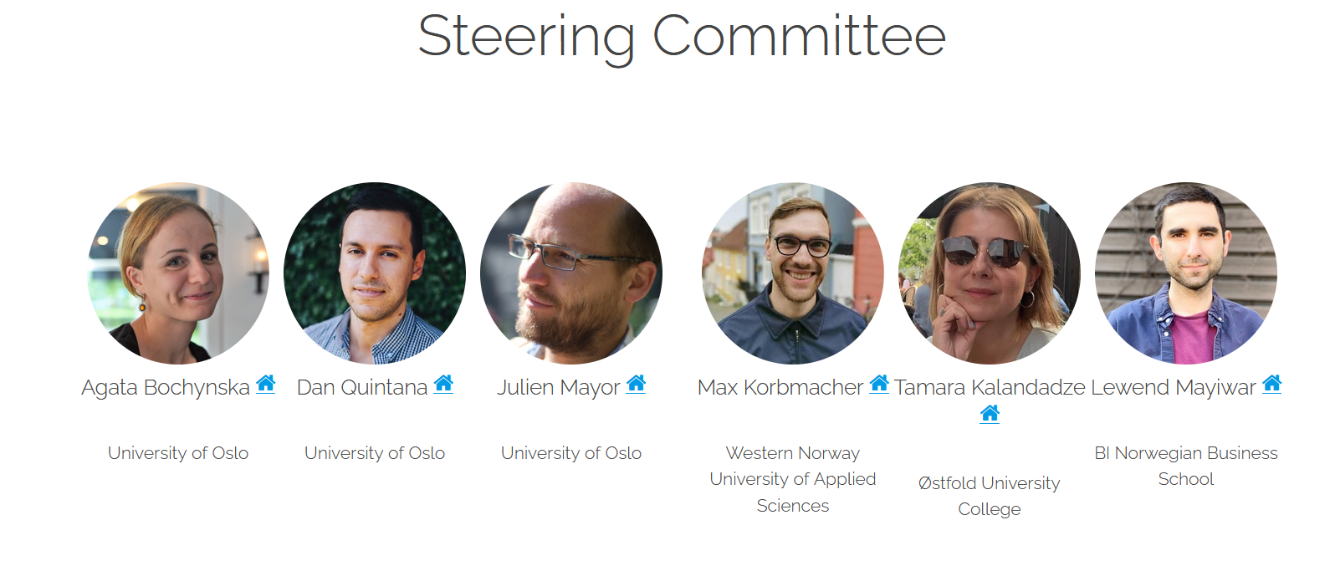

Slide 5
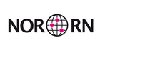
Coordinating activity in three focus areas:
1. Education
designing and establishing appropriate training activities
2. Communication
disseminating new evidence, propagating best practices, and promoting culture change
3. Transformation
designing and evaluating research improvement measures and policy in collaboration with stakeholders
https://www.norrn.no/terms-of-reference

Slide 6
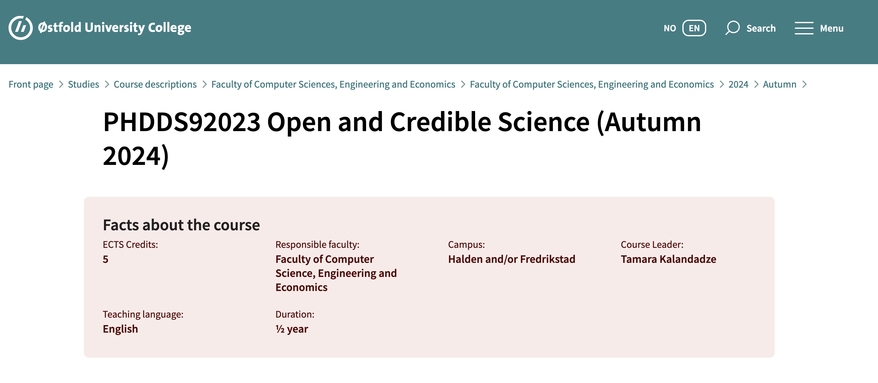
https://www.hiof.no/english/studies/courses/iio/iio/2024/autumn/phdds92023.html

