Slide 1
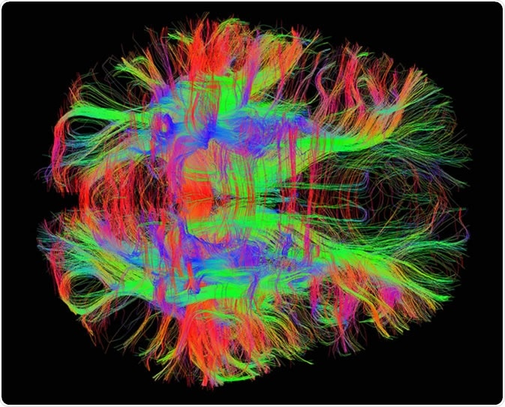
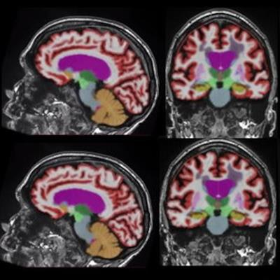
Magnetic Resonance Imaging Age and Ageing Markers
Max Korbmacher, PhD
18 October 2024
Images from mcgovern.mit.edu & AuntMinnie.com

Slide 2
Topics we can discuss
Brain Age: What it is, promises, limitations.
White matter microstructure: From tensors to the standard model, association studies (“pheno- & genotypes”).

Slide 3
Brain age

Slide 4
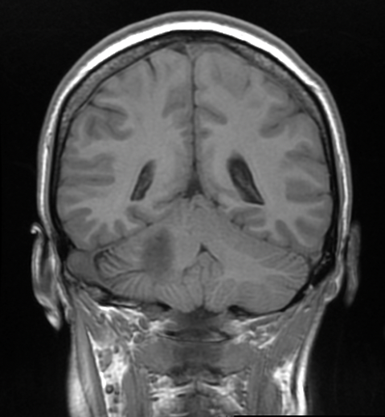
Brain age: background
1) Model training
Training model
Predicting chronological age with that model
Differences between brain age and chronological age
Individuals of different ages
Trained model
2) Predictions
Model applied to individual data
Brain age:
27 years old
Example individual.
Chronological age:
22 years
Difference / Brain age gap: 5 years
Notes:
Besides classical age-associations, one can use brain age
For that one trains a model, usually using machine learning on magnetic resonance images
This model is then used to make individual predictions, “a best guess” about the age of a person based on their brain
This can be done using different brain features and scales, from the voxel/pixel level to reconstructed features such as grey matter thickness in a brain region
Multiple studies indicate that the difference between chronological and brain age (the brain age gap) indicates multiple health outcomes and diseases

Slide 5
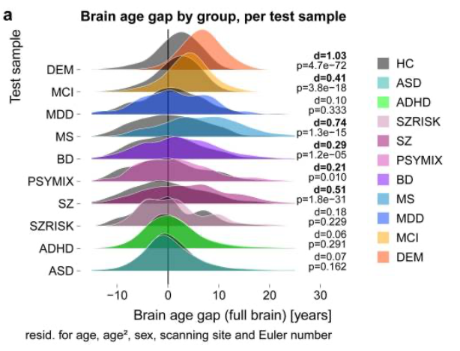
Brain age: application & promises
Kaufmann et al., 2019, Nat. Neur.
Notes:
Largest differences where brain is most affected, i.e. atrophy, yet unspecific
Can it be a prognostic and diagnostic marker?

Slide 6
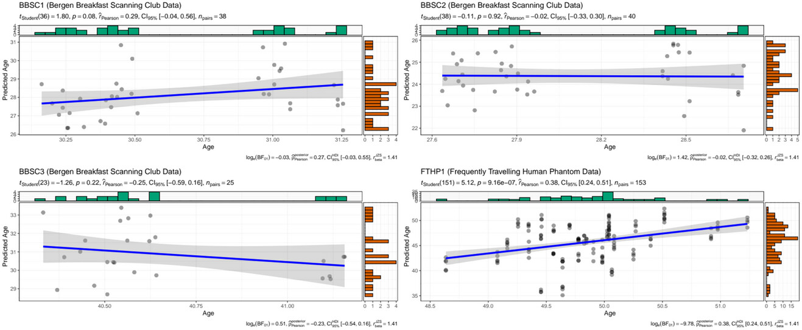
Brain age: rigorous testing
Can the best brain age models reliably predict on the individual level? (precision medicine)
The short answer: No.
Why?
Group-level stats for
model training
Covariates
Brain age predicted over time in 4 indivduals
Korbmacher et al., 2023, Brain & Beh.
Notes:
Machine learning relies on model metrics: RMSE, MAE, R, R^2
These are group-level values.
However, we are interested in individual-level predictions
Rigerous model testing involves validations in longitudinal data
Our data show that the state-of-the-art brain age modelpyment does not withstand the test
We need different training strategies or more robust models (e.g., underfitting or physics-informed models)
Another problem: covariates

Slide 7
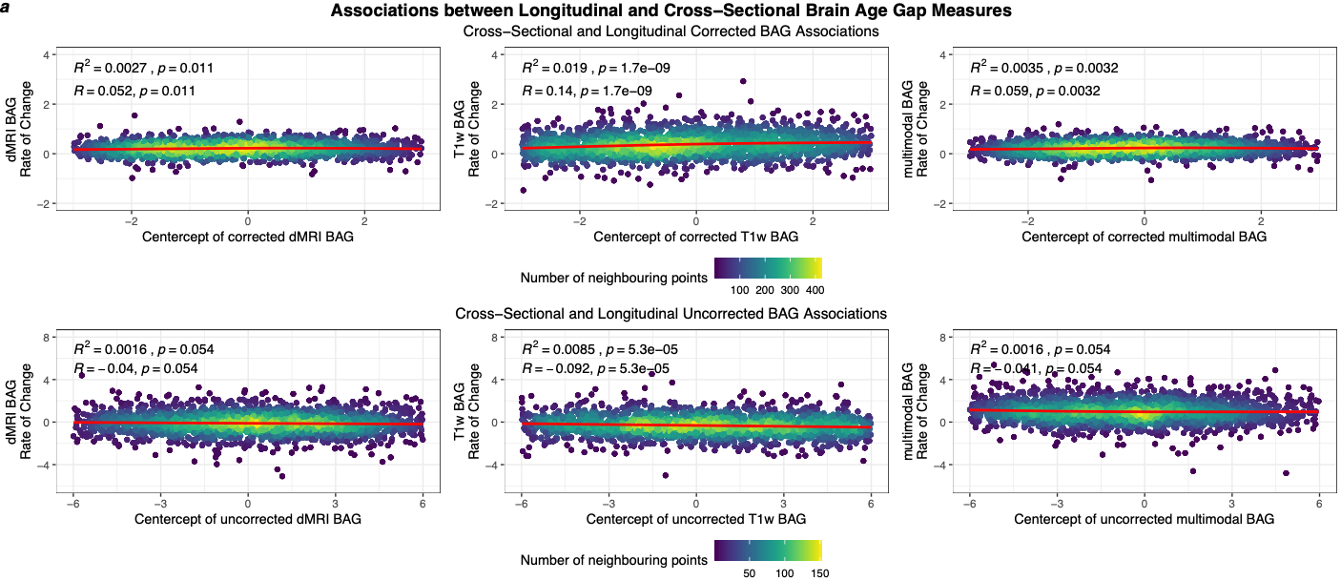
Brain age: rigorous testing
More longitudinal evidence: 2,520 longitudinal datasets from the UK Biobank, inter-scan interval = 1.12-6.90 years, M = 2.45 years
Cross-sectional (centercepts) brain age gaps (BAG) relate weakly the annual BAG change
Korbmacher et al., 2024a,bioRxiv

Slide 8
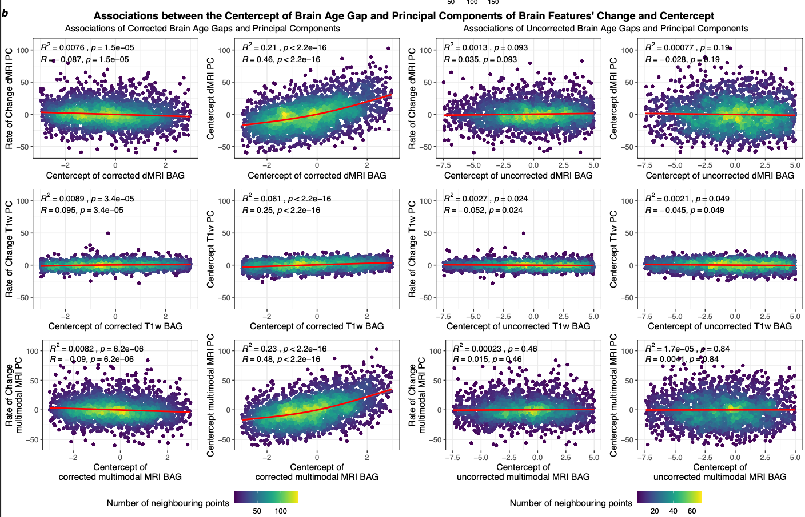
Brain age: rigorous testing
Only cross-sectional (centercepts) brain age gaps (BAG) relate to brain principal components
Korbmacher et al., 2024a,bioRxiv

Slide 9
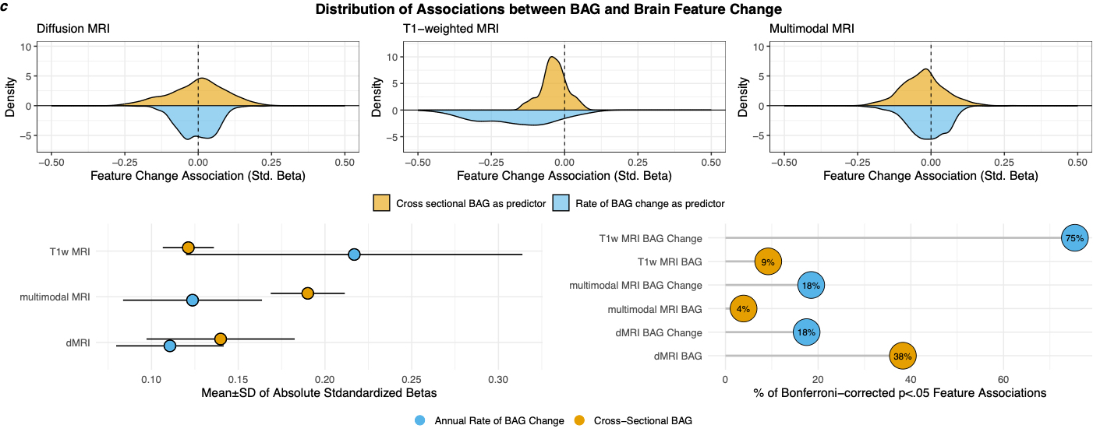
Brain age: rigorous testing
Yet, there are some interesting regional associations, highlighting diffusion MRI derived brain ages to reflect ageing
Korbmacher et al., 2024a,bioRxiv
Notes:
TOP: We can look at the distribution of effects (standardized beta coefficients) for relationships between delta BAG or centercept BAG and single brain features
BOTTOM LEFT: We can also look at the average absolute effect
BOTTOM RIGHT: Or at the number of sign. Associations per BAG

Slide 10
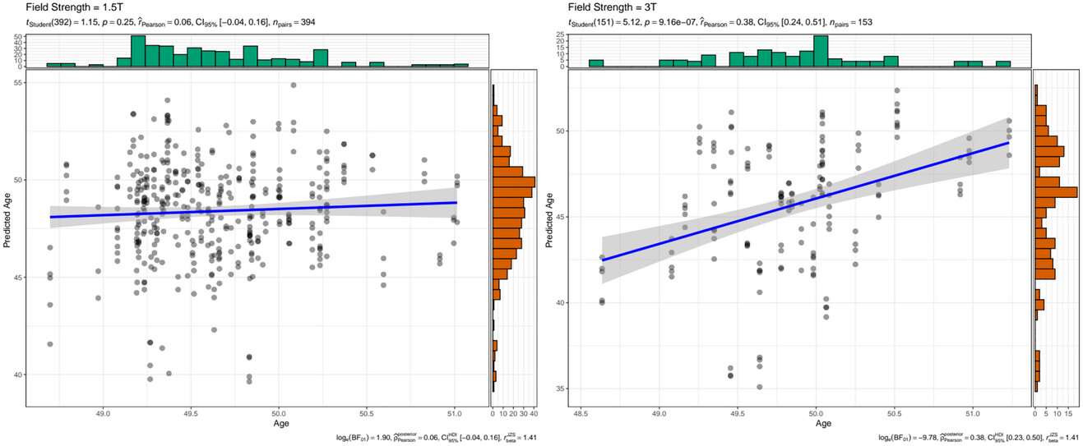
Brain age: covariates
Field strenth effect on a single individual’s brain age
Korbmacher et al., 2023, Brain & Beh.

Slide 11
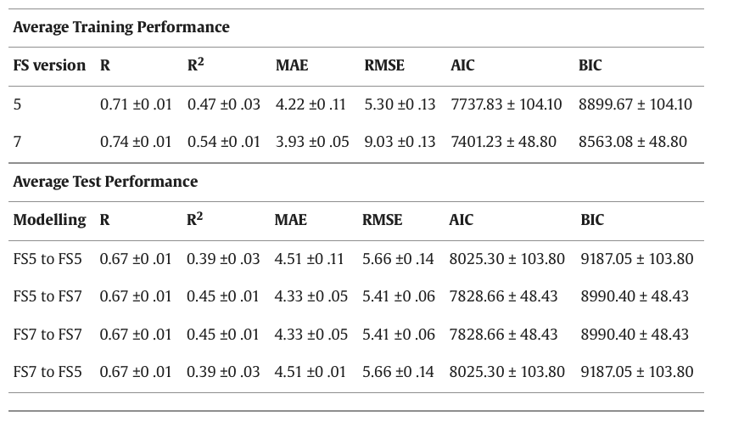
Brain age: covariates
FreeSurfer version (1,000 train-test iterations, N = 4,395 UKB)
Korbmacher et al., 2023, NeuroImage Rep.
Notes:
One can predict within FS version, or between version.
Between-version predictions are useful, as it is computationally expensive to

Slide 12
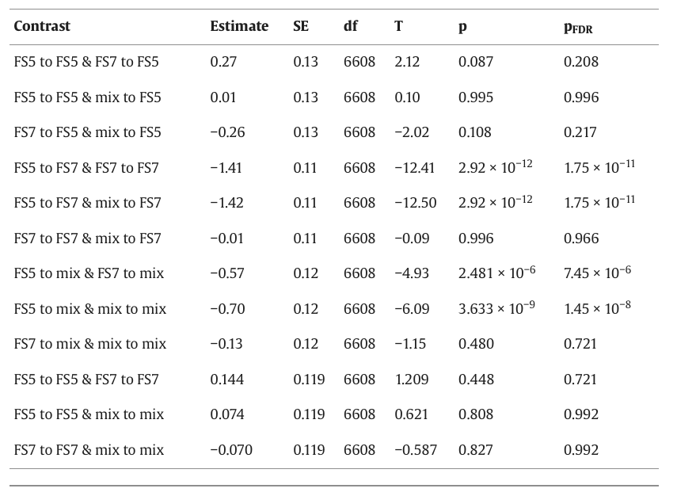
Brain age: covariates
Korbmacher et al., 2023, NeuroImage Rep.
Notes:
We can contrast the predctictions from different versions. Version-shuffling does not differ from within-version predictions.
We can also use other metrics to asses these model specific differences, showing the same result
Mix to singe version is just as good as single version to single version
Mix to mix is superior to single version to mix
Wy is this good? Because we want robust models, which do not suffer from using different software versions.

Slide 13
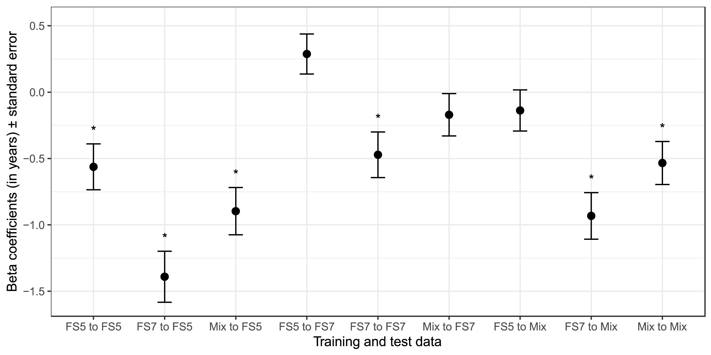
Brain age: covariates
FreeSurfer version practical example: b > 0 indicate a higher brain age of females
Korbmacher et al., 2023, NeuroImage Rep.
Notes:
Practically: sex differences are influenced by versions.
Again versio-shuffling might be a good middle way, “averaging across the reality of version-specifi group differences”

Slide 14
White matter microstructure

Slide 15
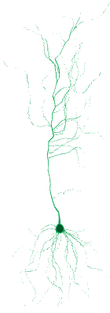
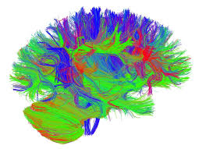
Diffusion MRI
a) Isotropic diffusion
b) Anisotropic diffusion
Diffusion Magnetic resonance imaging (dMRI)
Defined by Brownian motion (random molecular movement)
Tissue boundary
c) Neuron
d) White matter tracts
Notes:
Diffusion: random movement of molecules, e.g. in water a)
which is restricted by tissue in the brain b)
Particularly white matter, defined by axons (part of neuron in c), has a clear structure defined by tracts d) [colour indicates direction]
The diffusion coefficient will hence vary in different tissue types
The clearly restricted motion of molecules in white matter bundles is why diffusion MRI has often been used for white matter mapping

Slide 16
Diffusion MRI
a) Isotropic diffusion
b) Anisotropic diffusion
Diffusion Magnetic resonance imaging (dMRI)
Defined by Brownian motion (random molecular movement)
This motion can be modelled in different ways
Most commonly approach: Diffusion Tensor Imaging (DTI)
Notes:
We can use tensors consisting of three vectors to establish simple visualisations of diffusion
For isotropic diffusion, the tensor is ball shaped (a)
For anisotropic diffusion, the tensor is cigar shaped
OFTEN Using Gaussian tensors to model the diffusion direction is called diffusion tensor imaging
IMPORTANT: NOT MICROSTRUCTURE MODELLING
Problem: in most voxels, the organisation of tissue is complex, including crossing fibres and different tissue types
In these cases, we might need other diffusion approaches providing similar or different metrics

Slide 17
Diffusion MRI
a) Diffusion Kurtosis Imaging
b) Spherical Mean Technique
+
Diffusion Magnetic resonance imaging (dMRI)
Defined by Brownian motion (random molecular movement)
This motion can be modelled in different ways
Degree of
kurtosis
-
high
low
Tortuosity
c) Multi compartment assumptions
Glial cells
Axonal fibre bundle
Other tissue
Assumptions about diffusivity
?
Cerebrospinal fluid
Voxel extent
Notes:
For example, we can assume that water in biological tissue does not always behave Gaussian
We can use different levels of kurtosis to describe different tissue types or compartments
We deviate from the isotropic function and describe diffusion with kurtosis (influences distribution shape)
We can also extend the DTI model by attempting to model the path length travelled by protons, instead of the linear distance (Spherical Mean Technique)
Finally, we know that there are rarely only axons in a voxel
Hence, different tissue compartments should be addressed differentially
We can do so by making assumptions about differential diffusivity. Some approaches:
We can give a machine learning model the freedom to learn different orientation distribution functions (BRIA)
Or we make more static assumptions about diffusivity in different directions based on different compartments
E.g., thinking back the tensor, being different or similar tensor shapes in different tissue compartments
Or we use concrete assumptions about diffusivity, such as similar radial but dissimilar axial diffusivity (mcSMT)
Or independent axially diffusing compartments (WMTI)

Slide 18
White matter approaches
Many approaches
Parameters are correlated
Useful to look at their associations with clinically relevant scores
ABCD N = 5,147, UKB N = 37,083
WM skeleton-level age-associations
Korbmacher et al., 2024b,bioRxiv
Notes:
Known reversal pattern during brain development vs degeneration phases
Standard model metrics provide some extra info: water fractions strongest age-related at higher age (see BRIA)

Slide 19
White matter approaches
Korbmacher et al., 2024b,bioRxiv
Notes:
Sex classifications done by the principal components of tract level metrics per approach: not so clear answer.

Slide 20
White matter approaches
Korbmacher et al., 2024b,bioRxiv
Notes:
BMI: AK potentially interesting

Slide 21
Korbmacher et al., 2024b,bioRxiv
Notes:
PGRS associations were potenially most interesting (still needs validation by using different methdos)
Outlines kurtosis (just as for BMI) but also BRIA metrics
Strong effects for PGRS associations!

Slide 22
White Matter Ageing
White matter microstructure ageing
We confirm previous assumptions about white matter ageing
Tissue is more isotropic / more diffusion at higher ages
This is reflected by different diffusion approaches clustering & showing similar age associations:
Diffusion coefficients & CSF
Anisotropy, kurtosis, intra axonal diffusion
Diffusion approaches’ brain ages are similar ≈ measuring the same construct
Tissue degene-ration during ageing
Notes:
NOW, MORE ABOUT AGEING!
We confirm previous assumptions about white matter ageing [IN BOTH CROSS-SECTIONAL AND LONGITUDINAL DATA]
Due to atrophy, tissue is more isotropic / more diffusion at higher ages
This is reflected by the different diffusion approaches (remember the different possible approaches to estimate diffusivity)
The figure presents whole brain white matter ageing assessed by different microstructure
Diffusion coefficients & CSF cluster, and show >> signify free water?
Anisotropy, kurtosis, intra axonal diffusion cluster & similar ageing-trends >> signify cellular structures?
We also show that the rate of white matter ageing increases at higher ages
We still need to extend the investigations in terms of latent structures, but brain ages for the different diffusion approaches
This gives at least an indication of the different approaches measuring the same construct, which is white matter, and with it the age associations one can expect in white matter.

Slide 23
White Matter Ageing
We identify particularly age-sensitive regions
Limbic: fornix
Corpus callosum
Brain stem: cerebral peduncle
Notes:
We also looked at the regional pattern of age-associations, e.g. in this volcano plot (usually used in genetics studies) indicating longitudinal changes raw (a) and corrected for age, sex, and scanner site (b)
x: effect magnitude
y: log-transformed p-value > higher y = smaller p
Across studies, we outline the limbic region fornix, corpus callosum, and the brain-stem tract cerebral peduncle as age sensitive

Slide 24
Brain Asymmetries
Brain asymmetries’ age-associations strongest in limbic & ventricle near and brain stem regions
Coherent with other ageing findings
Notes:
Similar to the figure on recent slide: x = effect size, y = log-transformed p-value (associations were corrected for sex, age, scanner site)
Brain asymmetries’ age-associations strongest in limbic & ventricle near and brain stem regions
Both white and grey matter

Slide 25
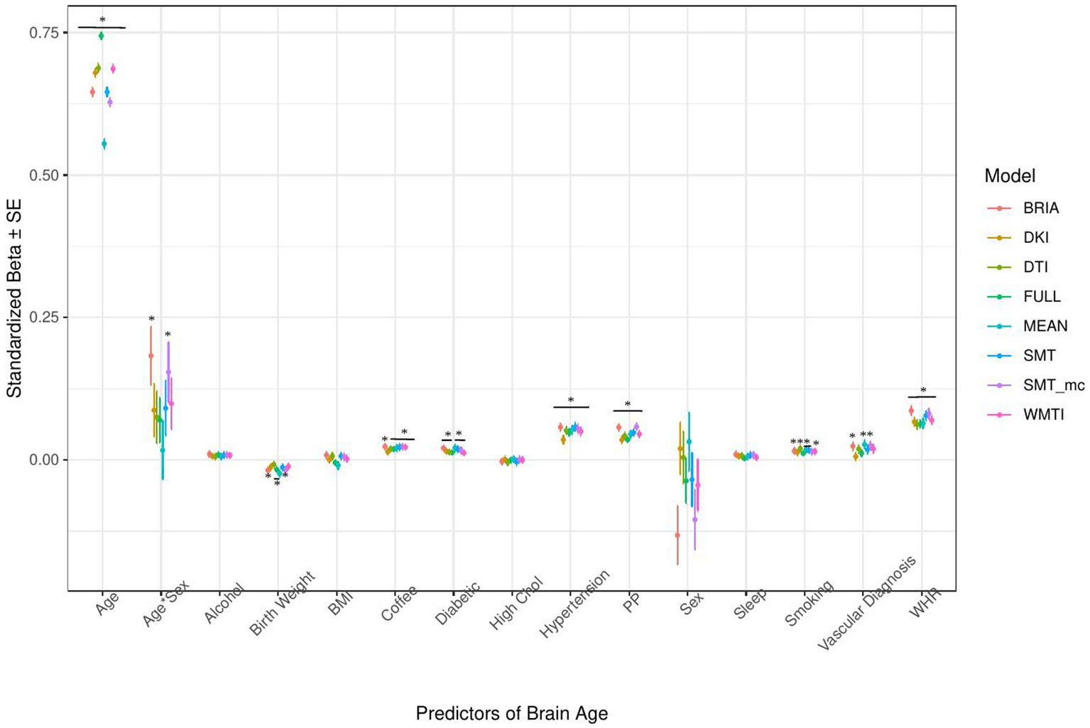
Phenotype Associations of WM Brain Age
White matter brain age relationships with bio-psycho-social factors
Significant predictors of brain age: waist-to-hip ratio, diabetes, hypertension, smoking, matrix puzzles solving, job- & health satisfaction and perception
WM brain age reflects overall health but is not well-predicted by any of the observed (BPS) domains
White matter brain age associations with health and lifestyle variables
Notes:
Phenotypes: Multiple multivariate regression to model different bio-psycho-social domains instead of only single variables
The biological factors model presenting health and lifestyle predictors of brain age can be seen in the figure for illustration purposes
Standardized beta coefficients (and standard errors) indicate the association strength between biological variables and brain age erstimated from white matter features of each utilised diffusion appraoch, such as DTI, DKI, etc.
Overall, the results show that there are a selection of variables which are consistently white matter brain age associated
We can call these variables bodily ageing indicators or indicators of health
>>white matter brain age reflective of health status
The overall models were however only weakly reflecting brain age variability
Other modelling domains need to be explored (SEM, Canonical Correlations,etc.)

Slide 26
Genotype Associations of White Matter
White matter associations with polygenic risk of psychiatric and Alzheimer’s disease
White matter microstructure ageing in the light of disease polygenicity
Potentially interesting: cerebral peduncle as
Yet…
These are small associations
No significance after correcting for multiple comparisons
Notes:
Genotypes: polygenic risk of Alzheimer’s disease and psychiatric disorders, here for the cerebral peduncle
Y = peduncle white matter metrics
x = disorder polygenicity
Box colour & number indicates strength of association (standardized beta coefficients)
When framed by box p < .05
Note: none of the associations survived corrections for mulitple comparisons!
SMALL ASSOCIATIONS

