Slide 1

FORRT
Framework for Open and Reproducible Research Training
www.forrt.org

Slide 2
The replication crisis has led to positive structural, procedural, and community changes
www.forrt.org

Slide 3

Learning from the Replication Crisis
The Problem
____________
Literature assessing the Replication Crisis has focussed on identifying what’s wrong (e.g., questionnable research practices and unhealthy structures). This is where the disucussion often stops.
Yet, there is much opportunity in learning from mistakes and improving. To move forward, positive change needs to be acknowledged, encouraged, and build upon.
Notes:
- My experience as a student: the replication crisis is quite the rabbit whole.
- I was interested, so it was no problem for me to do a lot of reading and podcast listening.
- However, not everybody is the same and especially the focus on things that have gone wrong might be discouraging.
- At the same time, outlining errors is more than important, and in a next step we need to learn from past mistakes.

Slide 4
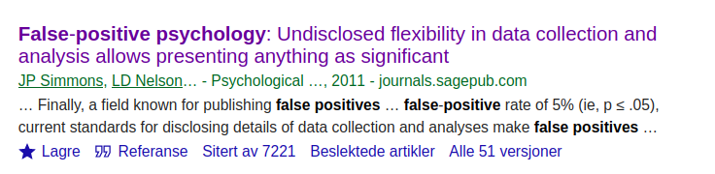
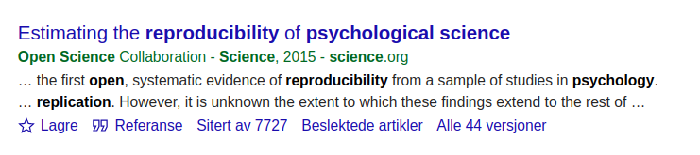
Learning from the Replication Crisis
The most cited studies in the context of the Replicaiton Crisis outline the problem. The next logical step is to move towards solving the problem / crisis.
Notes:
- Here, just some of the most prominent papers on the replication crisis illustrating my point: the focus has been on outlining the problem
- However, the way towards solving the crisis certainly needs attention too.

Slide 5
Credibility Revolution
Keeping the opportunity for change in mind, Simine Vazire coined the term Credibility Revolution instead.
Key characteristics of the Credibility Revolution:
greater emphasis on transparency and openness
a move toward preregistration of research
more direct-replication studies
higher standards for the quality and quantity of evidence needed to make strong scientific claims
Vazire (2018). Perspectives on Psychological Science.
Notes:
- It seems logical to see the replication crisis as a great learning opportunity and a chance to improve upon
- Within this framework of thinking, Simine Vazire came up with a potentially more helpful term describing the replication crisis: credibility revolution

Slide 6
Credibility Revolution
In other words, the change is already happening. A resource structuring and presenting the developments just had to be established.
Notes:
- the change described by Simine is already happening, but it’s cumbersome to get the right info at hand or even an overview

Slide 7
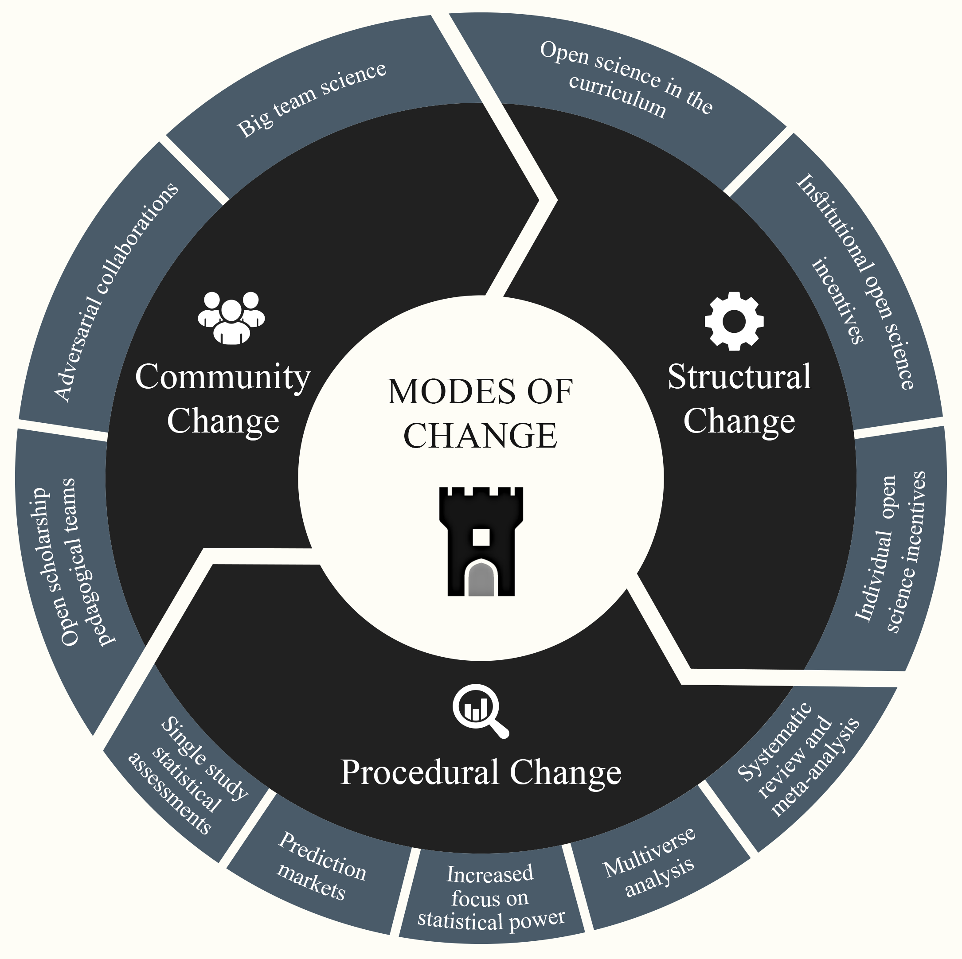
Providing an overview of changes in the field
Structural, procedural and community-level change as a consequence of the replication crisis.
Korbmacher et al. (2023). Communications Psychology
Notes:
- Hence, we came up with a way of structuring positive changes
- There are some general trends we noticed, being:
- an increased focus on working in teams (community level)
- methods and statistical procedures and tools which individuals could use (procedural level)
- normalisation of open science through policies and incentives (structural level)

Slide 8
A resource to build upon
Overview of the paper:
Short introduction to the replication crisis
Overview of positive changes in the field
Outlook on what’s next
Notes:
- The paper is supposed to be a resource which makes it easier to access the topic of the replication crisis & what to with it
- It can hence, for example, be used by students or educators

Slide 9
Structural Change
Curriculum changes
Implementing Open Science Practices in the curriculum
  Creating norms of Open Science usage (instead of exceptions)
  Large collection of open source teaching and learning materials
Replication studies as theses
  As part of large-scale collaborations
  As single studies (publication with the help of ECRs)
Notes:
But let’s start the beginning. What’s the problem we are trying to solve?
As the wave of scientific reform changes research practices and norms globally, higher education has largely been left behind.
While academics are increasingly adopting best practices to encourage higher standards for the quality of evidence and accessibility of research outputs, we are still failing to address how we teach, mentor, and supervise students through open science.
For example, It is still very common that undergraduates & graduates finish their studies without having heard about Open Science.
This undermines the goal of permanently redressing perverse academic incentives, it might make the w research evaluations that erode research quality.
As a result, it is still very common that graduates and undergraduates finish their studies without even hearing about open scholarship.
And to answer these questions, to the extent we can answer them, we have to work together.

Slide 10
Structural Change
Incentive changes
Badges
Registered Reports
Transparency and Openness Promotion (TOP) and other guidelines and factors for journals
Plan-S (EU-wide open publishing)
Re-designed peer review (e.g., PeerCommunityIn)
Research evaluation updated (e.g., San Francisco Declaration of Research Assessment)
Notes:
But let’s start the beginning. What’s the problem we are trying to solve?
As the wave of scientific reform changes research practices and norms globally, higher education has largely been left behind.
While academics are increasingly adopting best practices to encourage higher standards for the quality of evidence and accessibility of research outputs, we are still failing to address how we teach, mentor, and supervise students through open science.
For example, It is still very common that undergraduates & graduates finish their studies without having heard about Open Science.
This undermines the goal of permanently redressing perverse academic incentives, it might make the w research evaluations that erode research quality.
As a result, it is still very common that graduates and undergraduates finish their studies without even hearing about open scholarship.
And to answer these questions, to the extent we can answer them, we have to work together.

Slide 11
Procedural Change
Statistical assessments
Focus on α- and β-levels & distribution of p-values
Automatic numerical error and inconsistency detection
Multiverse, reviews, mega- and meta-analyses
Guides and resources on multiverse analysis & reproducible reviews and meta analyses
Notes:
But let’s start the beginning. What’s the problem we are trying to solve?
As the wave of scientific reform changes research practices and norms globally, higher education has largely been left behind.
While academics are increasingly adopting best practices to encourage higher standards for the quality of evidence and accessibility of research outputs, we are still failing to address how we teach, mentor, and supervise students through open science.
For example, It is still very common that undergraduates & graduates finish their studies without having heard about Open Science.
This undermines the goal of permanently redressing perverse academic incentives, it might make the w research evaluations that erode research quality.
As a result, it is still very common that graduates and undergraduates finish their studies without even hearing about open scholarship.
And to answer these questions, to the extent we can answer them, we have to work together.

Slide 12
Procedural Change
Predictions Markets
Several prediction market studies show that experts and non-experts can predict study replicability
Hence, another tool for researchers to assess the credibility of existing and hypothetical works
Notes:
But let’s start the beginning. What’s the problem we are trying to solve?
As the wave of scientific reform changes research practices and norms globally, higher education has largely been left behind.
While academics are increasingly adopting best practices to encourage higher standards for the quality of evidence and accessibility of research outputs, we are still failing to address how we teach, mentor, and supervise students through open science.
For example, It is still very common that undergraduates & graduates finish their studies without having heard about Open Science.
This undermines the goal of permanently redressing perverse academic incentives, it might make the w research evaluations that erode research quality.
As a result, it is still very common that graduates and undergraduates finish their studies without even hearing about open scholarship.
And to answer these questions, to the extent we can answer them, we have to work together.

Slide 13
Community Change
Open scholarship pedagogical teams
Teams such as FORRT collecting open-access educational resources to be used by educators
Adversarial Collaborations & Big Team Science
Crowdsourced research & distributed networks of research teams facilitate large-scale investigations
The same holds true for error checking each other
Science acceleration through cooperation
Notes:
But let’s start the beginning. What’s the problem we are trying to solve?
As the wave of scientific reform changes research practices and norms globally, higher education has largely been left behind.
While academics are increasingly adopting best practices to encourage higher standards for the quality of evidence and accessibility of research outputs, we are still failing to address how we teach, mentor, and supervise students through open science.
For example, It is still very common that undergraduates & graduates finish their studies without having heard about Open Science.
This undermines the goal of permanently redressing perverse academic incentives, it might make the w research evaluations that erode research quality.
As a result, it is still very common that graduates and undergraduates finish their studies without even hearing about open scholarship.
And to answer these questions, to the extent we can answer them, we have to work together.

Slide 14
Outlook
The credibility revolution motivated structural, procedural, and community changes that would have previously been considered idealistic, if not impractical.
Developments go beyond “fixing failed replications”: transparency, rigor, and quality in all aspects of research are now in the focus
Only change on multiple levels will be sustainable
  e.g., researchers focus on high-quality outputs [individual level] but are incentivised to focus on novelty [structural level] sustains old structures & behaviours
Notes:
But let’s start the beginning. What’s the problem we are trying to solve?
As the wave of scientific reform changes research practices and norms globally, higher education has largely been left behind.
While academics are increasingly adopting best practices to encourage higher standards for the quality of evidence and accessibility of research outputs, we are still failing to address how we teach, mentor, and supervise students through open science.
For example, It is still very common that undergraduates & graduates finish their studies without having heard about Open Science.
This undermines the goal of permanently redressing perverse academic incentives, it might make the w research evaluations that erode research quality.
As a result, it is still very common that graduates and undergraduates finish their studies without even hearing about open scholarship.
And to answer these questions, to the extent we can answer them, we have to work together.

Slide 15
What next?
Educational resources in preparation:
General presentation of the paper
  Slides for short presentation at your initiative, e.g. ReproducibiliTea
Syllabus to facilitate the teaching of a positive/constructive view of the replication crisis
  Slides & script for several lectures: here is a start for it (link)
Come and join us!
  Your help is very appreciated & will be credited on FORRT’s website
Notes:
- we want to create several resources based on the paper
- first, a short presentation giving an overview
- second, a full syllabus including lectures and scripts which can be directly used to teach about a constructuve view of the replication crisis
- for that, we would love your help!

Slide 16

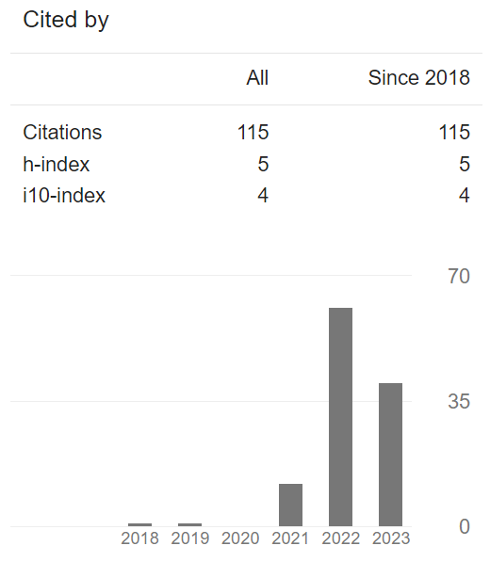
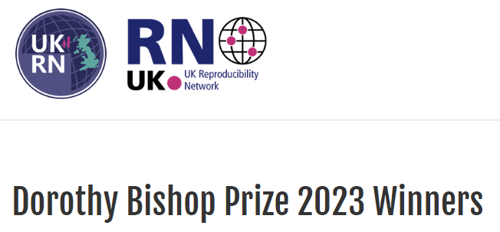

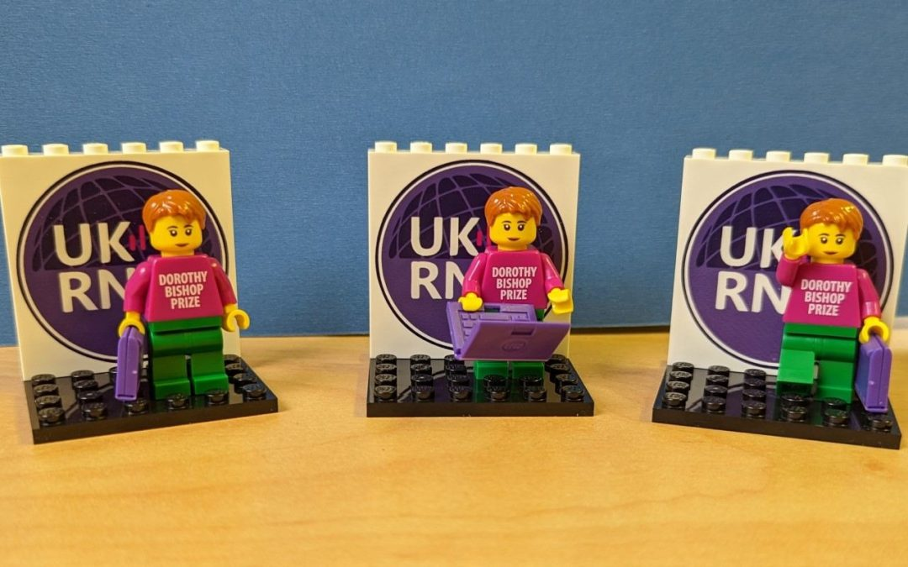


Thank you!
https://forrt.org
info@forrt.org
@FORRTproject
https://forrt.org/publications
Notes:
:)

