Slide 1
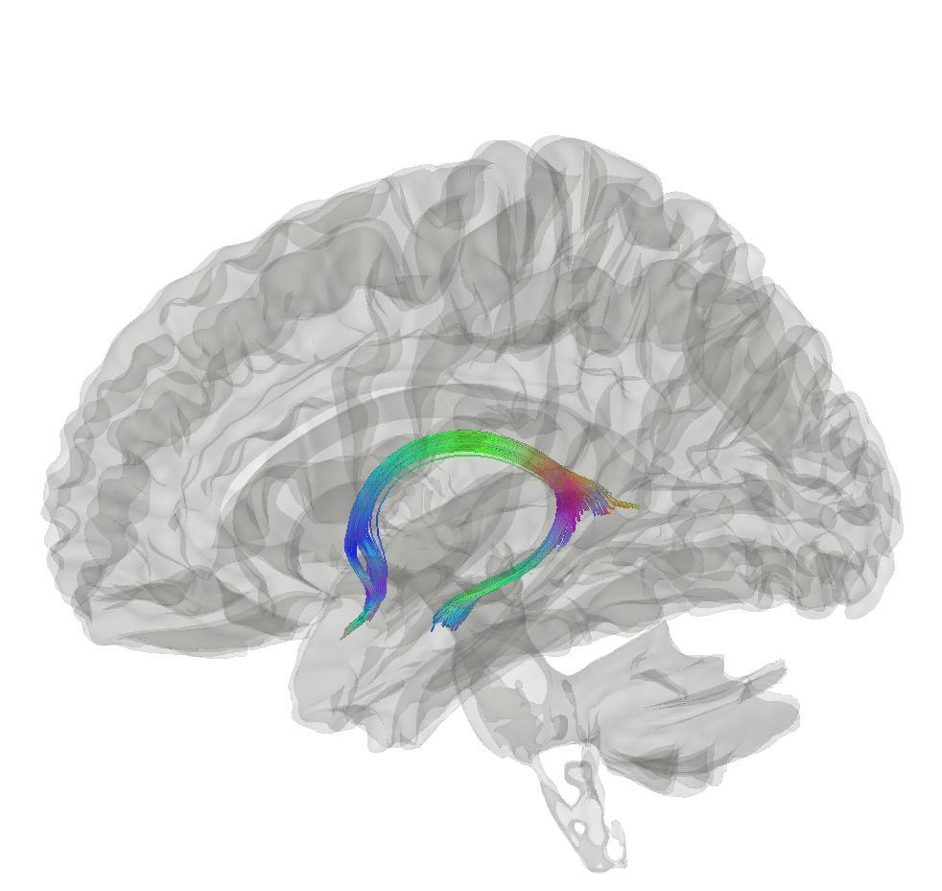



Mid-term evaluation
Max Korbmacher
PhD Student at the Western Norway University of Applied Sciences, Bergen
Max.Korbmacher@hvl.no

Slide 2
A quick run-through my project
Background
What has been done so far in the project?
  Study 1: brain-wide age-associations
  Study 2: bio-psycho-social white matter brain age associations
  Study 3: longitudinal/densly sampled assessments of brain age
  Study 4: laterality & hemispheric brain age
  Study 5: longitudinal white matter changes
What more to do to?

Slide 3
1. Background

Slide 4
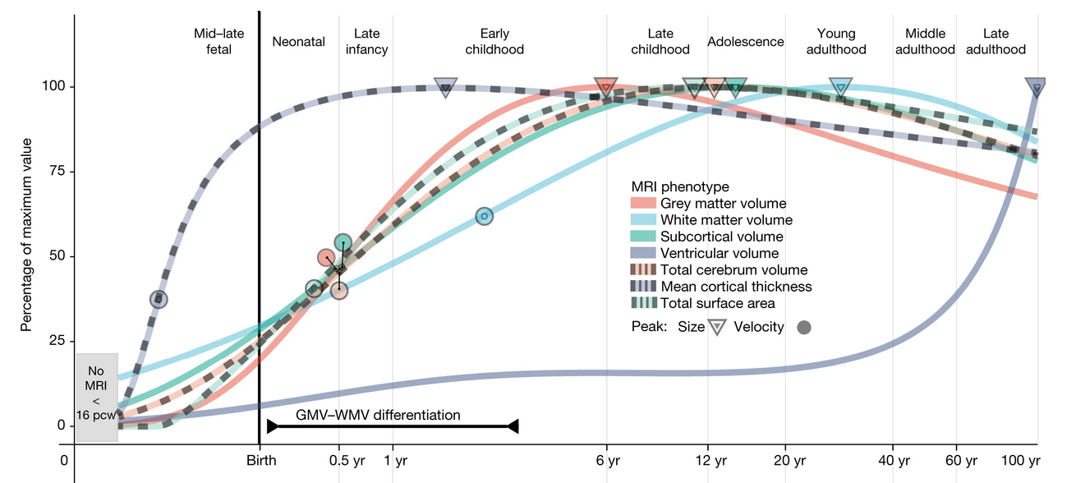
Brain ageing as a “health” proxy
There are normative patterns of brain tissue development throughout the lifespan
  Non-normativ development can indicate illness and symptom development¹
  Establishing normative patterns requires big data²
1 Rutherford et al., 2022, Elife, 11; 2 Marek et al., 2022, Nat., 603(7902)

Slide 5
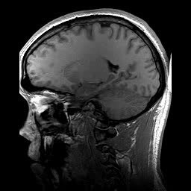
Brain age gap as biomarker?
Brain age gap (BAG) calculation
  Train a model from MR data
  Do age predicitons for each individual: “Your brain is X years old”
  Calculate the difference between chronological and predicted age
BAG associations
  Related with a whole bunch of phenotypes, clinical symptoms and diagnoses¹
  Larger in several clinical groups vs controls¹
Chronologically 22 years old
Age prediction
Biologically 28 years old
BAG = 6 years
1 Franke & Gaser, 2019, Front. Neurol., 789

Slide 6
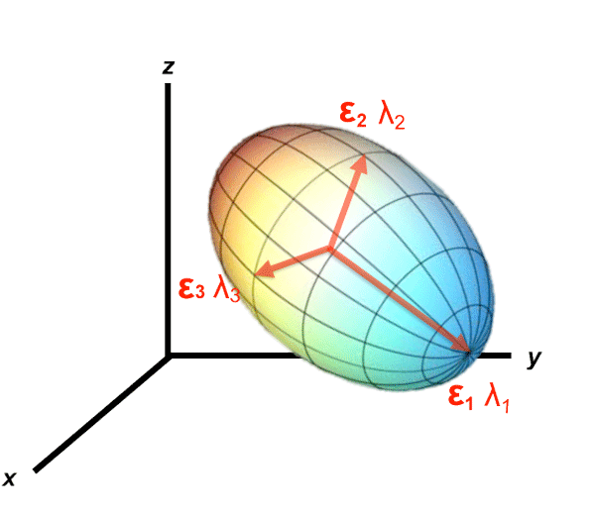
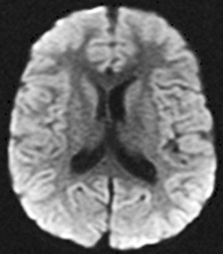
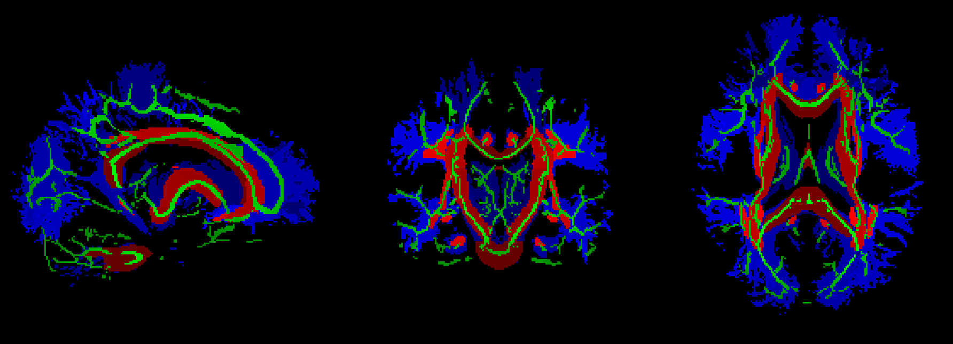
Main focus: white matter
Main data source: dMRI (but extending DTI with multicomp. approaches, e.g. for intra vs extra-axonal diff)
A
B
C

Slide 7
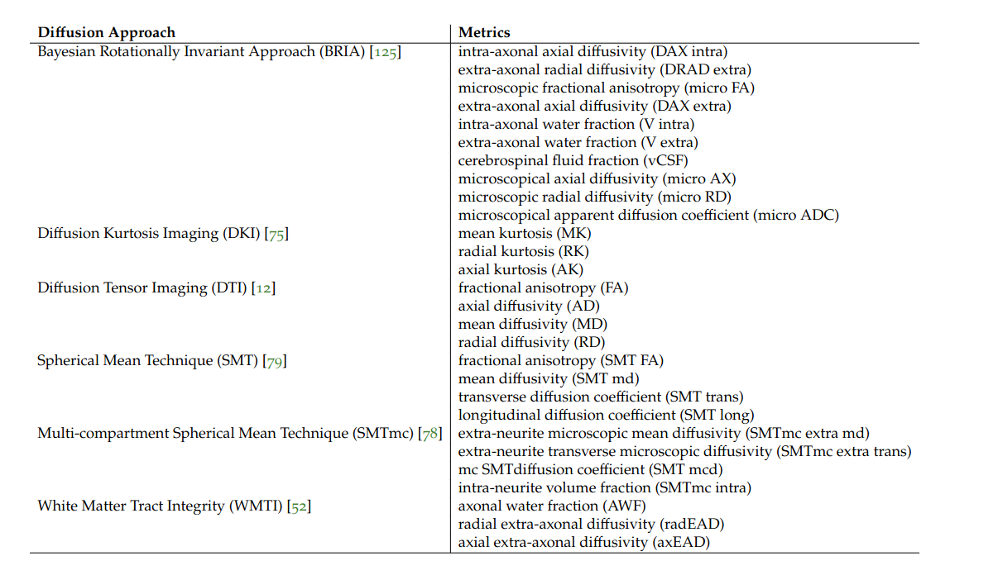
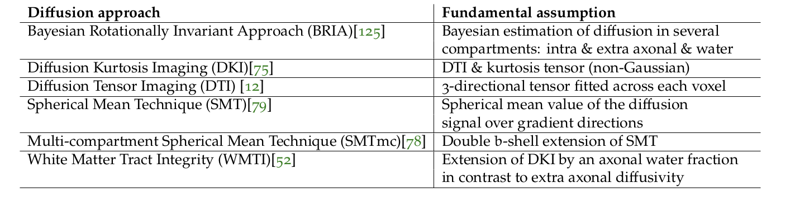
Main focus: white matter

Slide 8
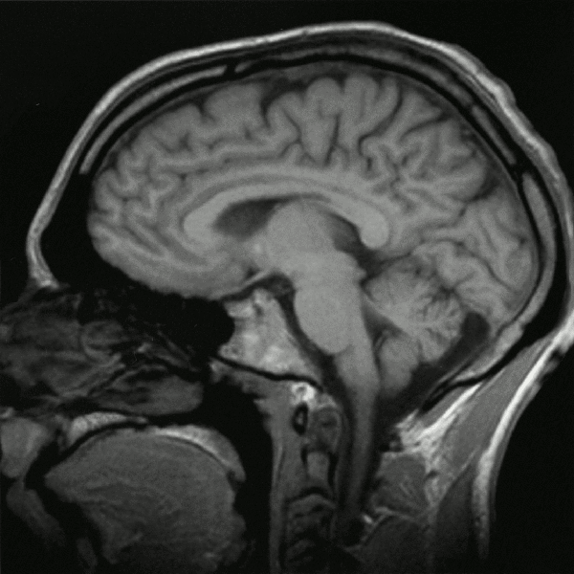
Secondary focus: T1w data
Secondary data source: sMRI
  Two uses:
    Minimally processed volumes
    Thickness, volume, and surface area averages

Slide 9

Data & what’s been done with it?
UK Biobank ~ 50k cross-sec, 3k 2x scans
  Brain age predictions
  Laterality / asymmetry assessment
  Ageing-related changes
  Association testing w age & phenotypes

Slide 10
Densly sampled & validation data
Bergen Breakfast Scanning Club
  Bergen Breakfast Scanning Club (N = 3, each > 25 scans, total = 110 scans)
  Frequently Travelling Human Phantom (N = 1, > 550 scans)
Local Oslo data (cross-sectional)
  TOP (N = 856)
  Norwegian Cognitive Neuro Genetics sample (N = 209)

Slide 11
2. What has been done so far in the project?

Slide 12
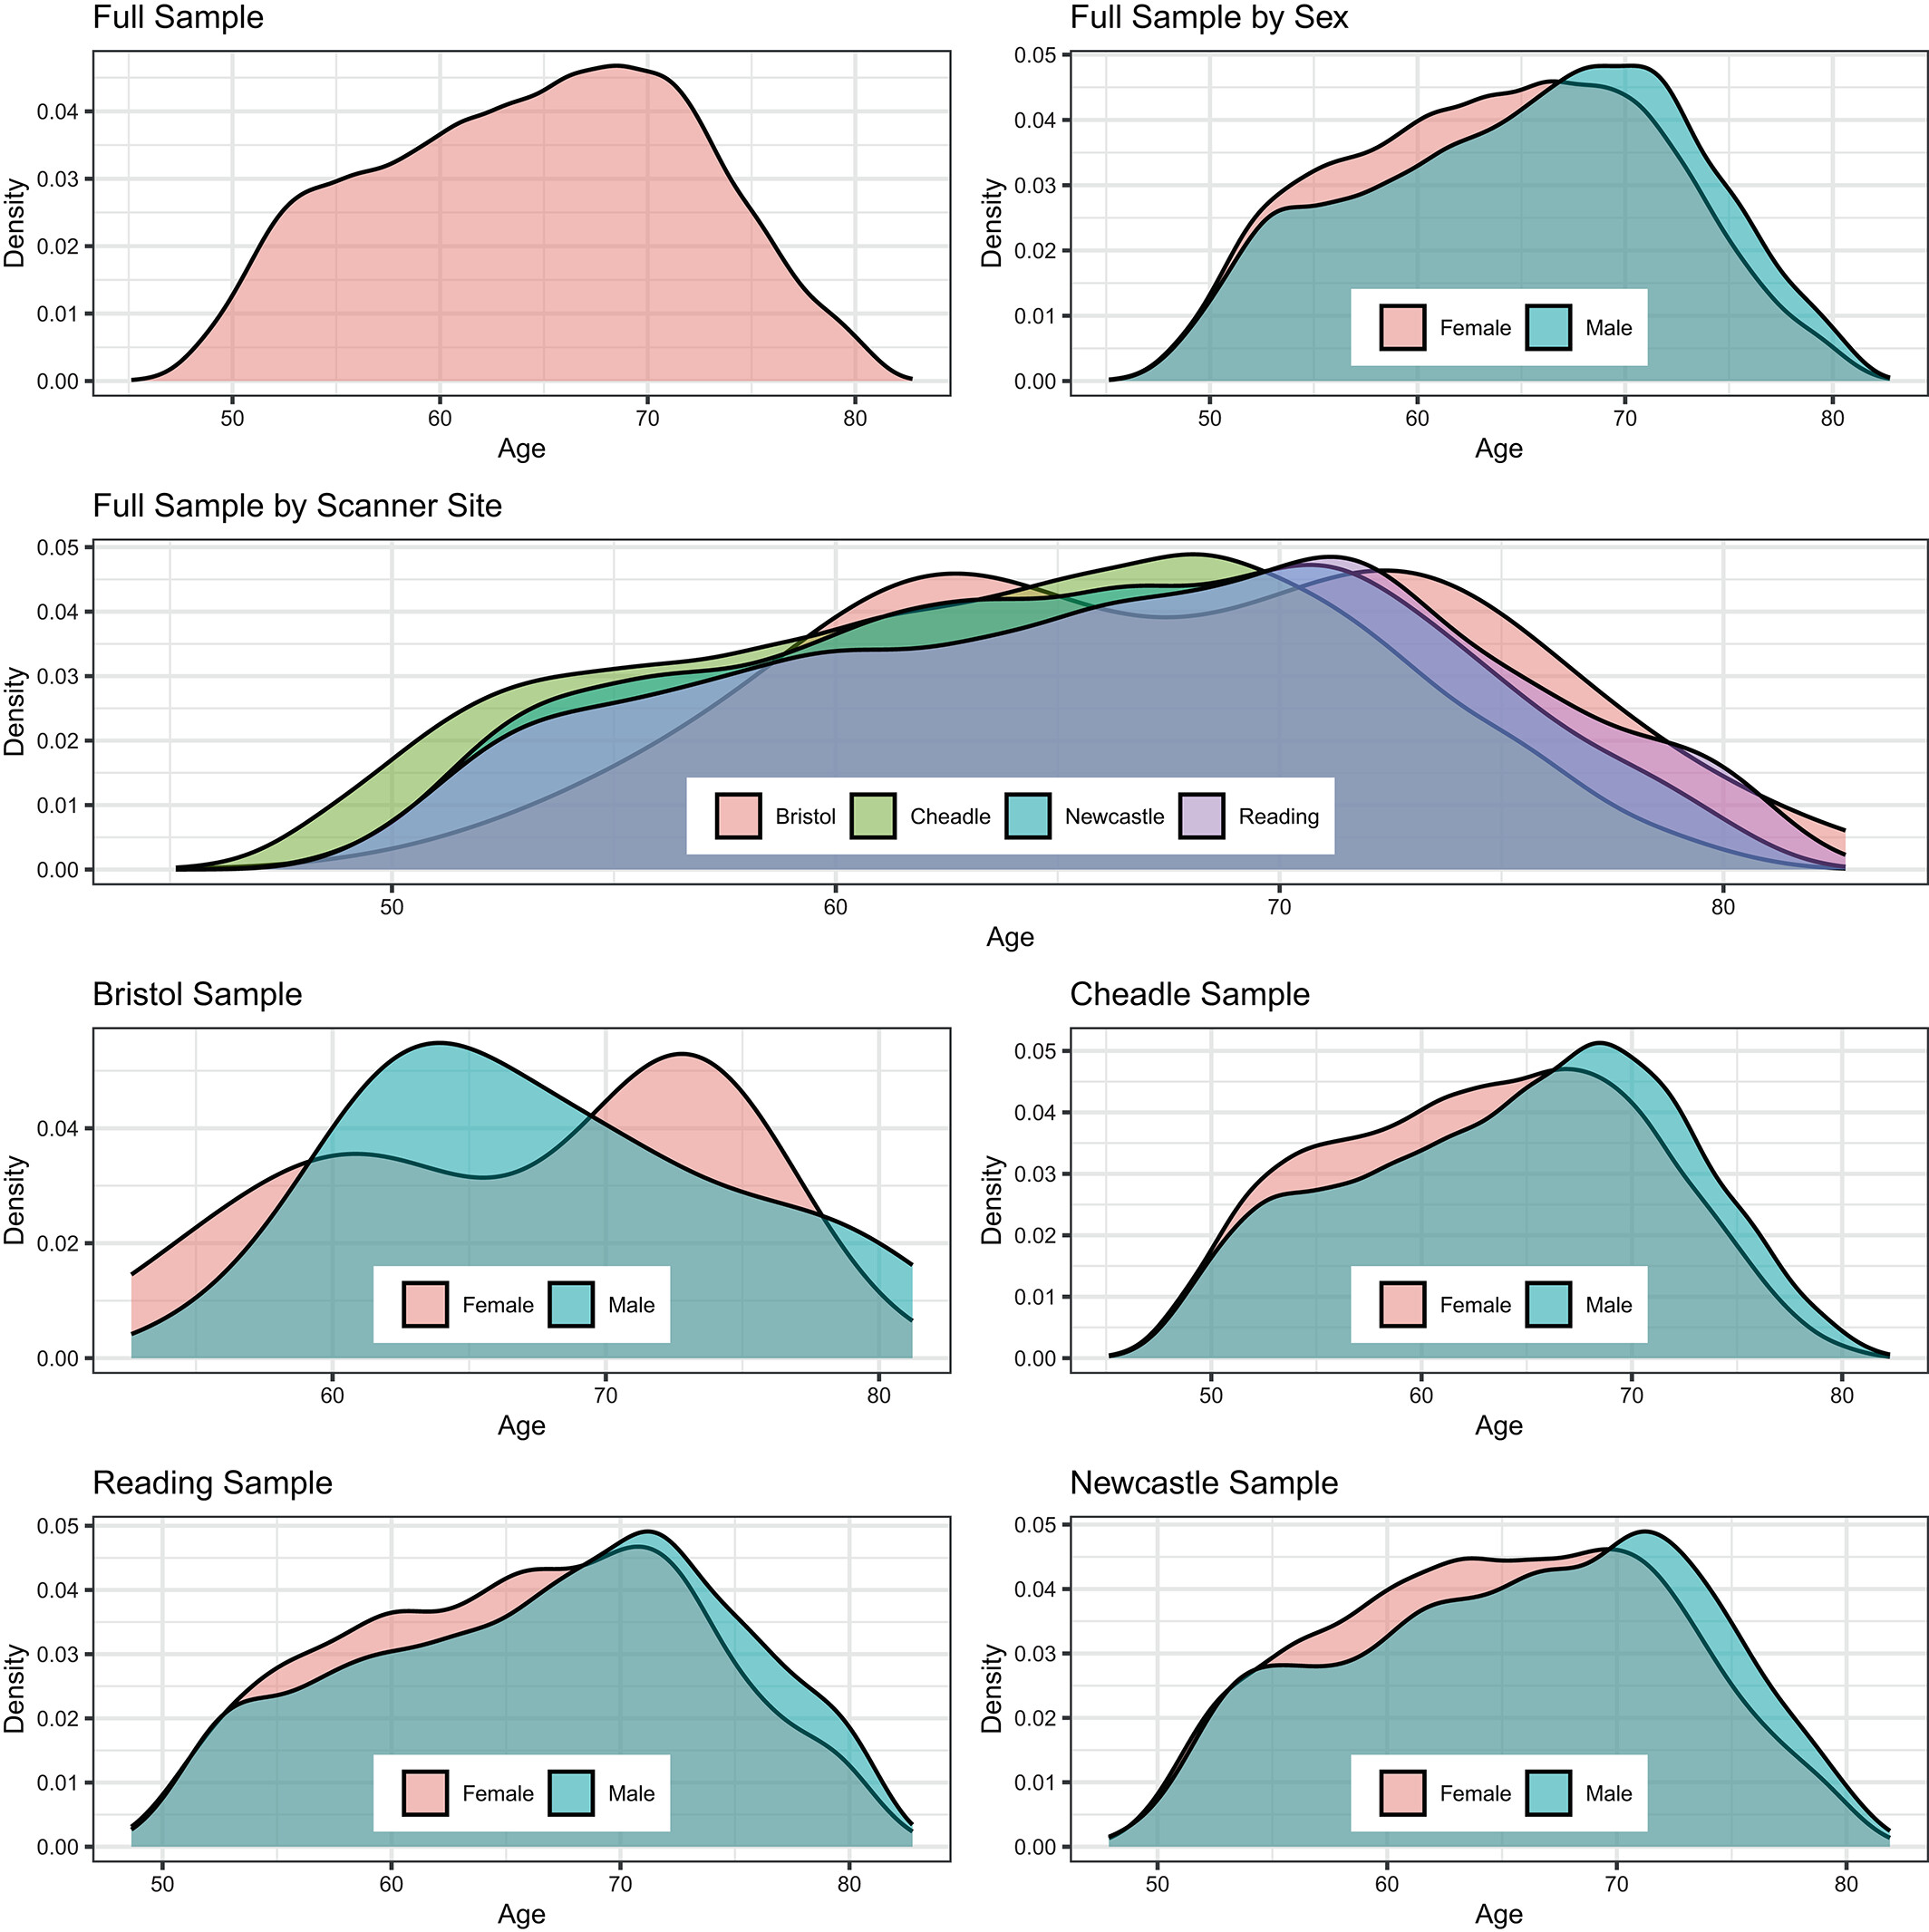
Study 1: Brain-wide WM-age ass.
After exclusions N = 35,749 UKB healthy adults
Multiple microstructure mapping approaches: DTI, DKI, BRIA, SMT & mcSMT, WMTI

Slide 13
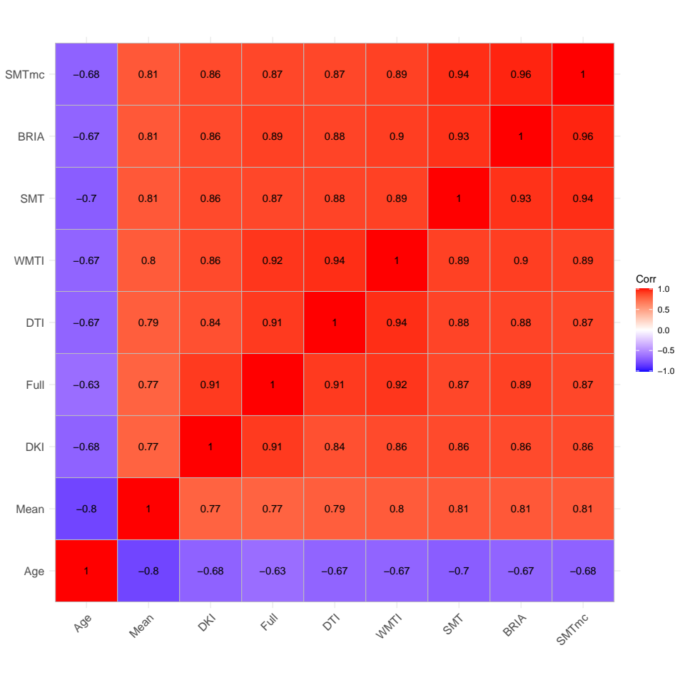
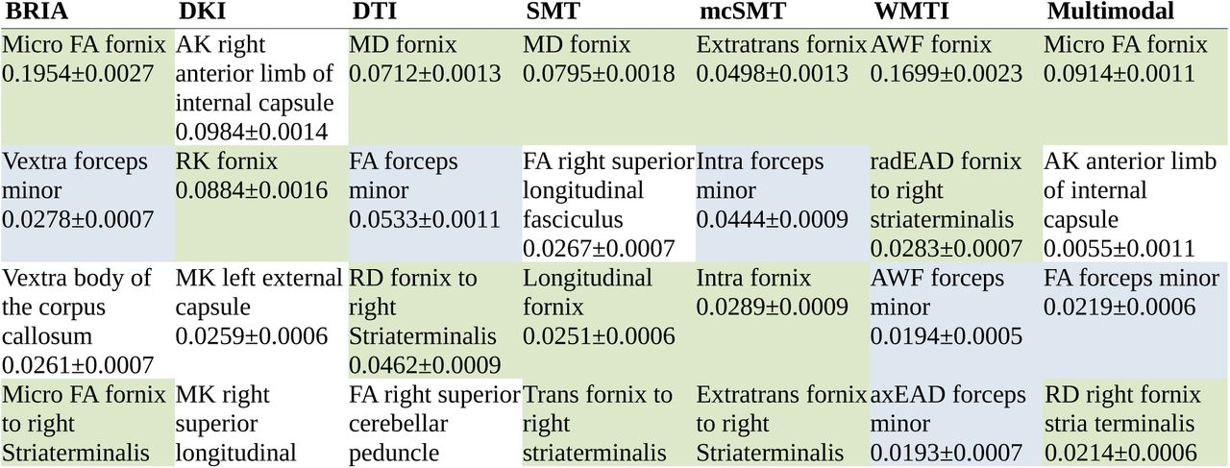
Study 1: Brain-wide WM-age ass.
Brain age estimates (using XGB on tabular data) similar across diffusion approaches (DTI, DKI, …)
Most important features for brain age predictios: fornix & forceps minor¹
1 Korbmacher et al., 2023, Hum. Brain Map.

Slide 14
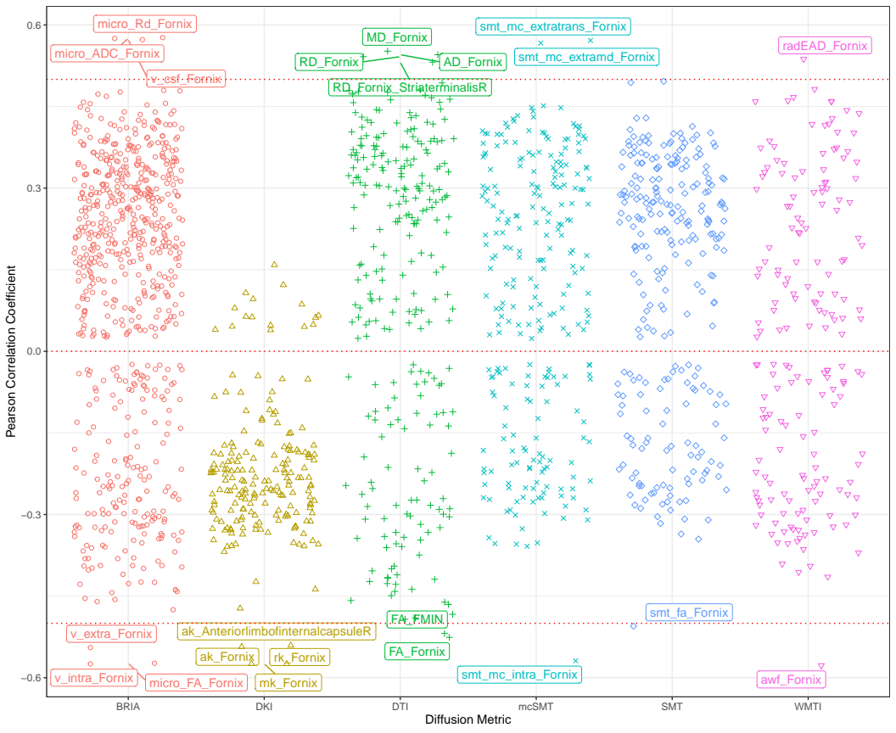
Study 1: Brain-wide WM-age ass.
Strong crude fornix WM microstructure-age relationships underline feature importance findings

Slide 15
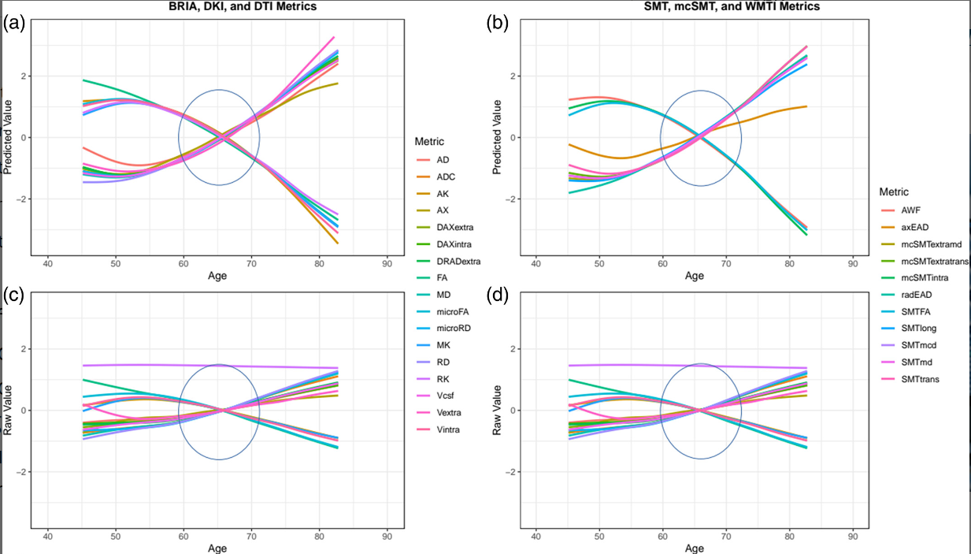
Study 1: Brain-wide WM-age ass.
Corrected (a-b) & uncorrected (c-d) WM microstructure-age relationships follow similar patterns across mapping approaches

Slide 16
Study 1: Brain-wide WM-age ass.
Meaning?
  Diffusion approaches reflect similar biological concept
  (Structural de-integration along the years)
  Fornix contributes most to explaining age, degenerates quicker than whole-brain averages
  Fornix: increases in radial diffusivity measures from DKI and BRIA (DRADextra) higher plasticity?
  Fornix as ageing biomarker? Deep brain stim target?

Slide 17
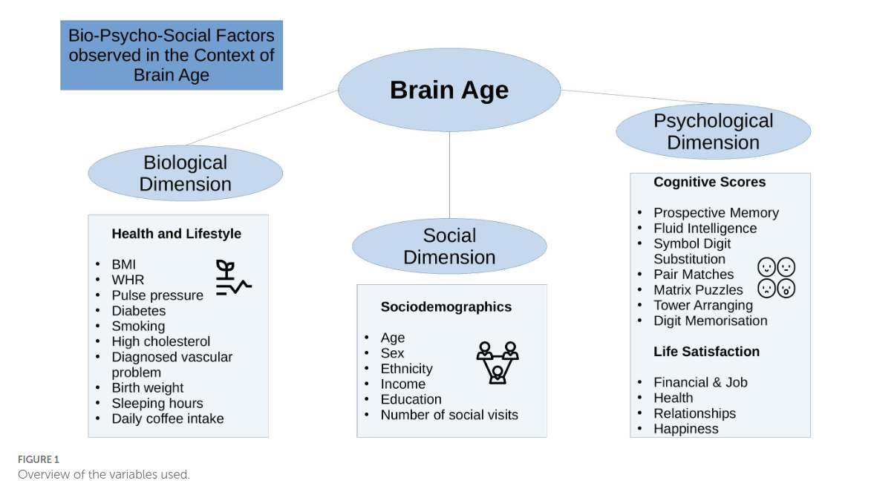
Study 2: Bio-psycho-social BA
Associating brain ages from study 1¹ with bio-psycho-social (BPS) factors²
  Waist-to-hip ratio, diabetes, hypertension, smoking, matrix puzzles solving, job- & health satisfaction and perception
Conclusion: brain age reflects overall health but is not well-predicted by any of the observed (BPS) domains
1 Korbmacher et al., 2023, Hum. Brain Map.; 2 Korbmacher et al., 2023, Front. Psy. 14:1117732

Slide 18
Study 3: Longitudinal Brain Age
Longitudinal changes in brain age remain unclear
From the evidence at hand it seems like brain age changes are only sensitive to pathology
Hence, we were estimating brain age for multiple time points for the same individuals using a pre-trained deep convolutional neural network (pyment)
Korbmacher et al., 2023, Brain & Beh. (in press)

Slide 19
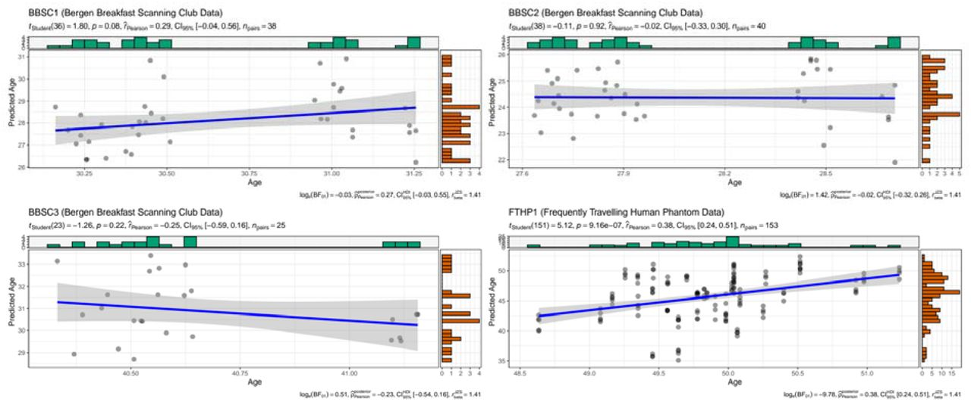
Study 3: Longitudinal Brain Age
Label-prediction correspondance was not too great
Too short inter-scan interval?
Korbmacher et al., 2023, Brain & Beh. (in press)

Slide 20
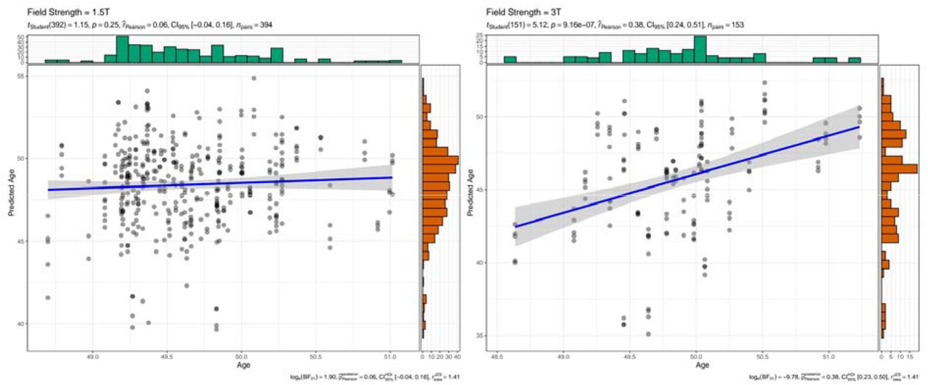
Study 3: Longitudinal Brain Age
Testing 2 potential additional reasons for low corrspond.
  Scan quality (diffuse results)
  Field strength (bingo, but only for one sub)
    (replicated in cross-sectional data)
Korbmacher et al., 2023, Brain & Beh. (in press)

Slide 21
Study 3: Longitudinal Brain Age
Interpretation
  Brain age systematically underestimated for healthy controls at 3T & higher prediction error than at 1.5T
  Underestimations can be larger(!) than what the model error would suggest when trained on cross-sec data
  Field strength matters for brain age estimates!
  Ergo: there is still a lot to improve when tansitioning brain age into a clinical marker
  Perhaps multiple brain age models for different groups?
Korbmacher et al., 2023, Brain & Beh. (in press)

Slide 22
Study 4: Laterality & hemi BA
Previous studies suggest relationships between brain asymmetry and different disorders
  Particularly, decreasing asymmetry observed in healthy GM ageing, which is accelerated in AD¹
Generalizable to different GM & WM metrics? And can we learn more about brain age through these observations?
1 Roe et al., 2021, Nat. Comm. 12, 71.

Slide 23

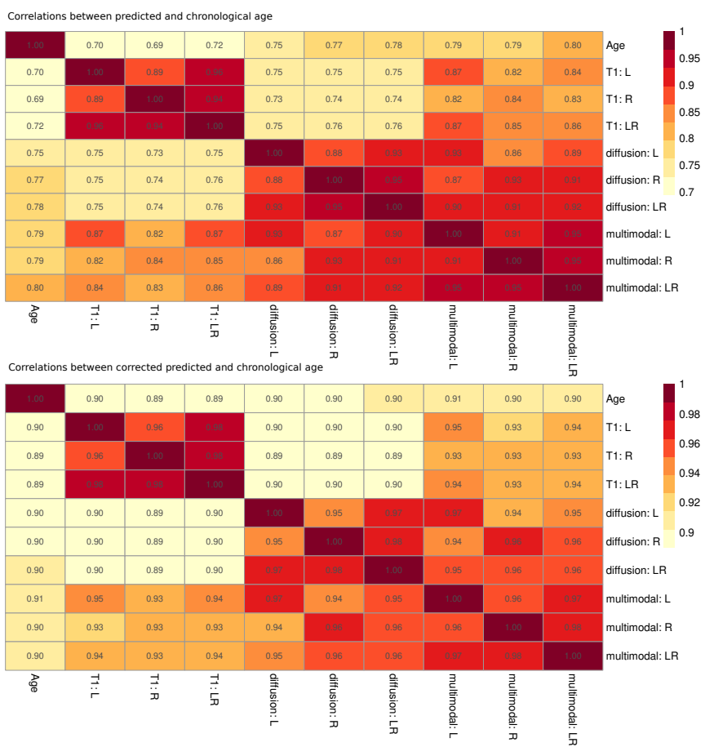
Study 4: Laterality & hemi BA
T1w (N = 48,040) & dMRI (N = 39,637) features, overlap/ multimodal N = 39, 507
Laterality calculated by laterality index (LI)
Hemispheric brain age (HBA) calculated on L/R features
  HBA & brain ages correspond closely within modalities
  No sign BA differences for modality, hemisphere, handedness
Preprint @ bioRxiv

Slide 24
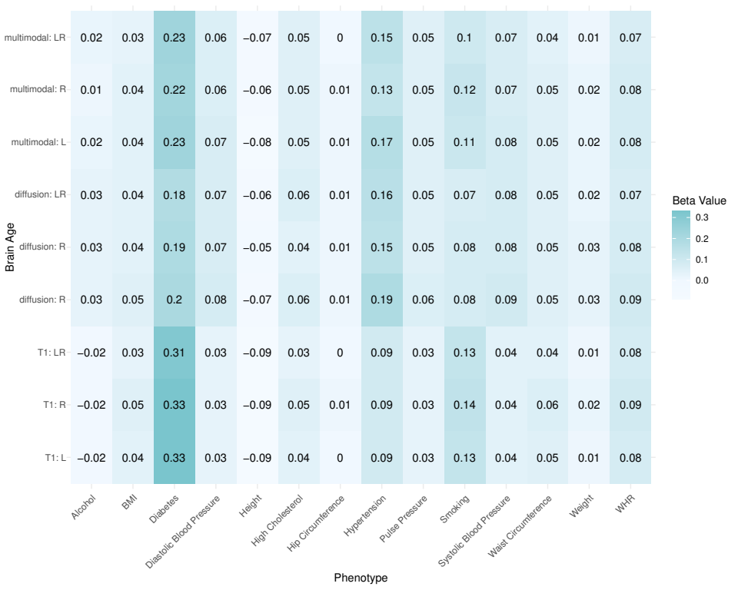
Study 4: Laterality & hemi BA
Brain ages of the same modality relate similarly to different phenotypes
Fig.: Association between general health and lifestyle phenotypes and BA estimated from different modalities, left, right and both hemispheres. For simplicity, standardized
slopes with |β| < 0.005 were rounded down to β = 0. L: left hemisphere, R: right hemisphere, LR: both hemispheres. Note that differences between participants who drink
alcohol compared to those who do not drink alcohol were non-significant, and hip circumference was only significantly associated with dMRI-derived BAs

Slide 25
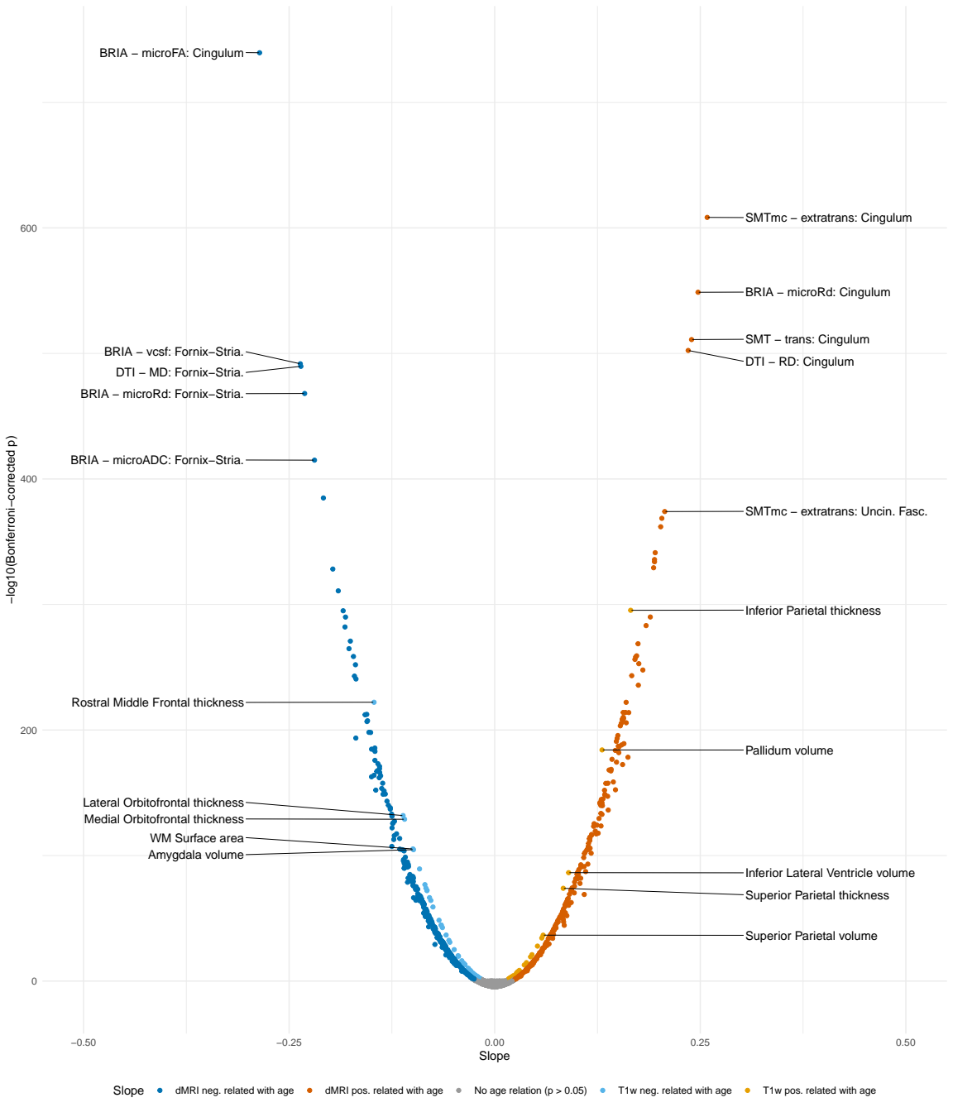
Study 4: Laterality & hemi BA
While L/R ageing trends are similar, brain age & feature asymmetry (LI) are age-dependent
WM asymmetries are more age-sensitive than GM asymmetries

Slide 26
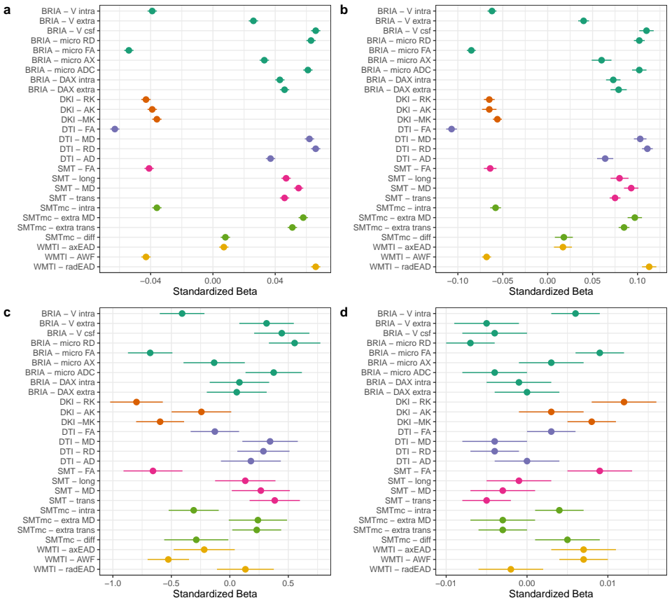
Study 5: longitudinal WM change
Summary of adjusted global average findings
  FA & intra-axonal water fraction decrease
  Diffusivity (axial, mean radial) & extra-axonal water fraction increase
  Kurtosis metrics decrease
  Panels: fixed effects of a) age, b) time point, c) sex, d) sex:age
Preprint under preparation

Slide 27
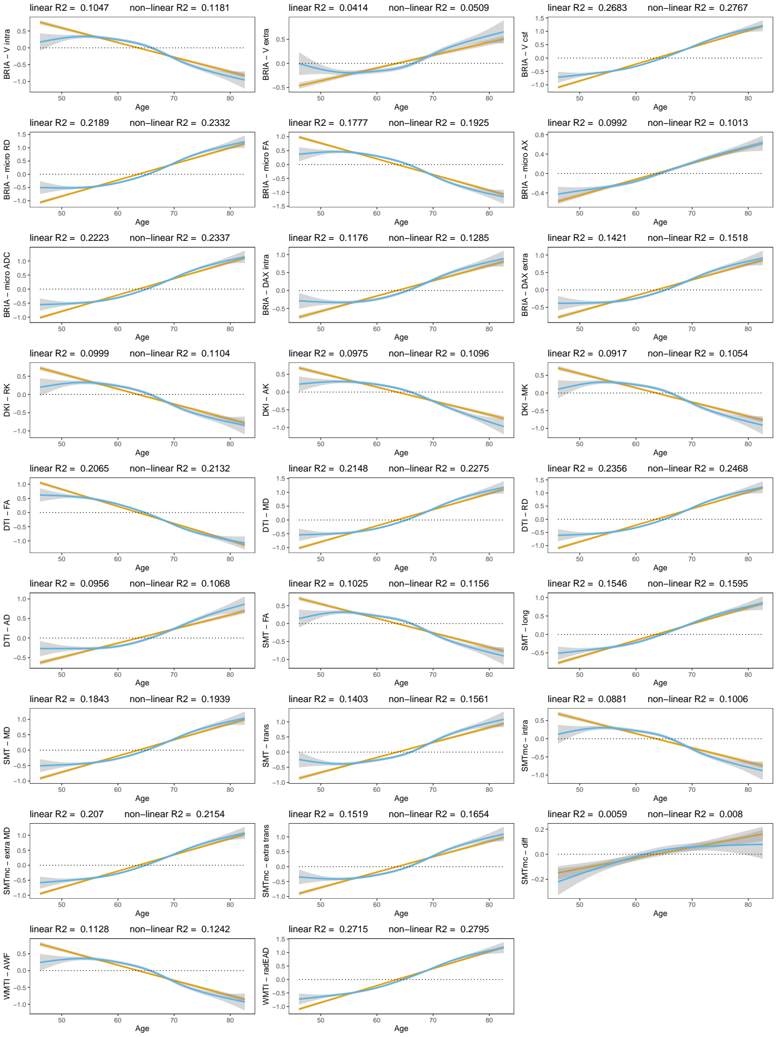
Study 5: longitudinal WM change
Summary of adjusted global average age associations of WM
(another representation of the first panel)

Slide 28
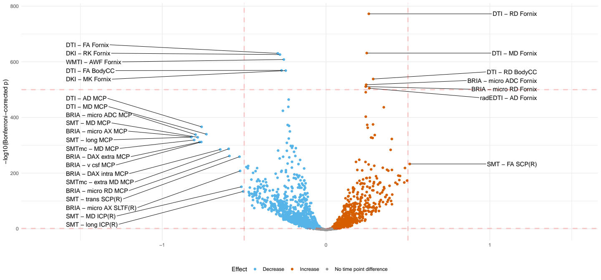
Study 5: longitudinal WM change
Summary of unadjusted region average findings
  Very similar trends to global findings in terms of metrics, but identification of regions
Crude age-white matter associations

Slide 29
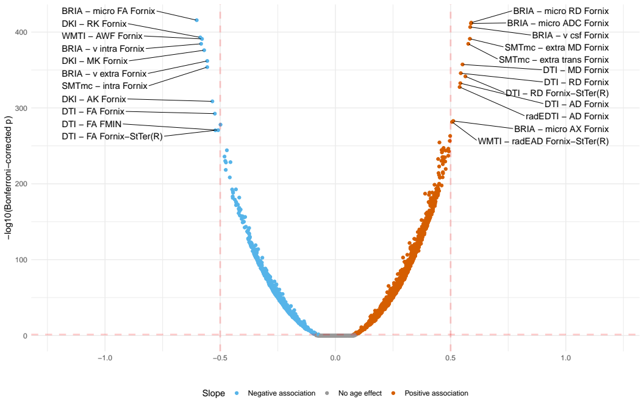
Study 5: longitudinal WM change
Summary of adjusted region average findings
  Very similar trends to global findings in terms of metrics, but identification of regions
Adjusted age-white matter relationships

Slide 30
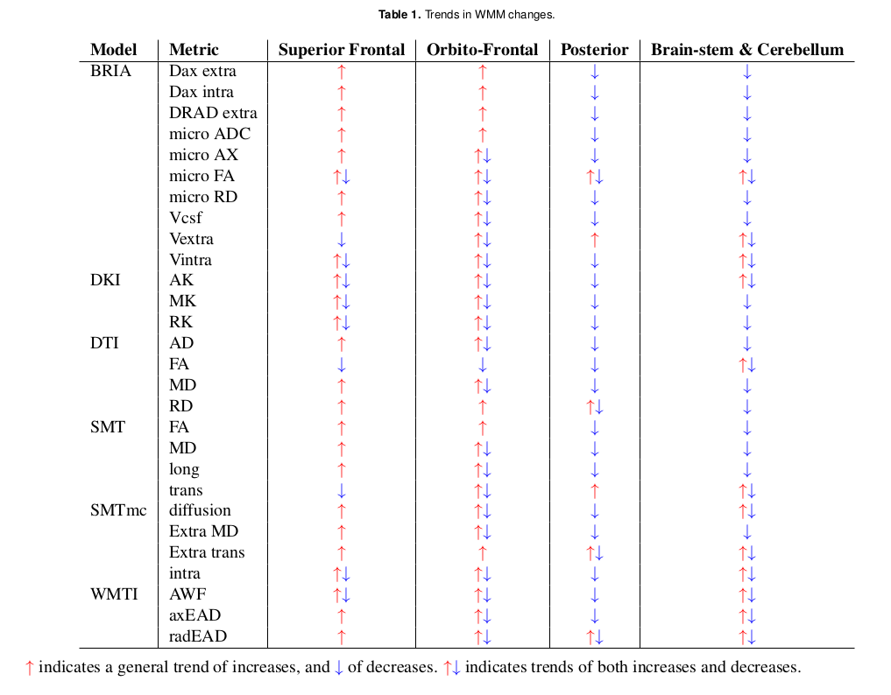
Study 5: longitudinal WM change
Summary of voxel-level findings
  Global FA decrease (de-myelination?)
  Sup.frontal diffusivity increase, otherwise decrease

Slide 31
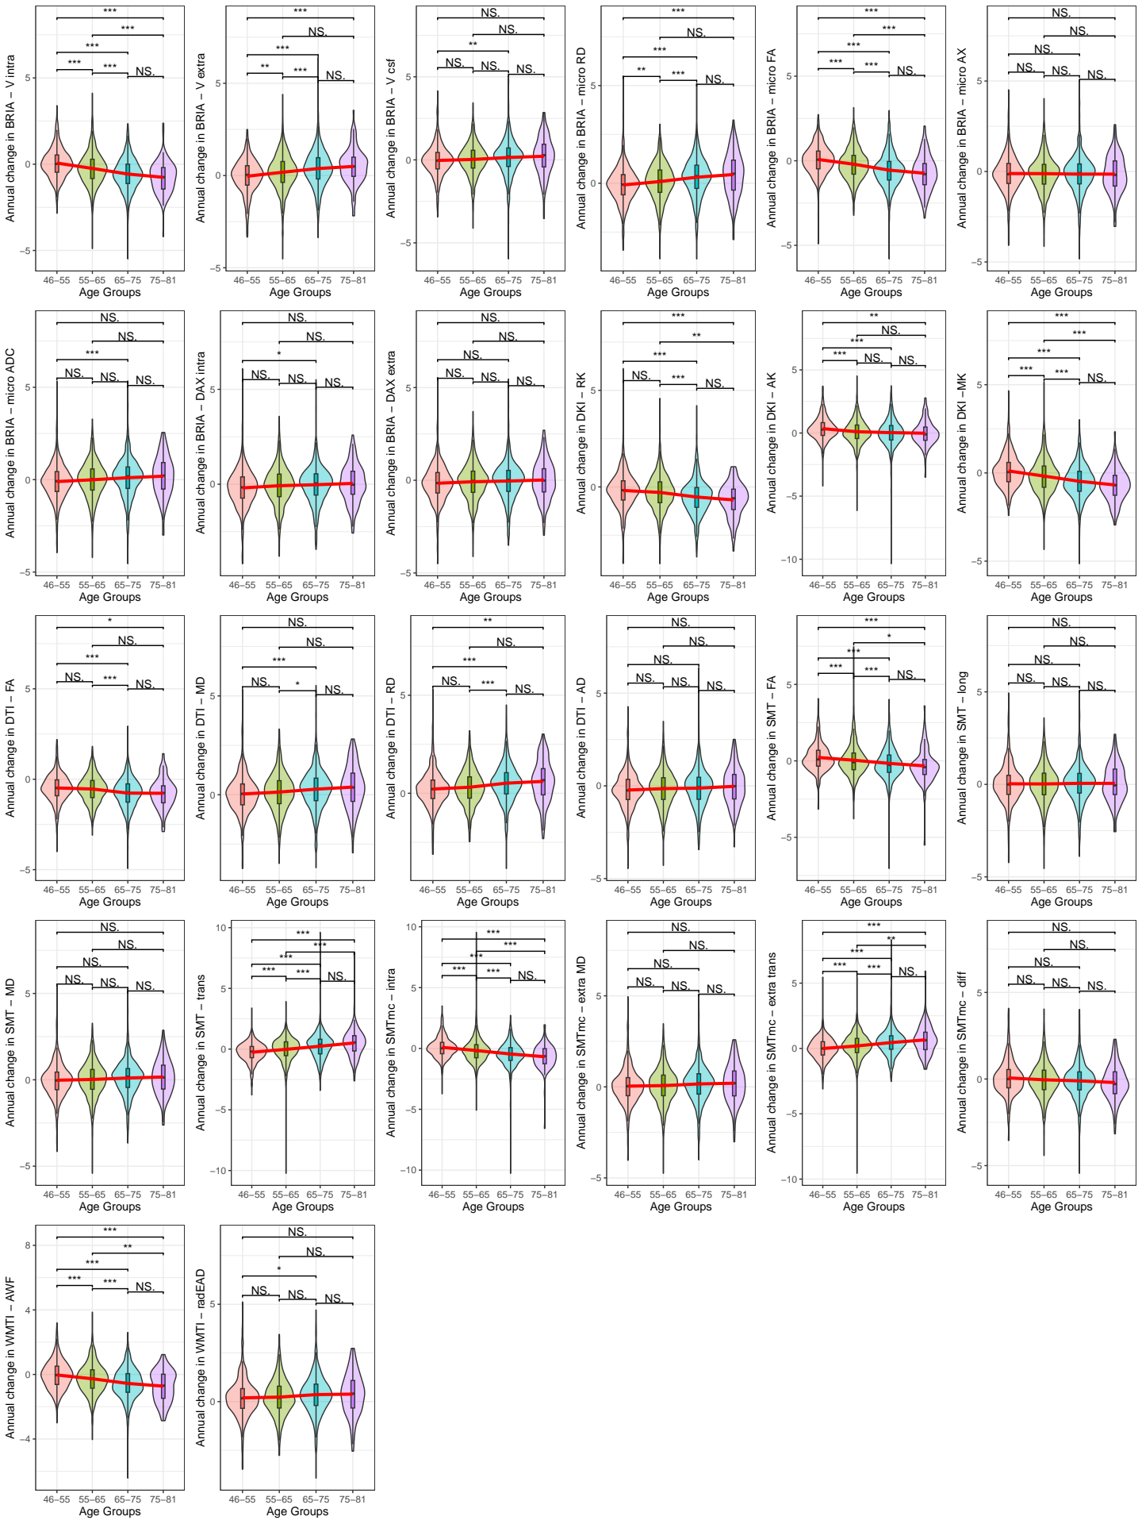
Study 5: longitudinal WM change
Age-relationship of the annual rate of change (ARoC) of global WM metrics:
  ARoC higher at higher ages for most metrics.

Slide 32
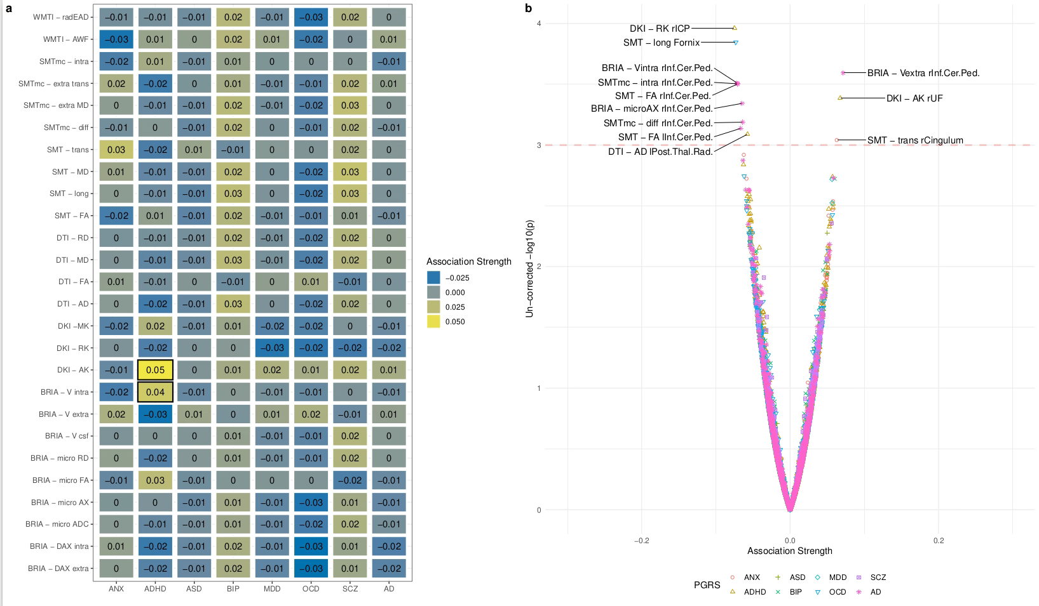
Study 5: longitudinal WM change
Gene-relationship of annual rate of change (ARoC) with global WM metrics: non-sign. after mult. comp. (small effects)

Slide 33
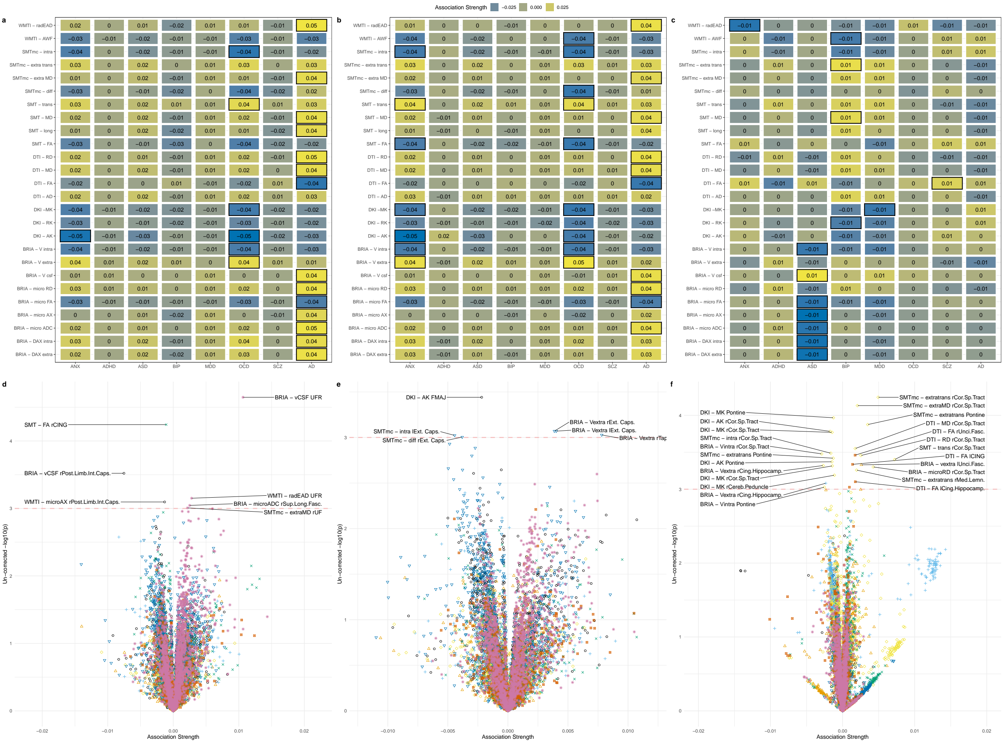
Study 5: longitudinal WM change
Gene-relationship with global cross-sectional WM metrics: non-sign. after mult. comp. (small effects)

Slide 34
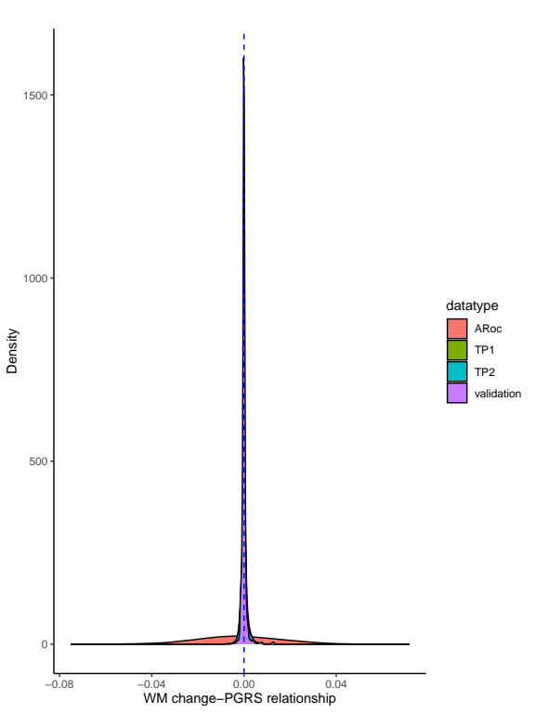
Study 5: longitudinal WM change
BUT! Looking at regions, ARoC in WMM is stronger related to polygenic risk than cross-sectional “snap-shots” of WMM
Meta statistics: Cohen’s d of difference ranged between 0.168-0.176
Hence, investigations on regional WMM-changes’ polygenic risk profiles might be useful in the future (once larger samples are available)

Slide 35
Summary of the project output
Brain age is a general indicator of health; can be conceptualised in different ways
However, its role as a clinical biomarker still requires further work
We find fornix to be a highly age-sensitive region
Distributed spatial pattern of polygenic risk across WM

Slide 36
3. What more to do?

Slide 37
What more to do?
What is the role of fornix in relationship to the rest of the brain thoughout ageing?
  Connectivity analysis
How do our findings translate to clinical samples?
  Use trained models on age-matched disease groups (neurodegenerative) or re-train
  Focus on fornix or brain age
Methodological considerations (longituinal changes in white matter brain age)
Perhaps entirely different approach (within-individuals statistics)?

Slide 38









Ivan I. Maximov
Lars T. Westlye
Eli N. Eikefjord
Arvid Lundervold
Thank you!
Dennis van der Meer
Ann Marie de Lange
Dani Beck
Ole A. Andreassen
Tiril Gurholt

Slide 39
Questions

