Slide 1

FORRT
Framework for Open and Reproducible Research Training
www.forrt.org

Slide 2
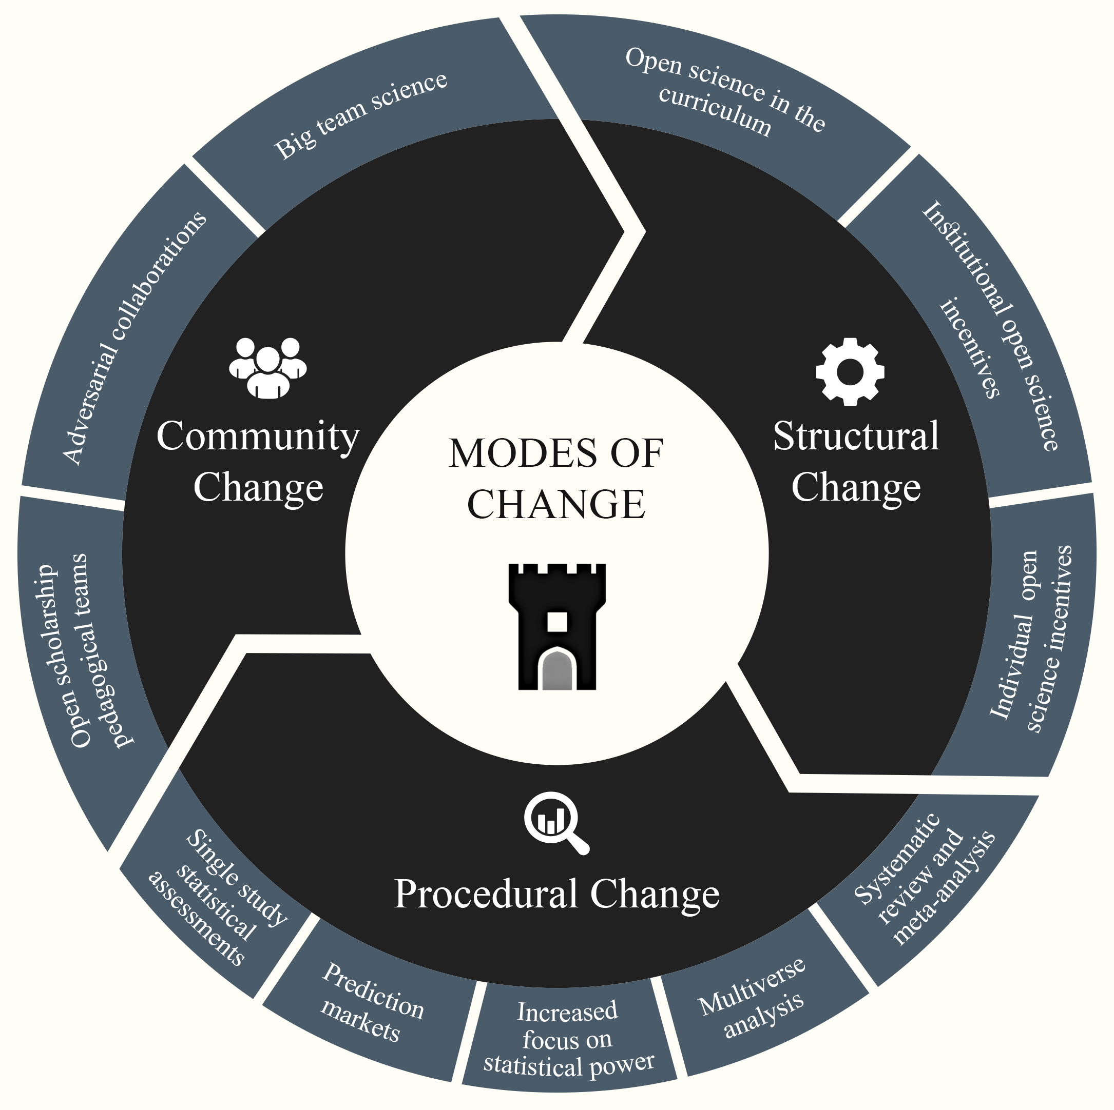
The replication crisis has led to positive structural, procedural, and community changes
www.forrt.org

Slide 3

Contents
How to collaborate in a large team of early career researchers.
The resulting paper: The replication crisis has led to positive structural, procedural, and community changes
An open science syllabus on positive changes from the replication crisis

Slide 4
1. Big ECR team science
Why writing a review paper together with many, many others?
Fighting the writer’s block
Leveraging collective knowledge
There is always something you don’t know.
It’s easy to miss information.

Slide 5
1. Big ECR team science
How to navigate such a big team?
Designated lead team
Documentation
Contribution / tenzing sheet
Communication, incl. timelines and objectives
Gdocs for writing
Working in stages
Stage 1: Add information to the article
Stage 2: Feedback on the manuscript as a whole
Stage n: Get experts to comment on their niche
Stage m: Language and meta comments

Slide 6
2. The resulting paper
Motivation
____________
Literature assessing the Replication Crisis has focussed on identifying what’s wrong (e.g., questionable research practices and unhealthy structures). This is where the discussion often stops.
Yet, there is much opportunity in learning from mistakes and improving. To move forward, positive change needs to be acknowledged, encouraged, and build upon.

Slide 7
2. The resulting paper
Organising Change
____________
Structural, procedural and community-level change as a consequence of the replication crisis.
Korbmacher et al. (2023). Communications Psychology
Notes:
unfortunately no time to go into too many details, but please check out the paper!

Slide 8
Structural Change
Curriculum changes
Implementing Open Science Practices in the curriculum
Creating norms of Open Science usage (instead of exceptions)
Large collection of open source teaching and learning materials
Replication studies as theses
As part of large-scale collaborations
As single studies (publication with the help of ECRs)

Slide 9
Structural Change
Incentive changes
Badges
Registered Reports
Transparency and Openness Promotion (TOP) and other guidelines and factors for journals
Plan-S (EU-wide open publishing)
Re-designed peer review (e.g., PeerCommunityIn)
Research evaluation updated (e.g., San Francisco Declaration of Research Assessment)
Notes:
But let’s start the beginning. What’s the problem we are trying to solve?
As the wave of scientific reform changes research practices and norms globally, higher education has largely been left behind.
While academics are increasingly adopting best practices to encourage higher standards for the quality of evidence and accessibility of research outputs, we are still failing to address how we teach, mentor, and supervise students through open science.
For example, It is still very common that undergraduates & graduates finish their studies without having heard about Open Science.
This undermines the goal of permanently redressing perverse academic incentives, it might make the w research evaluations that erode research quality.
As a result, it is still very common that graduates and undergraduates finish their studies without even hearing about open scholarship.
And to answer these questions, to the extent we can answer them, we have to work together.

Slide 10
Procedural Change
Statistical assessments
Focus on α- and β-levels & distribution of p-values
Automatic numerical error and inconsistency detection
Multiverse, reviews, mega- and meta-analyses
Guides and resources on multiverse analysis & reproducible reviews and meta analyses
Notes:
But let’s start the beginning. What’s the problem we are trying to solve?
As the wave of scientific reform changes research practices and norms globally, higher education has largely been left behind.
While academics are increasingly adopting best practices to encourage higher standards for the quality of evidence and accessibility of research outputs, we are still failing to address how we teach, mentor, and supervise students through open science.
For example, It is still very common that undergraduates & graduates finish their studies without having heard about Open Science.
This undermines the goal of permanently redressing perverse academic incentives, it might make the w research evaluations that erode research quality.
As a result, it is still very common that graduates and undergraduates finish their studies without even hearing about open scholarship.
And to answer these questions, to the extent we can answer them, we have to work together.

Slide 11
Procedural Change
Predictions Markets
Several prediction market studies show that experts and non-experts can predict study replicability
Hence, another tool for researchers to assess the credibility of existing and hypothetical works

Slide 12
Community Change
Open scholarship pedagogical teams
Teams such as FORRT collecting open-access educational resources to be used by educators
Adversarial Collaborations & Big Team Science
Crowdsourced research & distributed networks of research teams facilitate large-scale investigations
The same holds true for error checking each other
Science acceleration through cooperation

Slide 13
2. The resulting paper
Outlook
____________
The credibility revolution motivated structural, procedural, and community changes that would have previously been considered idealistic, if not impractical.
Developments go beyond “fixing failed replications”: transparency, rigor, and quality in all aspects of research are now in the focus
Only change on multiple levels will be sustainable
E.g., researchers focus on high-quality outputs [individual level] but are incentivised to focus on novelty [structural level] sustains old structures & behaviours

Slide 14
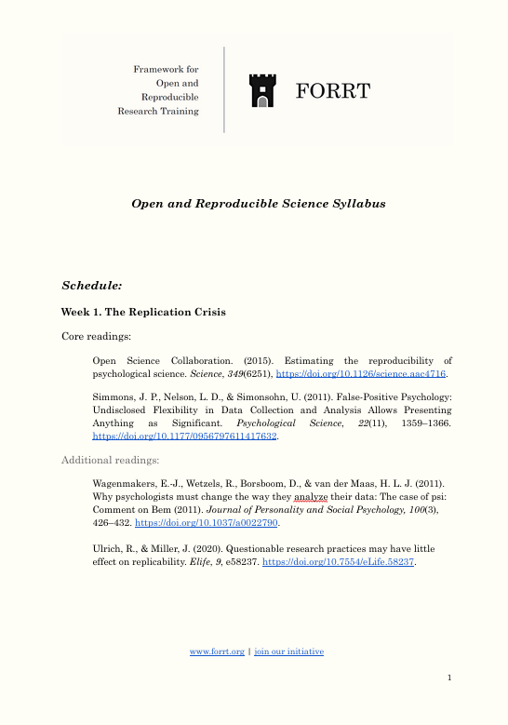
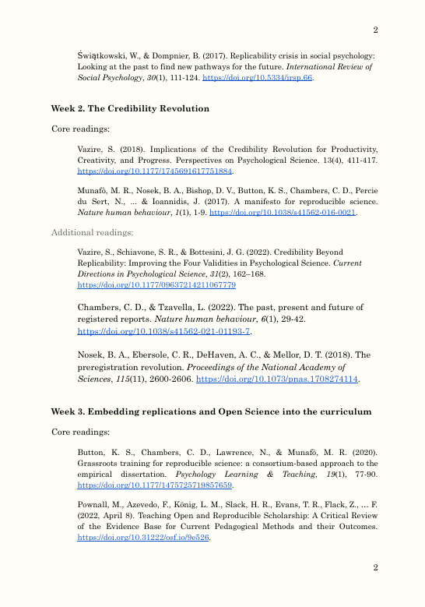
3. Educational resources
Syllabus & sets of presentation slides (soon on the FORRT website)

Slide 15
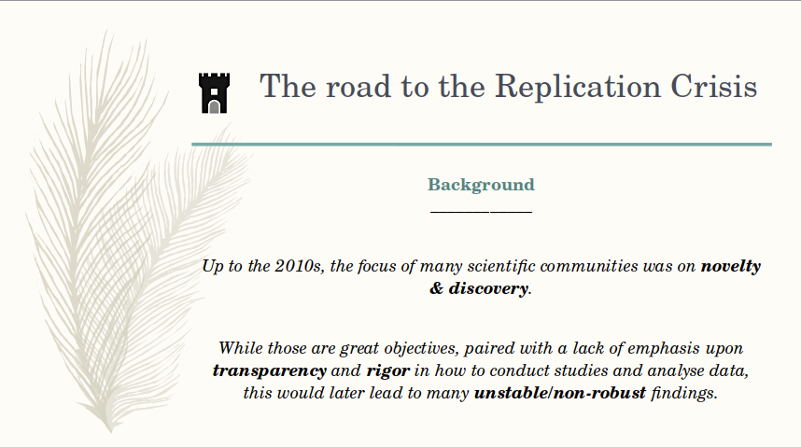
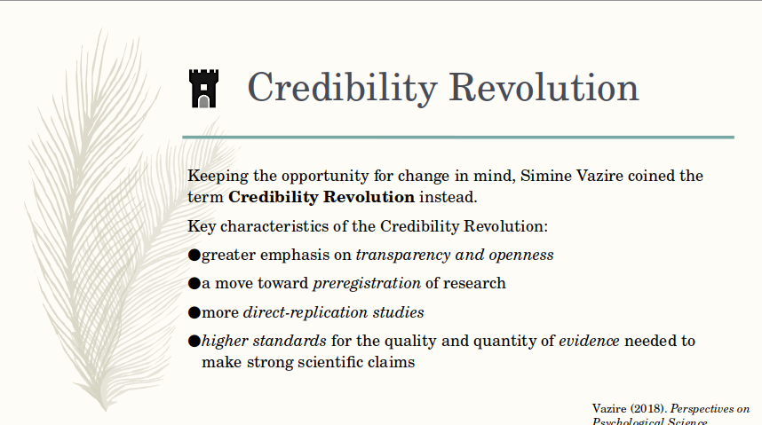
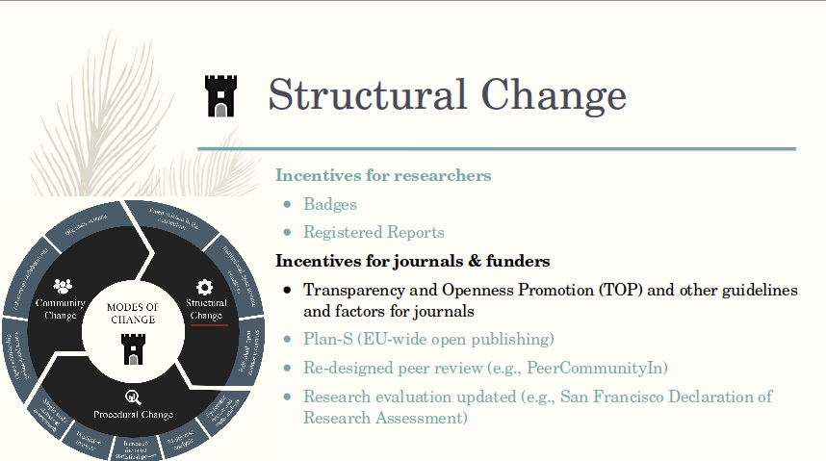
3. Educational resources
Slides on the paper (soon on the FORRT website)

Slide 16




Thank you!
https://forrt.org
info@forrt.org
@FORRTproject
https://forrt.org/publications
Notes:
So, I would like to conclude by saying that FORRT has many other initiatives, so please check our website if you are interested in discovering more initiatives and pedagogies and follow us on twitter for more updates. I would also encourage you to have a look at our publication page in case you would like to read our more recent publications on open scholarship and open educational resources.
In addition, we always welcome and appreciate new members at any career stage and from any discipline who are interested in open scholarship. If this presentation caught your interest and attention, please join our community in our slack channel. We would be happy to have you! Thank you very much for your attention and if there are any questions, please feel free to email us.

