Slide 1
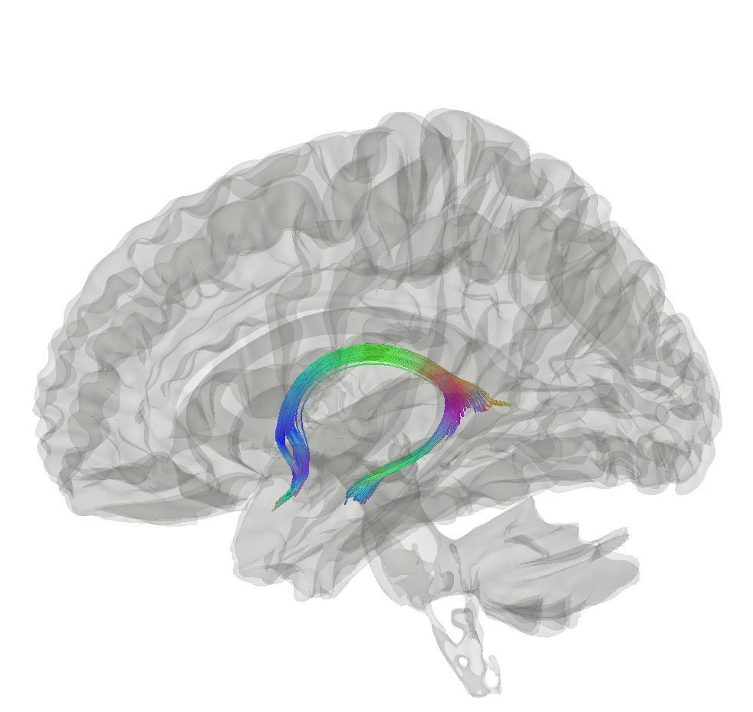



Midterm Evaluation:
Disease and Ageing Biomarker Identification from multimodal magnetic resonance imaging
Max Korbmacher
Western Norway University of Applied Sciences, Bergen
Email: Max.Korbmacher@hvl.no
Twitter: @KorbmacherMax

Slide 2
What I will talk about today
Concepts
Results
Conclusions
PART I: CONCEPTS
Brain ageing and brain age
Diffusion MRI (biophysical models)
PART II: RESULTS
White matter ageing
Putting brain age to the test
Brain asymmetries & hemispheric brain age
PART III: CONCLUSIONS

Slide 3
1. CONCEPTS

Slide 4
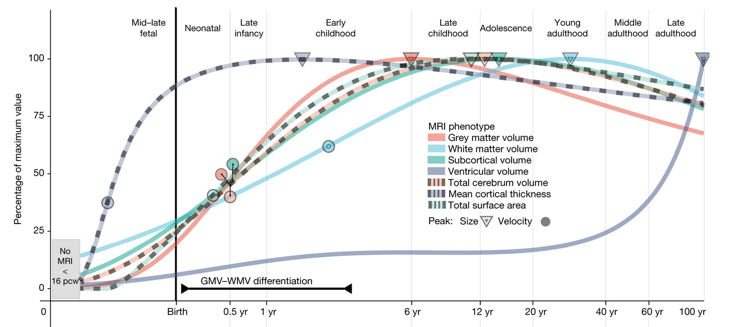
1. Brain ageing and brain age
Concepts
Results
Conclusions
There are normative patterns of brain tissue development throughout the lifespan
  Non-normativ development can indicate illness and symptom development¹
  Establishing normative patterns requires big data²
1 Rutherford et al., 2022, Elife, 11; 2 Marek et al., 2022, Nat., 603(7902)

Slide 5
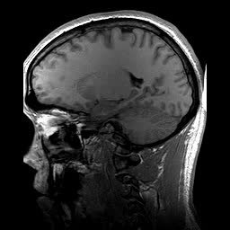
1. Brain ageing and brain age
Concepts
Results
Conclusions
Brain age gap (BAG) calculation
  Train a model from MR data
  Do age predicitons for each individual: “Your brain is X years old”
  Calculate the difference between chronological and predicted age
BAG associations
  Related with a whole bunch of phenotypes, clinical symptoms and diagnoses¹
  Larger in several clinical groups vs controls¹
Chronologically 22 years old
Age prediction
Biologically 28 years old
BAG = 6 years
1 Franke & Gaser, 2019, Front. Neurol., 789

Slide 6
1. Brain ageing and brain age
Concepts
Results
Conclusions
What’s the takeaway from normative ageing?
  We can use age-associations to learn about healthy and non-healthy ageing
  Brain age is a (simple) proxy of this (complex) process

Slide 7
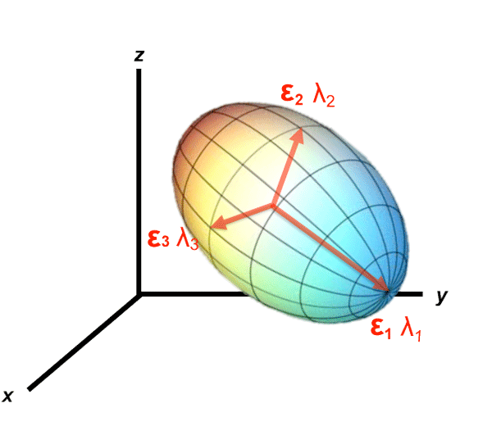
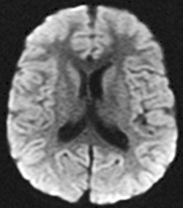
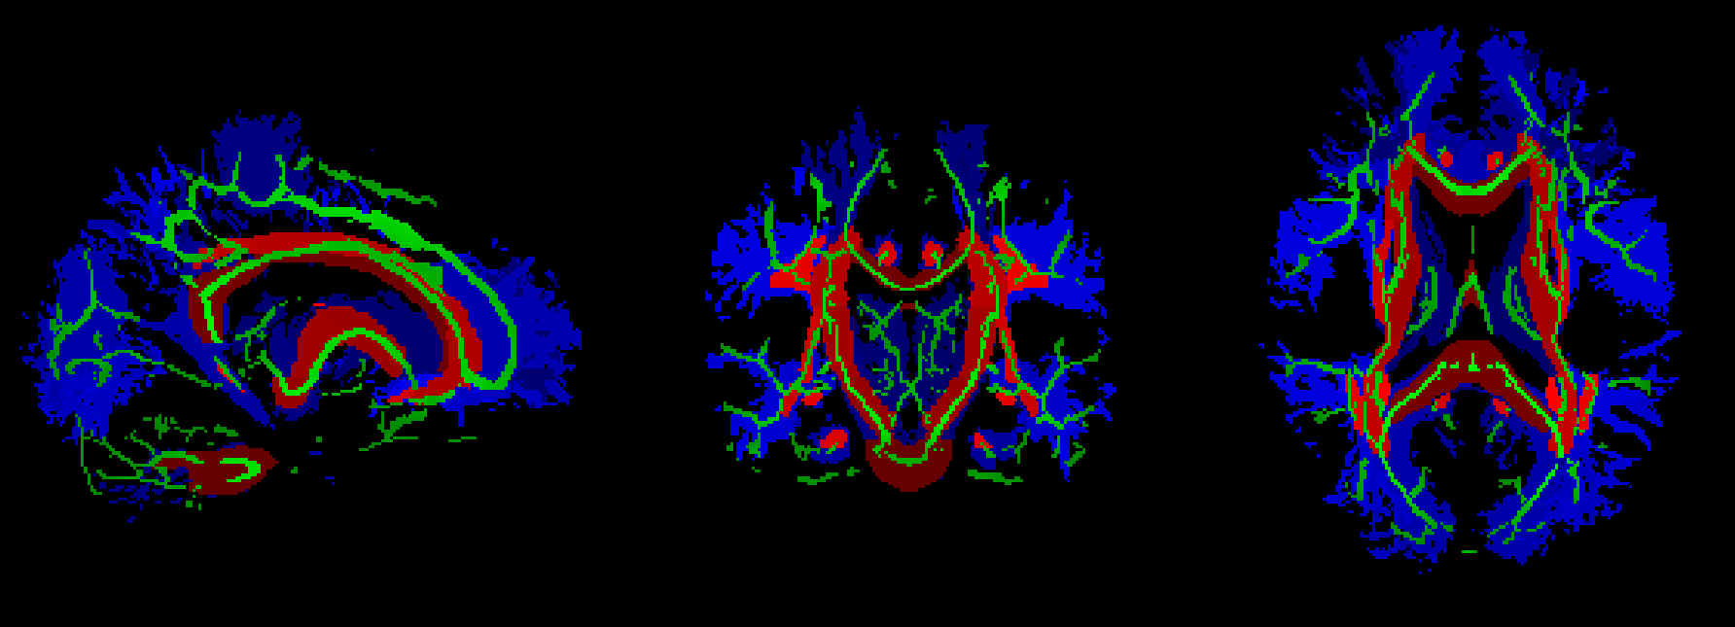
Concepts
Results
Conclusions
2. Diffusion MRI (biophy. models)
Biophysical modelling of diffusion: from signal representation to tissue models
A
B
C

Slide 8
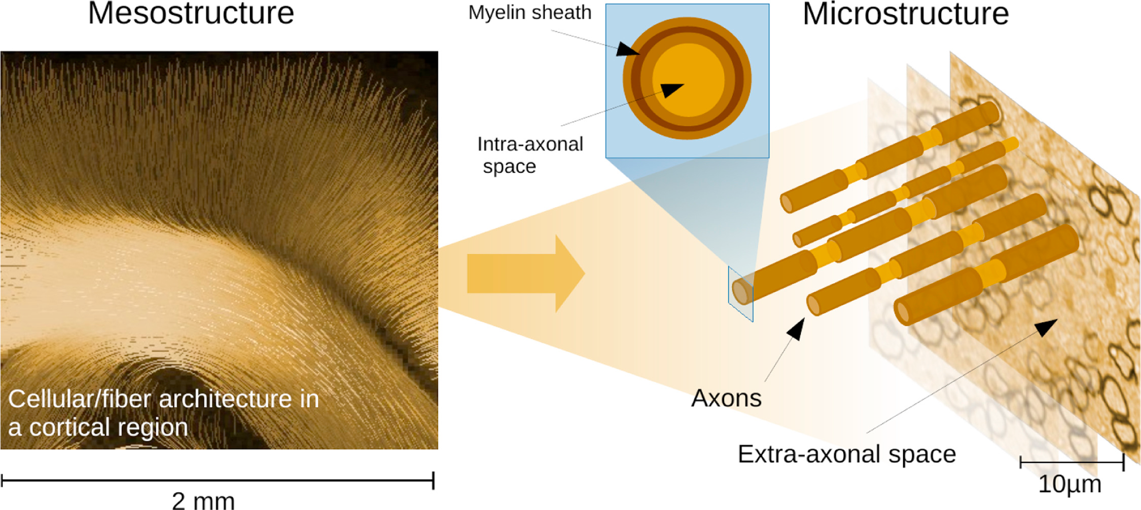
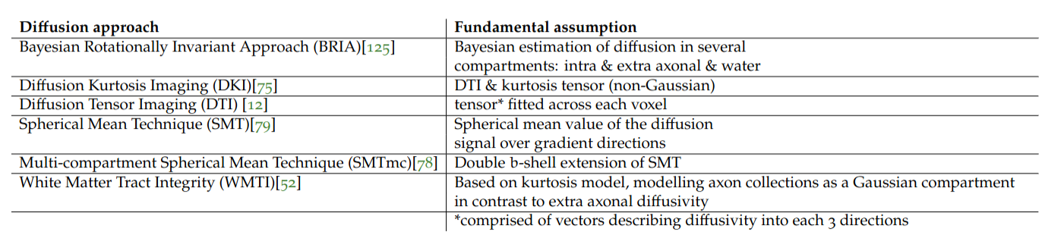
Concepts
Results
Conclusions
2. Diffusion MRI (biophy. models)
Signal representation models
  Ignore underlying tissue & simply desc. signal (DTI, DKI)
Tissue models
  Assumptions made about geometry (the others)
  This is useful as there are major differences between white and grey matter and cerebrosp. fluid
  Additional modelling opportunities of microstructure, intra- & extra-axonal space

Slide 9
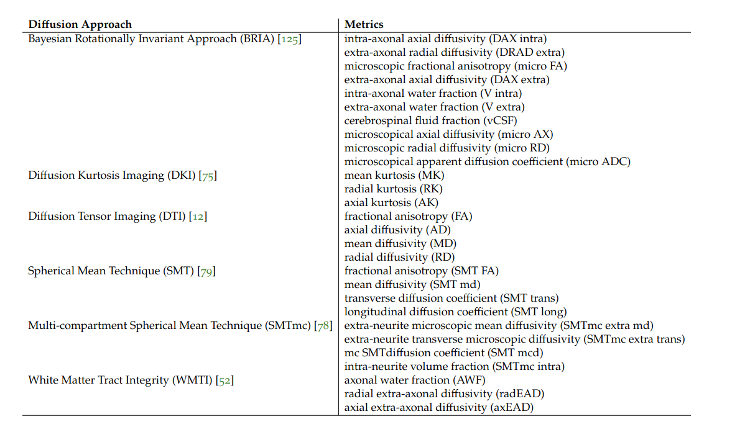
Concepts
Results
Conclusions
2. Diffusion MRI (biophy. models)
Now, let’s look at how we can combine the normative age-association idea (incl. brain age), and the metrics of different bio-physical models

Slide 10
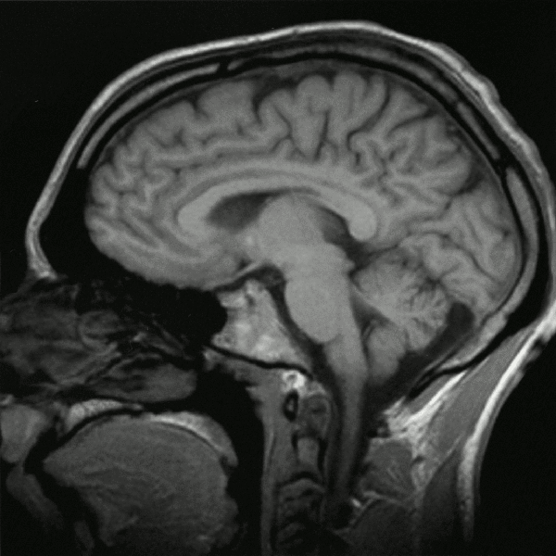
Concepts
Results
Conclusions
Secondary focus: T1w data
Secondary data source: sMRI
  Two uses:
    Minimally processed volumes
    Thickness, volume, and surface area averages

Slide 11

Data & what’s been done with it?
Concepts
Results
Conclusions
UK Biobank ~ 50k cross-sec, 3k 2x scans
  Brain age predictions
  Laterality / asymmetry assessment
  Ageing-related changes
  Association testing w age & phenotypes

Slide 12
Densly sampled & validation data
Concepts
Results
Conclusions
Bergen Breakfast Scanning Club
  Bergen Breakfast Scanning Club (N = 3, each > 25 scans, total = 110 scans)
  Frequently Travelling Human Phantom (N = 1, > 550 scans)
Local Oslo data (cross-sectional)
  TOP (N = 856)
  Norwegian Cognitive Neuro Genetics sample (N = 209)

Slide 13
2. RESULTS

Slide 14
Overview of the results
Concepts
Results
Conclusions
Study | Main Outcomes
Brain‐wide associations between white matter and age highlight the role of fornix microstructure in brain ageing | 1) Validation of diffusion approaches with brain age (similar patterns) 2) Fornix and forceps minor (corpos colassum are strongly age sensitive)
Bio-psycho-social factors’ associations with brain age: a large-scale UK Biobank diffusion study of 35,749 participants | 1) Further validation of diffusion approaches (similar association patterns of brain ages) 2) Brain age appears as general indicator of health
Considerations on brain age predictions from repeatedly sampled data across time | 1) Pre-trained state-of-the-art brain age model not applicable in clinic (strong variability) 2) Field strength explains some of variability
Brain asymmetries from midlife to old adulthood and hemispheric brain age | 1) Asymmetries decrease in WM but increase in GM, fornix strongly asymmetric 2) Hemispheric brain age
White matter changes along of two years: a longitudinal UK Biobank study | 1) mapping of voxel-to-global white matter (WM) ageing (highlighting again fornix) 2) distributed genetic underpinnings of WM

Slide 15
White matter ageing
Concepts
Results
Conclusions
Study | Main Outcomes
Brain‐wide associations between white matter and age highlight the role of fornix microstructure in brain ageing | 1) Validation of diffusion approaches with brain age (similar patterns) 2) Fornix and forceps minor (corpos colassum are strongly age sensitive)
Bio-psycho-social factors’ associations with brain age: a large-scale UK Biobank diffusion study of 35,749 participants | 1) Further validation of diffusion approaches (similar association patterns of brain ages) 2) Brain age appears as general indicator of health
Considerations on brain age predictions from repeatedly sampled data across time | 1) Pre-trained state-of-the-art brain age model not applicable in clinic (strong variability) 2) Field strength explains some of variability
Brain asymmetries from midlife to old adulthood and hemispheric brain age | 1) Asymmetries decrease in WM but increase in GM, fornix strongly asymmetric 2) Hemispheric brain age
White matter changes along of two years: a longitudinal UK Biobank study | 1) mapping of voxel-to-global white matter (WM) ageing (highlighting again fornix) 2) distributed genetic underpinnings of WM

Slide 16
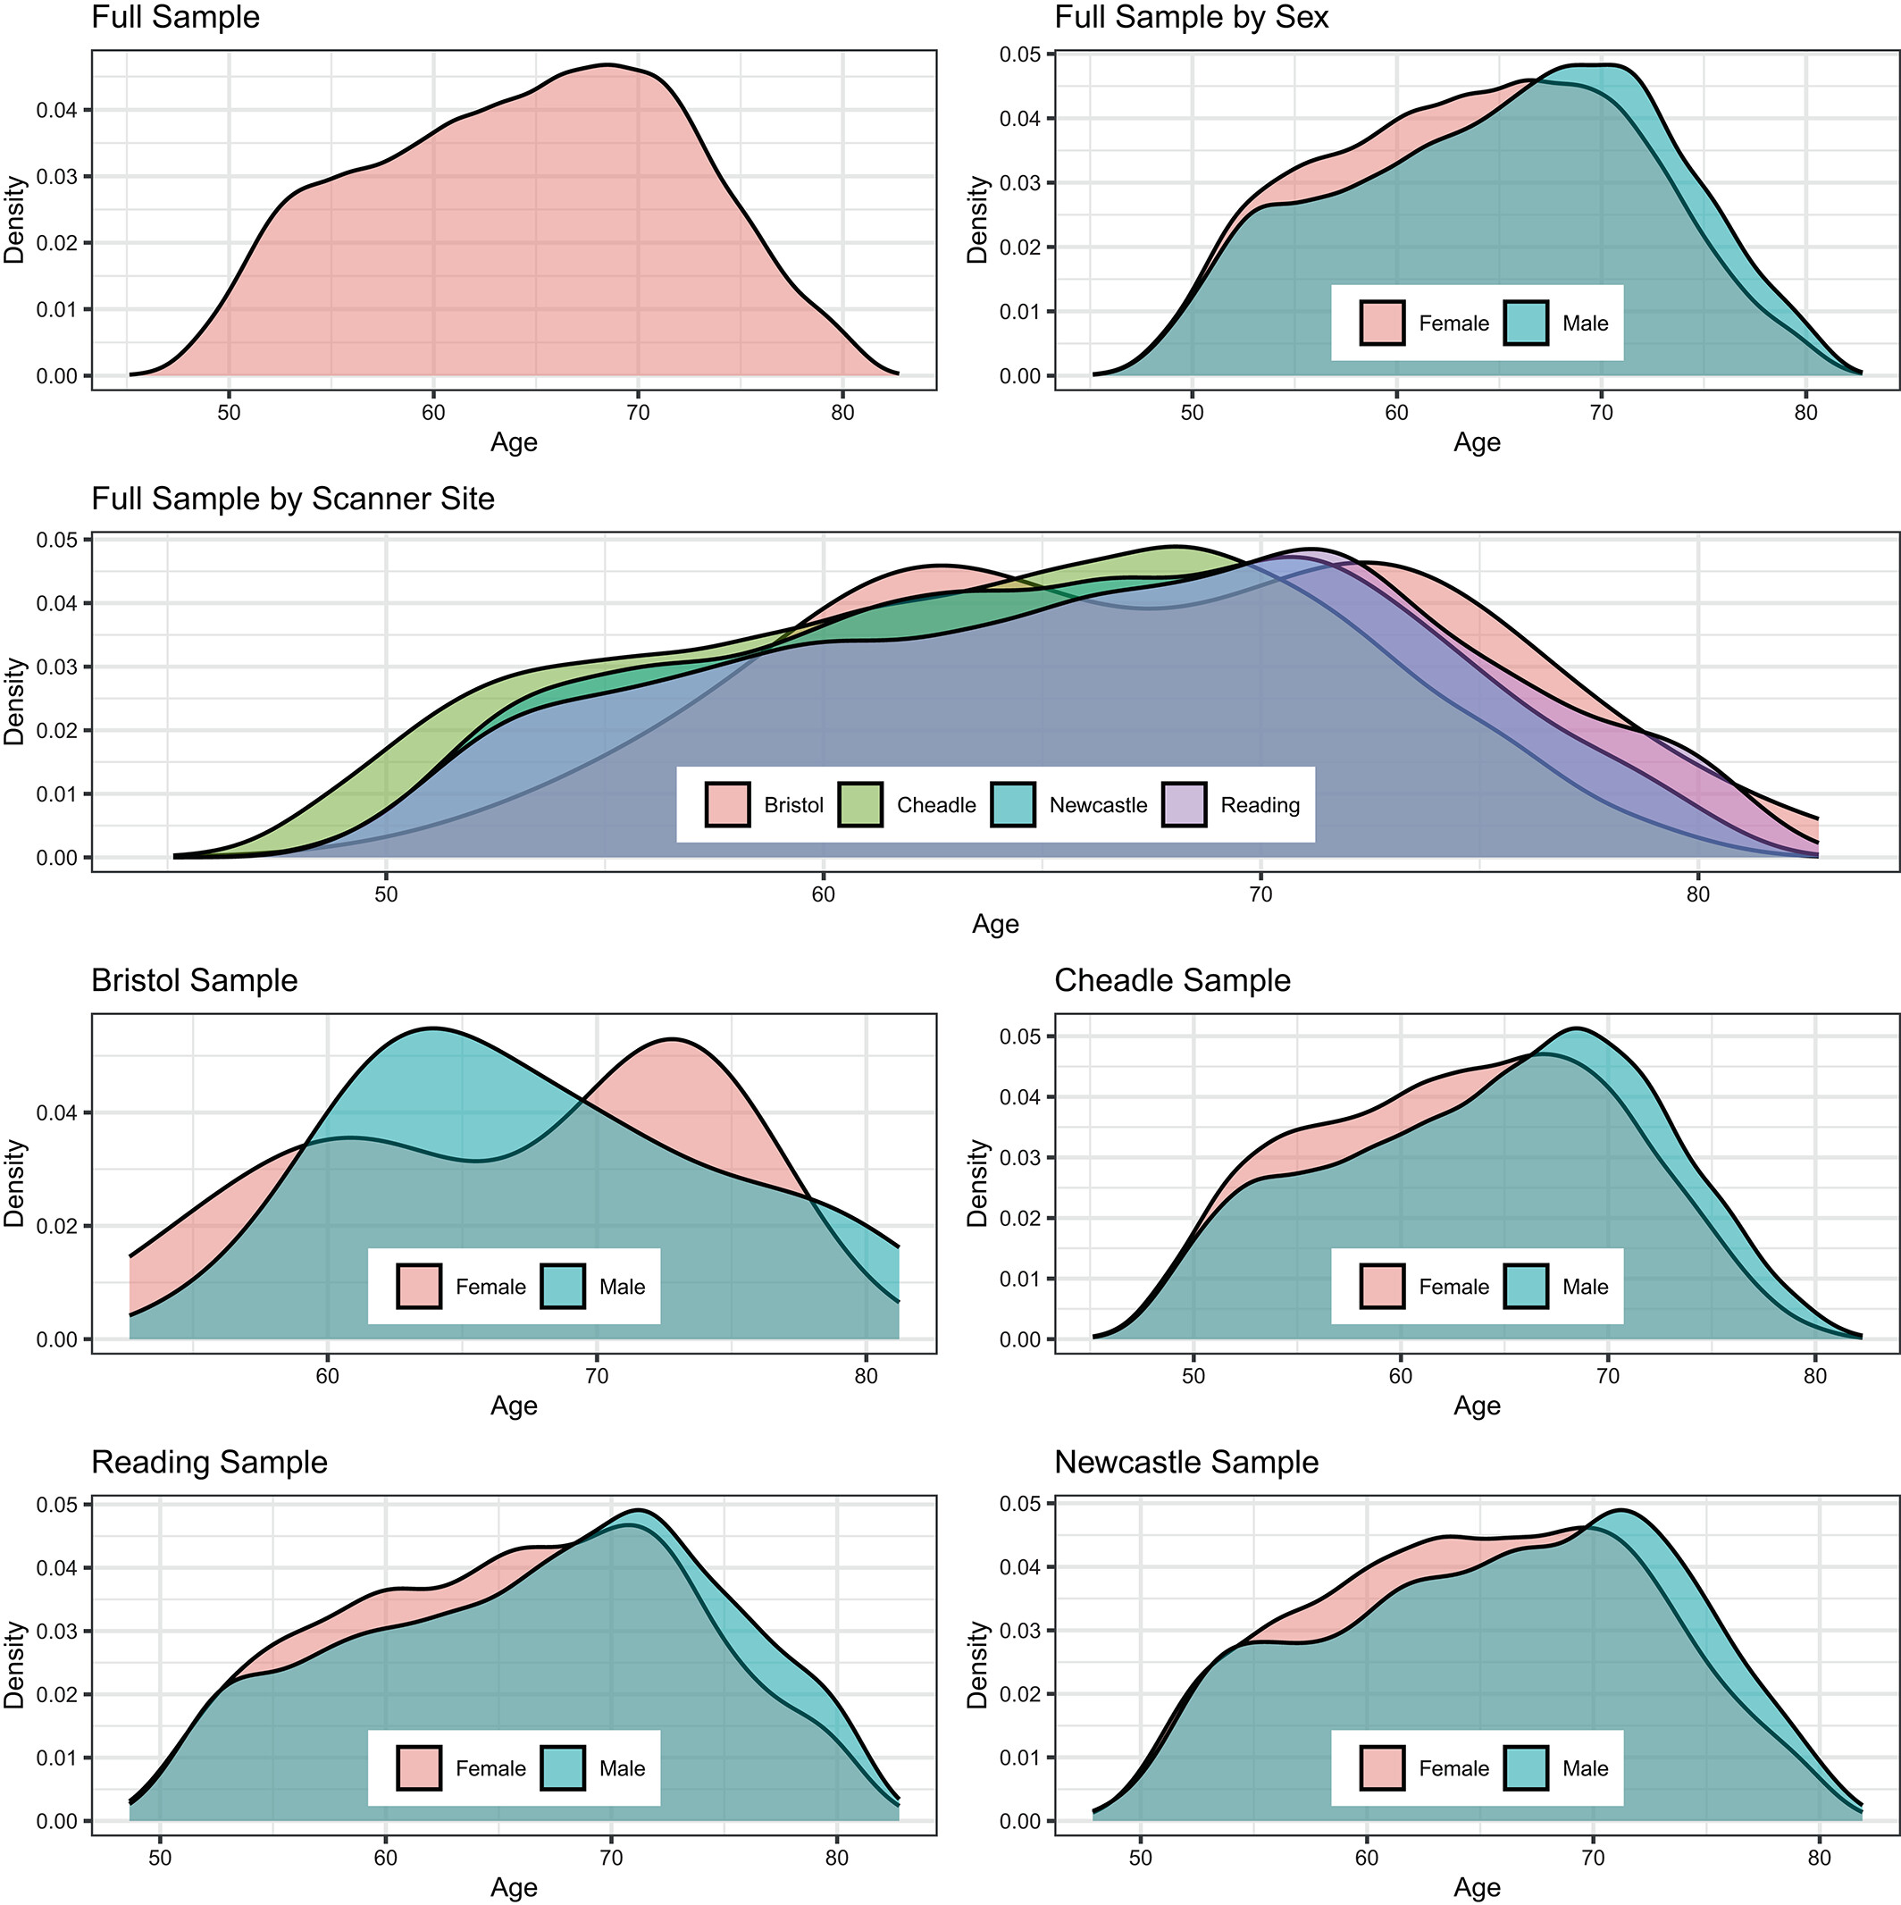
White matter ageing: study 1
Concepts
Results
Conclusions
After exclusions N = 35,749 UKB healthy adults
Multiple microstructure mapping approaches: DTI, DKI, BRIA, SMT & mcSMT, WMTI
1 Korbmacher et al., 2023, Hum. Brain Map. 44(10)

Slide 17
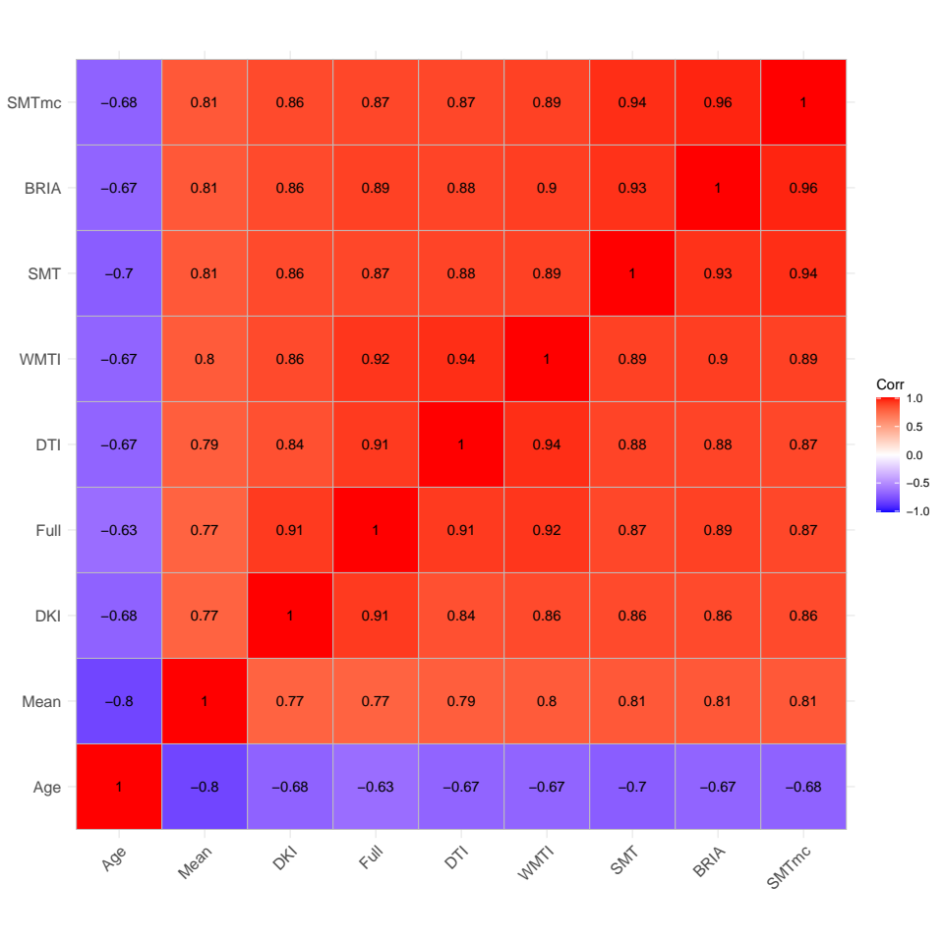
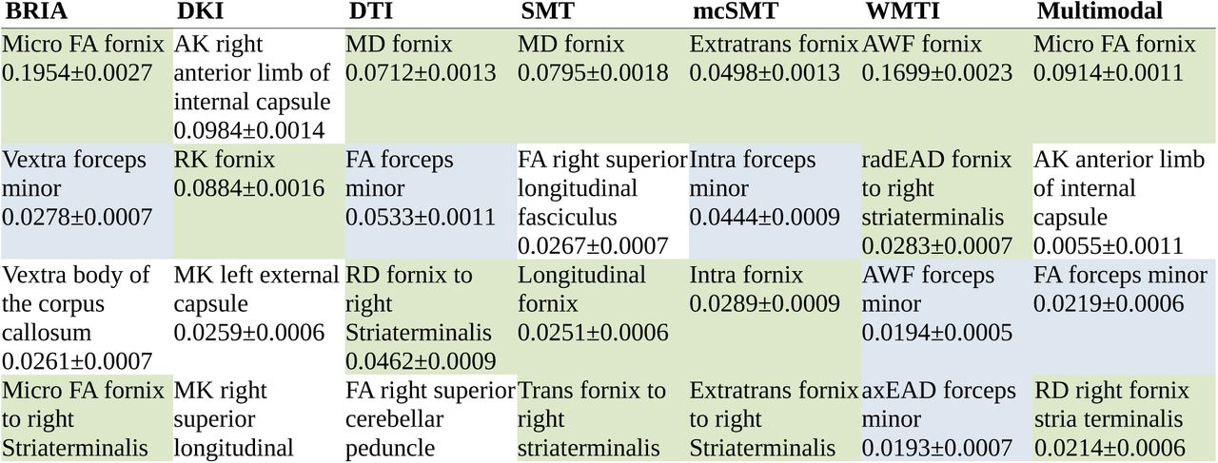
White matter ageing: study 1
Concepts
Results
Conclusions
Brain age estimates (using XGB on tabular data) similar across diffusion approaches (DTI, DKI, …)
Most important features for brain age predictios: fornix & forceps minor¹
1 Korbmacher et al., 2023, Hum. Brain Map. 44(10)

Slide 18
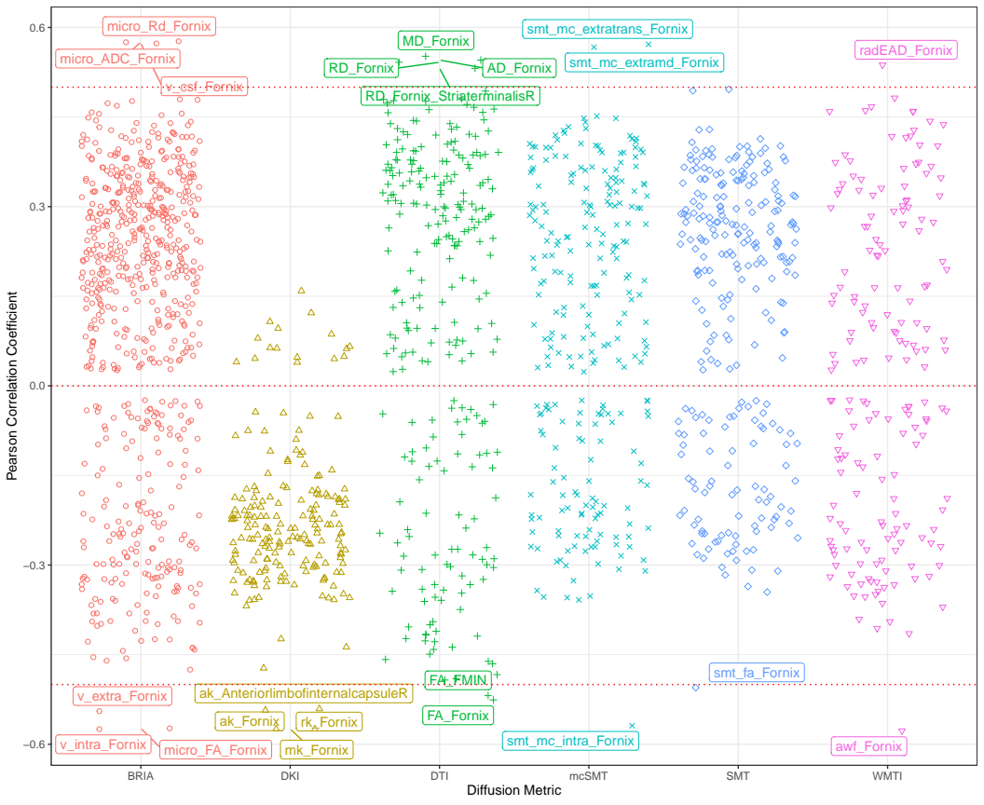
White matter ageing: study 1
Concepts
Results
Conclusions
Strong crude fornix WM microstructure-age relationships underline feature importance findings
1 Korbmacher et al., 2023, Hum. Brain Map. 44(10)

Slide 19
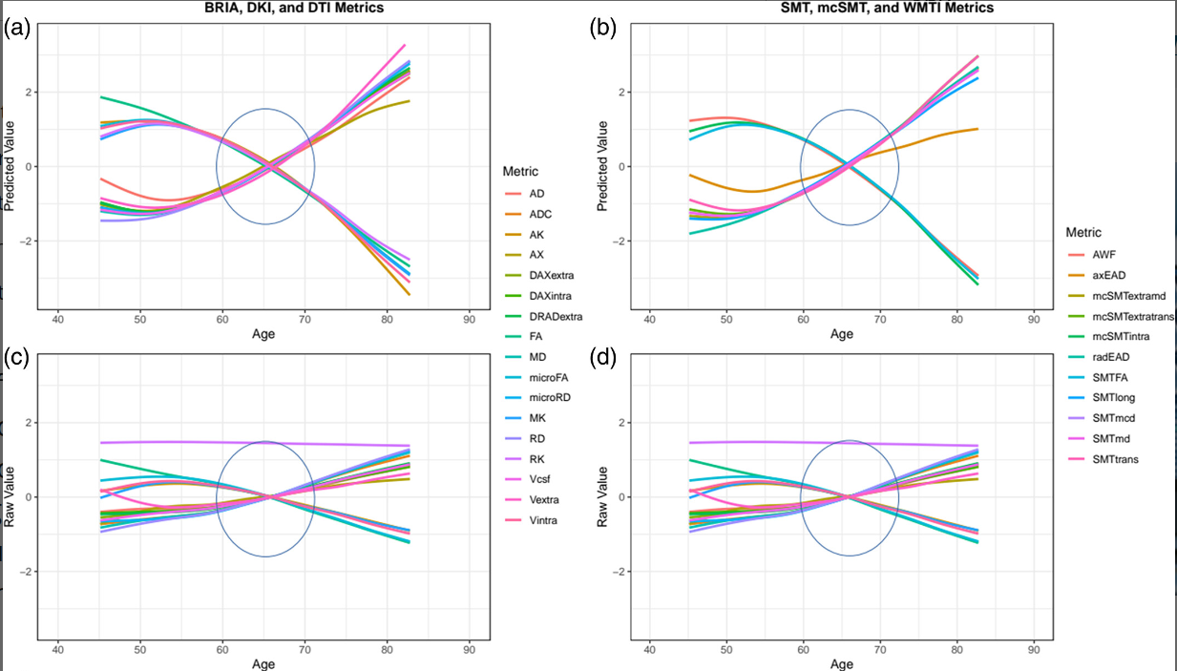
White matter ageing: study 1
Concepts
Results
Conclusions
Corrected (a-b) & uncorrected (c-d) WM microstructure-age relationships follow similar patterns across mapping approaches: diffusiv. & intra-axonal water fraction increases; FA, extra axonal water & kurtosis decrease
1 Korbmacher et al., 2023, Hum. Brain Map. 44(10)

Slide 20
White matter ageing: study 1
Concepts
Results
Conclusions
Meaning?
  Diffusion approaches reflect similar biological concept
  (Structural de-integration along the years)
  Fornix
    Contributes most to explaining age, degenerates quicker than whole-brain averages
    Increases in radial diffusivity measures from DKI and BRIA (DRADextra) higher plasticity?
    Ageing biomarker? Deep brain stim target?

Slide 21
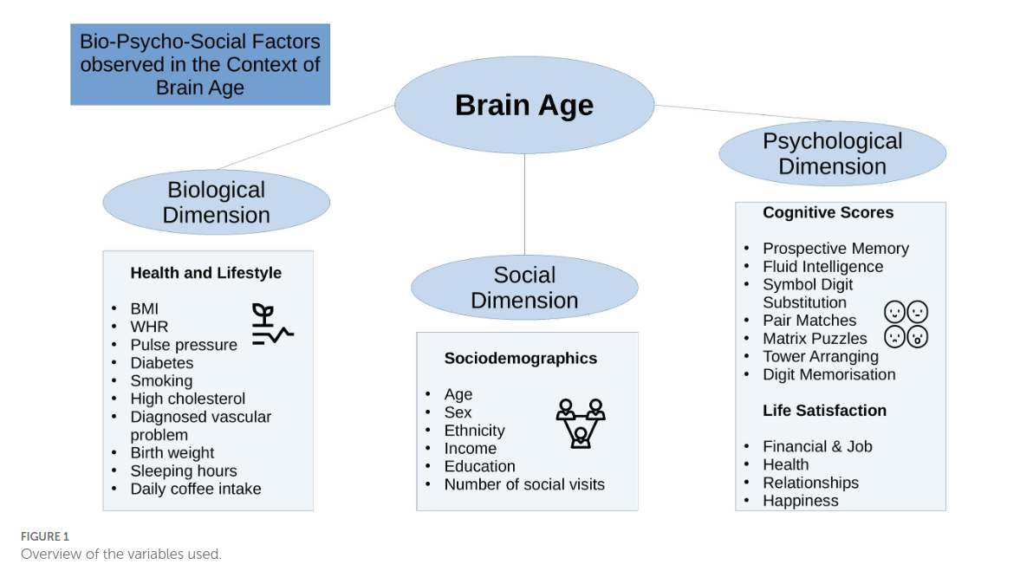
White matter ageing: study 2
Concepts
Results
Conclusions
Associating brain ages from study 1¹ with bio-psycho-social (BPS) factors²
  Sign. effects: Waist-to-hip ratio, diabetes, hypertension, smoking, matrix puzzles solving, job- & health satisfaction and perception
Conclusion: WM brain age reflects overall health but is not well-predicted by any of the observed (BPS) domains
1 Korbmacher et al., 2023, Hum. Brain Map.; 2 Korbmacher et al., 2023, Front. Psy. 14:1117732

Slide 22
White matter ageing: study 3
Concepts
Results
Conclusions
Longitudinal white matter assessments in the UKB (N=2,944, two scans with ca 2½ years in between)
  Different levels of analysis: global, regional, voxel
Polygenic risk score associations with WM and the annual rate of change
  Polygenic risk = risk to develop a disease based on a person’s genetic architecture
  ASD, MDD, SCZ, ADHD, BIP, OCD, ANX, AD
Preprint under preparation

Slide 23
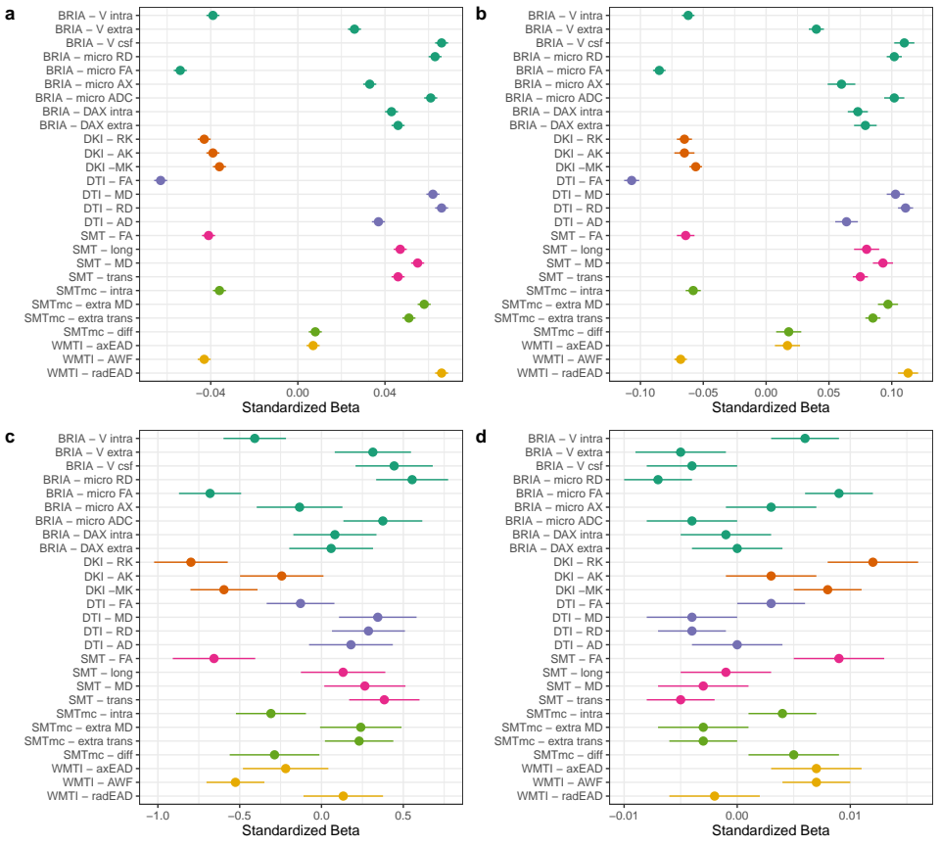
White matter ageing: study 3
Concepts
Results
Conclusions
Summary of adjusted global average findings
  FA & intra-axonal water fraction decrease
  Diffusivity (axial, mean radial) & extra-axonal water fraction increase
  Kurtosis metrics decrease
  Panels: fixed effects of a) age, b) time point, c) sex, d) sex:age
Preprint under preparation

Slide 24
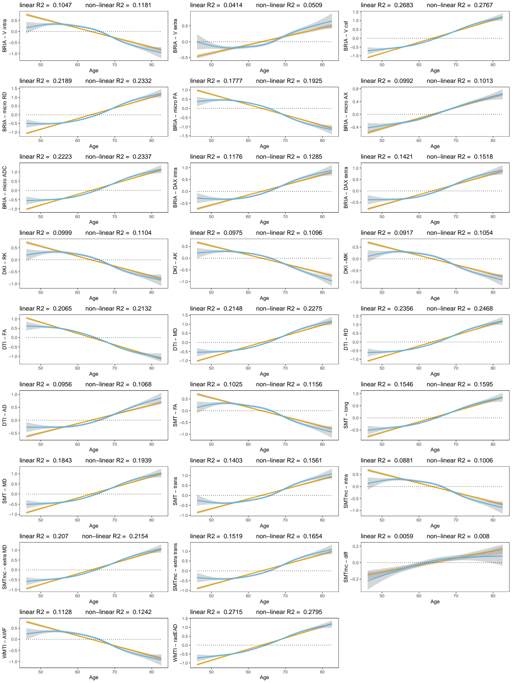
White matter ageing: study 3
Concepts
Results
Conclusions
Summary of adjusted global average age associations of WM
(another representation of the first panel)
Repl. cross-sec. findings:

Slide 25
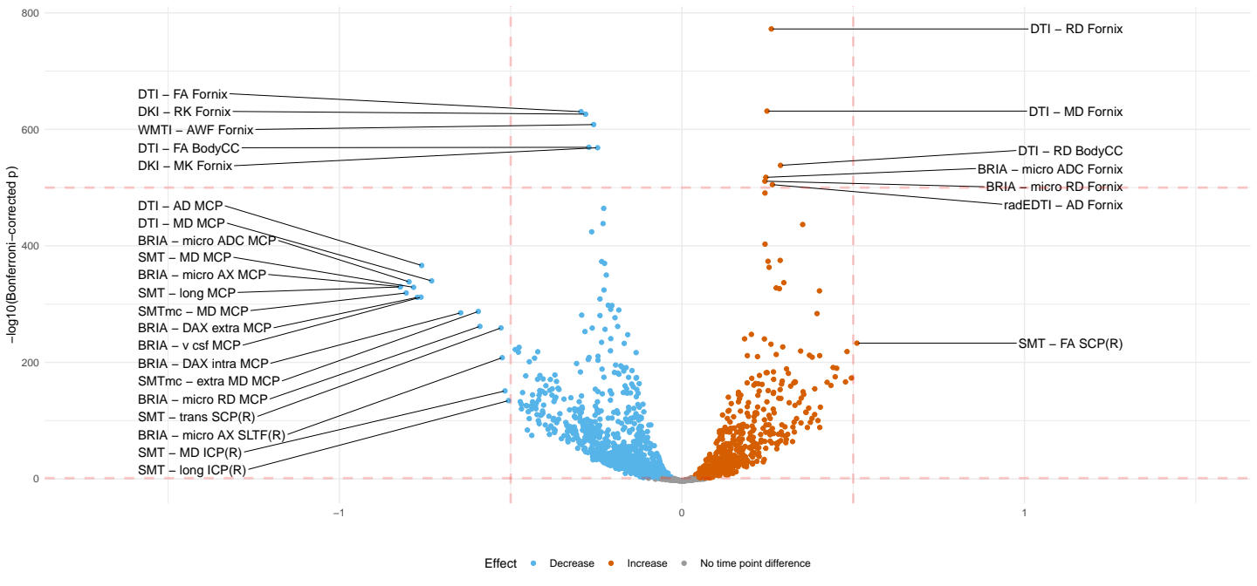
White matter ageing: study 3
Concepts
Results
Conclusions
Summary of unadjusted region average findings
  Very similar trends to global findings in terms of metrics, but identification of regions (peduncle&fornix)
Crude age-white matter associations
CC=corpus callosum, M/I/SCP=medial/inferior/superior cerebral peduncle, SLTF=superior longitudinal temporal fasciculus

Slide 26
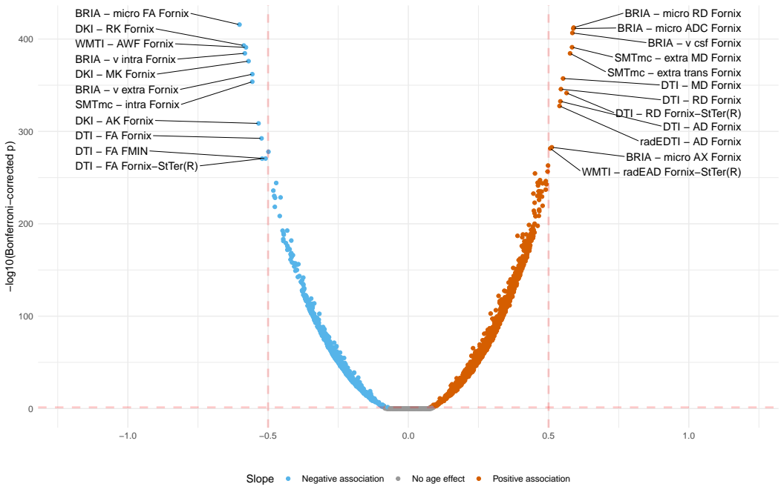
White matter ageing: study 3
Concepts
Results
Conclusions
Summary of adjusted region average findings
  Very similar trends to global findings in terms of metrics, but identification of regions (fornix)
Adjusted age-white matter relationships, StTer = stria terminalis

Slide 27
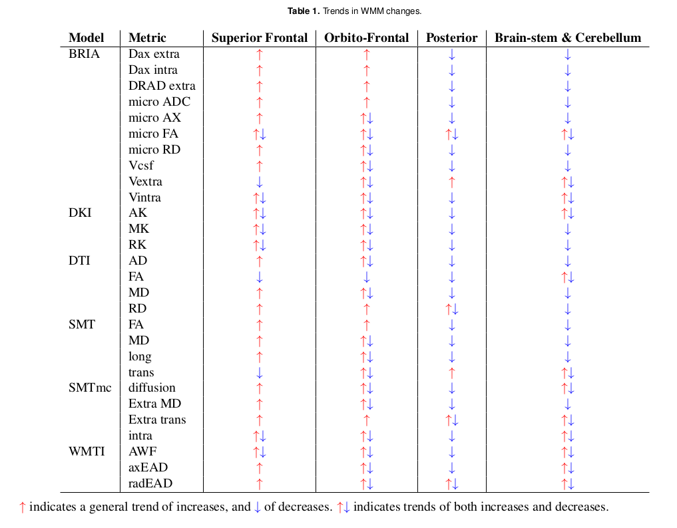
White matter ageing: study 3
Concepts
Results
Conclusions
Summary of voxel-level findings
  Global FA decrease (de-myelination?)
  Sup.frontal diffusivity increase, otherwise decrease

Slide 28
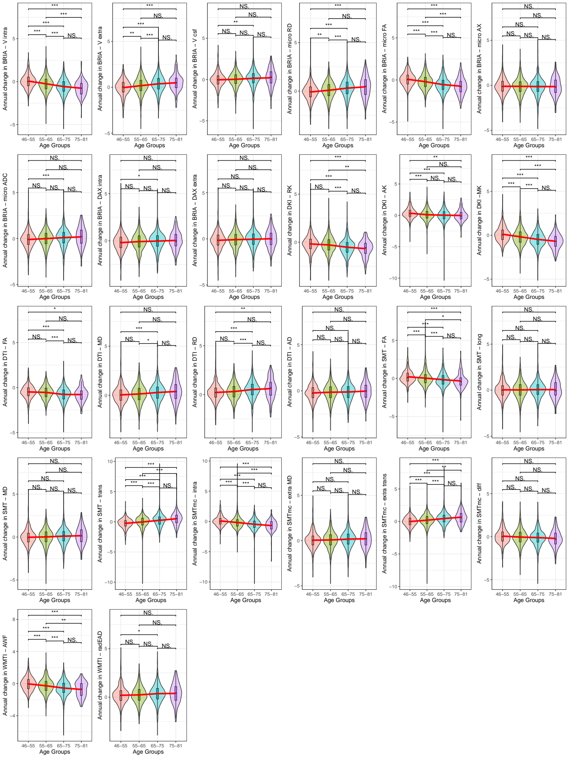
White matter ageing: study 3
Concepts
Results
Conclusions
Age-relationship of the annual rate of change (ARoC) of global WM metrics:
  ARoC higher at higher ages for most metrics.

Slide 29
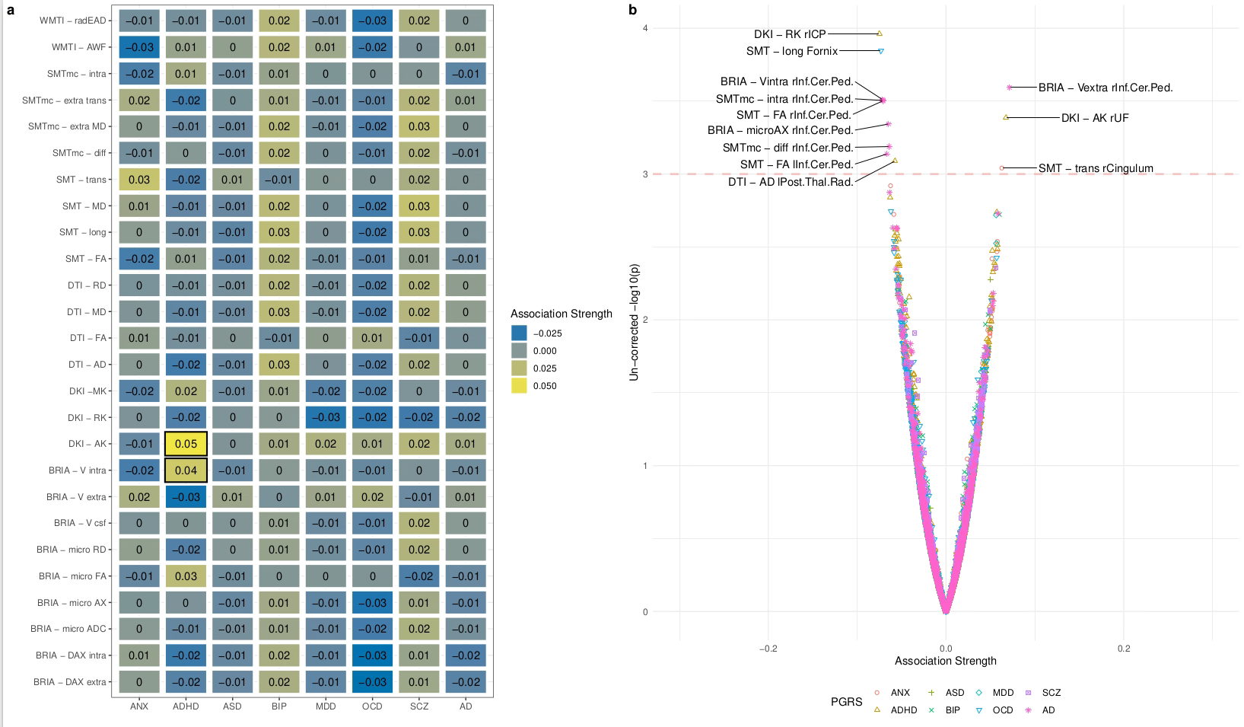
White matter ageing: study 3
Concepts
Results
Conclusions
Gene-relationship of annual rate of change (ARoC) with global WM metrics: non-sign. after mult. comp. (small effects)

Slide 30
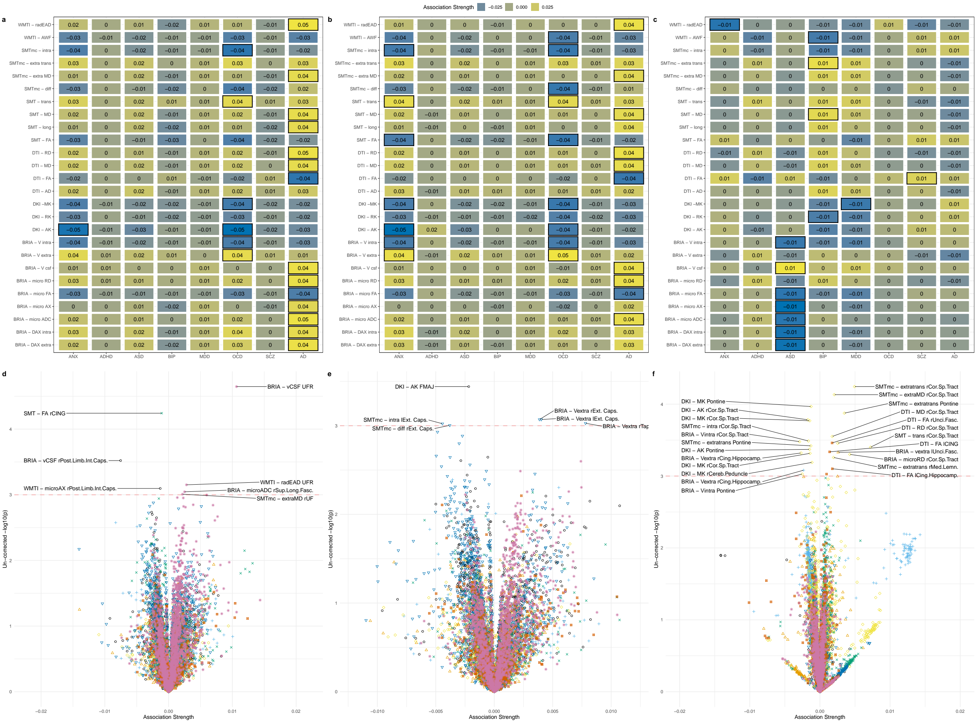
White matter ageing: study 3
Concepts
Results
Conclusions
Gene-relationship with global cross-sectional WM metrics: non-sign. after mult. comparis. (due to small effects)

Slide 31
Putting brain age to the test
Concepts
Results
Conclusions
Study | Main Outcomes
Brain‐wide associations between white matter and age highlight the role of fornix microstructure in brain ageing | 1) Validation of diffusion approaches with brain age (similar patterns) 2) Fornix and forceps minor (corpos colassum are strongly age sensitive)
Bio-psycho-social factors’ associations with brain age: a large-scale UK Biobank diffusion study of 35,749 participants | 1) Further validation of diffusion approaches (similar association patterns of brain ages) 2) Brain age appears as general indicator of health
Considerations on brain age predictions from repeatedly sampled data across time | 1) Pre-trained state-of-the-art brain age model not applicable in clinic (strong variability) 2) Field strength explains some of variability
Brain asymmetries from midlife to old adulthood and hemispheric brain age | 1) Asymmetries decrease in WM but increase in GM, fornix strongly asymmetric 2) Hemispheric brain age
White matter changes along of two years: a longitudinal UK Biobank study | 1) mapping of voxel-to-global white matter (WM) ageing (highlighting again fornix) 2) distributed genetic underpinnings of WM

Slide 32
Putting brain age to the test
Concepts
Results
Conclusions
Longitudinal changes in brain age remain unclear
From the evidence at hand it seems like brain age changes are only sensitive to pathology
Hence, we were estimating brain age for multiple time points for the same individuals using a pre-trained deep convolutional neural network (pyment) on T1w minimally processed data
Densely sampled data
  Bergen Breakfast Scanning Club (N = 3, each > 25 scans, total = 110 scans)
  Frequently Travelling Human Phantom (N = 1, > 550 scans)
Local Oslo data (cross-sectional)
  TOP (N = 856)
  Norwegian Cognitive Neuro Genetics sample (N = 209)
Korbmacher et al., 2023, Brain & Beh. (in press)

Slide 33
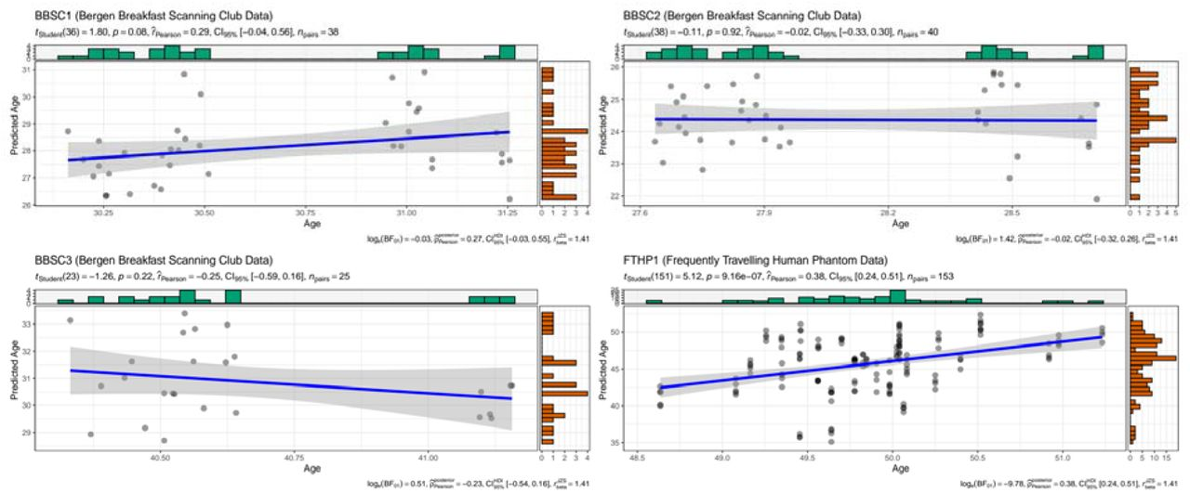
Putting brain age to the test
Concepts
Results
Conclusions
Label-prediction correspondance was not too great
Too short inter-scan interval?
Korbmacher et al., 2023, Brain & Beh. (in press)

Slide 34
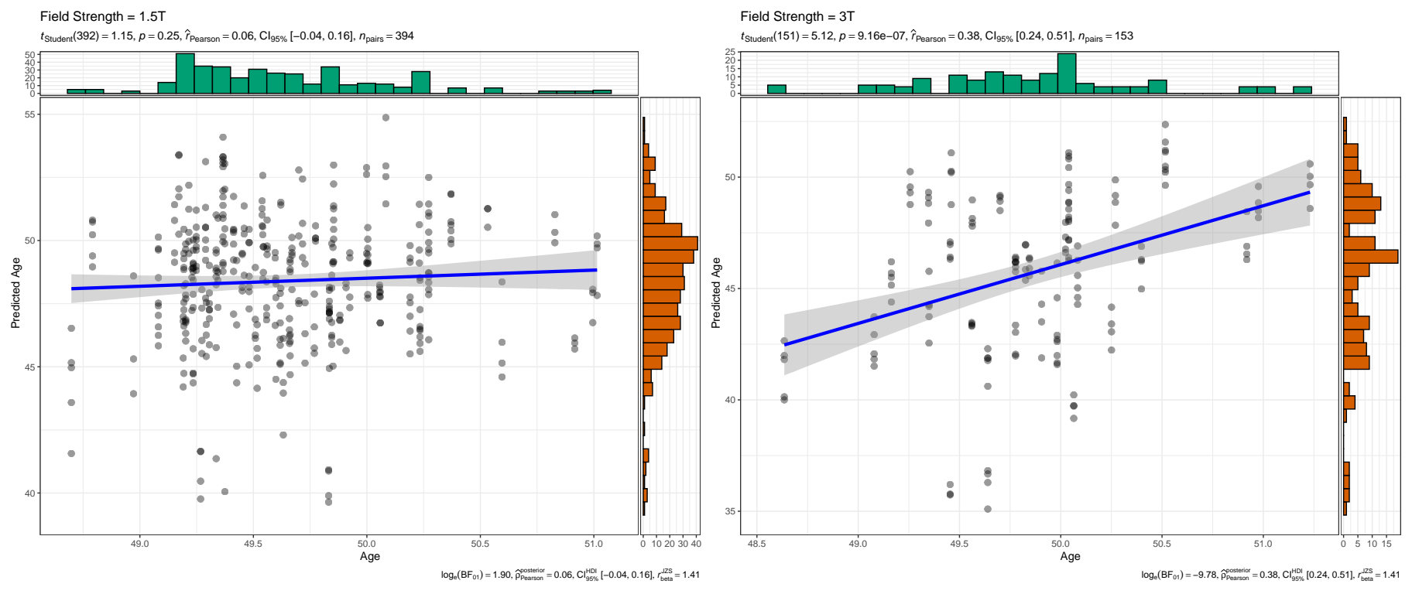
Putting brain age to the test
Concepts
Results
Conclusions
Testing 2 potential additional reasons for low corrspond.
  Scan quality (diffuse results)
  Field strength (bingo, but data only avail. for one sub.)
    Hence, replicated in cross-sectional data
Korbmacher et al., 2023, Brain & Beh. (in press)

Slide 35
Putting brain age to the test
Concepts
Results
Conclusions
Interpretation
  Brain age systematically underestimated for healthy controls at 3T & higher prediction error than at 1.5T
  Underestimations can be larger(!) than what the model error would suggest when trained on cross-sec data
  Field strength matters for brain age estimates!
  Ergo: there is still a lot to improve when tansitioning brain age into a clinical marker
  Perhaps multiple brain age models for different groups?
Korbmacher et al., 2023, Brain & Beh. (in press)

Slide 36
Brain asymmetry & hemispheric brain age
Concepts
Results
Conclusions
Study | Main Outcomes
Brain‐wide associations between white matter and age highlight the role of fornix microstructure in brain ageing | 1) Validation of diffusion approaches with brain age (similar patterns) 2) Fornix and forceps minor (corpos colassum are strongly age sensitive)
Bio-psycho-social factors’ associations with brain age: a large-scale UK Biobank diffusion study of 35,749 participants | 1) Further validation of diffusion approaches (similar association patterns of brain ages) 2) Brain age appears as general indicator of health
Considerations on brain age predictions from repeatedly sampled data across time | 1) Pre-trained state-of-the-art brain age model not applicable in clinic (strong variability) 2) Field strength explains some of variability
Brain asymmetries from midlife to old adulthood and hemispheric brain age | 1) Asymmetries decrease in WM but increase in GM, fornix strongly asymmetric 2) Hemispheric brain age
White matter changes along of two years: a longitudinal UK Biobank study | 1) mapping of voxel-to-global white matter (WM) ageing (highlighting again fornix) 2) distributed genetic underpinnings of WM

Slide 37
Brain asymmetry & hemispheric brain age
Concepts
Results
Conclusions
Previous studies suggest relationships between brain asymmetry and different disorders
  Particularly, decreasing asymmetry observed in healthy GM ageing, which is accelerated in AD¹
Generalizable to different GM & WM metrics? And can we learn more about brain age through these observations?
1 Roe et al., 2021, Nat. Comm. 12, 71.

Slide 38

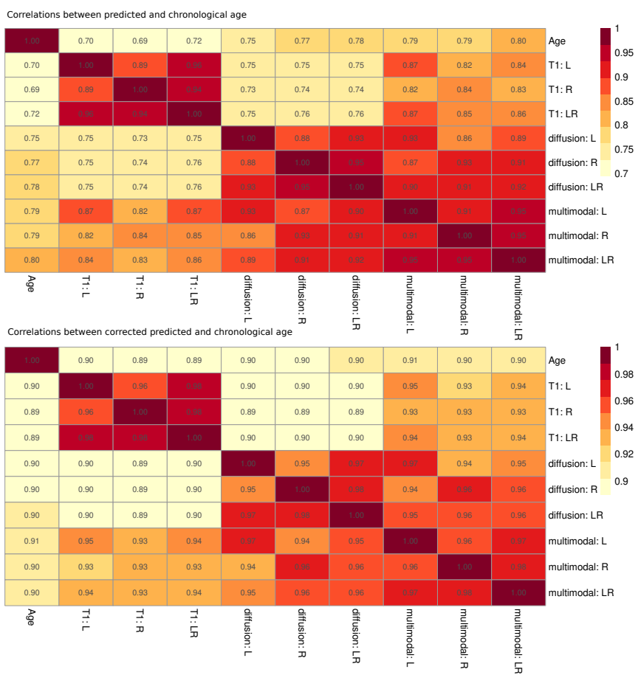
Brain asymmetry & hemispheric brain age
Concepts
Results
Conclusions
T1w (N = 48,040) & dMRI (N = 39,637) features, overlap/ multimodal N = 39, 507
Laterality calculated by laterality index (LI)
Hemispheric brain age (HBA) calculated on L/R features
  HBA & brain ages correspond closely within modalities
  No sign BA differences for modality, hemisphere, handedness
Preprint @ bioRxiv

Slide 39
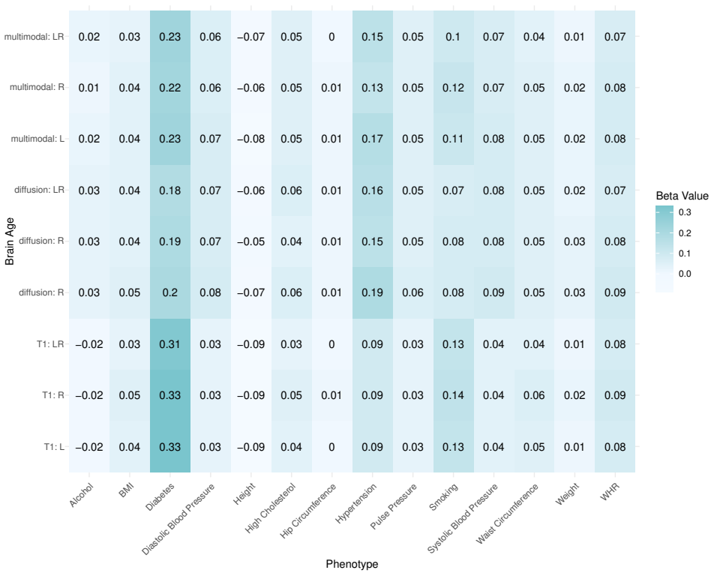
Brain asymmetry & hemispheric brain age
Concepts
Results
Conclusions
Brain ages of the same modality relate similarly to different phenotypes
Fig.: Association between general health and lifestyle phenotypes and BA estimated from different modalities, left, right and both hemispheres. For simplicity, standardized
slopes with |β| < 0.005 were rounded down to β = 0. L: left hemisphere, R: right hemisphere, LR: both hemispheres. Note that differences between participants who drink
alcohol compared to those who do not drink alcohol were non-significant, and hip circumference was only significantly associated with dMRI-derived BAs

Slide 40
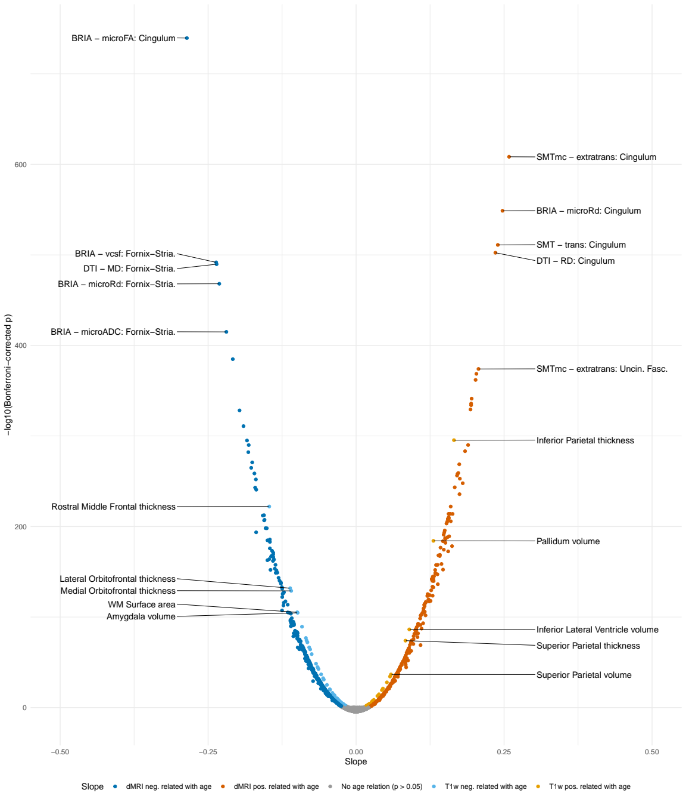
Brain asymmetry & hemispheric brain age
Concepts
Results
Conclusions
While L/R ageing trends are similar, brain age & feature asymmetry (LI) are age-dependent
WM asymmetries are more age-sensitive than GM asymmetries
Brain asymmetries are lower at higher ages, just as brain age asymmetries

Slide 41
3. CONCLUSIONS

Slide 42
Summary
Concepts
Results
Conclusions
Brain age is a general indicator of health; can be conceptualised in different ways
However, its role as a clinical biomarker still requires further work
We find fornix, corpus callosum, cerebral peduncle to be a highly age-sensitive regions
Distributed spatial pattern of polygenic risk across WM

Slide 43
Many remaining questions
Concepts
Results
Conclusions
What is the role of fornix in relationship to the rest of the brain thoughout ageing?
How do our findings translate to clinical samples?
Methodological considerations (e.g., longituinal changes in (white matter) brain age)
Perhaps entirely different approach (within-individuals statistics)?

Slide 44









Ivan I. Maximov
Lars T. Westlye
Eli N. Eikefjord
Arvid Lundervold
Thank you!
Dennis van der Meer
Ann Marie de Lange
Dani Beck
Ole A. Andreassen
Tiril Gurholt

Slide 45
Questions?
How to contact me:
Email: Max.Korbmacher@hvl.no
Twitter: @KorbmacherMax

