Slide 1
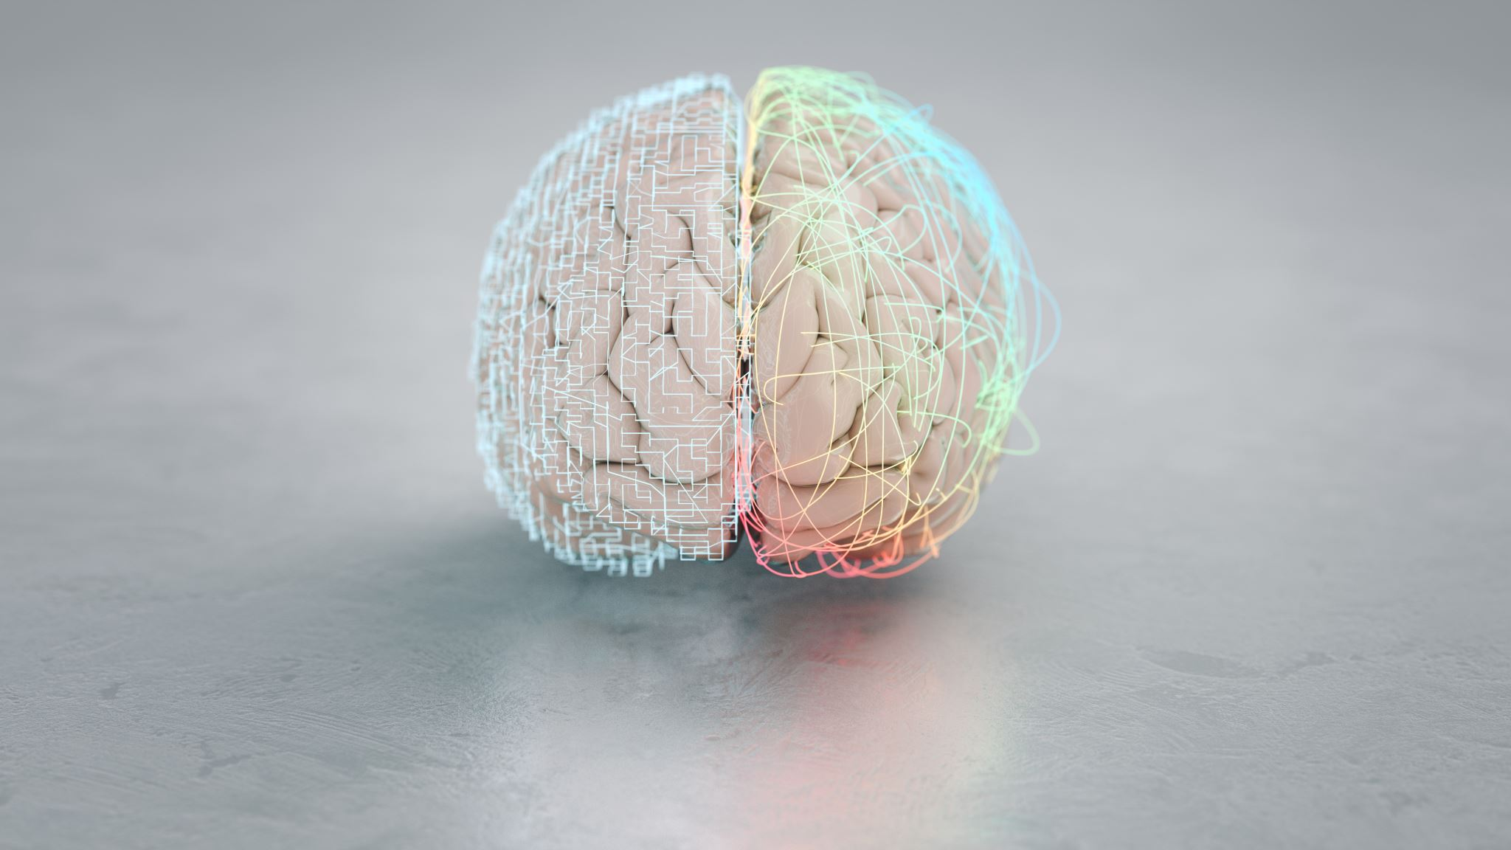
Brain asymmetries from midlife to old adulthood and hemispheric brain age
Max Korbmacher
Western Norway Unicersity of Applied Science

Slide 2
Background
Brain asymmetries are relevant for multiple brain functions, and potentially useful to examine disorders
There are no systematic multimodal magnetic resonance informed mappings of laterality and ageing effects

Slide 3
Goals
Map laterality from adulthood to senescence
Map age associations of laterality
Feature level
Brain age predicted from single hemispheres = hemispheric brain age (HBA)

Slide 4

Methods
UK Biobank sample (cross sectional N = 48,040)
Diffusion MRI / white matter microstructure regional features
T1-weighted / thickness, area, volume features
Freesurfer for T1-weighted reconstruction, FSL TBSS for diffusion features
Brain age and region-by-region linear models

Slide 5
Results
Asymmetric regional grey and white matter metrics, higher later in life
Hemispheric brain age (HBA)
Performance was concordant to conventional brain age predictions using metrics from both hemispheres
Yet, HBA offers supplemental general marker of brain asymmetry when setting left/right HBA into relationship with each other.
In contrast to WM brain asymmetries, left/right discrepancies in HBA are lower at higher ages.

Slide 6
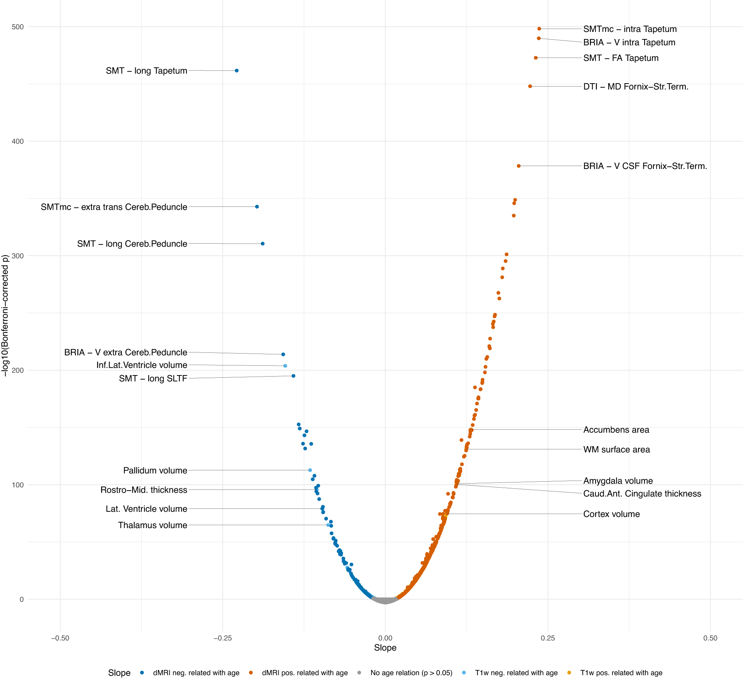
Results
Asymmetric regional grey and white matter metrics, higher later in life
Hemispheric brain age (HBA)
Performance was concordant to conventional brain age predictions using metrics from both hemispheres
Yet, HBA offers supplemental general marker of brain asymmetry when setting left/right HBA into relationship with each other.
In contrast to WM brain asymmetries, left/right discrepancies in HBA are lower at higher ages.

Slide 7
Results
Asymmetric regional grey and white matter metrics, higher later in life
Hemispheric brain age (HBA)
Performance was concordant to conventional brain age predictions using metrics from both hemispheres
Yet, HBA offers supplemental general marker of brain asymmetry when setting left/right HBA into relationship with each other.
In contrast to WM brain asymmetries, left/right discrepancies in HBA are lower at higher ages.

Slide 8
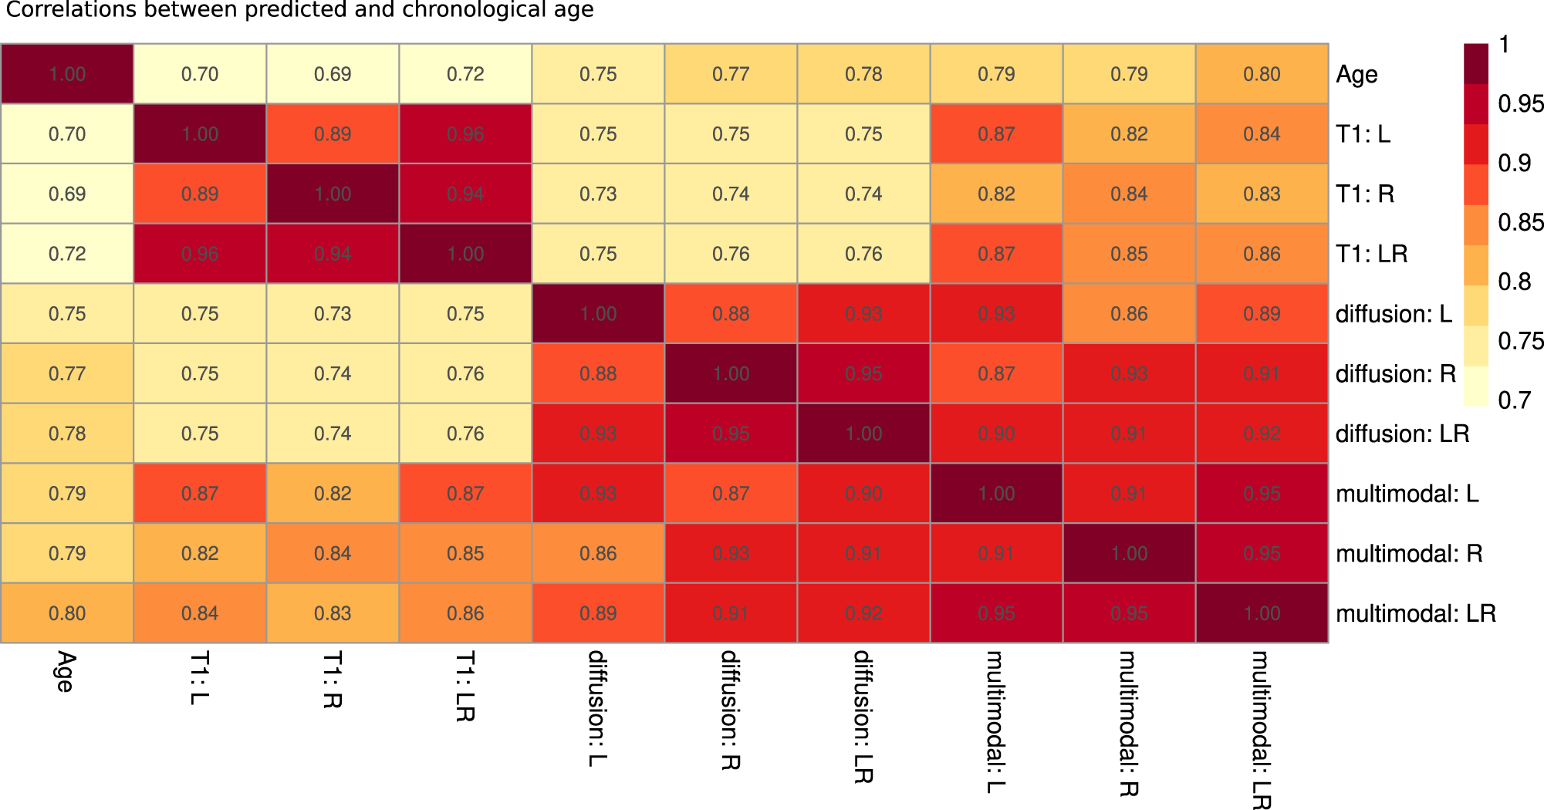
Results
Asymmetric regional grey and white matter metrics, higher later in life
Hemispheric brain age (HBA)
Performance was concordant to conventional brain age predictions using metrics from both hemispheres
Yet, HBA offers supplemental general marker of brain asymmetry when setting left/right HBA into relationship with each other.
In contrast to WM brain asymmetries, left/right discrepancies in HBA are lower at higher ages.

Slide 9
Results
Asymmetric regional grey and white matter metrics, higher later in life
Hemispheric brain age (HBA)
Performance was concordant to conventional brain age predictions using metrics from both hemispheres
Yet, HBA offers supplemental general marker of brain asymmetry when setting left/right HBA into relationship with each other.
In contrast to WM brain asymmetries, left/right discrepancies in HBA are lower at higher ages.

