Slide 1
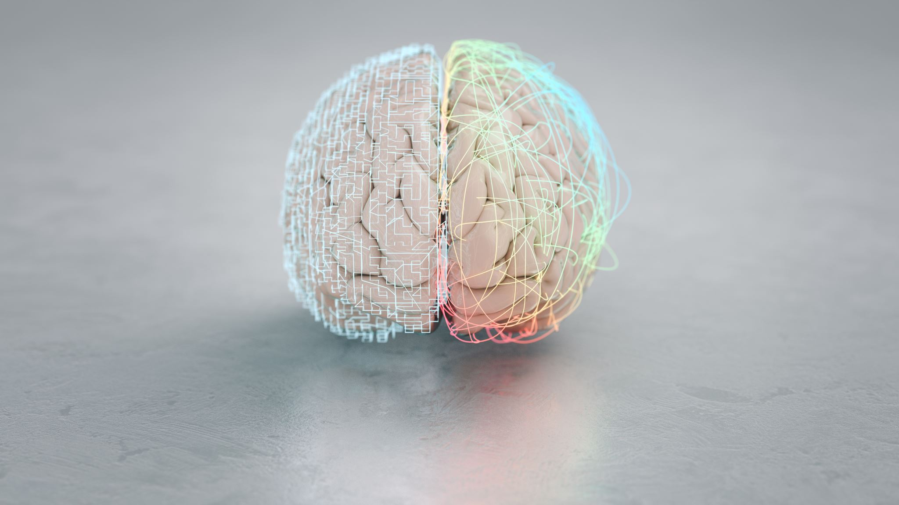
Distinct longitudinal brain white matter microstructure changes and associated polygenic psychiatric and neurodegenerative disorder risk
Max Korbmacher
Western Norway Unicersity of Applied Science

Slide 2

Methods
UK Biobank sample (longitudinal N = 2,329; independent cross-sectional N = 31,056)
Diffusion MRI
Polygenic risk scores
Tract-based spatial statistics, on various white matter microstructure metrics
Analyses from the voxel to the whole brain level

Slide 3
Results
Longitudinal trends confirm cross-sectional investigations
single and multi-compartment fractional anisotropy, intra-axonal water fraction, and kurtosis metrics decrease with age
diffusivity metrics, and free water increased with age
White matter degradation accelerates at higher ages
Polygenicity of disorders is weakly related with the annual rated of regional white matter change & cross-sectional white matter
Join me at poster #0115

