Slide 1
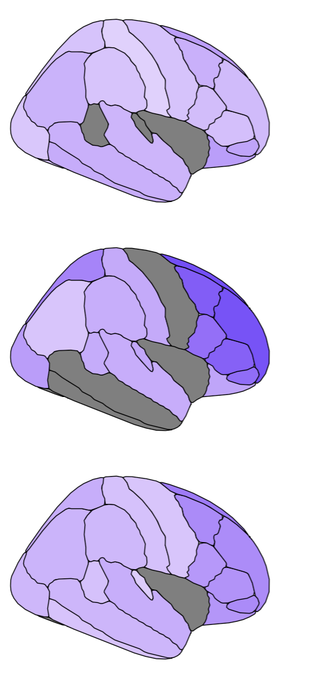
Regional grey matter degeneration in MS
Max Korbmacher, PhD
10th of April 2025

Slide 2
Contents
Why studying regional grey matter atrophy?
What does grey matter degeneration look like?
During healthy ageing
In MS
Clinical correlates: EDSS

Slide 3
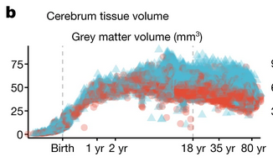
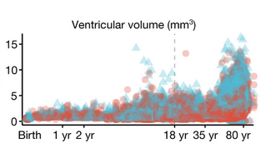
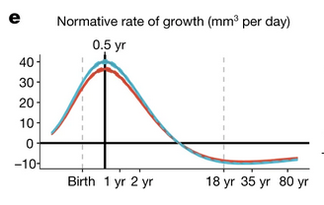
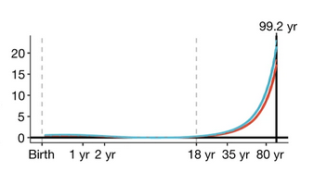
Why studying regional atrophy patterns?
What we know:
Brain atrophy happens
Whole brain measures of grey matter indicate atrophy during MS
Loads of cross-sectional evidence from case-control studies
What we know less about
Longitudinal evidence, especially comparing cases and controls (aka complex study designs)
Regional grey matter loss
Replicability of findings across cohorts
Harmonised data (male blue, females red)
N=123,984 ☺
Growth curves
Bethlehem et al., 2022, Nature, 604
Notes:
Let’s start by looking at what we know to understand why it is useful to look at measures of gray matter volume
the neuron’s cell bodies sit in the grey matter
Grey matter can shrink and expand based on different factors
When exactly such shrinkage signifies atrophy is not entirely clear but there are some very good guesses based on metabolic changes and tissue ratios
One would assume that GM starts SLOWLY degenerating in the late 20s when the celluar regeneration slows
As the metabolism changes more and more over the years, degeneration acellerates towards older ages
The early decrese in GM volume starting at the age of 6 might indicate white matter differentiation.

Slide 4
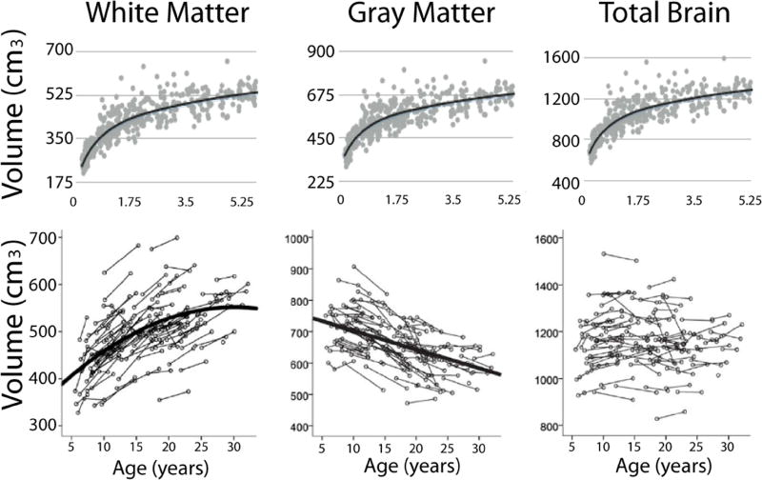
Why studying regional atrophy patterns?
What we know:
Brain atrophy happens
Whole brain measures of grey matter indicate atrophy during MS
Loads of cross-sectional evidence from case-control studies
What we know less about
Longitudinal evidence, especially comparing cases and controls (aka complex study designs)
Regional grey matter loss
Replicability of findings across cohorts
Bethlehem et al., 2022, Nature, 604
Lebel & Deoni et al., 2018, NeuroImage, 182
Notes:
This is the part that is not so easy: white matter differeniaties and takes more space in the cranium, grey matter volumes appear lower
So when does the degenerative or atrophy start?

Slide 5
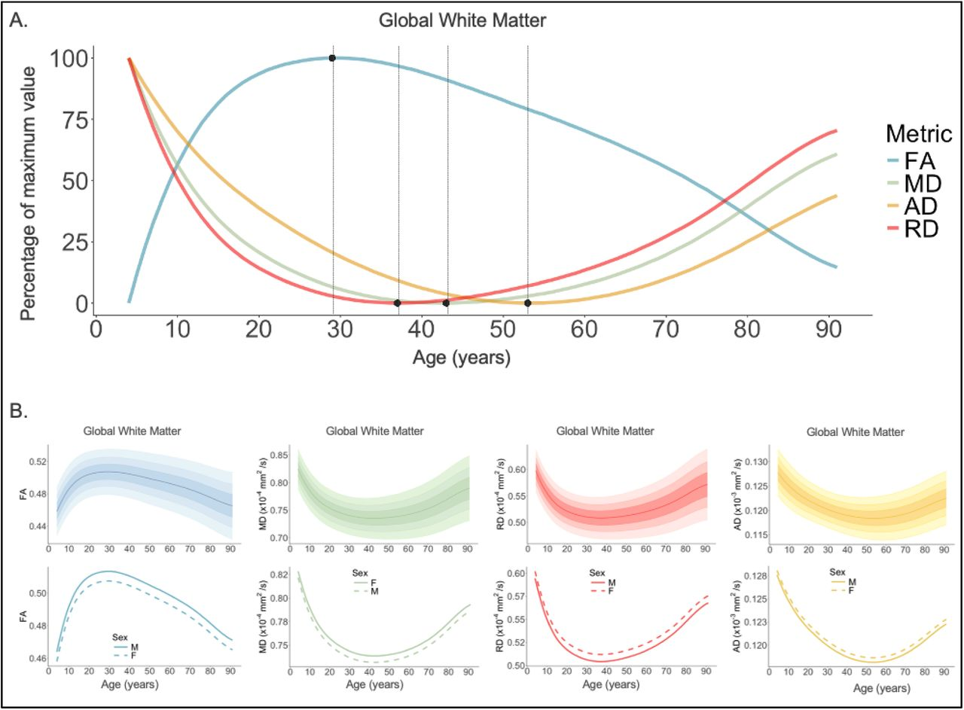
Why studying regional atrophy patterns?
What we know:
Brain atrophy happens
Whole brain measures of grey matter indicate atrophy during MS
Loads of cross-sectional evidence from case-control studies
What we know less about
Longitudinal evidence, especially comparing cases and controls (aka complex study designs)
Regional grey matter loss
Replicability of findings across cohorts
N=54,583 individuals; age: 4-91 years (Villalón-Reina et al., 2024, bioRxiv)
Notes:
We can also look at mesostrucural parameters, etc, indicating the same
This is fractional anisotropy

Slide 6
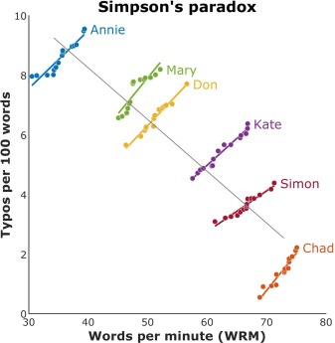
Why studying regional atrophy patterns?
What we know:
Brain atrophy happens
Whole brain measures of grey matter indicate atrophy during MS
Loads of cross-sectional evidence from case-control studies
What we know less about
Longitudinal evidence, especially comparing cases and controls (aka complex study designs)
Regional grey matter loss
Replicability of findings across cohorts
Notes:
Several articles say that “grey matter loss” is the most accurate atrophy indicator during MS
I doubt that, since it is a macrostructure parameter and there are many more sensiutive parameters, but it means that GM is interesting
Known unknowns
The localisation of the atrophy patterns is unclear
Lack of longitudinal studies {IMPORTANT BC OF PHENOMEN LIKE THE SIMPSON’S PARADOX}
Lack of replication studies

Slide 7
So … let’s look at some data.
Demographics
OFAMS sample (N=85, scans=1,375):
Age at baseline: 38.9 ± 8.3 years (range: 19–58)
Age at final follow-up: 49.6 ± 8.6 years
Oslo sample (N=165, scans=698):
Age at baseline: 38.1 ± 10 years (range: 18.5–67.6)
Age at final follow-up: 40 ± 10 years
Healthy ageing control sample (N=1,586, scans=2,952):
Age at baseline: 59.1 ± 5.2 years (range: 46.8–67.6)
Age at follow-up: 61 ± 5 years
Age capped to match MS sample ranges
Lifespan cross-sectional sample (N=scans=65,537):
Average age: 53.8 ± 22.1 years (range: 6–90.1)
Assembly of 8 databases

Slide 8
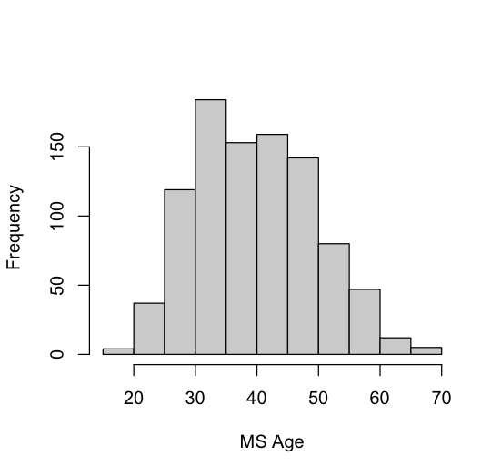
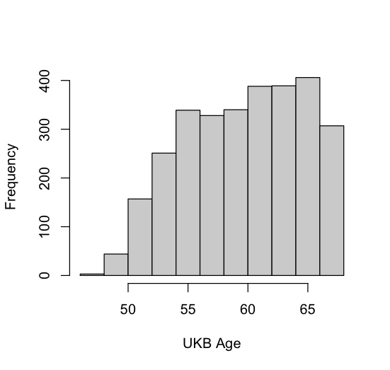
Standardized volumetric changes
Notes:
One can see that the MS patients have a stronger ageing effects than the UK Biobank who are up to 20 years older at the time of the first scan.
MS patients also seem to have a more frontal load in cortical atrophy

Slide 9
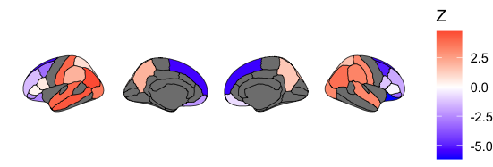
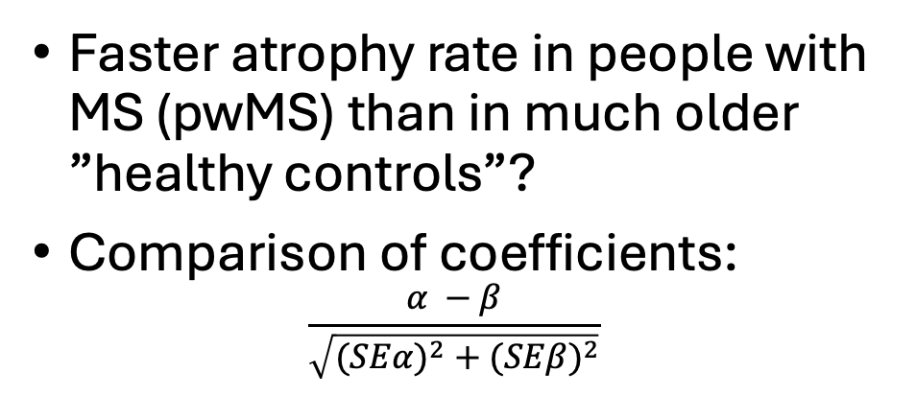
Let’s contrast atrophy in healthy ageing vs MS
MS age range: 18 - 67
UKB age range: 46 - 67
Faster atrophy rate in people with MS (pwMS) than in much older ”healthy controls”?
Comparison of coefficients:
$$\frac{α −β}{\sqrt{({SEα)}^{2}+({SEβ)}^{2}}}$$
Based on this, pwMS age faster in frontal areas:
Additionally the right pallidum (not presented here)
Notes:
To compare ageing rates between older healthy controls and pwMS, one can estimate the difference between model coefficients

Slide 10
Next step: clinical significance
EDSS correlations

