Slide 1
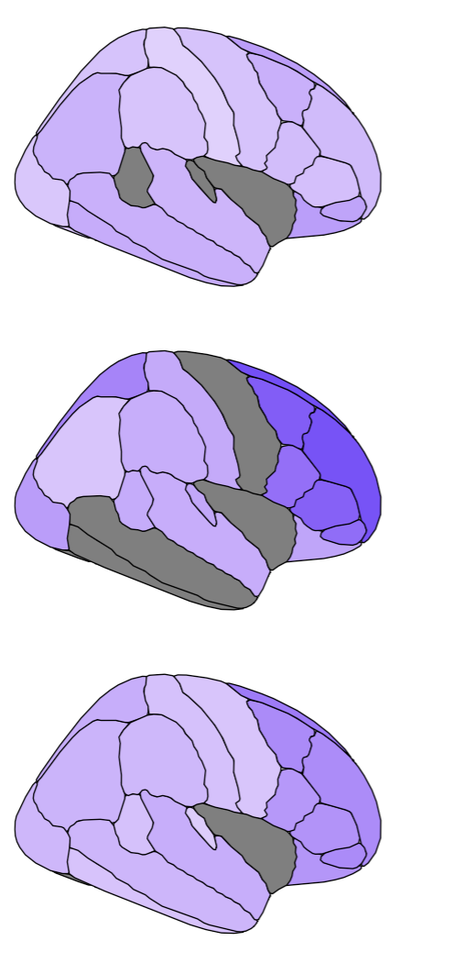
Regional grey matter degeneration in MS
Max Korbmacher, PhD
10th of April 2025

Slide 2
Contents
Why studying regional grey matter atrophy?
What does grey matter degeneration look like?
During healthy ageing
In MS
Clinical correlates: EDSS

Slide 3
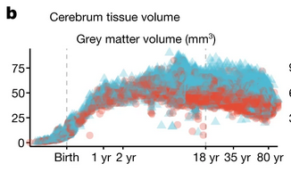
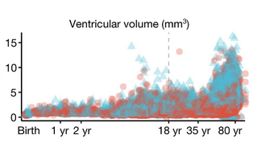
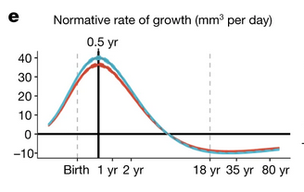
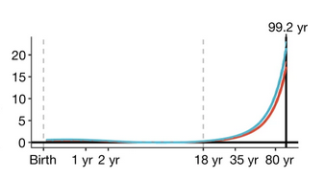
Why studying regional atrophy patterns?
What we know:
Brain atrophy happens
Whole brain measures of grey matter indicate atrophy during MS
Loads of cross-sectional evidence from case-control studies
What we know less about
Longitudinal evidence, especially comparing cases and controls (aka complex study designs)
Regional grey matter loss
Replicability of findings across cohorts
Harmonised data (male blue, females red)
N=123,984 ☺
Growth curves
Bethlehem et al., 2022, Nature, 604
Notes:
Let’s start by looking at what we know to understand why it is useful to look at measures of gray matter volume
the neuron’s cell bodies sit in the grey matter
Grey matter can shrink and expand based on different factors
When exactly such shrinkage signifies atrophy is not entirely clear but there are some very good guesses based on metabolic changes and tissue ratios
One would assume that GM starts SLOWLY degenerating in the late 20s when the celluar regeneration slows
As the metabolism changes more and more over the years, degeneration acellerates towards older ages
The early decrese in GM volume starting at the age of 6 might indicate white matter differentiation.

Slide 4
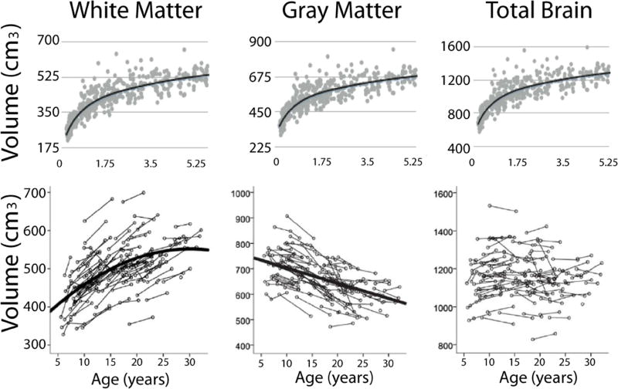
Why studying regional atrophy patterns?
What we know:
Brain atrophy happens
Whole brain measures of grey matter indicate atrophy during MS
Loads of cross-sectional evidence from case-control studies
What we know less about
Longitudinal evidence, especially comparing cases and controls (aka complex study designs)
Regional grey matter loss
Replicability of findings across cohorts
Bethlehem et al., 2022, Nature, 604
Lebel & Deoni et al., 2018, NeuroImage, 182
Notes:
This is the part that is not so easy: white matter differeniaties and takes more space in the cranium, grey matter volumes appear lower
So when does the degenerative or atrophy start?

Slide 5
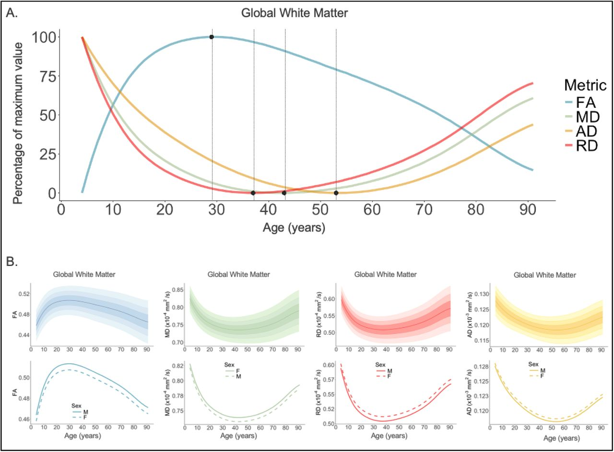
Why studying regional atrophy patterns?
What we know:
Brain atrophy happens
Whole brain measures of grey matter indicate atrophy during MS
Loads of cross-sectional evidence from case-control studies
What we know less about
Longitudinal evidence, especially comparing cases and controls (aka complex study designs)
Regional grey matter loss
Replicability of findings across cohorts
N=54,583 individuals; age: 4-91 years (Villalón-Reina et al., 2024, bioRxiv)
Notes:
We can also look at mesostrucural parameters, etc, indicating the same
This is fractional anisotropy

Slide 6
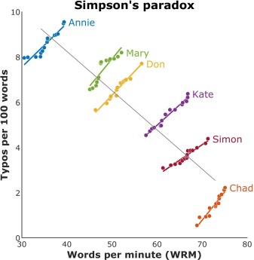
Why studying regional atrophy patterns?
What we know:
Brain atrophy happens
Whole brain measures of grey matter indicate atrophy during MS
Loads of cross-sectional evidence from case-control studies
What we know less about
Longitudinal evidence, especially comparing cases and controls (aka complex study designs)
Regional grey matter loss
Replicability of findings across cohorts
Notes:
Several articles say that “grey matter loss” is the most accurate atrophy indicator during MS
I doubt that, since it is a macrostructure parameter and there are many more sensiutive parameters, but it means that GM is interesting
Known unknowns
The localisation of the atrophy patterns is unclear
Lack of longitudinal studies {IMPORTANT BC OF PHENOMEN LIKE THE SIMPSON’S PARADOX}
Lack of replication studies

Slide 7
So … let’s look at some data.
Demographics
OFAMS sample (N=85, scans=244):
Age at baseline: 38.9 ± 8.3 years (range: 19–58)
Age at final follow-up: 49.6 ± 8.6 years
Oslo sample (N=165, scans=698):
Age at baseline: 38.1 ± 10 years (range: 18.5–67.6)
Age at final follow-up: 40 ± 10 years
Healthy ageing control sample (N=1,586, scans=2,952):
Age at baseline: 59.1 ± 5.2 years (range: 46.8–67.6)
Age at follow-up: 61 ± 5 years
Age capped to match MS sample ranges
Age-matched lifespan cross-sectional sample (N=scans=31,427):
Average age: 57.6 ± 9.24 years (range: 18.5–67.63)
Assembly of 8 databases

Slide 8
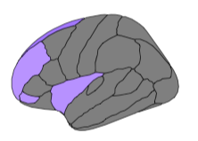
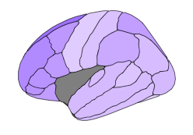
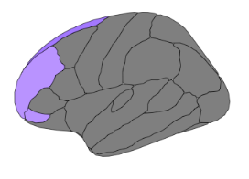
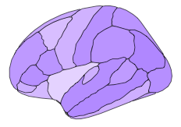
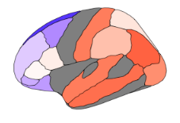
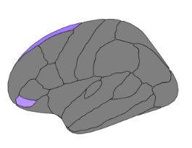
Overview of what is going on
EDSS
Overlap between age and EDSS correlations
Time
Volume
EDSS
Time
Deviation
What are the brain ageing patterns in MS and their overlap with functional loss?
Can normative models for these regions distinguish individual trajectories?
Ageing comparison: MS vs healthy agers
Overlap between faster ageing in MS and EDSS association localisation
Volume
Time
Do brains of people with MS age faster than those of older “healthy agers”?

Slide 9
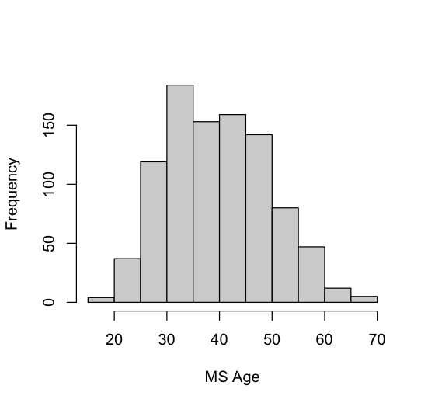
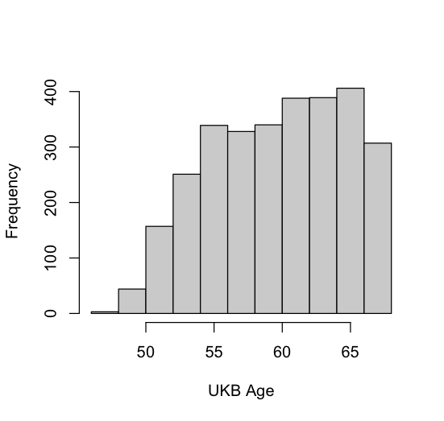
Standardized volumetric changes
Notes:
One can see that the MS patients have a stronger ageing effects than the UK Biobank who are up to 20 years older at the time of the first scan.
MS patients also seem to have a more frontal load in cortical atrophy
Especially superior frontal lobes, but also all other frontal areas

Slide 10
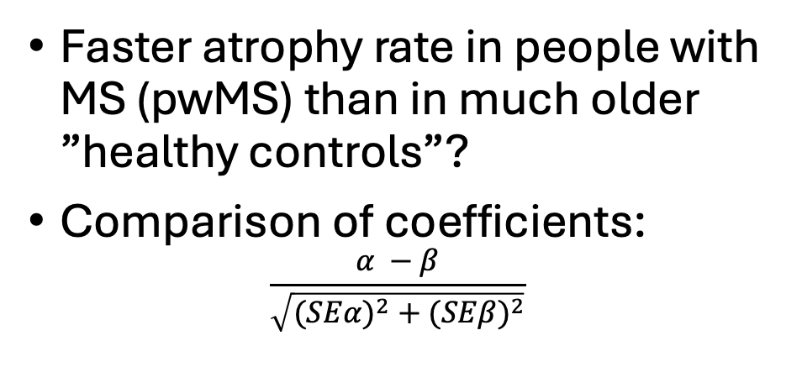
Let’s contrast atrophy in healthy ageing vs MS
MS age range: 18 - 67
UKB age range: 46 - 67
Faster atrophy rate in people with MS (pwMS) than in much older ”healthy controls”?
Comparison of coefficients:
$$\frac{α −β}{\sqrt{({SEα)}^{2}+({SEβ)}^{2}}}$$
Based on this, pwMS age faster in frontal areas:
Blue = faster ageing in MS than in 20 year old healthy agers (UKB), grey = no diff,. Red = faster ageing in UKB
Additionally the right pallidum (not presented here)
Notes:
To compare ageing rates between older healthy controls and pwMS, one can estimate the difference between model coefficients
Superior frontal, lateral orbitofronal, frontal pole, caudal middle frontal, pars orbitalis (all Z < -2)

Slide 11
Next step: clinical significance
EDSS correlations with brain volume over time
Rost.middl.front.
Sup.frontal
Precuneus
Motor cortex / precent.gyr.
Insula
Enthorinal cortex
Hippocampus
Pallidum
Pars orbitalis
Lat.orbitofront.
Thalamus
Notes:
When looking at how EDSS corresponds to brain volumes over time, one finds logically deep brain areas such as the Thalamus and pallidum to be strongest related to EDSS, as well as motor cortex
What is interesting is the importance of the hippocampal volumes
Finally, the pars orbitalis. precumeus and superior frontal cortex show some bilateral correlations, which is interesting, considering their not necessarily direct associated with the functions assessed with the EDSS score

Slide 12
Overlap regions of significant volume loss & EDSS associations over time
Rost.middl.front.
Sup.frontal
Precuneus
Motor cortex / precent.gyr.
Insula
Enthorinal cortex
Hippocampus
Pallidum
Pars orbitalis
Lat.orbitofront.
Thalamus
Notes:
We can now overlap the regions that degenerated significantly over time and the significant volume-EDSS associations over tmime

Slide 13
Extra: Overlap of accelerated ageing & EDSS correlated regions
Rost.middl.front.
Sup.frontal
Precuneus
Motor cortex / precent.gyr.
Insula
Enthorinal cortex
Hippocampus
Pallidum
Pars orbitalis
Lat.orbitofront.
Thalamus
Notes:
We can also overlap the regions that aged fastest or “abnormaly fast” as indicated by Z-score differences between UKB and MS and the EDSS regions

Slide 14
Normative modelling of regions of interst
How can we translate this into a potentially useful clinical tool?
To generalise the findings, we use normative models
This answers the question of whether one can identify MS trajectories across time based on volumetric deviations in the different regions
Notes:
Finally,

