Slide 1
An Introduction to Open Science or “From Replication Crisis to Credibility Revolution”
Max Korbmacher, PhD
Max.Korbmacher@gmail.com
Notes:
Hi there everybody, my name is Max. I work at different hospitals unis in Norway as something like a post-doc. I am a neuroscientists and work currently on biomarkers for electroconvulsive treatment (mainly depression patients) and multiple sclerosis.
I will hold this first introductory part and then come back later in the course. I thought of having 3x45mins with you where we have time in the end of each of these 45 minute blocks to discuss the contents we went through. However, please interrupt me and ask questions underway unless you don’t want to be recorded. Then, it is best to rather wait until a moment we do not record or stream. Also, if there is anything you want to let me know about after the lectures you can of course email me.

Slide 2
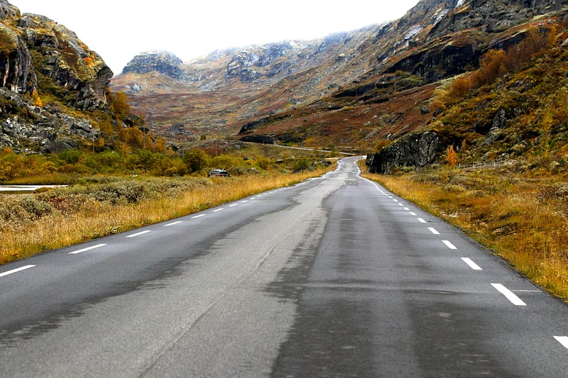
rawpixel.com
Notes:
Now, a little bit on my open science journey:
Pretty early on during my psychology Bachelor’s degree I was lucky enough to have a lecturer how talked to us about a replication study he was crazy enough to conduct during his PhD. Although he was a lucky one and could both replicate the original findings AND get the study published. He told us that this painful process made him also more attentive to the quality of evidence in many of the studies and claims we are taking for granted.
I left that day quite disappointed wondering about the point of learning about all the different research findings in social psychology which might then turn out to stand on shaky grounds.
At the same time, I didn't want to get disheartened by this insight and decided to learn more about what makes a good study, what makes a bad one, how to do good science and how to bulletproof the grounds of evidence you want to build upon.
Long story short, I guess I started at a similar place as you, and then I ended up engaging with many wonderful people in the open science world, be it different large organisations, smaller grassroots initiatives or projects I started myself. I have mostly been met with open arms and can just encourage you to go out there, ask, discover, experiment.
For me the learning-by-doing approach is the crucial part when breaking new grounds (not only for open science related topics but in general), and most people appreciate you reaching out, showing an interest in their work and really value you as a contributor. So, just keep that in mind: You are an important part of the open scholarship movement already and I hope this course can give you something for your own path.

Slide 3
The road to the Replication Crisis
Background
____________
Up to the 2010s, the focus of many scientific communities was on novelty & discovery.
While those are great objectives, paired with a lack of emphasis upon transparency and rigor in how to conduct studies and analyse data, this would later lead to many unstable/non-robust findings.
Notes:
The focus on novelty and discovery is an important part of scientific endeavour. It allows to bring a field forward, question concepts which have been by doing things differently or by introducing new insightful ways of understanding the world.
While these are great objectives, it is equally important to produce robust findings. Robust means that the findings hold, even when changing certain parameters around the findings (for example conducting the study in a similar sample at a different place) or ways of analysing the data. In other words, we want to produce findings we can trust, and which are as telling as possible for as many people in the world as possible, which refers to the generalisability of the findings.
For a long time, statisticians have outlined how to conduct and report studies to get robust findings and standards continue to evolve. For example, Cohen has already described the importance of statistical power and effect sizes in the 1980s (Those are concepts we will come back to later), e.g., in his 1988 book Statistical Power Analysis for the Behavioural Sciences. Standards for ensuring appropriate sample sizes and how to report statistics have changed.

Slide 4
The road to the Replication Crisis
Background
____________
Lack of standards + publishing pressures (novel findings) =
Some not so good studies.
Often used example in psychology: Bem (2011) claiming that people can predict an undecided 50/50% future event (p < .05) more that would be expected by chance
Notes:
So, to some degree, there was a lack of established standards, for example, analysing data a certain way. Adding to this was the pressure to publish novel findings.
Why were novel findings published more? Because they were considered interesting, sexy and thus more often read. They were considered more desirable and journal editors often used this as an evaluation criteria when deciding whether to publish a manuscript. Novelty clearly doesn’t equate to quality/rigor and this prioritisation of novelty prevents the build up of evidence towards areas of consensus which can be most impactful for policy impact.
Unfortunately, the focus on novelty and a lack of guidelines and hence understanding of statistics lead to many practices which introduce false positives - claims that effects existed when they don't. For example, false positives can be induced by the way data are analysed. Namely, when strictly trying to reject a null hypothesis (H0), it is important to do so by analysing the data once, not many times excluding some data points each time, or some condition to finally find a significant effect, unless the alpha-level is corrected. That will say, that we would need a lower p-value to call a finding significant (as the alpha level becomes lower when conducting multiple tests on the same hypothesis). For example, instead of requiring p-values at the common threshold of p<0.05, we could divide alpha by the number of tests (e.g., with 5 tests, we can call p<.01 significant).
You see that there are many different ways researchers could muddle with the analysis process, such as conducting many analyses, but only reporting significant results, or hypothesising after knowing the results. All the possible freedoms researchers have were also called researchers’ degrees of freedom. The misuse of researchers’ degrees of freedom was later also labelled “questionable research practices”, which resulted in the publication of some wild findings. The probably most notable of these papers was in the prestige journal JPSP by Bem (2011) on “precognition”, the ability to see into the future. Indeed, it was claimed that participants could predict a yet undecided 50/50 event. An impossibility? Not when introducing false positives into the data by analysing the data so long until a significant finding pops up somewhere and then only reporting this one analysis while discarding all others (and not considering them).
Replication problems of JESP and hence “high-impact journals” are not single cases. Just a recent finding is another point in a streak of failed replications of Journal of Consumer Research: https://doi.org/10.1016/j.jesp.2024.104619

Slide 5
The road to the Replication Crisis
Background
____________
Formalisation of statistical testing through Ronald Fisher.
Since that, research practices and methods constantly evolve.
Notes:
Let’s take a step back.
How did we end up in this complicated mess?
The reason goes back to how we do science and that this process is constantly evolving.
It has not always been a given that we do science the way we do it today, i.e.: Heavily relying on quantitative analyses using null hypothesis significance testing.
Null hypothesis significance testing has been introduced in the 1920s and adopted in the following decades.
The practice is not homogenously accepted and has never been:
There are well-known opponents of the statistical null-hypothesis method introduced by R. Fisher, such as the the behaviourist B.F.Skinner who is known for his work on behaviourism (conditioning rats).
You might have heard of Bayesian statistics, where the prior assumptions about a phenomenon set the premise for the statistical test outcome.
Either way, null hypothesis in a frequentist way, as it is usually called, became the dominant way of presenting scientific evidence
Since their introduction, null hypothesis testing methods and research practices have evolved
New methods
Considerations on what we should focus on, other things to avoid

Slide 6
The road to the Replication Crisis
Background
____________
Some key developments:
Effect size & statistical power (Cohen)
Notes:
Some key developments which had consequences for the statistical practices across fields were …
the works by Jacob Cohen on effect sizes and power
Effect sizes to make effects on different scales comparable
Power: the sensitivity to detect a true effect, if it is there. (If the statistical power is too low, we might not find the effect, even if it is there, i.e. false negative)

Slide 7
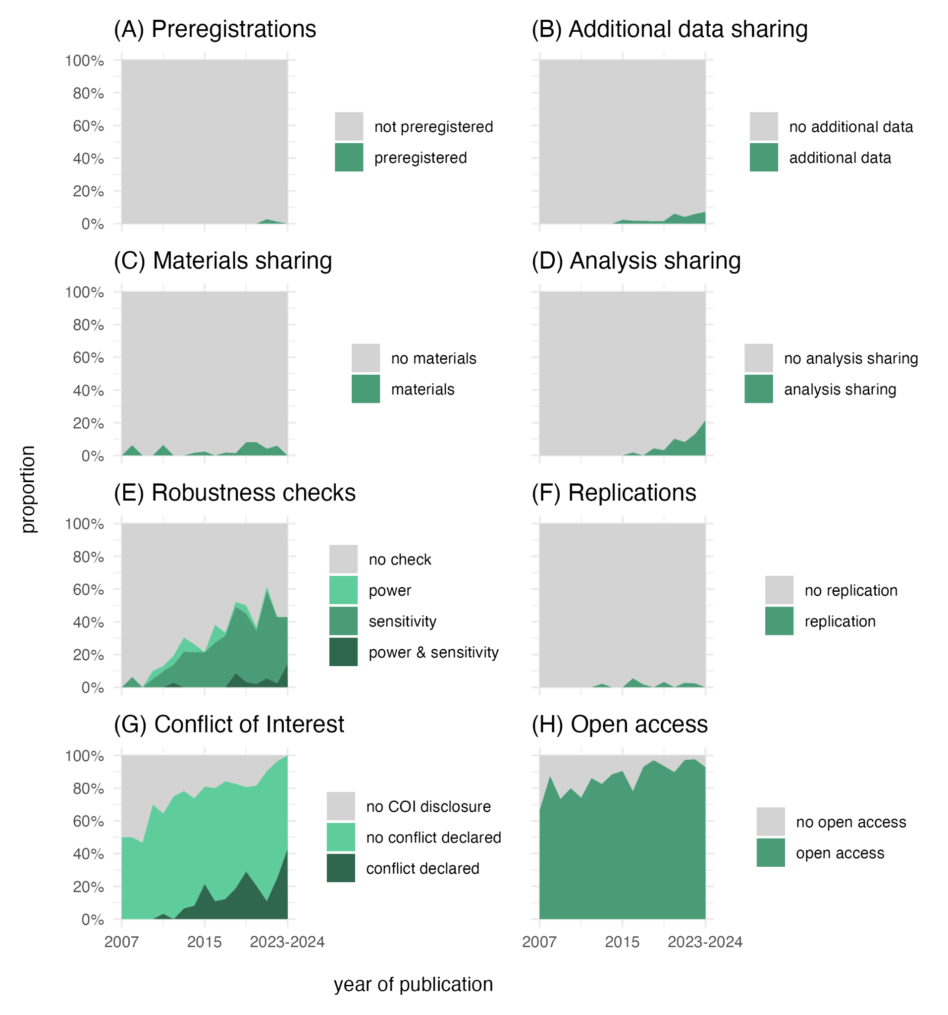

The road to the Replication Crisis
Background
____________
Some key developments:
Effect size & statistical power
Notes:
Some key developments which had consequences for the statistical practices across fields were …
the works by Jacob Cohen on effect sizes and power
Effect sizes to make effects on different scales comparable
Power: the sensitivity to detect a true effect, if it is there. (If the statistical power is too low, we might not find the effect, even if it is there, i.e. false negative)
These concepts are intertwined
Only over the recent decades reporting effect sizes and power have become more and more standard practices and are now often directly required by journals or by reviewers
In the graphic you see the results of an ongoing study analyzing the corpus of studies resulting from the mother and child cohort study which is a longitudinal biobank-styled study collecting biological and demographic data from mothers and their children.
Here, a large cohorts’ information was collected. The data are used by many researchers and hence a good benchmark for mapping different scientific practices over time.
This graphic is also helpful as it shows that open science practices resemble many different practices.
This describes well the problem of open science. Usually the definition is connected to practices which foster transparency, sharing of information, and fostering of robust scientific practices.

Slide 8
The road to the Replication Crisis
Background
____________
Some key developments:
Effect size & statistical power (Cohen)
Quantifying uncertainty (Neyman)
Notes:
Other key developments which had consequences for the statistical practices across fields were …
The works by Jerzy Neyman to quantify uncertainty
For example, he introduced confidence intervals, which help to get a better understanding of the uncertainty surrounding a certain effect size estimate under different conditions
For example, based on the certainty we need (0-100%), an effect examined under the same conditions falls into the specific interval. In other words, the more certainty, the larger the interval. Parameters that reduce uncertainty, on the other hand, shrink the interval, such as sample size.

Slide 9
The road to the Replication Crisis
Background
____________
Science is not a dish which can be cooked using a single never-changing recipe.
Notes:
You see that statistical practices have been evolving in a non-linear fashion.
Sometimes it is difficult to trace back why exactly this one practice has been adapted at that time and not earlier and another one never made it.
Yet, people want simple answers to manage their busy days. Yet, science often requires more complicated answers.
Science is simply not a dish which can be cooked using a singe recipe.
The consequences were however large when mindlessly following a recipe.

Slide 10
A Replication Crisis?
Background
____________
So, how to know what we know?
One attempt: replications.
The most prominent example comes from psychology: A 100-study replication study showed low rates of subjectively labelled replicability (39%) and effect sizes among these half the original.
Notes:
Going back to the study example from the beginning: seeing the future by Bem.
Studies like Bem’s caused controversy and it was not clear anymore whether it was possible to trust psychological findings. It was however also not clear how to verify findings, as replication studies were not welcomed by most journals. You might guess why. They were not novel.
Replication studies refer to testing a previously reported effect in a different sample. This can be done conceptually (more loosely) by capturing the effect in a different way to that originally reported (i.e., using different operationalisations, data processing and statistical approaches and/or different constructs; LeBel et al., 2018). Alternatively, replications are done as close to the original study as possible. There are ongoing discussions on how close replications can be to the original, and how to interpret them.
However, at the time, replications were sparse and offered an opportunity to assess the state of psychological science. The Open Science Collaboration (2015) provided for the first time an overview of replications of 100 highly cited study with results which suggested that many effects would not replicate the way one would have imagined.
Now, there was much discussion on whether this is a replication crisis or better described in another way. Yet, it was overall clear that the practices and circumstances which had lead up to this situation were sub-optimal, and there were several well-embedded problems to be addressed.

Slide 11
A Replication Crisis?
Background
____________
Replication vs reproduction
Replication = repeating the experiment or study to obtain new, independent data with the goal of reaching the same or similar conclusions.
Reproduction (computational reproducibility) = Ability to recreate the same results as the original study (including tables, figures, and quantitative findings), using the same input data, computational methods, and conditions of analysis.
(Parsons et al., 2021)
Notes:
As there are often confusion appearing about the terminology, here the difference between two key terms: replication and reproduction.
Replication = repeating the experiment or study to obtain new, independent data with the goal of reaching the same or similar conclusions.
Reproduction (computational reproducibility) = Ability to recreate the same results as the original study (including tables, figures, and quantitative findings), using the same input data, computational methods, and conditions of analysis.
Reference: Parsons, S., Azevedo, F., Elsherif, M. M., Guay, S., Shahim, O. N., Govaart, G. H., ... & Aczel, B. (2022). A community-sourced glossary of open scholarship terms. Nature human behaviour, 6(3), 312-318.

Slide 12
Learning from the Replication Crisis
Background
____________
Replication problems can be found in many fields.
E.g. psychology, cancer biology or economics
Notes:
Now, we started talking about the replication crisis in psychology, but many, perhaps most fields show replication problems. Of course, the same practices and incentive/publication system apply to other fields than psychology.
Since the large-scale replication effort in 2015 by the Open Science Collaboration, many more replications were done showing differential patterns across disciplines. This has even been demonstrated in areas considered more aligned to scientific study e.g., cancer biology.

Slide 13
Learning from the Replication Crisis
Background
____________
Examples of subjectively labelled replication rates:
Psychology: 64% successfully replications, with effect sizes being 32% smaller than the original effects (Nosek et al., 2022); but estimates of replicability using machine learning appear lower (41%; Youyou et al., 2023)
Cancer biology: 47% successfully replications, 92% of the effects were smaller than original effects (Errington et al., 2021)
Economics: 61% successfully replications, 34% effect size shrinkage (Camerer et al., 2016)
Notes:
Replication rates refer to subjectively labelled replication “success” or outcomes. This translates usually to a binary of successful and unsuccessful. However, there are many dimensions to replication outcomes. For example, an effect might reproduce, but be much weaker. Is the replication successful? (Usually, the answer would be yes.). What if the study can be only be partially be reproduced (only some effects or only in specific samples or under specific conditions)?
There are several larger replication projects:
Psychology (Nosek et al., 2023; https://doi.org/10.1146/annurev-psych-020821-114157; Youyou et al., 2023; https://doi.org/10.1073%2Fpnas.2208863120)
Cancer biology (Errington et al., 2021, https://doi.org/10.7554/eLife.71601)
Economy (https://doi.org/10.1126/science.aaf0918)
And we could go on and on with such replication projects, showing similar trends of a certain proportion of findings not replicating. So, the replication crisis is absolutely not unique to psychology or even the social sciences (see cancer biology example).
Now, let’s jump to 2023.
For a more nuanced discussion of “replication success” see, for example:
https://github.com/forrtproject/FReD/issues/4#issuecomment-2191826842
https://lakens.github.io/statistical_inferences/17-replication.html

Slide 14
Learning from the Replication Crisis
However, only a small percentage of all studies are replication studies:
Clarke et al. (2023): 0.2% Psychology (169 out of 84,834) | Marsden et al. (2018): 0% Language
Ankel-Peters et al. (2023):1% Economics | Makel et al. (2016): 0.5% Special Education
Kobrock & Roettger (2022): 0.06% Linguistics | McNeeley & Warner (2015): 2% Criminology
Hardwicke et al. (2021): 5% Psychology, 1% Social Sciences | Makel et al. (2014): 0.13% Education
Kelly (2019): 0.023% Ecology | Makel et al. (2012): 0.1% Psychology
Mueller-Langer et al. (2019): 0.1% Economics | Kelly (2006): 0-34% Biology
Notes:
While we see that replication study results often diverge from original study results (especially in terms of effect size shrinkage), executing replication studies is not a common practice.
This does not only apply to psychology but (to our knowledge) most scientific fields (see examples on the slide).
Estimates for the share of replication studies among all published studies are hence fairly low (usually below 1%).
Here are a few investigations assessing the current situation of replication practice in different fields.
Sources for the single estimates/studies:
Ankle-Peters et al. (2023): https://doi.org/10.1016/j.jebo.2023.05.009
Kobrock & Roettger (2022): https://doi.org/10.5070/G6011135
Hardwicke et al. (2021): https://doi.org/10.1177/1745691620979806
Kelly (2019): https://doi.org/10.7717/peerj.7654
Mueller-Langer et al. (2019): https://doi.org/10.1016/j.respol.2018.07.019
Marsden et al. (2018):https://doi.org/10.1111/lang.12286
Makel et al. (2016): https://doi.org/10.1177/0741932516646083
McNeeley & Warner (2015):https://doi.org/10.1177/1477370815578197
Makel et al. (2014): https://doi.org/10.3102/0013189X14545513
Makel et al. (2012): https://doi.org/10.1177/1745691612460688
Kelly (2006): https://doi.org/10.1086/506236
Original source of the overview Gilad Feldman’s slides:
http://mgto.org/2022glasgow

Slide 15
Learning from the Replication Crisis
The Problem
____________
Literature assessing the Replication Crisis has focussed on identifying what’s wrong (e.g., questionable research practices and unhealthy structures).
Notes:
We have seen that replication studies produced different results, dependent on the study and field. Overall, replication rates were lower than expected which subsequently led events to be labelled a replication crisis.
Yet, the share of replication studies of the total volume of studies is very low. It is hence yet still important to find ways to replicate studies (as well as to validate findings in other ways). So there is room for improvement here.
The field’s (psychological science) logical reaction to low replicability estimates of many key findings was to identify how we got there. Many questionable research practices and unhealthy structures (for example within the publishing system) were identified.
Just to give some examples of questionable research practices:
- Data manipulation, augmentation, faking
HARKING: Hypothesising after results are known
P-hacking (e.g., exclusions to obtain significant results)
Omitting of results and highlighting of others
Selectively reporting dependent variables
Manipulating the data collection processes by stopping or continuing data collection based on the desired outcome
Failing to disclose experimental conditions
False claims about the results of tests (rounding p = 0.054 down and saying it is significant )
Selectively reporting only the studies that showed desirable results
Etc.!
The list is long!

Slide 16
Learning from the Replication Crisis
The Problem
____________
Literature assessing the Replication Crisis has focussed on identifying what’s wrong (e.g., questionable research practices and unhealthy structures). This is where the discussion often stops.
Yet, there is much opportunity in learning from mistakes and improving. To move forward, positive change needs to be acknowledged, encouraged, and built upon.
Notes:
Unfortunately, the discussion often ends on the things one is not allowed to do. Or in other words, mistakes and shortcomings others learned.
These mistakes and shortcomings are incredibly important to inform future choices and learning, and they need to be acknowledged. However, also the positive change, all that has happened and resulted in feasible, practically applicable solutions needs acknowledging.

Slide 17
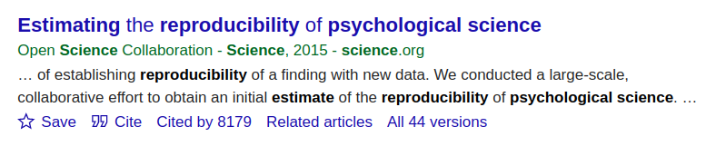
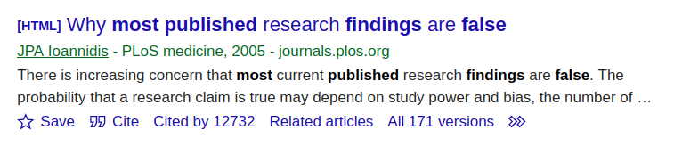
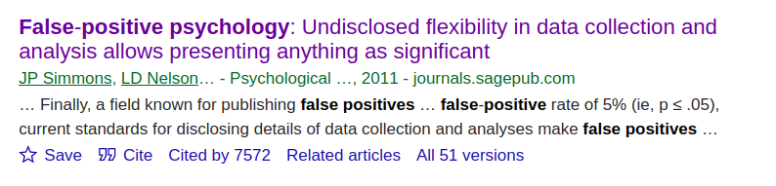
Learning from the Replication Crisis
The most cited studies in the context of the Replication Crisis outline the problem. The next logical step is to move towards solving the problem / crisis.
Notes:
Here, just some of the most prominent papers on the replication crisis illustrating the point: the focus has been on outlining the problem(s). This was necessary at the time as the field needed to understand that change is required.
However, the way towards solving the crisis and doing so in a sustainable fashion certainly needs attention too. This is where the paper “The replication crisis has led to positive structural, procedural, and community changes” comes in.

Slide 18
Credibility Revolution
Keeping the opportunity for change in mind, Simine Vazire coined the term Credibility Revolution instead.
Key characteristics of the Credibility Revolution:
greater emphasis on transparency and openness
a move toward preregistration of research
more direct-replication studies
higher standards for the quality and quantity of evidence needed to make strong scientific claims
Vazire (2018). Perspectives on Psychological Science.
Notes:
It seems logical to see the replication crisis as a great learning opportunity and a chance to improve upon (considering all the suggestions on how to improve scientific practice as a result of the crisis).
Within this framework of thinking, Simine Vazire came up with a potentially more helpful term describing the replication crisis: a credibility revolution. This term contains first of all the hope to being able to revolutionise some outdated practices and structures and replacing them with new and better alternatives. Secondly, the term refers to credibility which suffered across scientists and even influenced the perceptions of the general population. In short, the term invokes hope.
Vazire further suggest various key concepts which characterised the credibility revolution so far (2018):
greater emphasis on transparency and openness
a move toward preregistration of research
more direct-replication studies
higher standards for the quality and quantity of evidence needed to make strong scientific claims

Slide 19
Discussion I
Discussion points:
How would you describe your own field based on this first part of the lecture?
Do you think there might be a problem with questionable research practices?
Are there any solutions you are aware of?
How could the credibility revolution look in your field?

Slide 22
An Introduction to Open Science or “From Replication Crisis to Credibility Revolution” part II
Max Korbmacher, PhD
Max.Korbmacher@gmail.com
Notes:
In this part of the lecture, I really want to dive with you into the what has actually happened in response to the replication crisis beyond identifying problematic behaviours.
This is particularly important for you as researchers, because you are most likely most interested in the things you CAN do instead of all the things you CANNOT do. At least, usually the possibilities and opportunities one has are more stimulating than restrictions.

Slide 23
Credibility Revolution
During the discussion, we might have concluded that change is already happening.
A resource structuring and presenting the developments has just been lacking.
Notes:
The change described by Vazire is already happening, but it has been cumbersome to get the right info on the details of what is happening, how these changes are implemented practically. Simply put, it’s easy to miss out on some of the big positive changes by reflecting upon the progress still yet to be made.
Furthermore, the open science or science reform movement is moving. Developments are ongoing. Within the recent years, the developments towards a more open science have been cumulative.
Together with the Framework for Open and Reproducible Research Teaching (FORRT), I provided a conceptualisation of how the change happens: https://doi.org/10.1038/s44271-023-00003-2
The paper is supposed to be a resource which makes it easier to access the topic of the replication crisis & what to with it.
In the next slides I will dive deeper into the paper, which guides through the developments of the recent years. Since this is a FORRT project, I put in the figure and the emblem. This is active advertisement for the NGO ;)

Slide 24
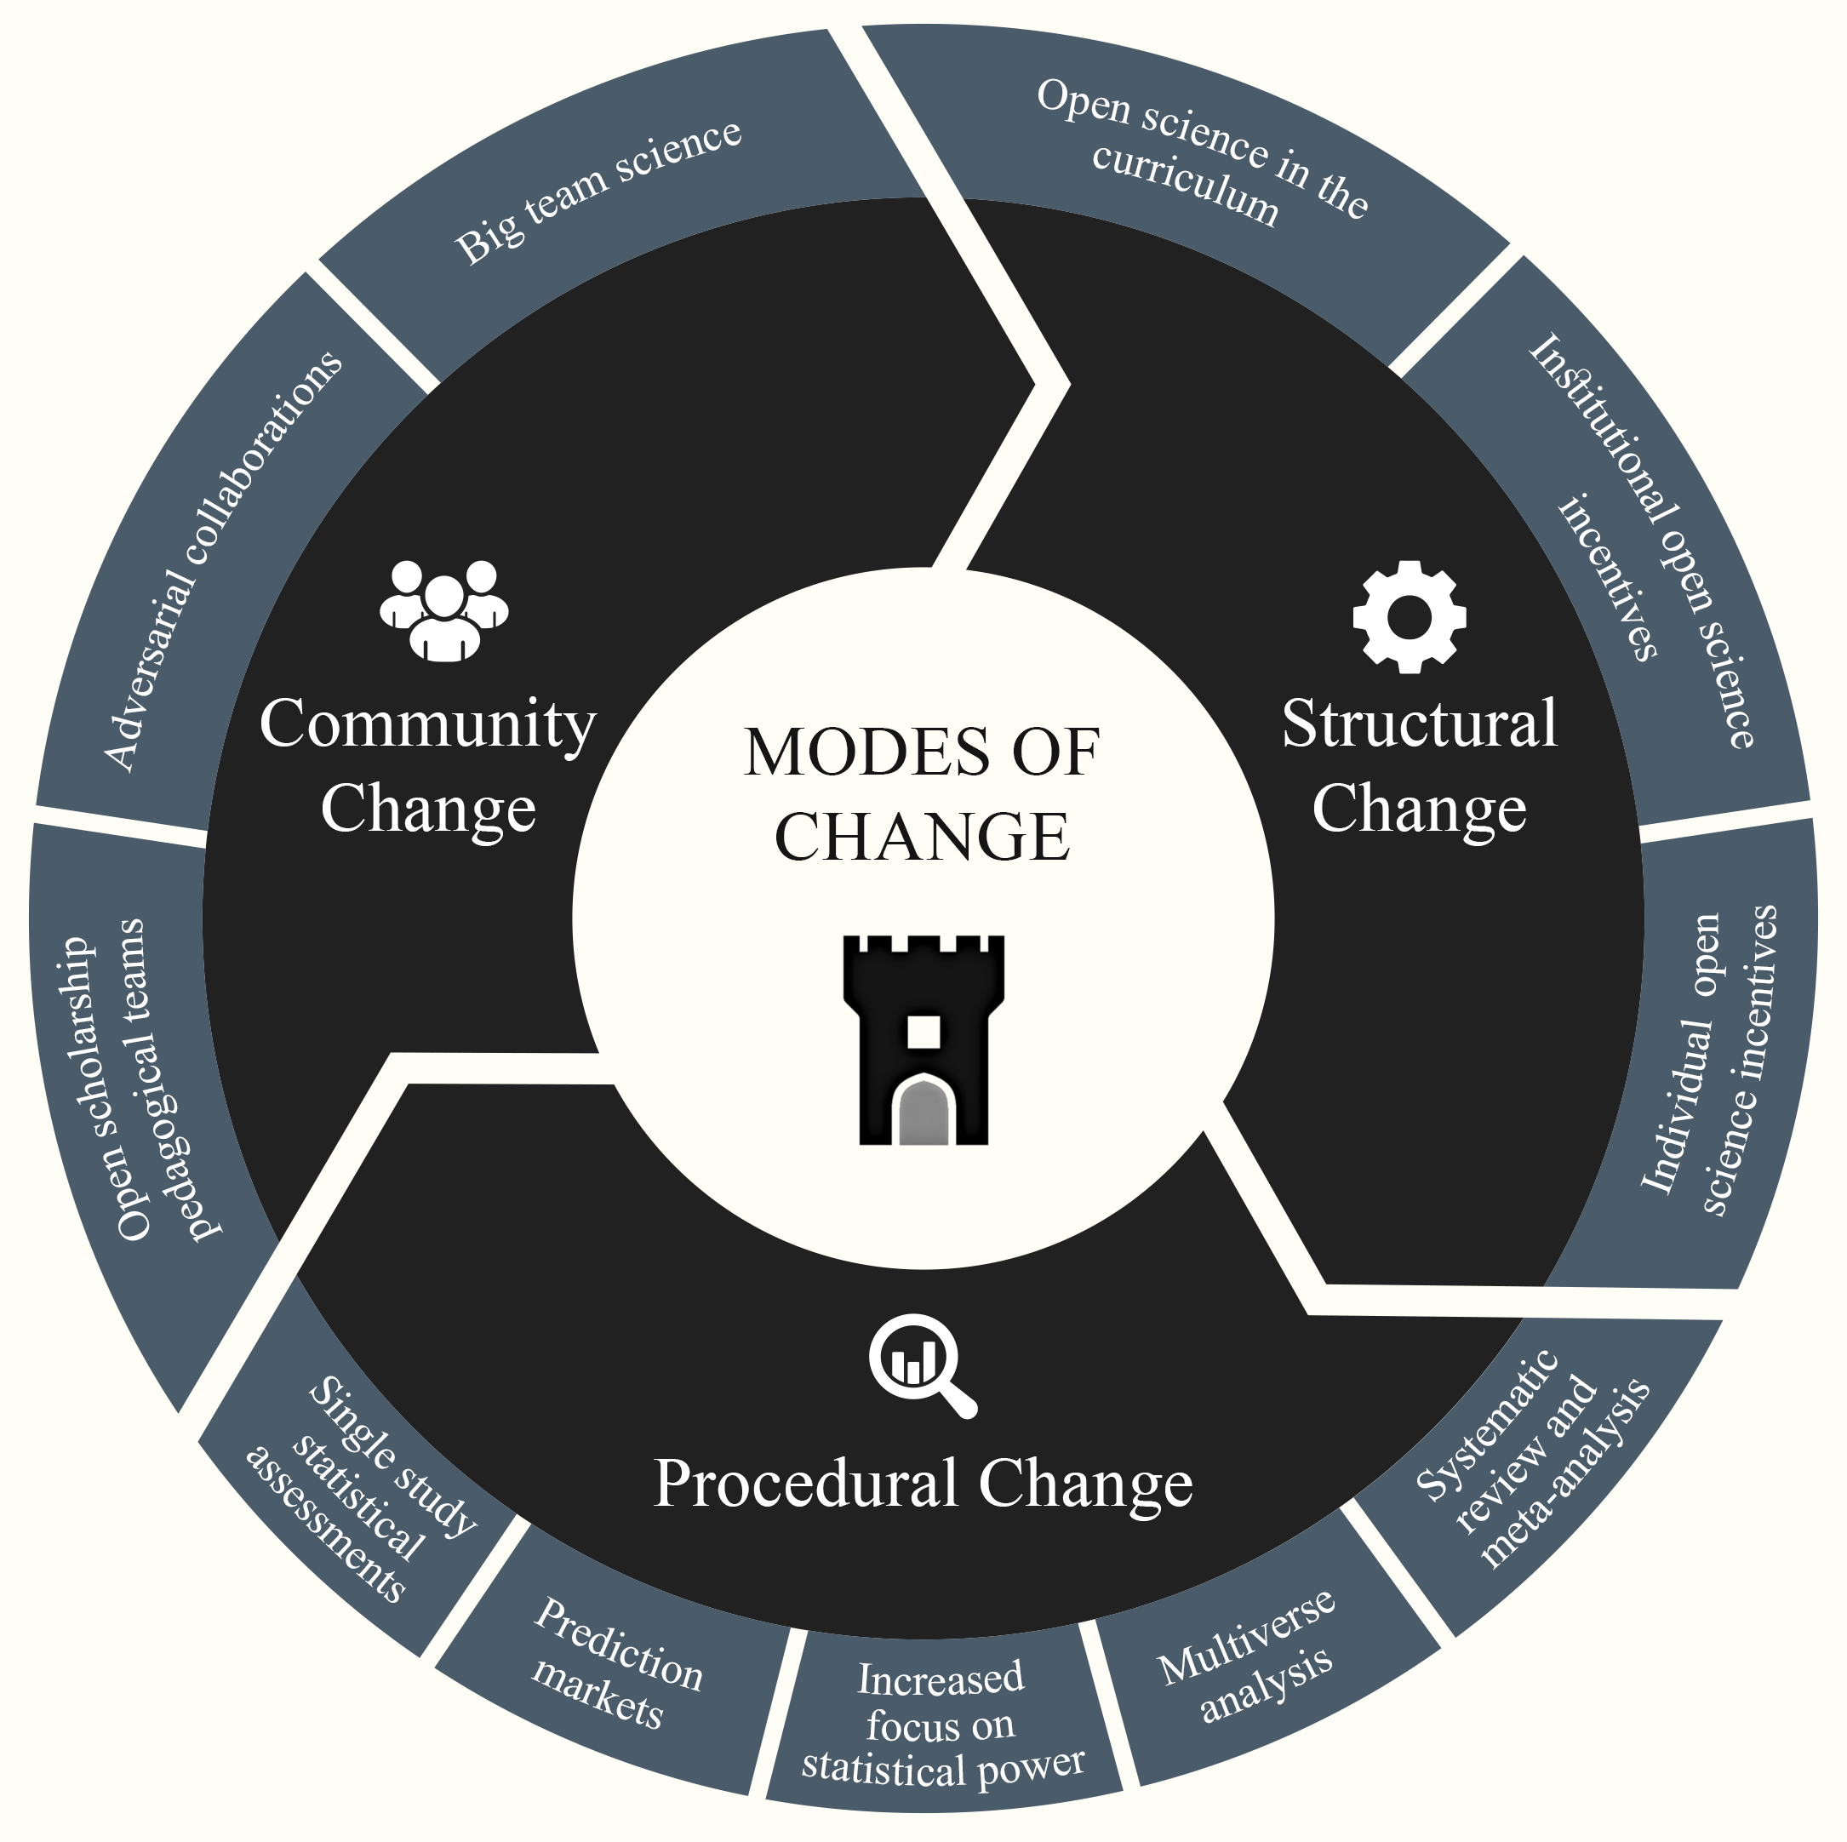
Organising Change
Structural, procedural and community-level change as a consequence of the replication crisis.
Korbmacher et al. (2023). Communications Psychology
Notes:
One way of structuring positive developments as a result of the replication crisis or credibility revolution is to classify by structural, community, and procedural change.
There are some general trends which can be noticed when reviewing the literature:
- an increased focus on working in teams (community level)
- methods and statistical procedures and tools which individuals could use (procedural level)
- normalisation of open science through policies and incentives (structural level)
The following sections will discuss the identified changes in each domain of change (structures, community-actions, and procedures).

Slide 25
Structural Change
Curriculum changes
Implementing Open Science practices in the curriculum
Replication studies as theses
Notes:
Much has changed in recent years on how methods and statistics are taught.
This can be generally summarised in two major changes:
Implementing Open Science Practices in the curriculum
Implementing replication studies as theses
Open Science or Open Scholarship Practices reflect the idea that scientific knowledge of all kinds, where appropriate, should be openly accessible, transparent, rigorous, reproducible, replicable, accumulative, and inclusive. Open science consists of principles and behaviours that promote transparent, credible, reproducible, and accessible science. Open science has six major aspects: open data, open methodology, open source, open access, open peer review, and open educational resources.
In the following, there will be a closer presentation on how a scheme for replication studies can be implemented.

Slide 26
Structural Change
Curriculum changes
Implementing Open Science practices in the curriculum
Creating norms of Open Science usage (instead of exceptions)
Large collection of open source teaching and learning materials
Replication studies as theses
As part of large-scale collaborations
As single studies (publication with the help of ECRs)
Notes:
Creating Norms
Learning about open scholarship practices influences how students approach science, both as a researcher or a consumer of research.
This includes:
Knowledge, expectations, attitudes, and engagement toward becoming more effective and responsible researchers and consumers of science.
Personal values connected to research.
Being better equipped to make rigorous scientific contributions.
Fostering equity and justice, breaking down status hierarchies and power structures (e.g., decolonisation, diversity, equity, inclusion and accessibility efforts)
Overall, open science skills foster critical thinking, which is a core element of the university education across disciplines.
The increasing uptake of Open Science related topics into the curricular aid the development of open science practices becoming the norm.

Slide 27
Structural Change
Curriculum changes
Implementing Open Science practices in the curriculum
Creating norms of Open Science usage (instead of exceptions)
Large collection of open source teaching and learning materials
Replication studies as theses
As part of large-scale collaborations
As single studies (publication with the help of ECRs)
Notes:
Creating knowledge bases
Various efforts to increase the adoption of open scholarship practices into the curriculum are being undertaken by pedagogical teams with the overarching goal of increasing research rigour and transparency over time.
The contributions generally split into three (overlapping) parts of providing …
Resources
Guidelines
Community
Since there is a breadth of tasks required in the pedagogic reform towards open scholarship, there are many teams and organisations specialising on particular portions of the reform. Just a few examples:
Meta science, research transparency, reproducibility, rigour, social justice, and ethics [Framework for Open and Reproducible Research Training (FORRT)]
Syllabi [Course Syllabi for Open and Reproducible Methods; Carpentries]
Journal clubs discussing open science [ReproducibiliTea]
Open Science events [RIOT Science Club]
Who is behind these efforts?
While these changes are structural, they are often driven by early career researchers.
(Unfortunately, often receiving little recognition for their contributions. However, in the future, these contributions might be widely acknowledged as valuable research work too.).

Slide 28
Structural Change
Curriculum changes
Implementing Open Science practices in the curriculum
Creating norms of Open Science usage (instead of exceptions)
Large collection of open source teaching and learning materials
Replication studies as theses
As part of large-scale collaborations
As single studies (publication with the help of ECRs)
Notes:
Higher Education instructors and programmes have begun integrating open science practices into the curriculum at different levels.
There are currently two presented ways of implementing replications as thesis:
Thesis replications as part of large-scale collaborations
Thesis replications as single studies (publication with the help of ECRs)
We start with the first one.
Replication studies in large-scale collaborations
There is one prominent “consortium approach”, by the Collaborative Replications and Education Project, which integrates replications in undergraduate courses as coursework with a twofold goal:
educating undergraduates to uphold high research standards
simultaneously advancing the field with replications
This approach requires a consortium of supervisors and their students who collaborate.
The procedure is typically the following:
1) Selection of the most cited studies from the most cited journals in the last three years
2) Administrative advisors rate the feasibility of the replication to decide whether to run the study across the consortium of supervisors and students.
3) Study is conducted by students.
4) After study completion, materials and data are submitted and used in meta-analyses, for which students are invited as co-authors.

Slide 29
Structural Change
Curriculum changes
Implementing Open Science practices in the curriculum
Creating norms of Open Science usage (instead of exceptions)
Large collection of open source teaching and learning materials
Replication studies as theses
As part of large-scale collaborations
As single studies (publication with the help of ECRs)
Notes:
Single replication study publications
Another options is to implement independent/single replication study theses.
The approach of selecting replication targets can be similar to the one described before (based on citations) or on supervisors’ & students’ interest.
However, in order to make sure that the replication studies also make it into the literature, extra effort is necessary. One can either ask other investigators to bring the dissertation to publication (e.g., early career researchers), or set up a scheme in which students publish the replications themselves.
Registered reports is a useful format for such replication efforts, as they allow for a review of the study before data are collected (stage one of a two-stage process). Students can submit a thesis based on the submission.
Registered reports refers to a new way of publishing results. Instead of delivering a presentation of the finished project for peer review, more of a project proposal is submitted and peer reviewed before any data are being collected or analysed. This way, crucial changes to the design can still be implemented before data are being collected, the suitability of analysis choices be evaluated, and a clear protocol for potential hypothesis tests is locked in. Once the peer reviewers are satisfied the manuscript gains a stage 1 acceptance. If the authors now follow the agreed protocol, the findings can be published independent of their direction. Hence, registered reports generally create findings which are more representative of reality and not prevailing bias in the publication system, which favours positive findings.
For an overview of journals offering registered reports see https://lookerstudio.google.com/reporting/95aff8ff-7ec6-4363-bf05-f81f61215bd3/page/IGhqB?s=jM4JLSJb80o
Or
https://www.cos.io/initiatives/registered-reports

Slide 30
Structural Change
Incentives
Targeting Researchers
Targeting Journals & Funders
Notes:
The third side of structural changes are incentives.
These can be categorised into incentives which target
Researchers, and
Journals & funders.
Incentives
Traditional incentives for academics to advance in their career are publishing articles, winning grants, and signalling the quality of the published work (e.g., perceived journal prestige)
More recent incentives are badges for preregistration, open data and materials
Badges might be used as a signalling tool for high research quality
Another form of open science incentives is the security which comes with registered reports, where publication in one or a set of journals can be secured when a stage 1 acceptance is reached
For example, using the PeerCommunityIn platform, researchers review independently submitted registered reports proposals. When they recommend the registered report for publication, it can be published directly in journals which have an agreement with PeerCommunityIn Registered Reports. The journal is a choice of the authors.

Slide 31
Structural Change
Incentives for researchers
Funding & publication opportunities
Badges
Registered Reports
Incentives for journals & funders
Transparency and Openness Promotion (TOP) and other guidelines and factors for journals
Plan-S (EU-wide open publishing)
Re-designed peer review (e.g., PeerCommunityIn)
Research evaluation updated (e.g., San Francisco Declaration of Research Assessment)
Notes:
Incentives for researchers
Funding opportunities come from both national and grassroots organisations (see more on the next two slides)

Slide 32
Structural Change
There are several (national) scientific organisations supporting replication research.
A few examples for initiatives supporting replication research
The replication program of the Dutch Research Council (NWO)
METAREP Germany (funded by the German Research Association)
Assessing computational reproducibility
Institute for Replication
Assessing credibility of research
Center for Open Science SCORE Program
Notes:
There are some national scientific organizations helping support researchers engaging in replicating and reproducing research or assessing the former :
Replication
Several examples at the Dutch Rearch Council (NWO) in the NL https://www.nwo.nl/en/researchprogrammes/replication-studies
The meta-scientific program to analyse and optimise replicability in the behavioral, social, and cognitive Sciences (METAREP) in Germany https://www.meta-rep.uni-muenchen.de/index.html or https://www.coll.mpg.de/162052/dfg-priority-program
Assessing reproducibility
computational reproducibility at I4R: https://i4replication.org/
Assessing the credibility of research
The Center for Open Science SCORE program https://www.cos.io/score

Slide 33
Structural Change
Additionally, there are several grassroots organisations supporting replication research. One example is FORRT.
Examples for projects to build resources to keep track of replication and reproducing studies
FORRT’s replication HUB (overview page)
FORRT Replication database (FReD)
FORRT Reversals
Open MTK
Notes:
There are some national scientific organizations helping support researchers engaging in replicating and reproducing research or assessing the former :
Here we focus on FORRT, which offers multiple resources
FORRT’s replication HUB: https://forrt.org/replication-hub/
FORRT's Replication database (call: https://osf.io/f3w26, info for contributors: https://docs.google.com/document/d/1GayDFTFAHhNl0klTS2GLkac6mKrBzGtw/edit)
Reversals project: https://forrt.org/reversals/
Replications of Marketing Studies (Open MTK): https://openmkt.org/research/replications-of-marketing-studies/

Slide 34
Structural Change
Incentives for researchers
Funding opportunities
Badges
Registered Reports
Incentives for journals & funders
Transparency and Openness Promotion (TOP) and other guidelines and factors for journals
Plan-S (EU-wide open publishing)
Re-designed peer review (e.g., PeerCommunityIn)
Research evaluation updated (e.g., San Francisco Declaration of Research Assessment)
Notes:
Incentives for researchers
Badges are now awarded in some journals for open science practices (including open data, code, materials, preregistration) with the aim of signalling study quality
Registered reports
Allow for a “in-principle acceptance” before collecting data
That makes sure to save resources by
1) Ensuring quality of the research by reviews during an early stage of the projects
2) Ensure publication independent of the results.
Studies on registered reports generally suggest that these studies are conducted with more rigor than non-registered reports

Slide 35
Structural Change
Incentives for researchers
Funding opportunities
Badges
Registered Reports
Incentives for journals & funders
Transparency and Openness Promotion (TOP) and other guidelines and factors for journals
Plan-S (EU-wide open publishing)
Re-designed peer review (e.g., PeerCommunityIn)
Research evaluation updated (e.g., San Francisco Declaration of Research Assessment)
Notes:
Incentives for journals and funders
There are multiple incentives provided for journals and funders to take up open science practices.
These can be grouped by several guidelines which have been widely adopted, such as the Transparency and Openness Promotion (TOP) guidelines by the center for open science comprising eight modular standards to reflect journals’ transparency standards:
Citation standards
Data transparency
Analytic methods transparency
Research materials transparency
Design and analysis transparency
Study preregistration
Analysis plan preregistration
Replication

Slide 36
Structural Change
Incentives for researchers
Funding opportunities
Badges
Registered Reports
Incentives for journals & funders
Transparency and Openness Promotion (TOP) and other guidelines and factors for journals
Plan-S (EU-wide open publishing)
Re-designed peer review (e.g., PeerCommunityIn)
Research evaluation updated (e.g., San Francisco Declaration of Research Assessment)
Notes:
Incentives for journals and funders
Plan-S for
Mandates open publishing when the research is funded by public grants
Increase in open access options illustrates how journals are being effectively incentivized to expand their repertoire and normalize open access
Potential issue which yet has to be resolved: article processing charges have increased, causing new forms of inequities
For example, researchers who do not have the funds available for certain journals can not publish in them. As of today, many of the high prestige or high impact journals also have the highest publication fees. This way, researchers with a lack of funding are somewhat excluded from publishing in these journals which also decreases the visibility of their research. This has also various signalling functions. Funders, as one example, will be more likely to recognise high impact journals and allocate funds to those who publish there. Here, the phenomenon becomes circular.
Publication funds differ across countries. Scandinavian countries possess an open access fund which makes it possible to publish all articles as open access versions. The funds also cover all publication charges. Other countries leave the publication fees be a responsibility of the universities or single researchers. Hence, the global distribution of publications in high impact journals follows largely the world’s economic fingerprint, favorizing Western (and English-speaking) countries.
For an article showing the immense publication charges and venues which are being generated see this article: https://doi.org/10.1162/qss_a_00272

Slide 37
Structural Change
Incentives for researchers
Funding opportunities
Badges
Registered Reports
Incentives for journals & funders
Transparency and Openness Promotion (TOP) and other guidelines and factors for journals
Plan-S (EU-wide open publishing)
Re-designed peer review (e.g., PeerCommunityIn)
Research evaluation updated (e.g., San Francisco Declaration of Research Assessment)
Notes:
Incentives for journals and funders
New peer-review models, e.g., PeerCommunityIn
Relatively new community-driven system in which experts review and recommend preprints or registered reports to journals (as mentioned before)
What is special about PeerCommunityIn is that it is independent of journals.
Usually peer review happens “for” a journal at which authors submit.
At PeerCommunityIn preprints and registered reports can be submitted and then reviewed by researchers in that community who signal interest.
Publication can be done in an open access outlet from Peer Community In or journals which have agreements with Peer Community In
Another suggestion: the journal eLife abolishes accept/reject decisions once a paper goes into peer review
eLife is relatively new high impact journal with an editorial board which is happy to frequently try new initiatives, such as publishing the peer review, and now removing accept/reject decisions after peer review
The rationale is that much energy and time of both authors and reviewers is spent on the peer review process, and delays the publication time of manuscripts
This effort is wasted if the paper is rejected after several rounds of comments from the reviewers, which are answered by the authors and many iterations of improvements on the manuscript.

Slide 38
Structural Change
Incentives for researchers
Funding opportunities
Badges
Registered Reports
Incentives for journals & funders
Transparency and Openness Promotion (TOP) and other guidelines and factors for journals
Plan-S (EU-wide open publishing)
Re-designed peer review (e.g., PeerCommunityIn)
Research evaluation updated (e.g., San Francisco Declaration of Research Assessment)
Notes:
Incentives for journals and funders
New research evaluation models
Fundamental problem: focus on flawed metrics such as the impact factor when evaluating applications to positions or grants
Declarations to update such assessments:
San Francisco Declaration of Research Assessment (DORA)
Coalition for Advancing Research Assessment (CORA)
Emphasis on considering all research outputs, including software and data, and considering the qualitative impact of research, such as its policy or practice implications.
Another aspect is the computational reproducibility of the analyses presented in articles (https://doi.org/10.15626/MP.2023.4020)
As the computational reproducibility represents a problem in many articles, automatic or semi-automatic tools such as codecheck might be useful (https://codecheck.org.uk/)
As a consequence, more fields might soon move towards computational reproducibility checks in order to guarantee the robustness of the findings

Slide 39
Procedural Change
Predictions Markets
Several prediction market studies show that experts and non-experts can predict study replicability
Hence, another tool for researchers to assess the credibility of existing and hypothetical works
Notes:
We start with prediction markets, which have recently been proposed to be useful to assess research credibility through expert or lay-people assessments.
Usually assessments of replicability of certain claims
Large prediction market projects such as the repliCATS project have yielded replicability predictions with high classification accuracy (between 61% and 86%)
repliCATS is an interdisciplinary group of researchers interested in how structured group deliberation processes can improve scientific processes and practices, from post-publication peer review to improving the generalizability of research to global South contexts.
The repliCATS project is part of the MetaMelb research group at the University of Melbourne, co-led by Professor Fiona Fidler & Professor Simine Vazire, and funded by DARPA (US defense)
repliCATS have assessed the replicability of more than 3,000 published claims with the help of more than 500 reviewers of these claims, with this number still growing
Replication markets offer yet another tool for researchers to assess the credibility of existing and hypothetical works
In that sense, it is an ongoing discussion whether low credibility estimates from replication markets can be used to inform decisions on which articles to replicate

Slide 40
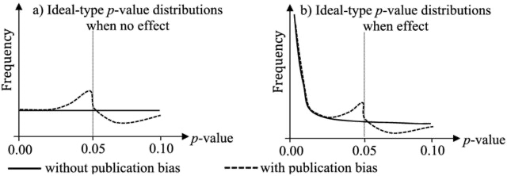
Procedural Change
Statistical assessments
Assessing sets of studies: Focus on α- and β-levels (Type I and II error rates) & distribution of p-values
Assessing single studies; Automatic numerical error and inconsistency detection
Notes:
One can assess either a body of studies or statistical parameters within single studies.
Let’s start with methods addressing a whole body of studies.
Sets of studies
Failure to control error rates and design high-power studies can contribute to low replication rates.
Hence, development of various quantitative methods to assess expected distributions of statistical estimates (i.e., p- or Z-values)
P-curve: measuring the deviation from an expected uniform distribution of p-values considering a false (Figure a) or true (Figure b) null hypothesis
Z-curve: like p-curve, but assessing the distribution of test statistics while considering the power of statistical tests and false discovery rate within a body of literature
P- and Z-curves attempt to represent the same phenomenon: the distribution of test statistics. This distribution should equally include significant and non-significant findings (or Z-values closer and further away from zero), as our hypotheses are simply not always true
Yet, often when doing such analyses, one can observe many more p-values close to zero than would be expected, in some cases even when assuming that the null hypothesis is false. This is then called a biased literature: the body of literature is influenced by the reward system which favious confirmed hypotheses / low p-values.
In other words, such p- or Z-curve estimations of bias in the literature identify selective reporting trends and help establish a better estimate of whether replication failures may be due to features of the original study or features of the replication study
Assessments of different sets of studies generally shows publication bias = non-significant findings are under-reported, leading to a distorted representation of the actual effects in the literature
Another solution: lower α-levels to 0.005 or abolishing it entirely
It is also possible to justify the alpha level based on the executed study & in regard to the magnitude of acceptable Type I versus Type II errors (https://doi.org/10.1038/s41562-018-0311-x)
A practical example is the journal Evolution and Human Behavior, where the False Discovery Rate clearly shows a relationship with the alpha level (https://replicationindex.com/2024/06/24/rr24-evohumbeh/)
One can also collect evidence using
Equivalence tests, or
Bayesian analysis

Slide 41
Procedural Change
Statistical assessments
Assessing sets of studies: Focus on α- and β-levels (Type I and II error rates) & distribution of p-values
Assessing single studies: Automatic numerical error and inconsistency detection
Notes:
Assessing single studies
When assessing single studies, there are different tools which can easily check for mathematical inconsistencies and impossibilities.
Two examples are
Granularity-Related Inconsistency of Means (GRIM) test: evaluates the consistency of mean values of integer data (e.g., from Likert-type scales), considering sample size and the number of items
Sample Parameter Reconstruction via Iterative TEchniques (SPRITE): reconstructs samples and estimates of the item value distributions based on reported descriptive statistics
Adopting these efforts can serve as an initial step in reviewing existing literature, to ensure that findings are not the result of statistical errors or potential falsification.
Researchers themselves can implement these tools to check their work and identify potential errors.
With greater awareness and use of such tools, we can increase accessibility and enhance our ability to identify unsubstantiated claims.

Slide 42
Procedural Change
Multiverse analysis
There is nearly never a single correct way of analysing a dataset
Instead, there is a multiverse
Multiverse analysis incorporates as many sensible ways as possible
Notes:
Researcher degrees of freedom—i.e., decisions researchers can make when using data—have been shown to influence the outcomes of analyses performed on the same data
In more complex data, e.g., in neuroimaging, no one analysis pipeline is like the other (potentially not even within the same lab)
The scientific process involves numerous analytical decisions that are often taken for granted as non-deliberate actions following established procedures but whose cumulative effect is far from insignificant.
Even in a research setting with high accuracy motivation and unbiased incentives, reliability between researchers may remain low, regardless of researchers’ methodological expertise
Multiverse analysis or its sibling sensitivity analysis can offer solutions to these challenges
Multiverse analyses are used to test the same hypotheses but using as many reasonable analysis strategies as possible, which then allows to come to a conclusion about the strength and direction of an effect independent of the modelling choices
Examples for multiverse analyses can be found here: https://doi.org/10.1038/s41467-022-31347-8 and here: https://doi.org/10.1177/1368430221990104
Multi analyst studies are different from multiverse analyses, as they require several researchers or teams of researchers to analyse the same set of data and answer questions about the data. Multiverse analyses, on the other hand, are usually executed by a single researcher or team of researchers.
Examples for multi analyst studies can be found here: https://osf.io/4zvst/ and here: https://doi.org/10.1073/pnas.2203150119 and here: https://doi.org/10.1038/s41586-020-2314-9

Slide 43
Procedural Change
Systematic review and meta-analysis
Guides and resources on reproducible reviews and meta analyses addressing two major problems:
Bias in the literature
Researchers’ degrees of freedom in methodological choices
Notes:
Data synthesis from several primary studies can be done by systematic reviews and meta-analyses
Both systematic reviews and meta-analyses are used to make sense of large amounts of data, reaching beyond a single study
Systematic reviews usually use more qualitative analysis, based on textual data, whereas meta-analyses rely on the statistical test details reported in the assessed studies
Problem 1: biassed literature (e.g, due to prioritisation of novelty or statistically-significant results)
Can be observed (to a certain extent) using funnel plots in meta-analyses
Problem 2: researcher degrees of freedom in determining inclusion criteria, methodological approaches, and the rigour of the primary studies
Solution: development of best practices for open, and reproducible systematic reviews and meta-analyses such as
Preferred Reporting Items for Systematic Reviews and Meta-Analyses (PRISMA)
Non-Interventional, Reproducible, and Open (NIRO) systematic review guidelines
The Generalized Systematic Review Registration Form
PROSPERO, a register of systematic review protocols
Guidelines often include a risk of bias assessment, where different biases are assessed and reported
Remaining problem: most systematic reviews and meta-analyses do not follow standardized reporting guidelines
Hope for the future: increased uptake of guidelines in articles and as journal submission requirements
Finally, implementing confirmatory tests, large sample sizes, preregistration and methodological transparency leads to higher replication rates (https://doi.org/10.1038/s41562-023-01749-9 > However, mind that this paper lacks a preregistration itself, and has been heavily criticised for it.)

Slide 44
Community Change
Big Team Science
Crowdsourced research & distributed networks of research teams facilitate large-scale investigations
The same holds true for error checking each other and constructive critiquing (red teams and adversarial collaborations)
Science acceleration through cooperation
Notes:
Community change encompasses how work and collaboration within the scientific community evolves. We describe two of these recent developments: Big Team Science and adversarial collaborations.
Big team science
What is big team science?
Large-scale, collaborative communities working on a scholarly common goal and pooling resources across labs, institutions, disciplines, cultures, and countries
Big teams can have different goals, such as mass replications (e.g., the Open Science Collaboration, Many Labs) or cross-cultural and robust research (e.g., Psychological Science Accelerator)
How does big team science make a contribution to the scientific field?
Leverages the resources and knowledge of many scientists
Institutionalisation of good scientific practices to improve research quality, including:
interdisciplinary internal reviews,
incorporating multiple perspectives,
implementing uniform protocols across participating labs, and
recruiting larger and more diverse samples
The latter also extends to researchers themselves: Big Team Science can increase representation, diversity, and equality and allow researchers to collaborate by either coordinating data collection efforts at their respective institutions or by funding the data collection of researchers who may not have access to funds & by accrediting labour correctly

Slide 45
Community Change
Adversarial Collaborations
Collaboration between two or more critical parts to reach a consensus-based resolution of scientific debates
Red Teaming
Error search
Originates from computer science where errors in code are monetarily rewarded
Notes:
Adversarial collaborations
Scholarly critique typically occurs after research has been completed
Review
Comments to an article
Blogs
However, more helpful before the research is conducted and the article is written
Here, adversarial collaborations can offer a consensus-based resolution of scientific debates
Researchers with differing viewpoints collaborate to facilitate more efficient knowledge production and self-correction by reducing bias
Red teaming
Similar to adversarial collaborations, but more focussed on error finding
Inspired by the world of software development where bugs in the code are found
This approach can be used for analyses and scripts
However, whether these initiatives contribute to research that is less biased in its central assumptions depends on wherein the “adversarial" nature lies.
For example, two researchers may hold the same biased negative views towards one group, but opposing views on the implications of group membership on secondary outcomes. An adversarial collaboration from the same starting point pitching different methodological approaches and hypotheses about factors associated with group membership would still suffer from the same fundamental biases.
An example of such error bounty hunting attempt is ERROR: https://error.reviews/

Slide 46
Discussion II
Discussion points:
Should we talk about a crisis or a revolution?
How would you see your role as a researcher in the different modes of change?
Where do you see opportunities to influence research practices?

Slide 49
An Introduction to Open Science or “From Replication Crisis to Credibility Revolution” part III
Max Korbmacher, PhD
Max.Korbmacher@gmail.com
Notes:
In the final part, I would like to talk a little more about expanding on the presented structure (which really is just a way of mapping what has happened in one way, there might be better ones).
I would like to touch on aspects which were not discussed that much in the paper and I would like to hear your input and thoughts in the end.

Slide 50
Expanding structural, procedural and community changes
Generalizability
Formal theory building
Qualitative research
Diversity and inclusion
Notes:
To expand the developments discussed and to address current challenges in the field, we can now discuss a selection of areas that can benefit from the previously described structural, procedural, and community changes:
Generalizability
Theory building
Open scholarship for qualitative research, and
Diversity and inclusion as an area necessary to be considered in the context of open scholarship

Slide 51
Expanding structural, procedural and community changes
Generalizability
Formal theory building
Qualitative research
Diversity and inclusion
Notes:
Generalizability
Extant work outlines the generalizability of effects in psychological research as a serious concern
Reason/the problem:
Traditionally, variables such as stimuli, tasks, or contexts were ignored when generalising findings
Methodological variation can be partially achieved through statistical estimation (e.g., including random effects of stimuli in models)
Also acknowledging and discussing study limitations represent an option
HOWEVER unmeasured variables, stable contexts, and narrow samples still present substantive challenges to the generalizability of results
Solutions:
Big team science: large, diverse samples, methodological knowledge (expert pooling)

Slide 52
Expanding structural, procedural and community changes
Generalizability
Formal theory building
Qualitative research
Diversity and inclusion
Notes:
Formal Theory building
Replication crisis has been suggested as a theory crisis instead
Low rates of replicability may be explained in part by the lack of formalism and first principles
E.g., 1) improper testing of theory or failures to identify auxiliary theoretical assumptions
2) verbal formulation of psychological theories and hypotheses cannot always be directly tested with inferential statistics
Potential solutions?
Moving away from broad, unspecific claims and theories towards specific quantitative tests that are interpreted with caution and increased weighting of qualitative and descriptive research (Yarkoni, 2022)
Formalising theories as computational models and engaging in theory testing rather than null hypothesis significance testing (Oberauer & Lewandowsky, 2019)
Step-by-step solution suggestion (Devezer et al., 2021)
(1) Define variables, population parameters, and constants involved in the problem, including model assumptions
(2) Formulate a formal mathematical problem statement
(3) Results are used to interrogate the problem
(4) If the claims are valid
(4a) Examples can be used to present practical relevance, while also
(4b) Presenting possible extensions and limitations.
Finally, (5) Policy making recommendations can be given.
Additional discussion of improving psychological theory and its evaluation is needed to advance the credibility revolution

Slide 53
Expanding structural, procedural and community changes
Generalizability
Formal theory building
Qualitative research
Diversity and inclusion
Notes:
Qualitative research
Background
Open scholarship research focused primarily on quantitative data collection and analyses
substantively less consideration for compatibility with qualitative or mixed methods
Barriers to open science in qualitative research
Context-dependent, and labour-intensive features of qualitative research can create barriers, for example, to preregistration or data sharing
some of the tools, practices, and concerns of open scholarship are simply not compatible with many qualitative epistemological approaches (e.g., a concern for replicability)
Privacy concerns
Hence, no one-size-fits-all solution to all qualitative research
New approaches
Various new approaches presented
Protocols
E.g., for preregistration, data sharing, replication studies
Overall, validity, transparency, ethics, reflexivity, and collaboration can be fostered by engaging in qualitative open science
Open practices which allow others to understand the research process and its knowledge generation are particularly impactful here.

Slide 54
Expanding structural, procedural and community changes
Generalizability
Formal theory building
Qualitative research
Diversity and inclusion
Notes:
Diversity and inclusion
Issue: The playing field is not equal for all actors, underlining the need for flexibility that takes into account
Regional differences (e.g., global south)
Marginalised groups (e.g., ethnicity, sex & gender)
Differences in resource allocation when implementing open science practices.
Solutions:
Choosing (preferably free) open access options (incl preprints & post-prints)
Waive article processing charges for researchers from low, or low-and-middle income countries
Pooled funding applications, & re-distributions of resources in international teams of researchers, and international collaborations
On the last point (international collaborations & collaborative efforts)
Big Team Science is a promising avenue to produce high-quality research while embracing diversity; yet, predominantly volunteering-based
Might exclude researchers who do not have allocated hours or funding for such team efforts.
Hence, beyond these procedural and community changes, structural change aiming to foster diversity and inclusion is essential.

Slide 55
Outlook
The credibility revolution motivated structural, procedural, and community changes that would have previously been considered idealistic, if not impractical.
Developments go beyond “fixing failed replications”: transparency, rigor, and quality in all aspects of research are now the focus
Only change on multiple levels will be sustainable
e.g., researchers focus on high-quality outputs [individual level] but are incentivised to focus on novelty [structural level] sustains old structures & behaviours
Notes:
The credibility revolution motivated structural, procedural, and community changes that would have previously been considered idealistic, if not impractical.
Developments were originally fuelled by failed replications
However, Developments go beyond “fixing failed replications”: transparency, rigor, and quality in all aspects of research are now in the focus
Moreover, replication rates alone may not be the best measure of research quality (and rather transparency & rigour)
Only change on multiple levels will be sustainable
e.g., researchers focus on high-quality outputs [individual level] but are incentivised to focus on novelty [structural level] sustains old structures & behaviours
Multiple positive changes are already implemented and embedded
Hence, we hope to provide our scientific community with hope, and a structure, to make further advances in the crises and revolutions to come.

Slide 56
Outlook
There are other pieces which make similar arguments:
Big-Think: Is psychology good for anything? Recent high-profile instances of fraud in psychology have led some to wonder if there's anything useful about the field at all.
Paul Bloom: Psychology is ok. A response to Adam Mastroianni
Notes:
New piece argues that, despite concerns about fraud and replicability, psychology has made important contributions, but like "fish surrounded by so much psychological water, we don’t even notice."

Slide 57
Discussion III
Discussion points:
Are we in a credibility revolution?
Are we still on track doing open science?
Have open science practices already become part of “a single recipe to cook science”?
And should we be more critical of the way how we do open science?
What are open questions to you?
Notes:
Are we really done identifying problematic behaviours? It seems not so. Also, are we revolutionising? (In my opinion yes, but it can be debated)
Are we on track?
See for example the controversy about the retraction of a high publicity paper by some of the leading open science figures: https://doi.org/10.1038/s41562-023-01749-9 “High replicability of newly discovered social-behavioural findings is achievable”
Or unclarities about the effectiveness of preregistration, e.g.: https://gala.gre.ac.uk/id/eprint/47245/
Are there open questions which you want to address or think need addressing? Something else we should discuss?

Slide 58




Thank you!
https://sites.google.com/view/maxkorbmacher/
Max.Korbmacher@gmail.com
@KorbmacherMax
/ X
https://doi.org/10.1038/s44271-023-00003-2

Slide 59

Learning from the Replication
Crisis
Additional Reading
____________
For a more detailed overview of the replication crisis and open science practices see Charlotte Pennington’s “A Student’s Guide to Open Science.”
Notes:
For more details on both the replication crisis and what has happened in response to it see this very accessible book. Especially recommended for students.

Slide 60
Contributors
Max Korbmacher
Flavio Azevedo
Thomas Rhys Evans
Charlotte Pennington
Christopher Graham
Mahmoud Elsherif
Notes:
I want to thank everyone who has contributed to these slides and the project!

