Slide 1
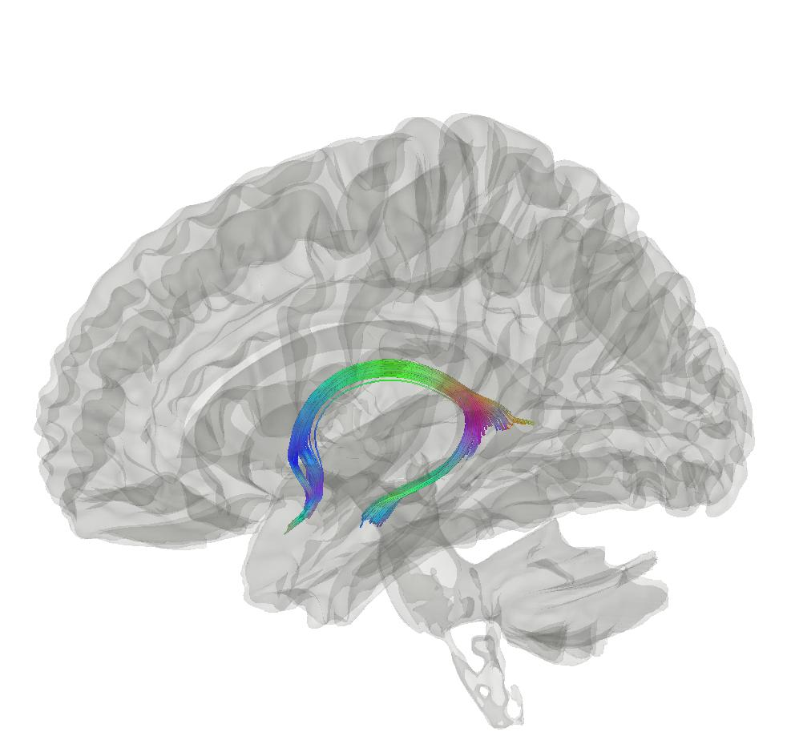


Disease and Ageing Biomarker Identification from multimodal magnetic resonance imaging (DABI)
20.06.2022
Max Korbmacher, PhD Student
Max.korbmacher@hvl.no
Western Norway University of Applied Sciences
Supervisors: Ivan Maximov, Lars Westlye, &
Eli Eikefjord

Slide 2
Presentation Points
Background
Machine Learning for MRI Biomarker Identification: Brain Age
Paper 1: Diffusion MR Brain Age Predictions
  Methods
  Results
Further PhD Plans

Slide 3
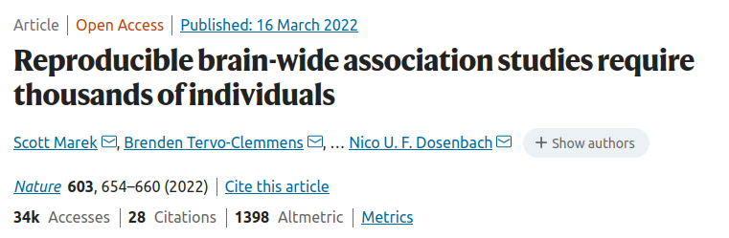
Background
Findings repeatedly show the statistical power is important to produce reproducible neuroimaging findings (in many cases)
The way forward are large sample studies
  Approximate population level inference
  Hence, generalisable

Slide 4
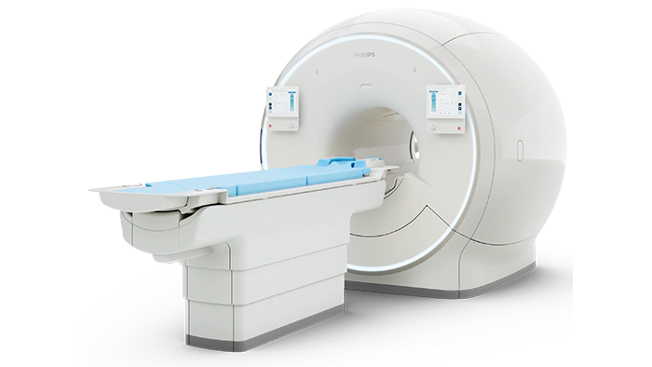
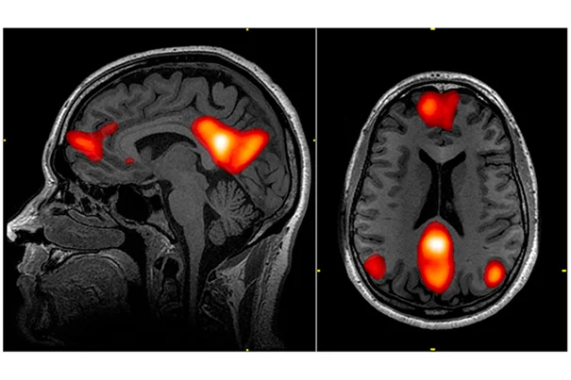
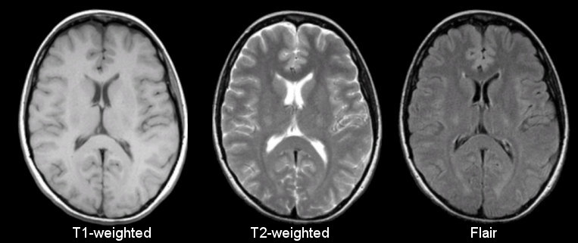
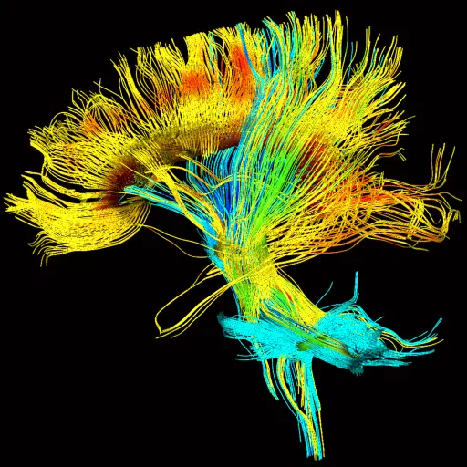
Background
UK Biobank is one example with imaging data from over 40,000 individuals
  Participant problem solved for many structural MRI inquiries
Yet, there is still the problem of interpreting data
  Many metrics, many brain regions
  What to look for?
  How to translate knowledge for clinicians?

Slide 5
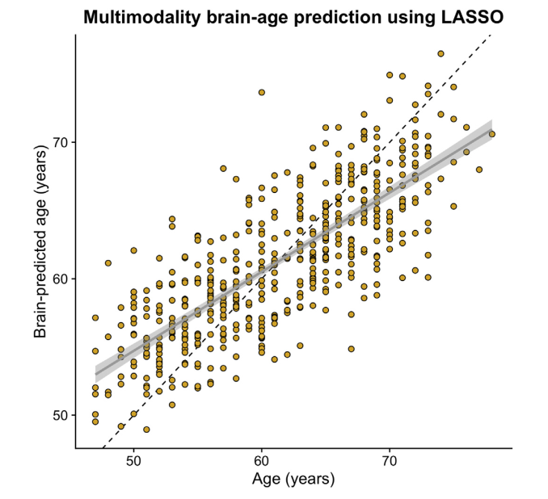
Machine Learning for MRI Biomarker Identification: Brain Age
Proposed solution to interpretability problem: brain age predictions via machine learning [1], [2]
  Allows to predict age from hundreds of variables per participant
  When subtracting chronological from biological/brain age we get a mismatch
  This mismatch is indicative of different disorders [1]
    Still problematic to identify disorders preclinically (neurodegenerative disorders) or at all (pyschiatric)
  Hence, brain age is potentially a useful clinical biomarker
[1] Jonsson et al., 2019, Nat.Com; [2] Kaufmann et al., 2019, Nat.NeuroSci; [3] Cole, 2020, NeurobioAging
Example: Brain age prediction from LASSO regression [3]
r = 0.786, R2 = 0.618, MAE = 3.515

Slide 6
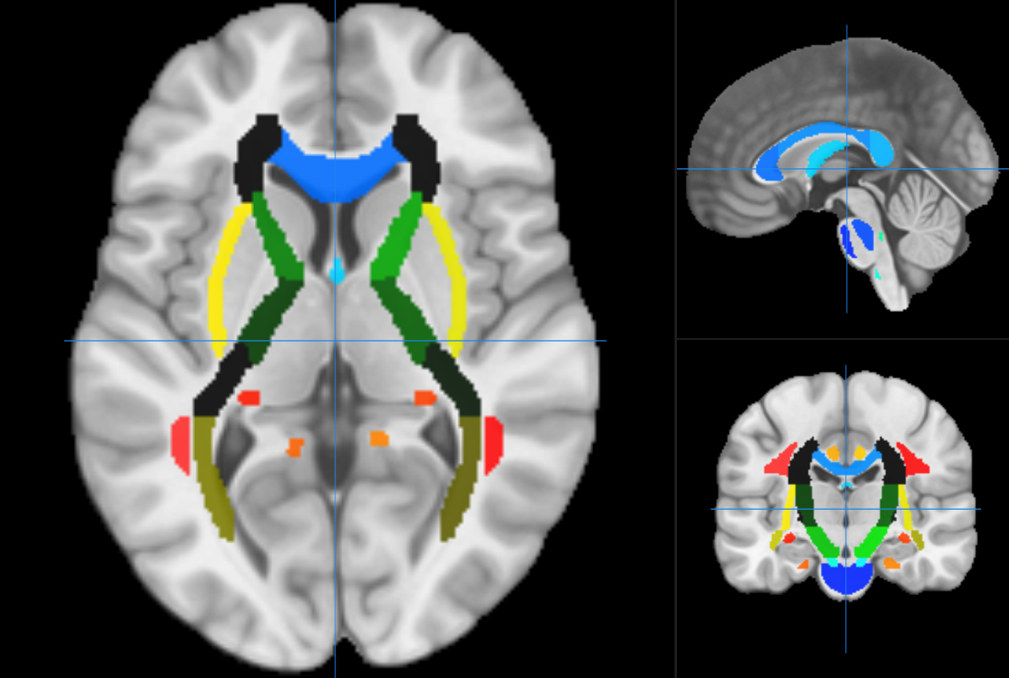
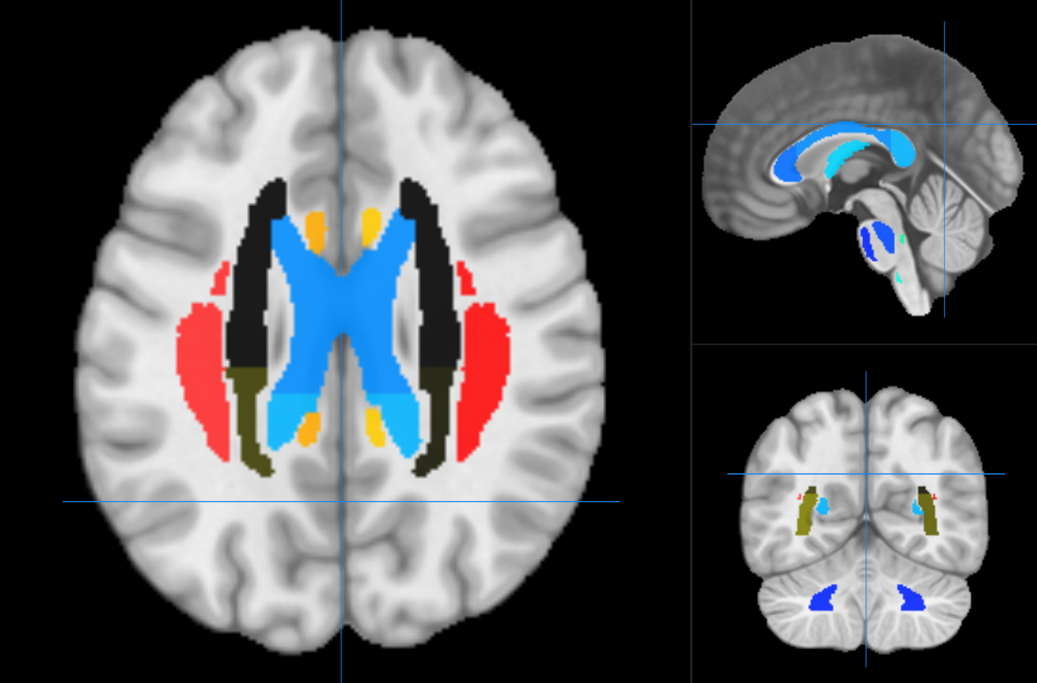
Paper 1: Methods
Six diffusion approaches calculated for JHU atlas
  Diffusion Tensor Imaging (DTI) (4 metrics)
  Diffuson Kurtosis Imaging (DKI) (3 metrics
  Bayesian Rotationally Invariant Approach (BRIA) (10 metr)
  Spherical Mean Technique (SMT) (4 metrics)
  multi-compartment SMT (mcSMT) (4 metrics)
  White Matter Tract Integrity (WMTI) (3 metrics)
28 metrics x (20tracts + 48regions + 1mean)
= 1932 diffusion features
Metrics tell about intra and extra axonal space,
water fraction, fractional anisotropy
All being indicative of white matter characterist.
e.g. fiber dens, axonal diameter, & myelination

Slide 7
Paper 1: Methods
XGBoost to make brain age predictions from the
1932 features
Questions:
1) Are the results from the 7 diffusion
approaches comparable?
2) Which are driving regions of ageing?

Slide 8
Paper 1: Results
Brain Age Prediction Model Performance
Approach | MRI features | R² | RMSE | MAE | Prediction-Age Correlation* | Corrected Prediction-Age Correlation*
BRIA | 690 | 0.550 (0.012) | 5.007 (0.057) | 4.002 (0.042) | 0.742 [0.737, 0.747] | 0.892 [0.889, 0.894]
DKI | 207 | 0.576 (0.015) | 4.958 (0.077) | 3.975 (0.068) | 0.754 [0.755, 0.764] | 0.903 [0.901, 0.905]
DTI | 276 | 0.571 (0.014) | 4.983 (0.072) | 3.984 (0.062) | 0.756 [0.751, 0.761] | 0.900 [0.897, 0.902]
SMT | 276 | 0.531 (0.010) | 5.214 (0.053) | 4.183 (0.036) | 0.729 [0.724, 0.734] | 0.899 [0.897, 0.901]
mcSMT | 276 | 0.519 (0.011) | 5.175 (0.045) | 4.153 (0.036) | 0.721 [0.716, 0.726] | 0.892 [0.889, 0.894]
WMTI | 207 | 0.585 (0.012) | 4.903 (0.065) | 3.928 (0.050) | 0.765 [0.761, 0.770] | 0.902 [0.900, 0.904]
Mean multimodal | 28 | 0.393 (0.012) | 5.932 (0.051) | 4.812 (0.046) | 0.627 [0.621, 0.634] | 0.905 [0.903, 0.907]
Full multimodal | 1932 | 0.645 (0.011) | 4.534 (0.041) | 3.624 (0.037) | 0.804 [0.800, 0.808] | 0.907 [0.905, 0.909]

Slide 9
Paper 1: Results
Brain Age Prediction Model Performance
Approach | MRI features | R² | RMSE | MAE | Prediction-Age Correlation* | Corrected Prediction-Age Correlation*
BRIA | 690 | 0.550 (0.012) | 5.007 (0.057) | 4.002 (0.042) | 0.742 [0.737, 0.747] | 0.892 [0.889, 0.894]
DKI | 207 | 0.576 (0.015) | 4.958 (0.077) | 3.975 (0.068) | 0.754 [0.755, 0.764] | 0.903 [0.901, 0.905]
DTI | 276 | 0.571 (0.014) | 4.983 (0.072) | 3.984 (0.062) | 0.756 [0.751, 0.761] | 0.900 [0.897, 0.902]
SMT | 276 | 0.531 (0.010) | 5.214 (0.053) | 4.183 (0.036) | 0.729 [0.724, 0.734] | 0.899 [0.897, 0.901]
mcSMT | 276 | 0.519 (0.011) | 5.175 (0.045) | 4.153 (0.036) | 0.721 [0.716, 0.726] | 0.892 [0.889, 0.894]
WMTI | 207 | 0.585 (0.012) | 4.903 (0.065) | 3.928 (0.050) | 0.765 [0.761, 0.770] | 0.902 [0.900, 0.904]
Mean multimodal | 28 | 0.393 (0.012) | 5.932 (0.051) | 4.812 (0.046) | 0.627 [0.621, 0.634] | 0.905 [0.903, 0.907]
Full multimodal | 1932 | 0.645 (0.011) | 4.534 (0.041) | 3.624 (0.037) | 0.804 [0.800, 0.808] | 0.907 [0.905, 0.909]

Slide 10
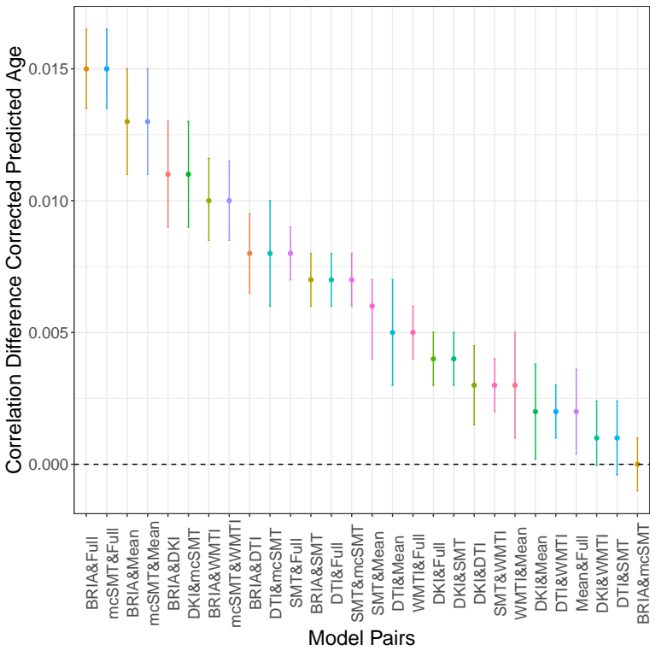
Differences between correlations of chronological and corrected predicted age across diffusion approaches with 95% confidence interval
Brain Age Prediction Model Performance
Approach | MRI features | R² | RMSE | MAE | Prediction-Age Correlation* | Corrected Prediction-Age Correlation*
BRIA | 690 | 0.550 (0.012) | 5.007 (0.057) | 4.002 (0.042) | 0.742 [0.737, 0.747] | 0.892 [0.889, 0.894]
DKI | 207 | 0.576 (0.015) | 4.958 (0.077) | 3.975 (0.068) | 0.754 [0.755, 0.764] | 0.903 [0.901, 0.905]
DTI | 276 | 0.571 (0.014) | 4.983 (0.072) | 3.984 (0.062) | 0.756 [0.751, 0.761] | 0.900 [0.897, 0.902]
SMT | 276 | 0.531 (0.010) | 5.214 (0.053) | 4.183 (0.036) | 0.729 [0.724, 0.734] | 0.899 [0.897, 0.901]
mcSMT | 276 | 0.519 (0.011) | 5.175 (0.045) | 4.153 (0.036) | 0.721 [0.716, 0.726] | 0.892 [0.889, 0.894]
WMTI | 207 | 0.585 (0.012) | 4.903 (0.065) | 3.928 (0.050) | 0.765 [0.761, 0.770] | 0.902 [0.900, 0.904]
Mean multimodal | 28 | 0.393 (0.012) | 5.932 (0.051) | 4.812 (0.046) | 0.627 [0.621, 0.634] | 0.905 [0.903, 0.907]
Full multimodal | 1932 | 0.645 (0.011) | 4.534 (0.041) | 3.624 (0.037) | 0.804 [0.800, 0.808] | 0.907 [0.905, 0.909]

Slide 11
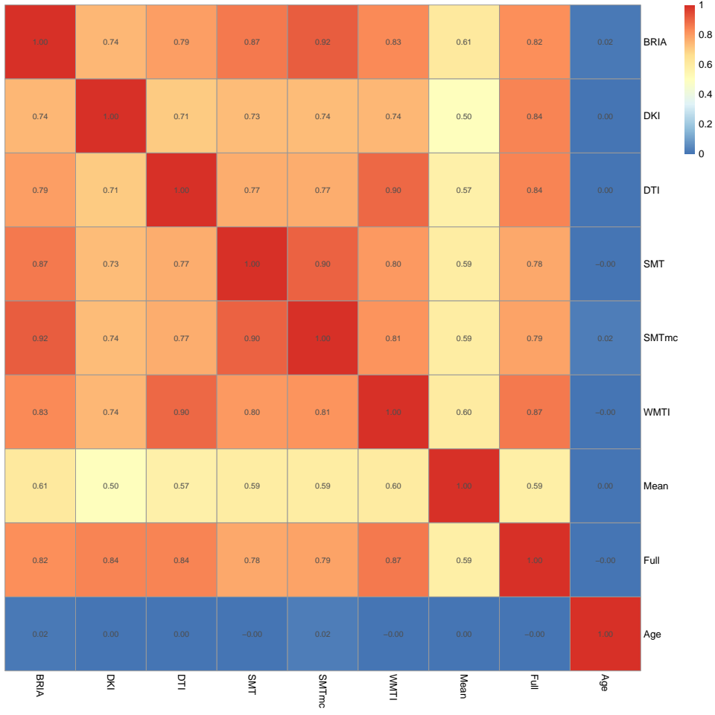
Paper 1: Results
Correlations of corrected BAG and age across diffusion approaches
What we didn’t see in the table was the brain age gap (BAG)
Main message: BAG strongly related across models but not with age (correction worked)

Slide 12
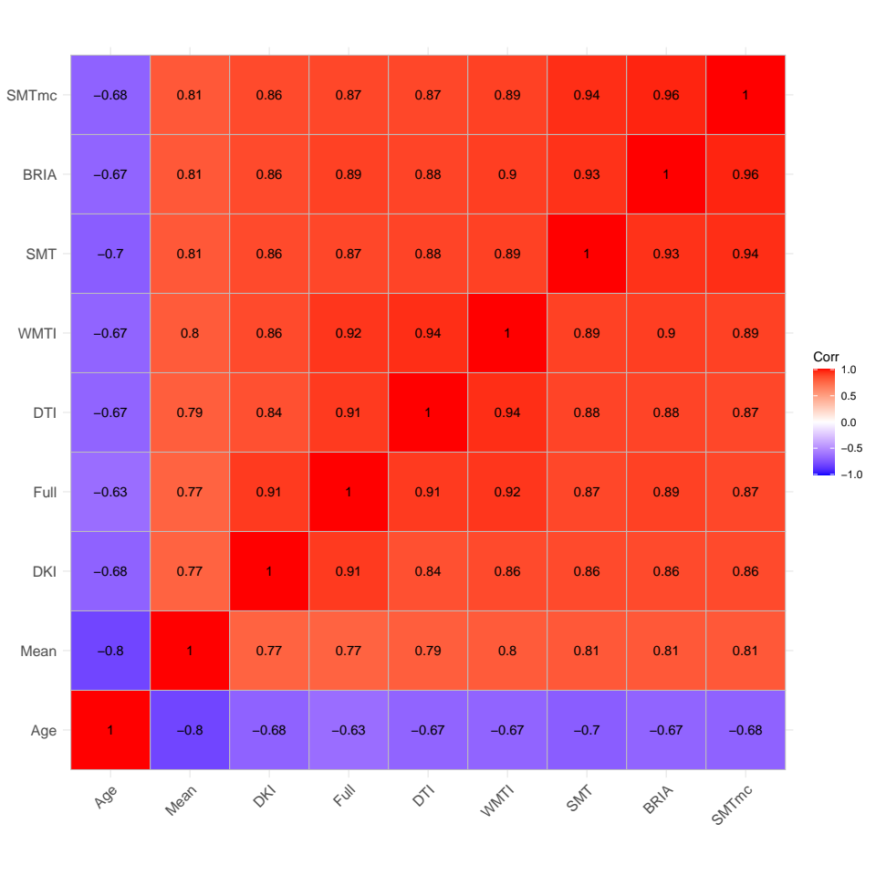
Paper 1: Results
Correlations of corrected BAG and age across diffusion approaches
Just to show, the relationships are stronger when not correcting for age-bias
Message stays the same: models including dMRI features from different models seem to predict age similarly
That is also reflected in BAG, which is ultimately the utilized metric in many studies / the biomarker(?)

Slide 13
Paper 1: Results
Questions:
1) Are the results from the 7 diffusion
approaches comparable?
2) Which are driving regions of ageing?

Slide 14
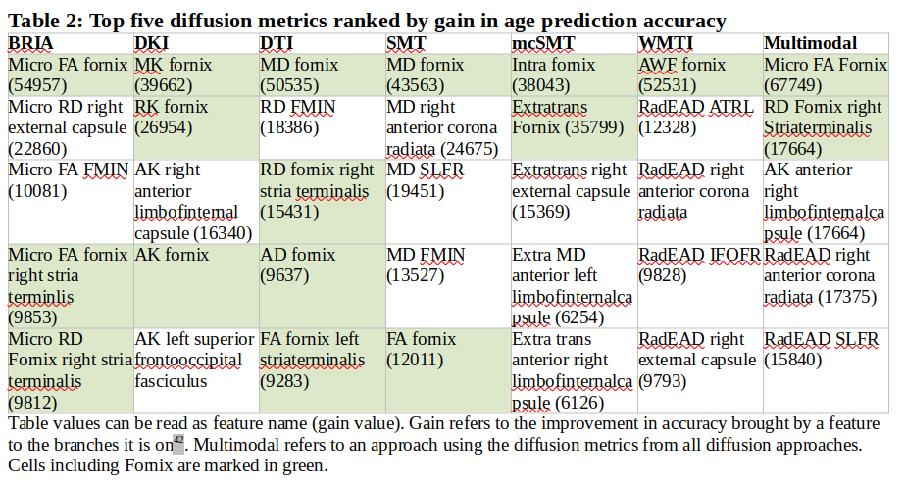
Paper 1: Results
XGBoost to make brain age predictions from the
1932 features
Questions:
1) Which are driving regions of ageing?
2) Are the results from the 7 diffusion
approaches comparable?

Slide 15
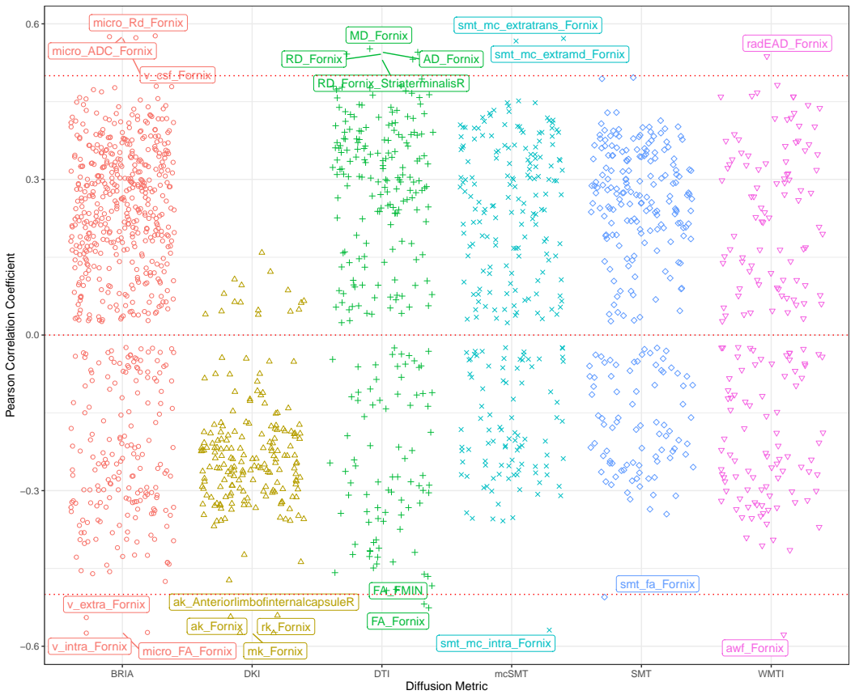
Paper 1:
Results
Correlations between diffusion metrics and chronological age
Correlation strengths reflect feature importance (gain) for the different diffusion models
Fornix as the dominant region across metrics

Slide 16
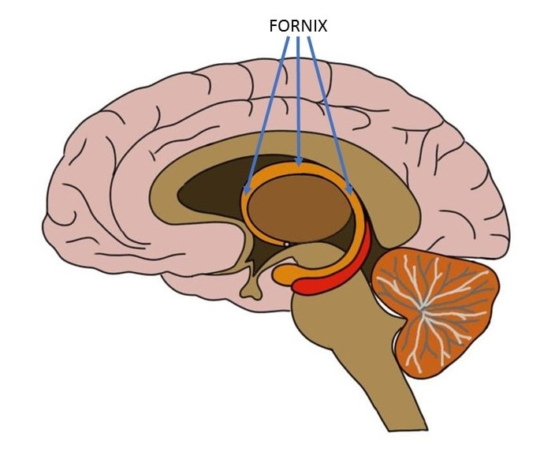
Paper 1:
Results
Correlations between diffusion metrics and chronological age
Correlation strengths reflect feature importance (gain) for the different diffusion models
Fornix as the dominant region across metrics

Slide 17

Paper 1: Results
Changes in Fornix throughout ageing?
Fornix = hippocampal output tract, part of limbic system
Cutting it causes recall memory problems
Close to hippocampus which has strong association with ageing, age-disorders and cognition (esp. memory)
Previously associated with resting state activity in 10,000 UKB participants [1]
Is the fornix an integral part of brain networks?
[1] Kernbach et al., 2018, PNAS

Slide 18
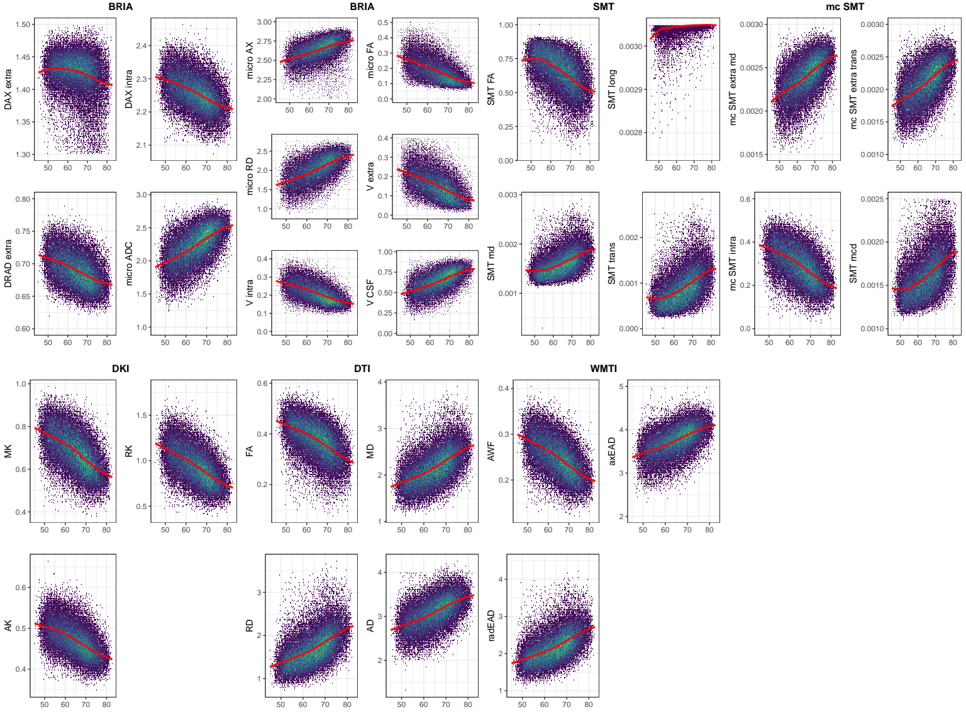
Paper 1:
Results
At a closer look at the 28 metrics we see that they are all age sensitive
We tested this comparing models:
  Metric ~ Age + Age² + Site*Sex + Sex*Age + Sex + Site
  Metric ~ Site*Sex + Sex + Site
Models including age were better at predicting metrics
Figure: Fornix diffusion features across age

Slide 19
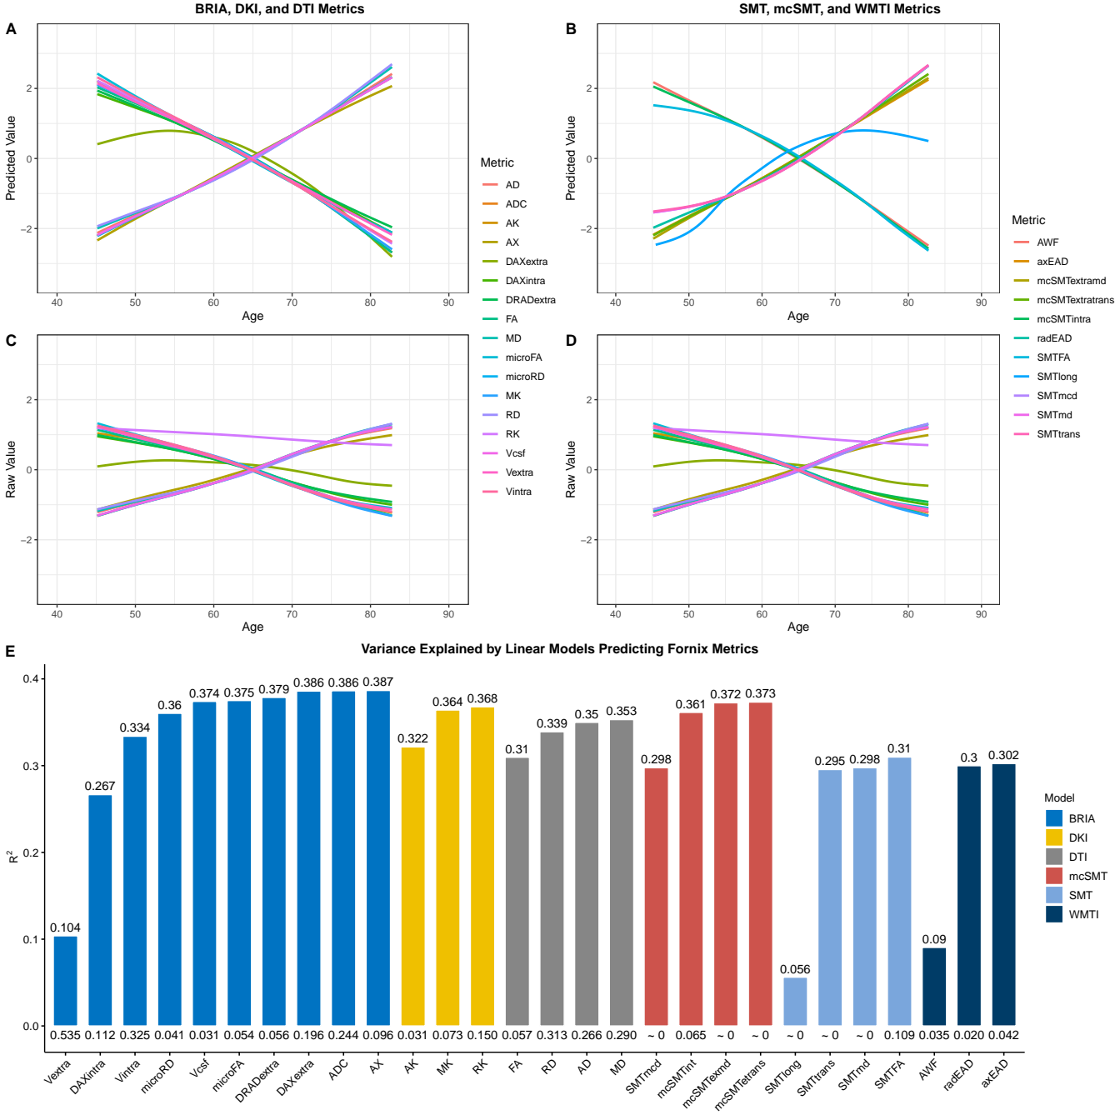
Paper 1: Results
Z-values plotted
  A-B accounting for sex, age, site
  C-D raw Z-scored scores
Bar chart: R² and SE for A-B
  Fairly consistent across metrics
Is the relationship between age and WM largely linear from age 40?
  Answer: yes, when comparing models
But what happens at age 65?
  Somewhat a function of distribution of agemean=65.46 / agemedian=64.97?
Figure: Raw and predicted fornix diffusion metrics by chronological age

Slide 20
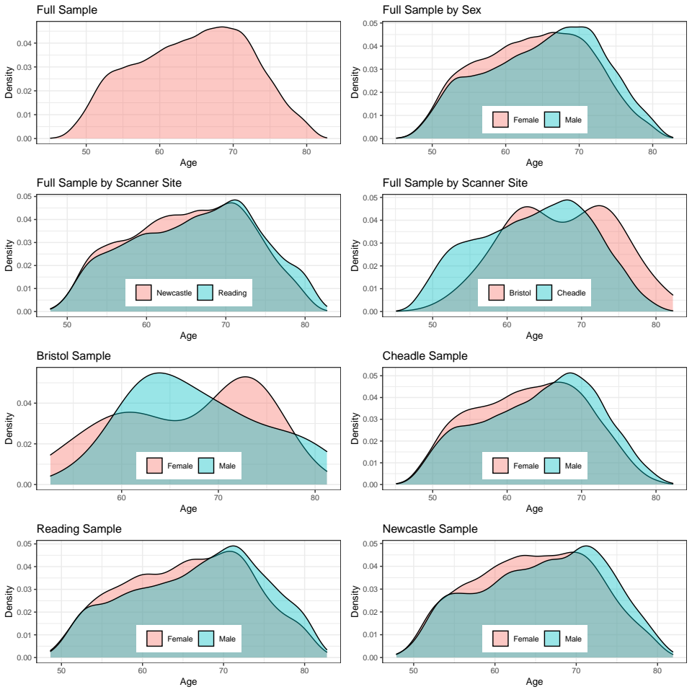
Paper 1: Results
But what happens at age 65?
  Somewhat a function of distribution of agemean=65.46 / agemedian= 64.97?
Figure: Density plots for the sample’s age by sex and scanner site

Slide 21
Paper 1: Results
But what happens at age 65?
  Somewhat a function of distribution of agemean=65.46 / agemedian= 64.97?
  Do nearly all metrics behave the same because the average for each metric lays at age 65 (and trajectories are near-linear)?
What do these results mean?
  Diffusion approaches age-sensitive in a comparable fashion
  Measure similar phenomenon
  But: redundancy of metrics?
Figure: Raw and predicted fornix diffusion metrics by chronological age

Slide 22
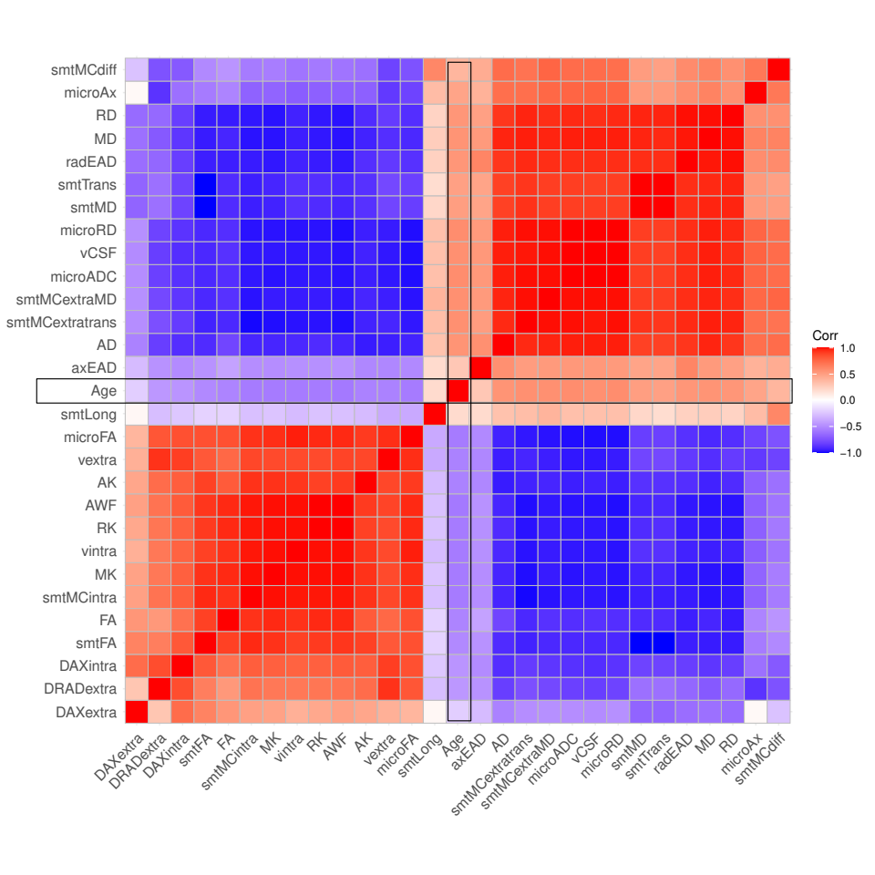
Paper 1: Results
What do these results mean?
  Diffusion approaches age-sensitive in a comparable fashion
  Measure similar phenomenon
  But: redundancy of metrics?
Figure: Correlation matrix for fornix diffusion metrics and chronological age

Slide 23
Further PhD Plans
Group differences and phenotype associations with BAG
Compare brain age predictions from grey matter and white matter
Predict blood pressure from brain structure
Investigations years 2-4:
  Laterality effects
  Irritable Bowel Syndrome predictions (classifications or brain age predictions)
  Combining (structural and functional) modalities: deep learning assessment of driving regions of brain ageing
  Finally: diffusion MR or multimodally predicted BAG relationships with psychiatric and brain disorders

Slide 24
Comments or Questions?

Slide 25

Thank you!

Slide 26






Contact
Email: Max.korbmacher@hvl.no

Slide 27
Comparisons of linear and generalized additive models predicting fornix features
Metric | LM AIC | GAM AIC | LM BIC | GAM BIC | LM R²_{adj} | GAM R²_{adj}
vintra | -126767.79 | -126755.60 | -126665.98 | -126662.27 | 0.36 | 0.36
vextra | -106952.81 | -106929.99 | -106851.00 | -106836.66 | 0.38 | 0.37
vCSF | -65781.67 | -65773.53 | -65679.86 | -65680.20 | 0.39 | 0.39
microRD | 633.36 | 643.11 | 735.18 | 736.43 | 0.39 | 0.39
microFA | -104706.06 | -104634.30 | -104604.25 | -104540.97 | 0.38 | 0.38
microAx | -54814.08 | -54790.59 | -54712.27 | -54697.26 | 0.27 | 0.27
microADC | -14954.91 | -14946.59 | -14853.10 | -14853.26 | 0.39 | 0.39
DRADextra | -177654.37 | -177648.58 | -177552.56 | -177555.25 | 0.30 | 0.30
DAXintra | -125641.12 | -125639.53 | -125539.31 | -125546.20 | 0.30 | 0.30
DAXextra | -138873.67 | -138808.20 | -138771.86 | -138714.87 | 0.09 | 0.09
RK | -34108.48 | -34109.41 | -34006.67 | -34016.08 | 0.37 | 0.37
AK | -146039.18 | -146041.08 | -145937.37 | -145947.75 | 0.32 | 0.32
MK | -85601.85 | -85603.57 | -85500.04 | -85510.24 | 0.36 | 0.36
FA | -103953.22 | -103924.62 | -103851.41 | -103831.30 | 0.31 | 0.31
MD | 12874.23 | 12878.93 | 12976.04 | 12972.25 | 0.35 | 0.35
RD | 18339.73 | 18359.69 | 18441.54 | 18453.02 | 0.34 | 0.34
AD | 6684.86 | 6689.75 | 6786.67 | 6783.08 | 0.35 | 0.35
smtFA | -57196.69 | -57161.31 | -57094.88 | -57067.98 | 0.31 | 0.31
smtLong | -686016.98 | -685869.48 | -685915.17 | -685776.15 | 0.06 | 0.05
smtMD | -507904.58 | -507869.45 | -507802.77 | -507776.13 | 0.30 | 0.30
smtTrans | -479144.23 | -479104.60 | -479042.42 | -479011.28 | 0.30 | 0.29
smtMCintra | -93427.21 | -93427.11 | -93325.40 | -93333.78 | 0.36 | 0.36
smtMCextraMD | -521137.14 | -521125.59 | -521035.33 | -521032.26 | 0.37 | 0.37
smtMCextratrans | -499929.78 | -499929.66 | -499827.97 | -499836.34 | 0.37 | 0.37
smtMCdiff | -575225.03 | -574996.85 | -575123.22 | -574903.53 | 0.22 | 0.21
AWF | -145979.93 | -145981.86 | -145878.11 | -145888.53 | 0.37 | 0.37
axEAD | 56711.05 | 56715.91 | 56812.86 | 56809.24 | 0.10 | 0.10
radEAD | 21189.85 | 21203.80 | 21291.67 | 21297.12 | 0.33 | 0.33
Even when allowing for splines, non-linear fit was not better than linear fit.

Slide 28
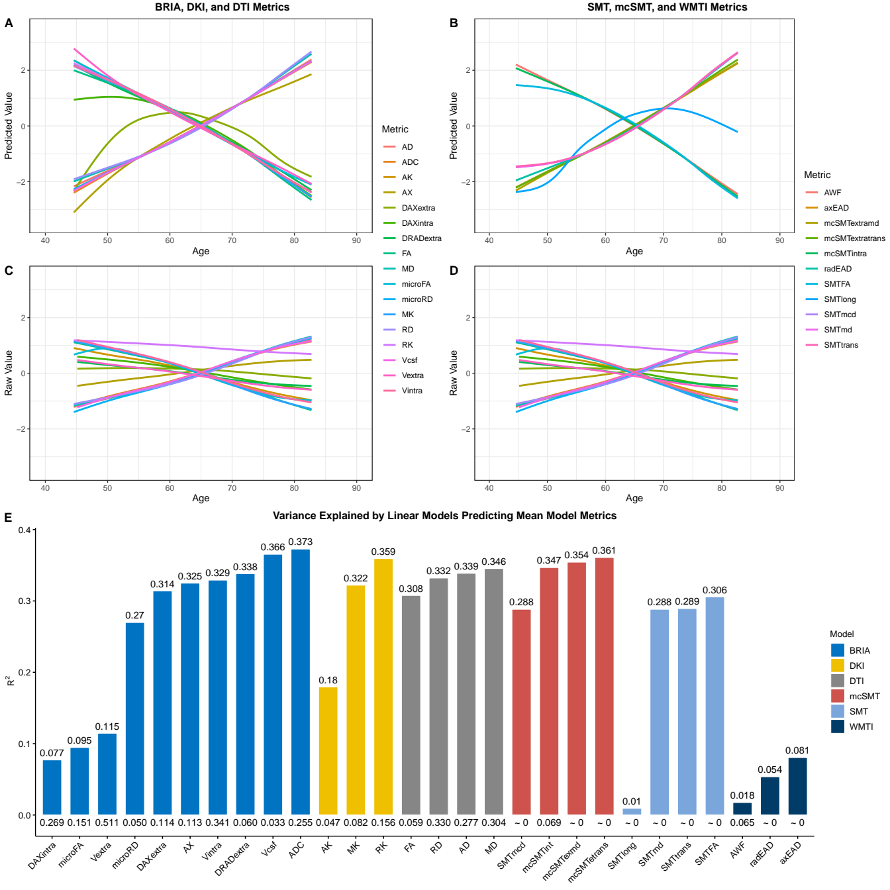
Raw and predicted MEAN skeleton diffusion metrics by chronological age
Slightly different curves from fornix scores, but largely overlapping
Age 65 crossing appears the same way

Slide 29
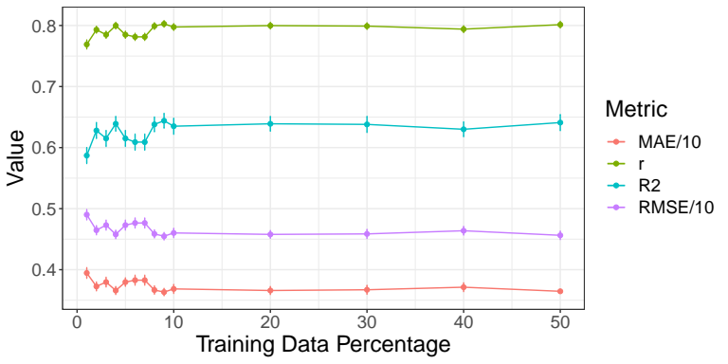
Paper 1: Methods
Model performance for different train-test splits using all data (1932 features, n = 35,749)
Trained models tested (10-fold cross val) on 50% data (opposite half of the highest train split) >> Train-test split fixed at 10%-90%

Slide 30
Paper 1: Methods
Questions:
1) Are the results from the 7 diffusion
approaches comparable?
2) Which are driving regions of ageing?
Approach
BRIA
DKI
DTI
SMT
mcSMT
WMTI
Mean multimodal
Full multimodal

