Slide 1
Repetitive Research: Who and what is it good for?
Max Korbmacher
Haukeland University Hospital

Slide 2
Outline
Background
Why should we do repetitive research?
What are we talking about when saying repetitive research?
What is it good for?
Who does this apply to?

Slide 3

Background: why repeating?
28 November 1660: the Royal Society is formed
Their motto: Nullius in verba (Take nobody’s word for it)
Notes:
The oldest scientific society in the world is the Royal Society, which was formed in 1660
Their motto, which is also the title of a nice podcast, is nullius in verba = take nobody’s word for it
Here you can already see that double checking oneself and others is an early idea in science
And how to double check: well, repeating what has been done is a very good approach

Slide 4
Background: why repeating?
The backbones of our philosophy of science are supported by repetetive research:
Epistemic reliability
Notes:
We can also look at the ideas of the most influential philosophers of science of the last century.
While the tools of double checking have changed, new methods have been developed, also the philosophy of science has evolved, the importance of checking or repeating remains unchallenged.
Let me give you some examples:
Epistemic Reliability introduced by Alvin Goldman (1979)
Refers to the degree to which scientific methods and results can be trusted
Replications and reproductions are essential for verifying the reliability of scientific findings.
They help ensure that results are not due to chance or specific conditions of a single study

Slide 5
Background: why repeating?
The backbones of our philosophy of science are supported by repetetive research:
Epistemic reliability
Falsifiability
Popper (1959) in The Logic of Scientific Discovery:
We do not take even our own observations quite seriously, or accept them as scientific observations, until we have repeated and tested them. Only by such repetitions can we convince ourselves that we are not dealing with a mere isolated ‘coincidence,' but with events which, on account of their regularity and reproducibility, are in principle inter-subjectively testable.
Notes:
Falsifiability was proposed by Karl Popper (1934)
The concept reflected in null-hypothesis testing introduced by Fisher Neyman, and Pearson
the ability to replicate experiments is a key aspect of falsifiability, also if repetitions were previously perhaps rather understood as not fooling oneself
Still, falsifiability also means that if a study's results cannot be replicated, it may indicate that a theory is not robust
The self-checking notion comes nicely through from a quote from The Logic of Scientific Discovery from 1959:
We do not take even our own observations quite seriously, or accept them as scientific observations, until we have repeated and tested them. Only by such repetitions can we convince ourselves that we are not dealing with a mere isolated ‘coincidence,' but with events which, on account of their regularity and reproducibility, are in principle inter-subjectively testable.

Slide 6
Background: why repeating?
The backbones of our philosophy of science are supported by repetetive research:
Epistemic reliability
Falsifiability
Paradigm shifts
Notes:
Now, to conclude with the real scientific advances, we can look at paradigm shifts introduced by Thomas Kuhn
Paradigm shifts:
Paradigm shifts involve the accumulation of anomalies that cannot be resolved within the current paradigm.
Replications can highlight these anomalies and contribute to theory construction and deconstruction.
Particularly in the face of ridicules findings which are very difficult to believe such as precognition, the ability of people to predict the future, double checking becomes crucial
Such ridiculous findings, following multi-lab replication attempts, and what we now call the replication crisis might be exactly what leads towards a paradigm shift

Slide 7
Background: why repeating?
The backbones of our philosophy of science are supported by repetetive research:
Epistemic reliability
Falsifiability
Paradigm shifts
More practically: Study findings are influenced by many factors beyond the true underlying effect.
Notes:
More practically that would mean that study findings are usually influenced by many different factors
Statistically: error rates i.e. true and false negative and positives
Measurement error and reliability
Validity of the study
Bias
With so many sources of error, it appears rather logical to repeat and replicate than simply believing whatever and moving on
Especially if we want to build upon the work of others, i.e. stand on shoulders of giants or have a cumulative science

Slide 8
Background: why repeating?
Why repeating? Or rather why not?
Notes:
In other words, the question should not be “why repeating?” but rather “why not?”
Whether it is your own or other’s science, the intuition would be, if it can be repeated, we can trust it more.

Slide 9
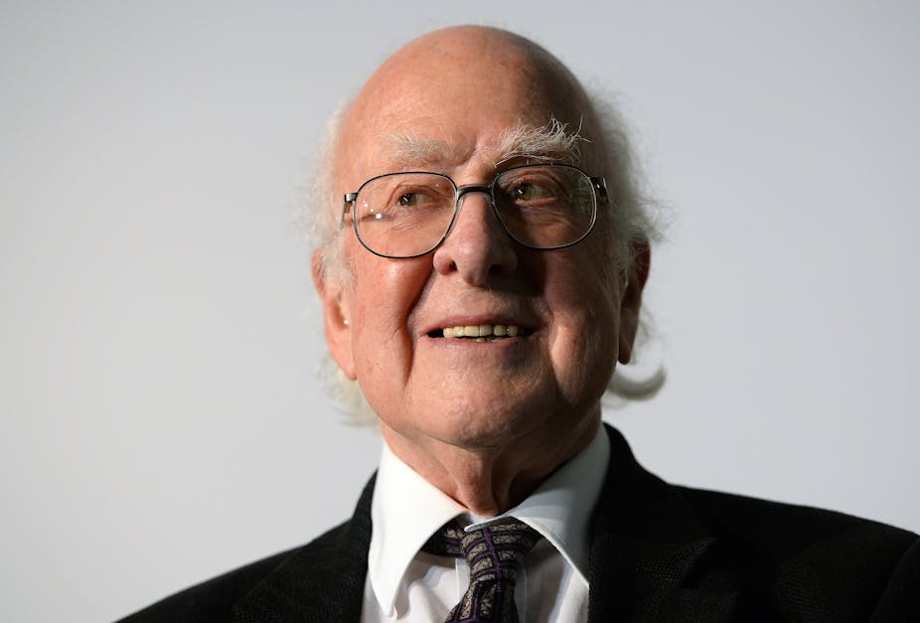
Background: why repeating?
p<0.00000029
Peter Higgs (source: Andy Rain/EPA Images)
Notes:
In some fields, it is however very difficult or expensive and thereby not feasible to repeat experiments
For example, in particle physics, and you see down here Peter Higgs, known for the Higgs Boson, the standards for calling something a true positive are stricter.
In other fields, it is easy to repeat studies, and the alpha level is set at a conventional 0.05.
And in many subfields physics, findings are only accepted when being repeated.

Slide 10
“Repetition is not redundancy”
A quote from many people (among others, my office co-inhabitant)

Slide 11
Background: types of repetitive research
Reproduction: repeating research re-using data
Replication: repeating research by collecting new data
Direct or close replication
Conceptual replication
Notes:
Before talking more about repetitive research…
Let us define what we are talking about when saying repetitive research
There are many different terms used, but I will treat them below two ubrella terms: reproductions and replications
Reproductions refer to repeating a study by using the data that are already available
For example re-analysing the data with the same or different code
One could also add additional data or change methods (possible term: reinvestigation)
Replication: sampling new data but attempting to examine the same phenomenon
One can attempt to do this as close as possible to the original finding
Or come up with a study using similar methods and examining the same or similar phenomena
The vagueness of my definitions lets you guess already that there is not necessary consensus about how to define replications

Slide 12
What is repitition good for?
Checking the existing
Building something new
Notes:
What are replications good for?
What are reproductions good for?
Many examples…
Many labs, many analysts, … science itself
This talk explores different forms of repetitive research, its value across scientific disciplines, highlighting who benefits from it, and how it can drive innovation rather than hinder it. Embracing repetitive research can improve scientific credibility, support early-career researchers, and foster a more open and collaborative research culture.

Slide 13
Who is repitition good for?
…
Notes:
Problematise early career researchers
Highlight big team science
Show some examples where it went wrong
Good for science at large

Slide 14
“Repetition is not redundancy”
A quote from many people (among others, my office co-inhabitant)
Did I mention this earlier?

