Slide 1


BrainAge: Suggestions for what it is and how to use it.
Max Korbmacher, PhD
Haukeland University Hospital Bergen, Norway
Western Norway University of Applied Sciences

Slide 2
What I want to talk about today
What BrainAge is.
(Or why it is not what most people think it is.)
Is BrainAge useful?
Where to go from here?

Slide 3
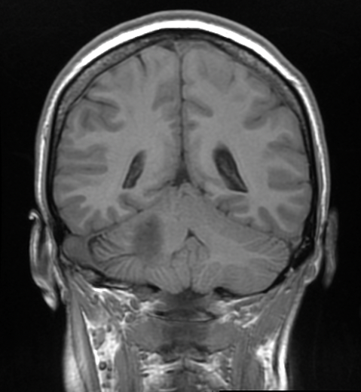
BrainAge?
1) Model training
Training model
Prediction of age with that model = brain age
Differences between (brain) age and chronological age = a marker of something
Individuals of different ages
Trained model
2) Predictions
Model applied to individual data
Brain age:
27 years old
Example individual.
Chronological age:
22 years
Difference / Brain age gap: 5 years
Notes:
Let’s start with what BrainAge is.
One can cook it down to a three step process:
Training a model
Predicting on new data
Using the predictions to estimate individual level prediction errors, also called brain age gap, brain age delta, brain predicted age gap, etc.

Slide 4
BrainAge gap = prediction error
Notes:
Let’s dial back before we start talking about biomarkers and use a more sober definition of BrainAge:
BrainAge is the expected age of an individual based on their data.
The expectations originates from a model which depends on data.
Data depends on assumptions about anatomical, and biophysical plausibility.
Assuming that we get it right and that we have a perfect understanding of how any brain should look at any point in time in their lifes, looking at prediction errors might be a great biomarker of everything. But you might see the limitations already.

Slide 5
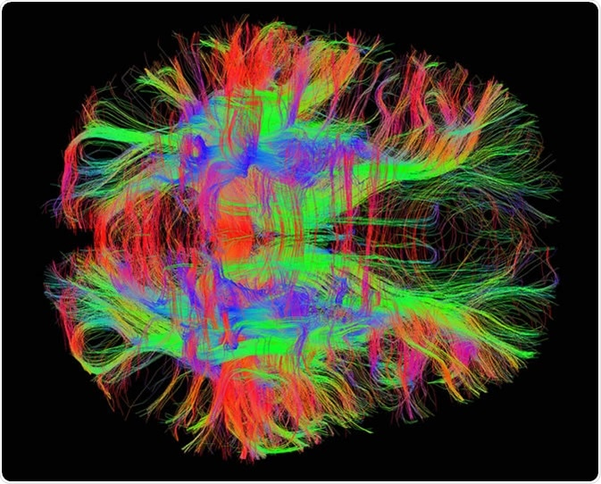
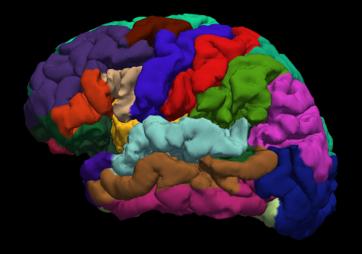
The most common way of training BrainAge models
Notes:
The way of how models are trained is of course important and provide different biological meaning.
Let’s give some examples:
Do we look at contrasts from T1w images? Here we will only see different shades of black and white. We can see hyperintensities and can differentiate white from grey matter, etc.
We can also process data using biophysical models to extract information not visible to the bare eye, e.g. using tractography.
We can also reduce the dimensionality of the data into a table by parcellating and extracting some metric of interest
The different types of data allow for different machine learning types
The general rule:
images allow for deep learning, most commonly CNNs
Tables are better using traditional machine learning, like random trees, tree boosting, or even simple regression

Slide 6
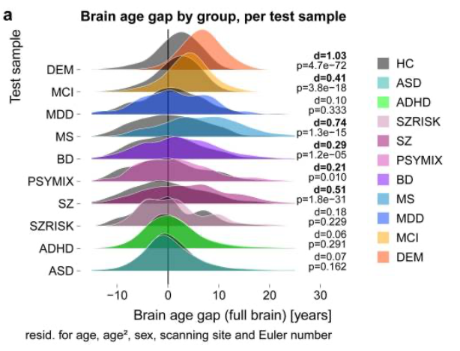
The promise of BrainAge
Kaufmann et al., 2019, Nat. Neur.
Notes:
Anyways, let’s ignore all concerns and technical stuff and apply BrainAge.
Why is this prediction error interesting??
Differences in BrainAge between HC and disorders
Especially for those disorders which cause strong anatomical changes
Or with other words: Largest differences where brain is most affected, i.e. atrophy, yet unspecific
Can it be a prognostic and diagnostic marker?
Is BrainAge a generalisable marker?

Slide 7
BrainAge ≠ ageing
Notes:
Most BrainAge papers jump from the cross-sectional concept to longitudinal assumptions of ageing effect.
Not in their statistical testing, but in the semantics in the papers.
This is unlucky and likely a confusion due to the naming of the concept.
To my current knowledge, there is no evidence supporting the claim for the most common way of modelling being using all the available features.
All the available features means whatever processing stream you use, you use all the data you get. Be it all regions, voxels, tracts or whatever.

Slide 8
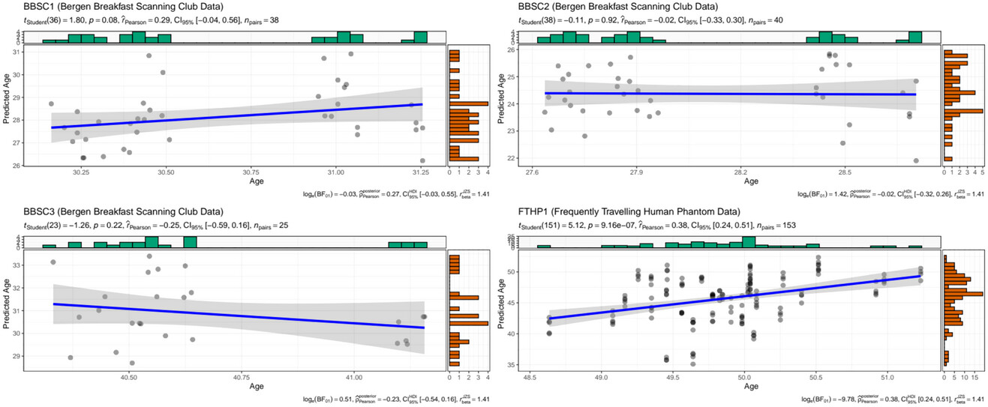
BrainAge≠Ageing: individual-level longitudinal validation
Can the currently “best” brain age model reliably predict on the individual level? [Short answer: No.]
Why?
Group-level penalisation during training
Covariates
etc
Brain age predicted over time in 4 indivduals
Korbmacher et al., 2023, Brain & Beh.
Notes:
Machine learning relies on model metrics: RMSE, MAE, R, R^2
These are group-level values.
However, we are interested in individual-level predictions
Rigerous model testing involves validations in longitudinal data
Our data show that the state-of-the-art brain age model pyment does not withstand the test
Pyment was trained on 50,000 T1w minimally processed datasets and is a CNN
We need different training strategies or more robust models (e.g., underfitting or physics-informed models)
Another problem: covariates

Slide 9
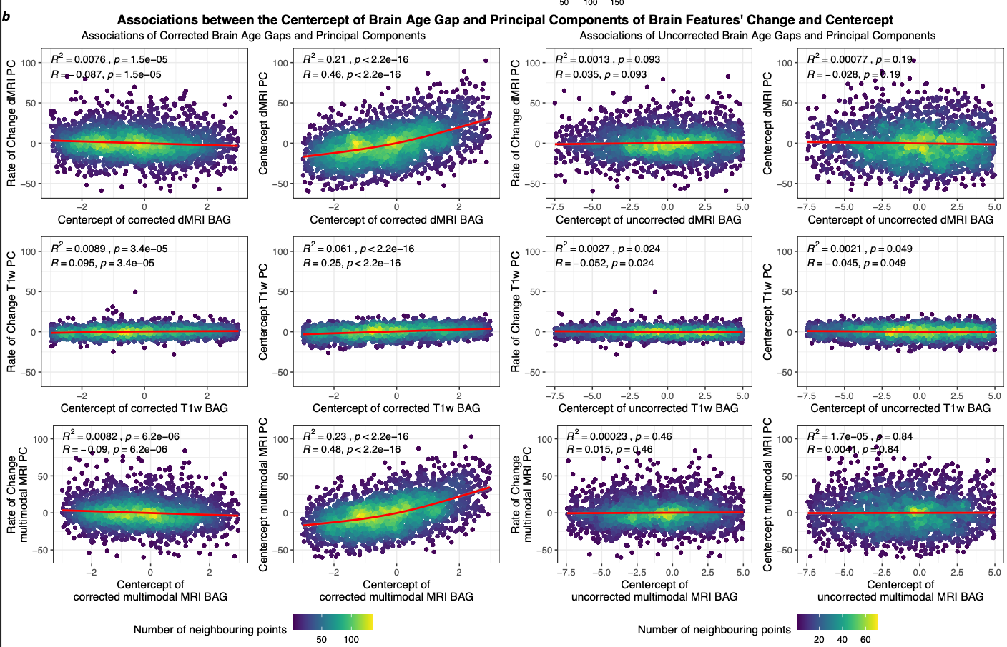
BrainAge≠Ageing: group-level longitudinal validation
LONGITUDINAL
CROSS-SECTIONAL
2,520 longitudinal datasets from the UK Biobank, inter-scan interval = 1.12-6.90 years, M = 2.45 years
Fig.: BrainAge reflects the state rather than change of the brain
Korbmacher et al., 2025, Human Brain Mapping
Notes:
Let’s take two different perspectives:
Participants: more participants, but less data per individual (37k training, 2.5k test)
Data processing: biophysical models to extract data from raw
While we see that brain age associates with age on the group level, NOT THE INDIVIDUAL LVL AS WE JUST SAW, it is unclear whether it reflects brain ageing
How did we do it? In simple terms:
Estimating principal components of brain features and brain ages
Correlate them
Result:

Slide 10
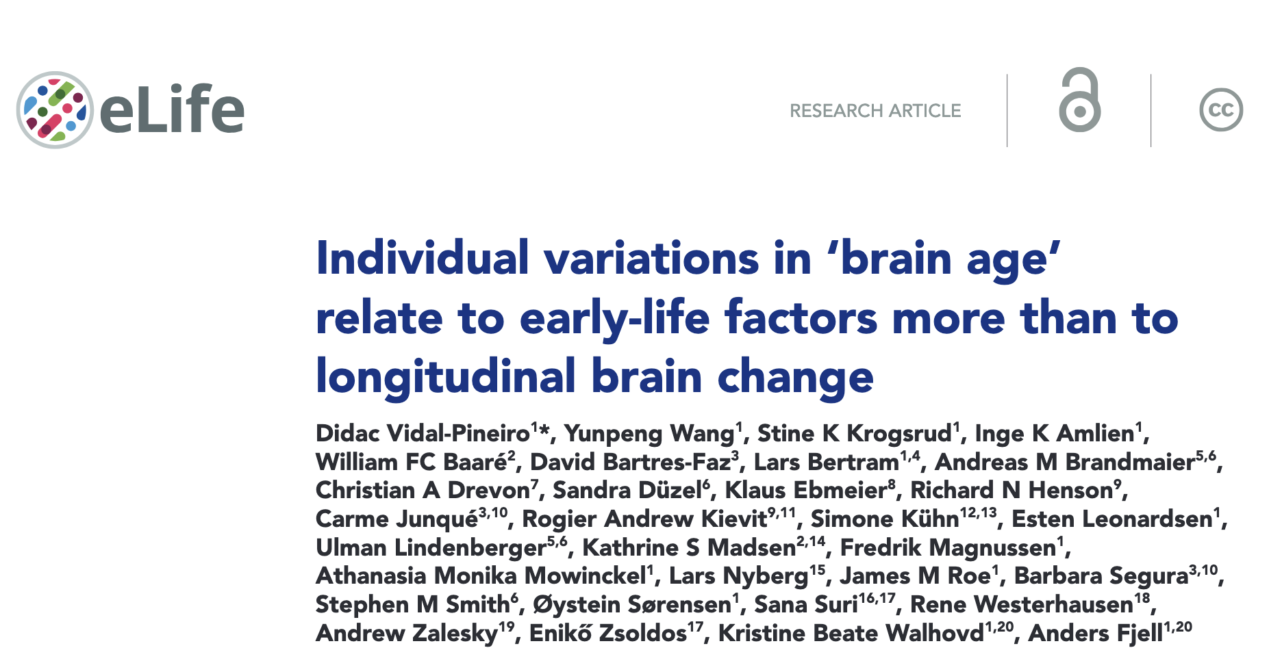

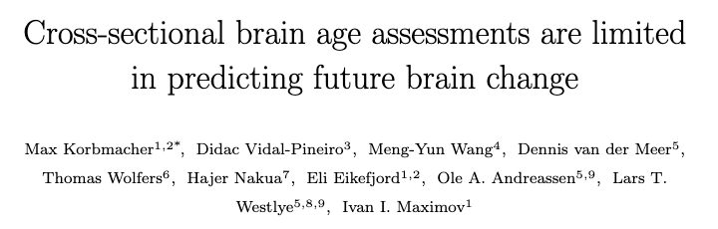
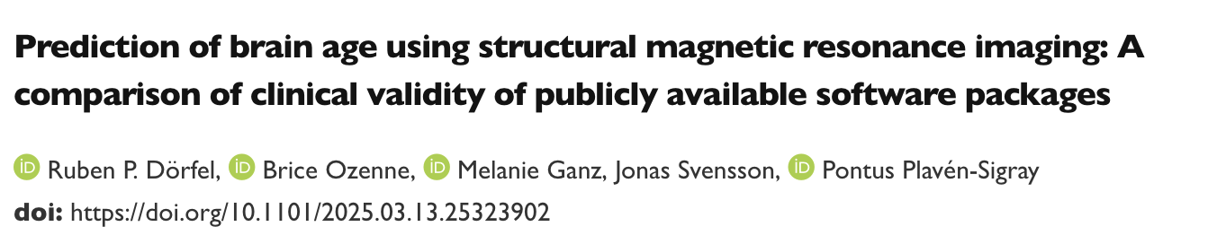
BrainAge≠Ageing: group-level longitudinal validation in other studies
Notes:
There are two other studies I am aware using different cohorts and algorithms coming to the same conclusions.

Slide 11
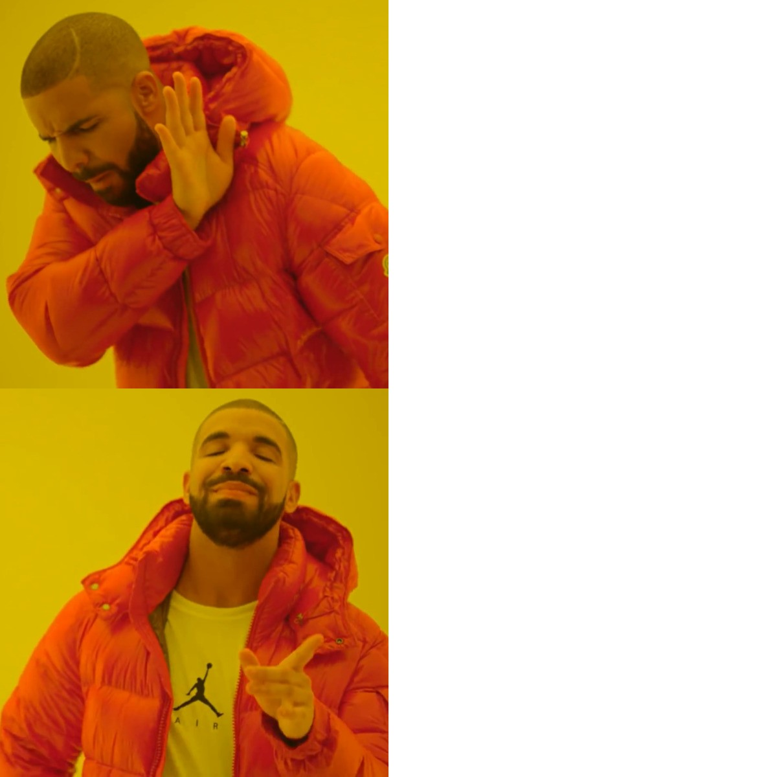
BrainAge reflects ageing processes
BrainAge reflects the state of the brain
Notes:
So, if you want to use the available brain age algorithms, use them to learn something about brain states, not brain ageing.
BUT! There are a few things to do!

Slide 12
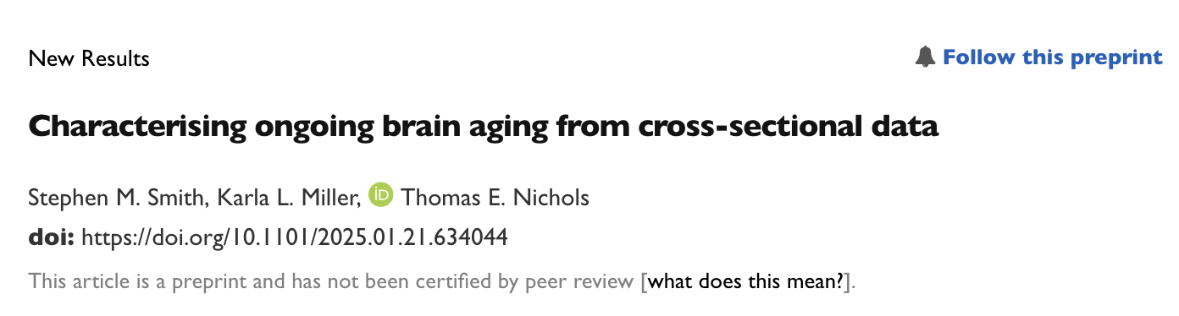
How to make BrainAge sensitive to longitudinal processess?
According to Smith, Miller & Nichols, one needs to figure out clusters of multimodal phenotypes which disperse
E.g., white matter in some tracts + cardiometabolics + certain genotypes might be useful to predict
Notes:
According to Smith, Miller & Nichols, one needs to figure out clusters of multimodal phenotypes which disperse
E.g., white matter in some tracts + cardiometabolics + certain genotypes might be useful to predict
But this needs to be actually implemented in other samples than the UK Biobank which was used here
Yet, the approach in itself is promising also from another perspective: transfer learning

Slide 13
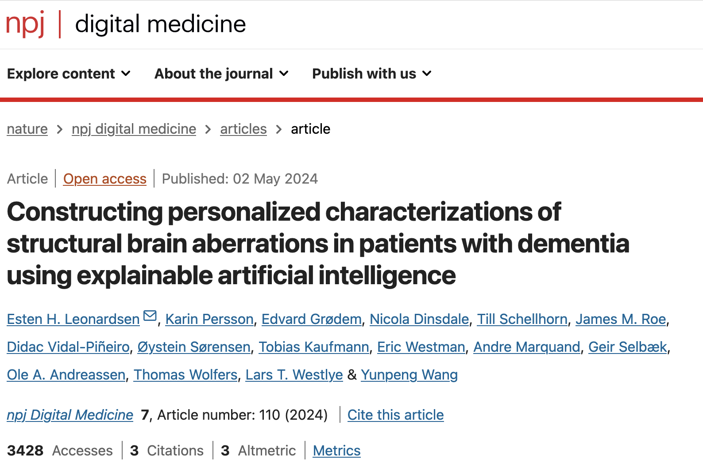
Transfer learning using brain age
Notes:
Here is an example where pyment was used as a starting point to train a new algorith based on longitudinal data

Slide 14
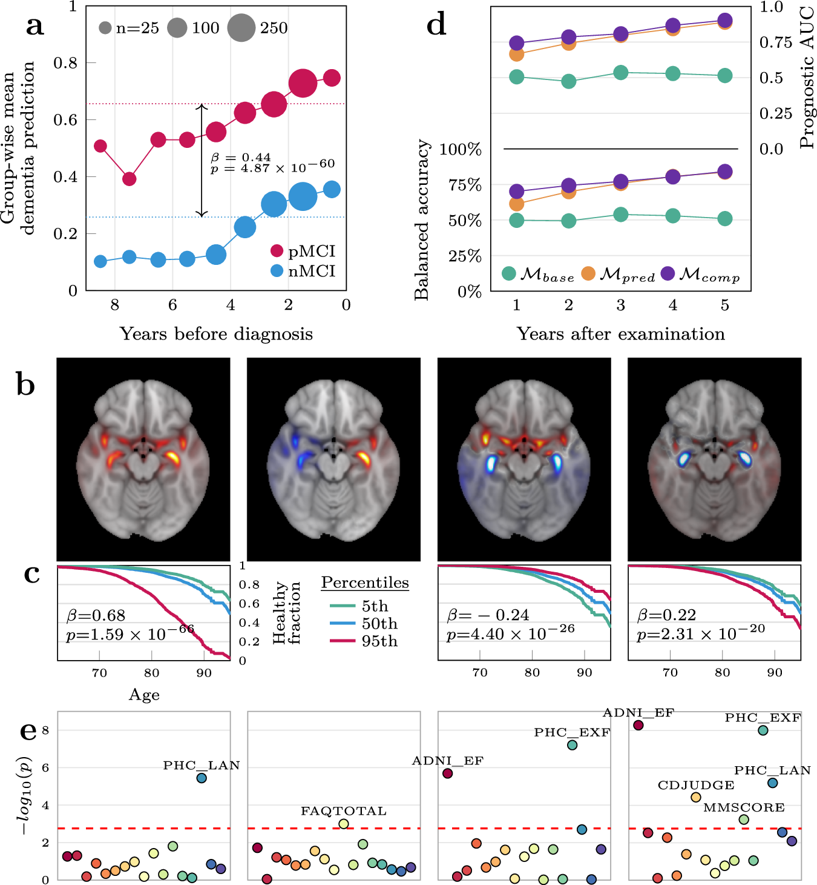
Transfer learning using brain age
Notes:
The results were promising for classifying …
progressive MCI from non-progressive MCI (a)
Identifying regions of interest for the progression (b)
Identifying survival based on the ROIs (c)
Predictive performance of the three models predicting progression in the years following the MRI examination. The baseline model () included only sex and age as covariates, the next model included the prediction from the dementia classifier as a predictor, while the final model also added the component vectors representing the relevance maps. (d)
Correlations of the components with cognitive measures (e)

Slide 15
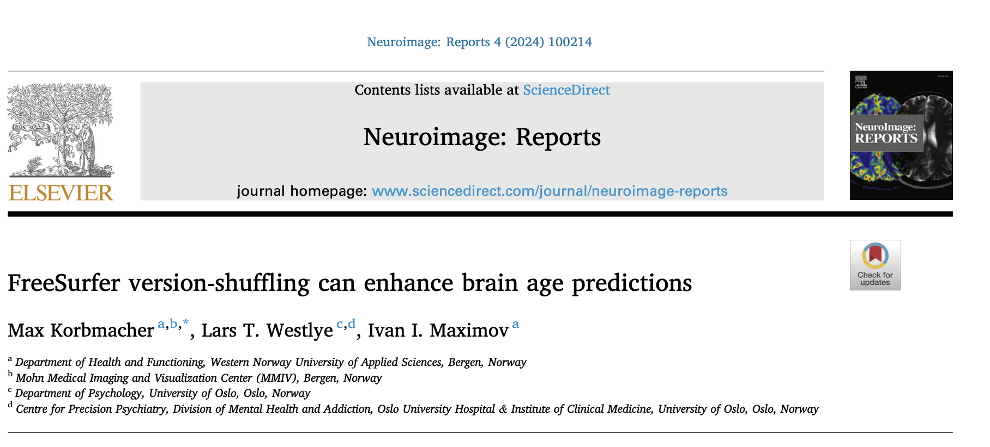
Still, in the end, data matter
Notes:
The data is always the underlying feature of all statistics and whatever algorithm we come up with, it’s usually not better than the data it reflects
The more robust we make the algorithm to different conditions, the better
Here, we simply used different FreeSurfer versions, showing that shuffling versions
In DeepLearning this is also done by data augmentation.
These steps are computationally expensive but potentially crucial to build robust models

Slide 16

Notes:
And then we go on with our lives.

Slide 17
Conclusion
BrainAge is most commonly a cross-sectional estimate
Differs for disease groups, correlates strongest with other cross-sectional estimates
The biological underpinnings of current approaches’ BrainAge are unclear
Prognostic and diagnostic utility is unclear
There are promising ideas to build upon the BrainAge concept
Notes:
BrainAge is most commonly a cross-sectional estimate
Differs for disease groups, correlates strongest with other cross-sectional estimates
The biological underpinnings of current approaches’ BrainAge are unclear
Prognostic and diagnostic utility is unclear
There are promising ideas to build upon the BrainAge concept

Slide 18






Thank you!
How to contact me:
max.korbmacher@helse-bergen.no

Slide 19


Feature selection
Notes:
Maybe for ageing into a motor dysfunction the cerebellum and only the cerebellum is important.
Maybe for

