Slide 1



Learn and practice open science and improve psychological research with the Psychological Science Accelerator (PSA)
Max Korbmacher
PhD Student at Western Norway University of Applied Sciences, Bergen
Max.Korbmacher@hvl.no

Slide 2

Max Korbmacher
PhD Student at Western Norway University of Applied Sciences, Bergen
Max.Korbmacher@hvl.no

Slide 3
Contents
Background
What, why how: Open Science
The Psychological Science Accelerator
Getting involved at the PSA
A few output examples
The project timeline at PSA
Involvement, practically

Slide 4
Open Science
What’s Open Science?
A movement > «the science reform movement»
A set of practices > «better science»

Slide 5
Open Science
Why Open Science?
Cohen pointed already in the 80s towards several potential problems with the way we do science
The wake-up call came from 2011 onwards
Bem published (p-hacked) results showing that people can predict the future in the Journal of Personality and Social Psychology
Stapel falsified data of many studies
Bem (2011): https://doi.org/10.1037/a0021524

Slide 6
Open Science
Why Open Science?
Reassessments of the evidence in psych science: large replication study of 100 experiments by the Open Science Collaboration (OSC, 2015)
Effects sizes ~1/2 of original studies
39% of effects were subjectively rated to have replicated the original result
OSC: https://doi.org/10.1126/science.aac4716

Slide 7
Open Science
How to do Open Science?
After the 2015 paper the feeling was that something must change…
Rethinking how the sausage is made?
Why not doing things together instead of alone and uncoordinated?

Slide 8
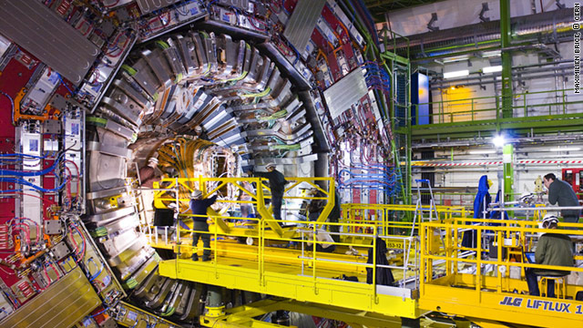
Open Science
How to do Open Science?
A great example of big team science: CERN

Slide 9
Open Science
How to do Open Science?
Why not doing the same for psychological research?
The Psychological Science Accelerator was born

Slide 10
Psychological Science Accelerator
What is the PSA?
The PSA is a standing network of psychological scientists who volunteer their research resources to projects that are selected, refined, implemented, analyzed, summarized, and disseminated via democratic processes involving the entire PSA network, with oversight and leadership from expert committees
https://psysciacc.org/

Slide 11
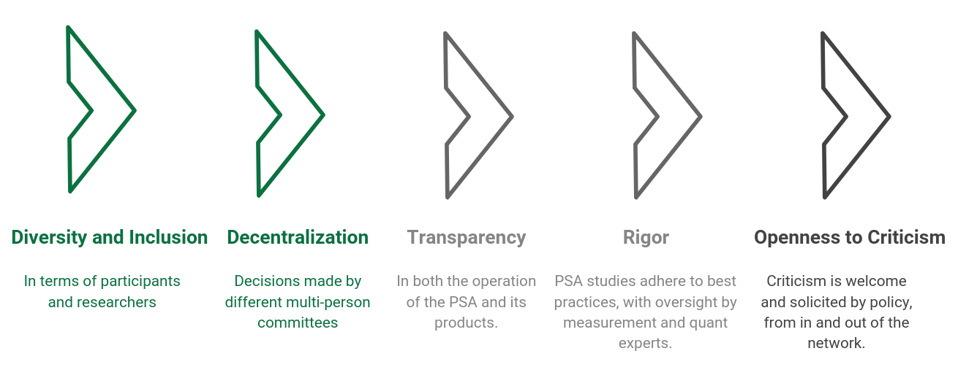
Psychological Science Accelerator
PSA Principles

Slide 12
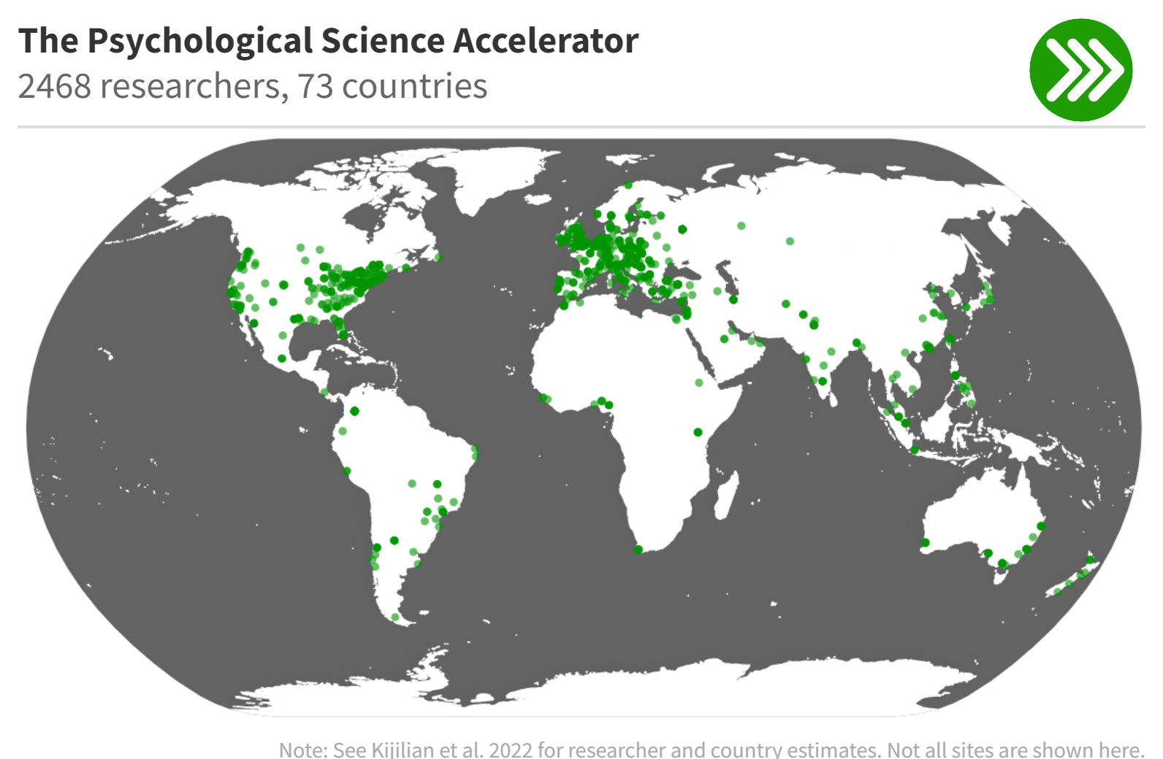
Psychological Science Accelerator

Slide 13
Psychological Science Accelerator
Why is such network useful?
Leverage the knowledge, abilities and work force of a large network
Rigorous, large international studies tackling the WEIRD and other problems

Slide 14
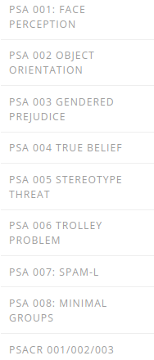
Psychological Science Accelerator
PSA Projects

Slide 15
Getting involved at the PSA
PSA Projects
Where I got involved in 2020
(call for collaborators)

Slide 16
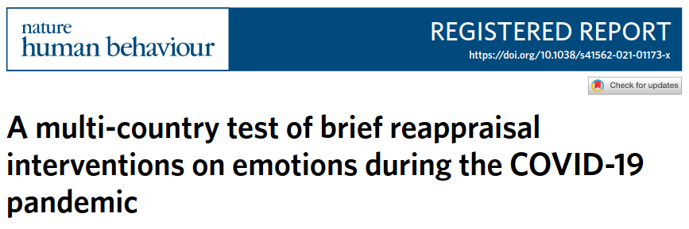
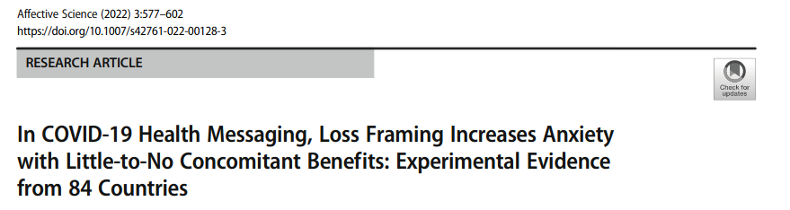
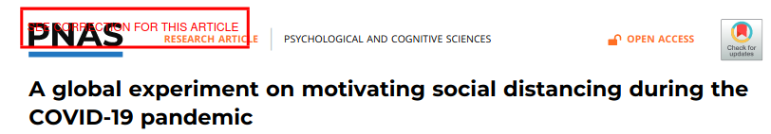
Getting involved at the PSA
PSA Projects: Covid-19 rapid response

Slide 17
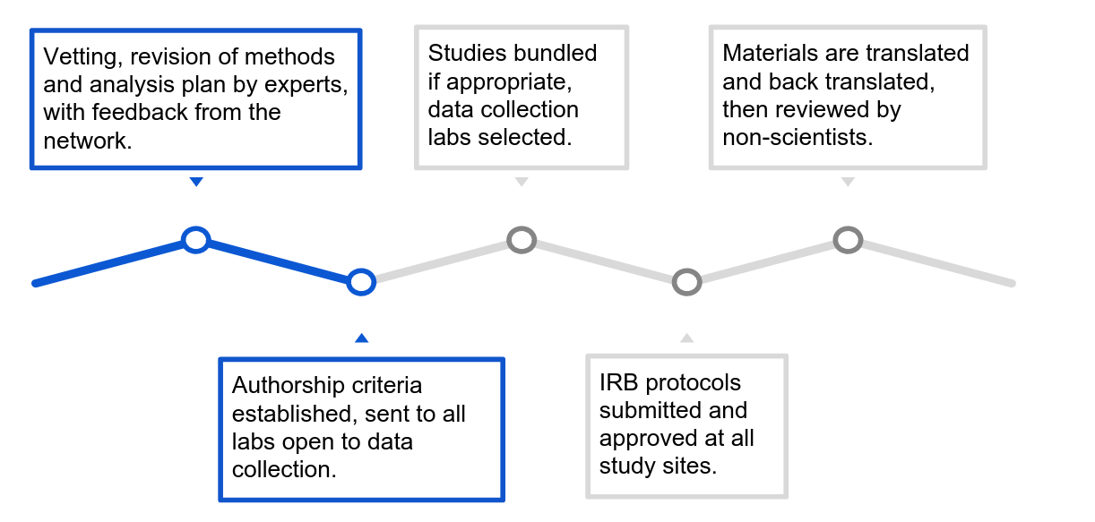
Getting involved at the PSA
PSA Projects: Project timeline
1. Proposals submitted, elected by commit.
2. Study prep:

Slide 18
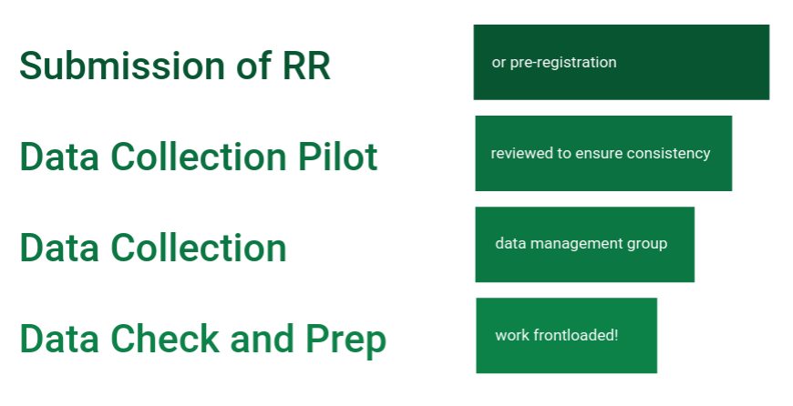
Getting involved at the PSA
PSA Projects: Project timeline
3. Implementation

Slide 19
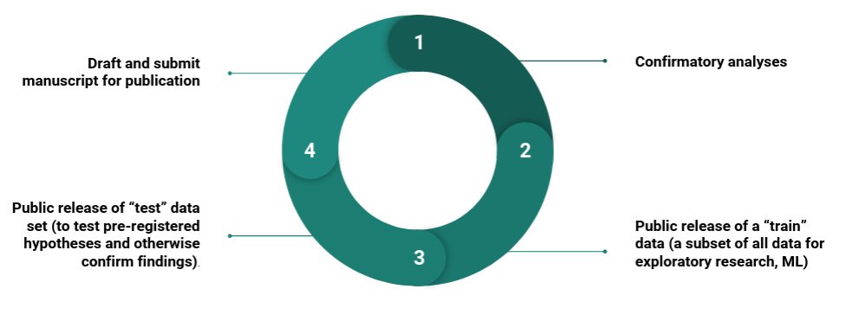
Getting involved at the PSA
PSA Projects: Project timeline
4. Analysis and Dissemination

Slide 20
Getting involved at the PSA
PSA Projects: get involved in the first two stages (or before)
There are many, many positions to be filled
Committees, administration, translation, data collection
My involvement: mainly translations, some data collection

Slide 21
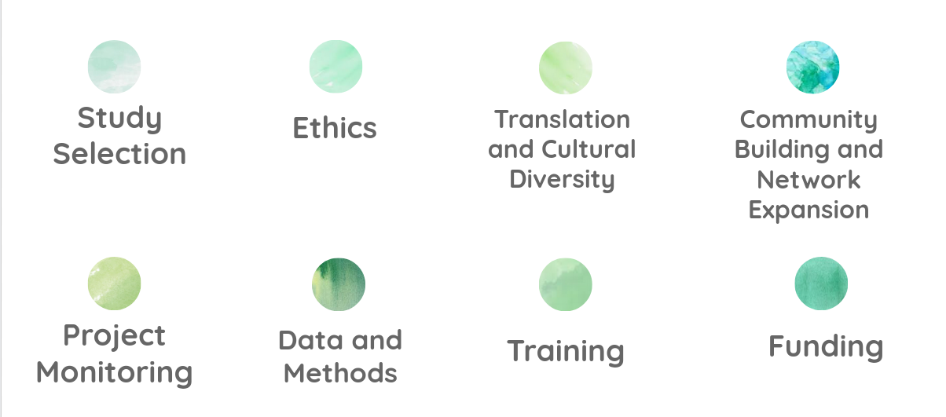
Getting involved at the PSA
PSA Projects: get involved in a committee

Slide 22
Recap: Why PSA
Overall, the PSA is an example of best research practices:
Great planning ahead, ‘expert consultations’
Registered reports
Data & code sharing
Welcoming and supportive community

Slide 23
Recap: How to get involved
Join specific projects of interest
Be involved in one or more roles: peer review/study feedback, data collection, translation, analysis, project administration and/or writing & editing the manuscript.
Propose studies to the PSA
Join any of the various PSA committees
Flexibly contribute your expertise, perspective and passion

Slide 24
Recap: Why to get involved
1.) Propose and collaborate on large-scale, cross-cultural studies
2.) Garner co-authorship in high-readership publications
3.) Contribute to the methods reform movement in psychological science and
4.) Form regional support groups of other researchers in your area
5.) Collaborate on various initiatives and immerse in a community of passionate psychological science researchers

Slide 25



Reach the PSA
https://twitter.com/PsySciAcc https://psysciacc.org/ Use this invitation link

