Slide 1
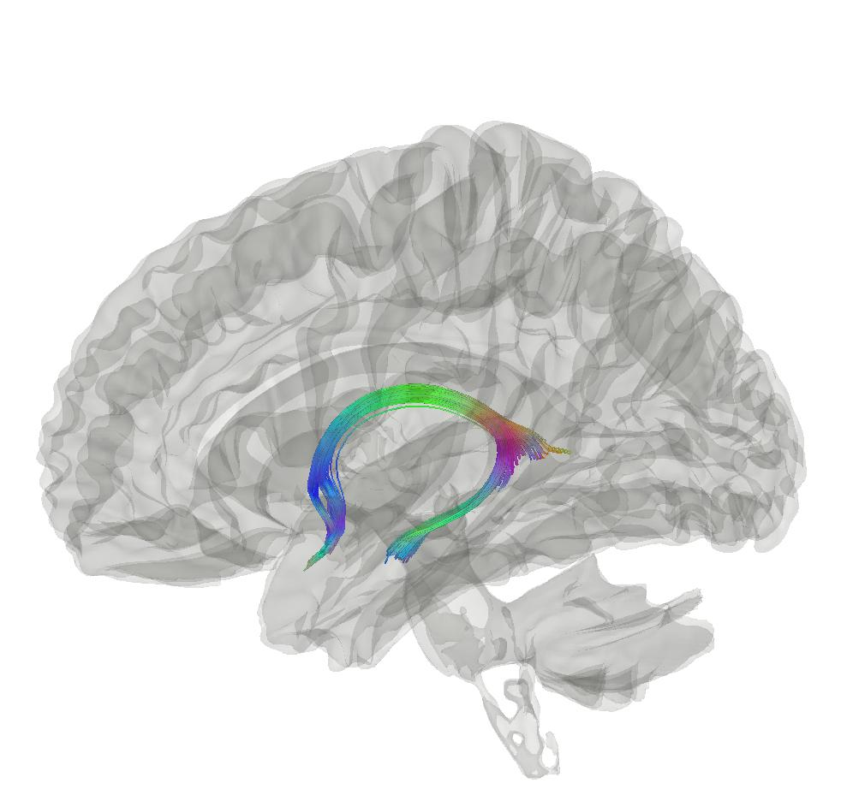



Brain age: a biomarker of general brain health?
Max Korbmacher
PhD Student @ Western Norway University of Applied Sciences, Bergen
Max.Korbmacher@hvl.no

Slide 2
Contents
Why brain ageing is an important but tricky research topic
A suggestion of how to research brain ageing
“Brain age gap” a biomarker?

Slide 3
Brain ageing is tricky to research
Brain ageing = The actual process of brain changes over time
Why this is tricky to research:
Repeated experiments take loads of effort + money
Brain is complex and has near infinite parameter combinations which can be observed (tissue types at different locations, their function, connections, etc.)

Slide 4

A suggestion to research brain ageing: brain age estimates
Brain ageing = The actual process of brain changes over time
Brain age = The estimated age based on a sample of magnetic resonance imaging data sets
Potentially clinically interesting as non-normative trajectories of brain ageing are related to psychiatric and neurological disorders¹
With large scale data sets like the UK Biobank (50k imaging sets), usual power problems can be circumvented
1 Rutherford et al., 2022, eLife, 11; 2 Marek et al., 2022, Nat., 603(7902)

Slide 5
Brain age models
Brain age models can be trained on
Minimally processed MRI data as provided by the scanner (e.g. image/CNN problem)
Or regionally averaged, tabular data (e.g. gradient boosting)

Slide 6
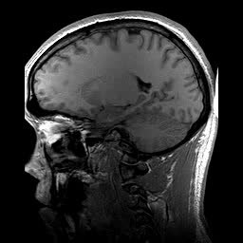
Brain age gap, a biomarker?
Brain age gap (BAG) calculation
Train a model from MR data
Do age predicitons for each individual: “Your brain is X years old”
Calculate the difference between chronological and predicted age
BAG associations
Related with a whole bunch of clinical symptoms and diagnoses¹
Larger in several clinical groups vs controls¹
Chronologically 22 years old
Age prediction
Biologically 28 years old gammel
BAG = 6 years
1 Franke & Gaser, 2019, Front. Neurol., 789

Slide 7
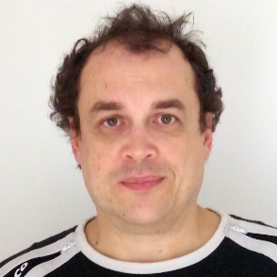
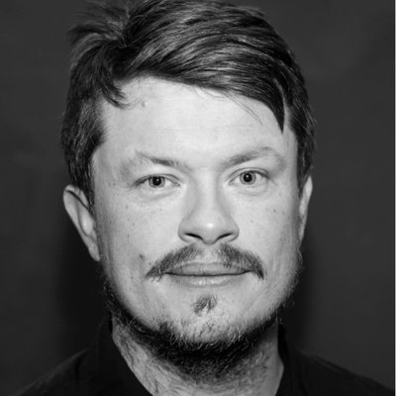
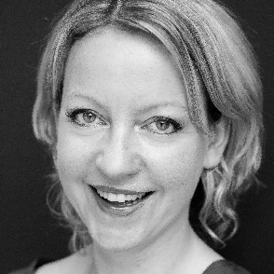
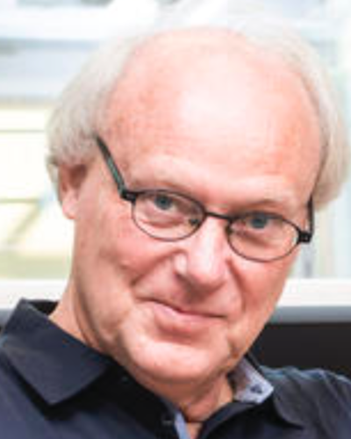

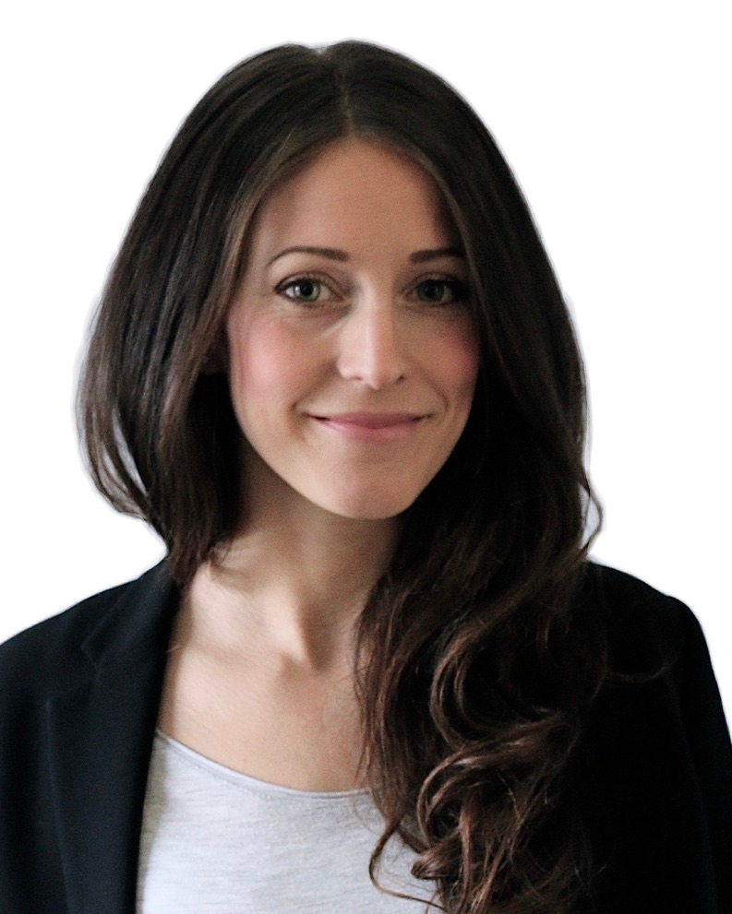
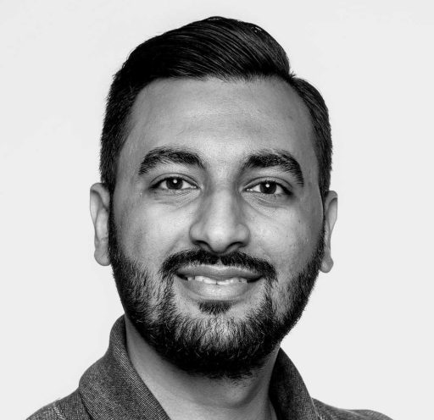
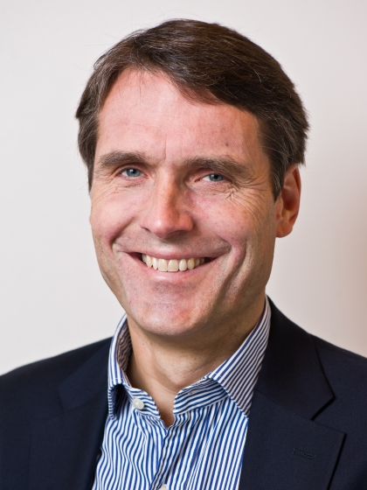
Ivan I. Maximov
Lars T. Westlye
Eli N. Eikefjord
Arvid Lundervold
Thank you!
Dennis van der Meer
Ann Marie de Lange
Dani Beck
Ole A. Andreassen

Slide 8
Questions?

