Slide 1
Hvordan å lage en god poster?
Max Korbmacher, PhD stipendiat

Slide 2
Bakgrunn
Dere fikk allerede en video innledning:
- hvorfor å lage poster
- grunnlagg til hvordan å lage en poster

Slide 3
Akademisk Artikkelskriving
- mange har bacheloroppgaven som første akademisk arbeid
- den har en lignande struktur av akadem. artikler:
  - Abstract
  - Introduksjon
  - Resultater
  - Diskusjon

Slide 4
Akademisk Artikkelskriving
- Struktur fra Mensh & Kording (2017)

Slide 5
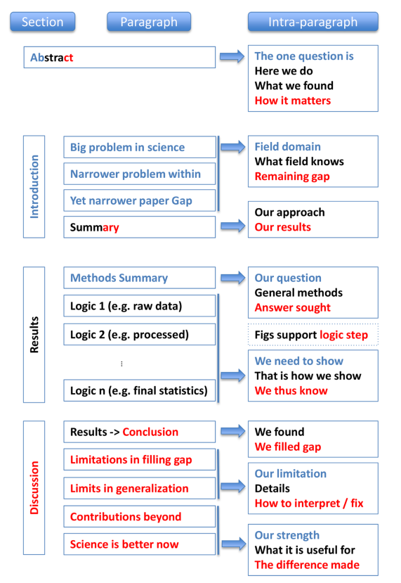
Akademisk Artikkelskriving

Slide 6
Forbindelsen: Artikkelskriving & Poster

Slide 7
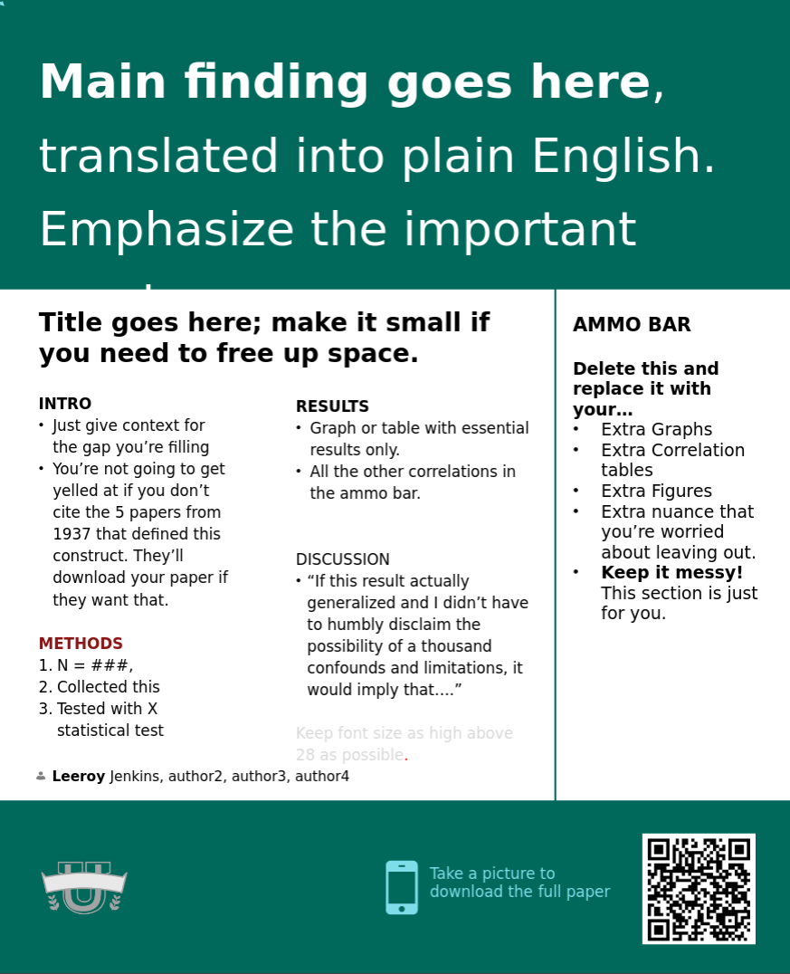
Oppbygging

Slide 8

Eksempel

Slide 9
God eller dårlig?

Slide 10
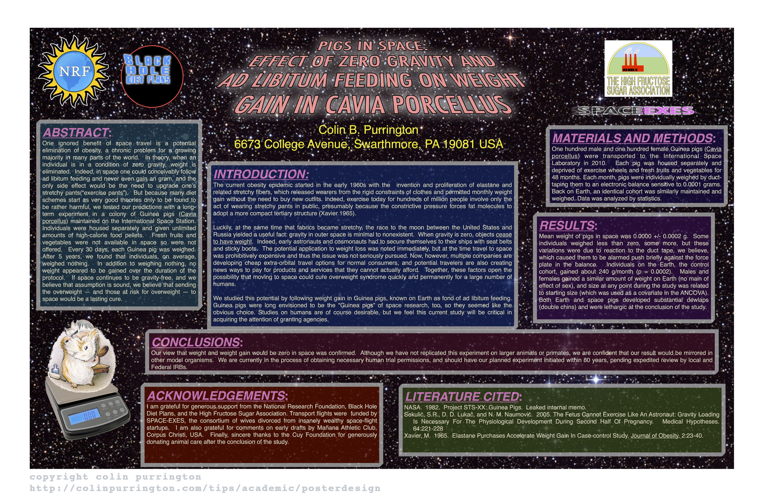
God eller dårlig?

Slide 11
God eller dårlig: noen notiser
Too much text (I’ve been on mission to push for 800 words).
Background image is distracting (distracts from illustrations).
Text box backgrounds are dark, which makes text really hard to read.
Text box backgrounds are all different colors, for no reason (distracting).
Text boxes are different widths (distracting, hard to follow flow of poster).
Some text boxes too wide (aim for 45-65 characters per line).
Text boxes not separated from each other by pleasing “white” space.
Text box edges not aligned (distracting).
Text justified, which causes bad inter-word spacing. Also makes reading harder (brain uses jaggedness of left-justified text).
Logos are distracting, useless, crowd title.
Title word art distracting, hard to read, juvenile.
Title is in all caps, which is harder to read and obscures Latin name.
Title is italicized, which also obscures Latin name style conventions.
Author font and color is annoying (comic sans should be reserved for comic books).
Author font color is too loud relative to other text.
Results are presented in sentences instead of visually with charts.
Section headers have too much formatting (big font, bolded, italicized, underlined, and colored — ack!). Choose one. [Note: I forgot to number the sections…that would have been even worse.]
Terrible graphic of Guinea pig on scale. Need one of the actual set up (pigs eating while weightless, for example).
Inclusion of an Abstract consumes space needlessly. Abstract section should be banned from posters. Posters ARE an abstract. ... (tbc)

Slide 12
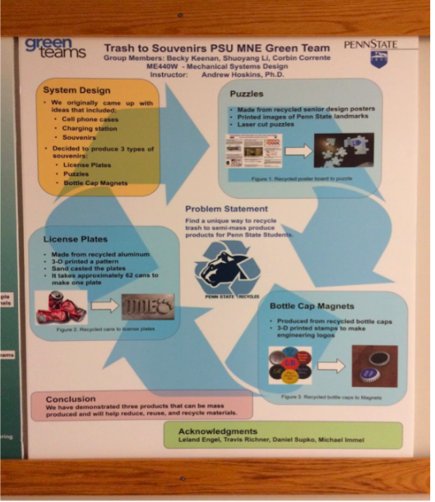
God eller dårlig?

Slide 13
God eller dårlig?
The Good:
1. Nice organization of text into different boxes
2. Good use of bullets
3. Not too many colors
4. Decent amount of white space
The Bad:
1. The order of what you should read on the poster is not logical
2. Flow of text would make more sense if overall if it was top to bottom, left to right
3. Awkward spacing for the class and instructor name at top
4. There is no reference section

Slide 14
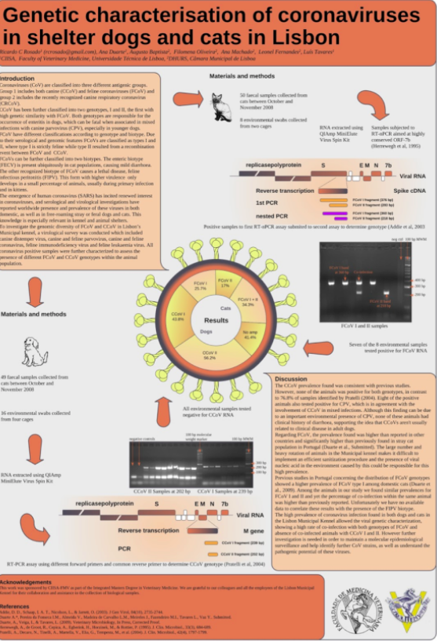
God eller dårlig?

Slide 15
God eller dårlig?
The Good:
1. Acknowledgements and references in their own section at the bottom
2. Logos at the bottom
The Bad:
1. Overall disorganized look
2. It is difficult to know which way to read this poster, even with the arrows
3. The large blocks of text are intimidating to read
4. Title font is too large compared to the rest of the poster
5. The images blend together and are thus hard to interpret
6. No consistency between sections: some sections are in text boxes and other
are not
7. The dark backgrounds for the title block and references draw your eye away from the body of the poster

