Slide 1
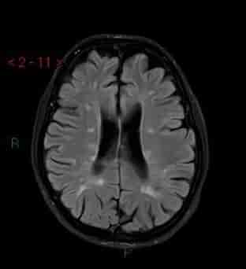
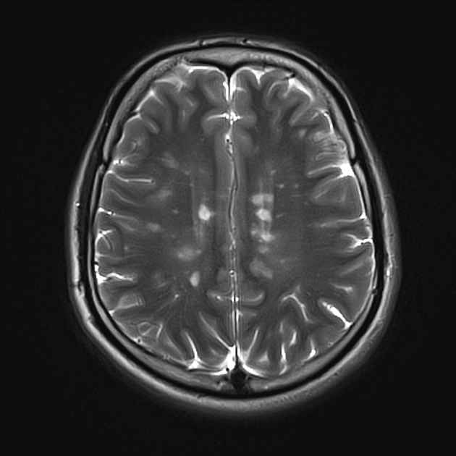
PROMising: Patient Recorded Outcome Measures predict multiple sclerosis trajectories better than brain, blood and genotyping.
Max Korbmacher, PhD
29 November 2024
Images from https://radiopaedia.org/articles/multiple-sclerosis

Slide 2
Contents
Background
What data to look at when predicting patients’ trajectories?
Diagnosis, prognosis, predicting the future
Data: geno- & phenotypes, MRI
Multiverse analysis: reducing individual researcher bias
What, how why?
Results
Notes:
I will attempt to give you a general overview of
some of the plausibly usable data to predict MS patient trajectories.
And HOW to use it
And I will present you with an analysis tool which usable in scenarios like this: multiverse analysis
Finally some results from the OFAMS clinical trial data

Slide 3
1. Background: The optimal scenario
Patient comes in
Testing / diagnosis / prognosis
We can tell what will happen over the next 10 years (and perhaps even how to stop negative trends)
Individual-adapted follow-ups
Treatment plan
etc.
Notes:
A patient comes in and we already know or diagnose multiple sclerosis.
We know MS is progressive and patients only become worse.
Hence, the right treatment and follow-up plan is important.
To do that the right way, we need the right predictors “to predict the future”

Slide 4
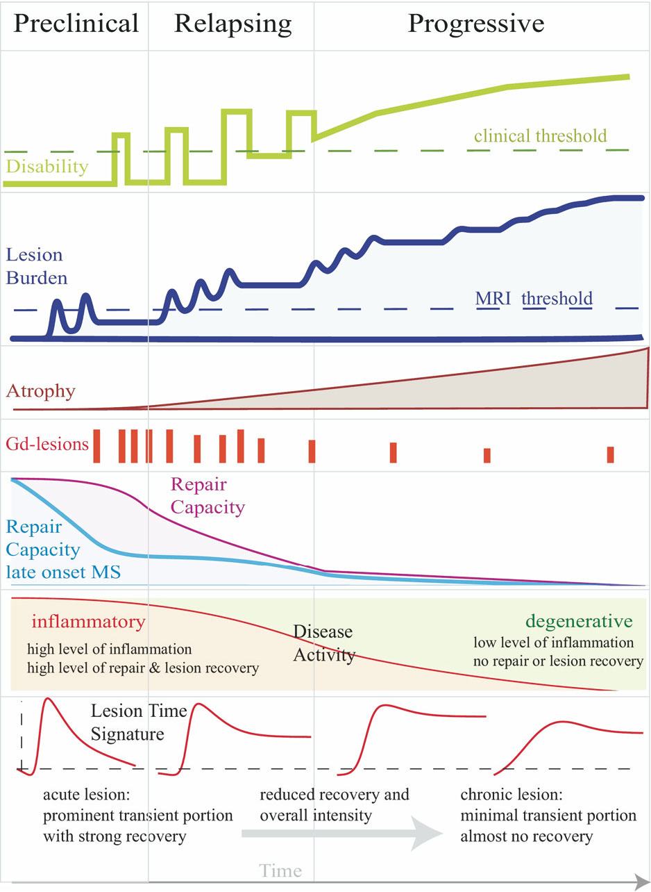
1. Background: What stops us?
Unclear when what happens exactly in which order, with which variability, and how to measure it
Examples:
Lesions are used dignostically, yet unclear whether they have much meaning for the patients’ worsening
MS is an inflammatory disease, but we struggle with pinpointing a subset of inflammatory markers to the disease or its stages
Images from https://radiopaedia.org/articles/multiple-sclerosis & Meier et al. (2006). Neurotherapeutics 4(3).

Slide 5
2. What data to look at?
Magnetic resonance imaging
“Omics”
Clinical measures
Patient reported outcome measures (PROMs)
Vitamin levels
Demographics
Notes:
MRI
Lesions
More modern, less understood: atrophy, e.g. measured by volumetrics
MRI machine learning derivative: brain predicted age
Omics
Proteomics: neurofillament lightchain, CH3L1
Genomics: HLA-DRB1 carriers
Clinical scores
Expanded Disability Status Scale (EDSS)
Paced Auditory Serial Addition Test (PASAT)
Patient reported outcome measures (PROMS)
Vitamin A, D, E levels, smoking status, age, treatment with omega 3 fatty acids during clinical trial

Slide 6
2. What data to look at?
Formalising this somewhat mathematically
Y = b₀ + b₁X₁ + … + b_{i}X_{i}
How will the patient do?
The change in clinical measures
Based on “stuff” we measure at baseline
Magnetic resonance imaging
“Omics”
Patient reported outcome measures (PROMs)
Vitamin levels
Demographics
Notes:
Let’s formalise this mathematically

Slide 7
3. Multiverse analysis
Y = b₀ + b₁X₁ + … + b_{i}X_{i}
Notes:
What we presented was a saturated model.
We throw in all variables we have
But there are many problems connected to this procedure and we cannot be sure whether our results will be due to the selection of variables we did
Multicollinearity (can induce false correlations)
Researcher bias

Slide 8
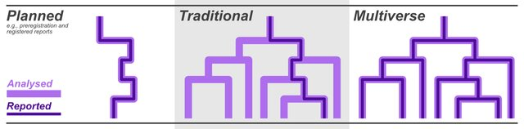
3. Multiverse analysis
Image from Marshall & Duthie (2024). bioRxiv
Y = b₀ + b₁X₁ + … + b_{i}X_{i}
Notes:
By running AND REPORTING many more analyses with plausible combinations of variables in such a model, one might be able to get less biased coefficients
In my case: 369,512 linear regression models (can be computationally costly)

Slide 9
3. Multiverse analysis
Reporting:
Proportion of effects with the same sign
Median p-value
Median effect±MAD (right figure)
Notes:
Many variables appear of interest when looking at the initial median coefficients

Slide 10
99.76% of effects are positive, Md b = 0.13, Md p = 9.54*10⁻¹²
92.78% of effects are negative, Md b = -0.40, Md p = 1.59*10⁻¹⁴⁹
Example of an unclear effect:
35.19% of effects are positive, Md b = 0.09, Md p = 1.47*10⁻¹⁵
49.60% of effects are positive
Notes:
Let’s walk through the results, and check interesting values

Slide 11
99.76% of effects are positive, Md b = 0.13, Md p = 9.54*10⁻¹²
92.78% of effects are negative, Md b = -0.40, Md p = 1.59*10⁻¹⁴⁹
Example of an unclear effect:
35.19% of effects are positive, Md b = 0.09, Md p = 1.47*10⁻¹⁵
49.60% of effects are positive
Conclusions: Baseline EDSS, Vitamin A, and PROMs, as well as nb relapses 12 months prior, can predict the decline in cognitive performance of MS patients measured by the Paced Auditory Serial Addition Test.
Notes:
Let’s walk through the results, and check interesting values
PASAT-score decrease of 2.17 points in the 10-year period (t(75)=-2.23,p=0.028).

Slide 12
Conclusions when predicting EDSS:
No impressive evidence when predicting EDSS changes.
Note, that EDSS changes were small over the examined 10-years, due to working treatment: EDSS increase of 0.88 points (t(77)=5.08,p=2.54*10-6).
Again, brain age gap, PROMs, vitamine A levels might be of interest when attempting to predict patient trajectories.
Notes:
Predicting Expanded Disability Status Scale (EDSS) scores throws up some similar predictors of interest: vitamin A, BAG, and PROMS

Slide 13
Perhaps we should just ask patients how they are?
Notes:
Perhaps we should just ask patients how they are?
While we need better questionnaires, there are good interview techniques in place.
We might save a lot of time and money by starting with the simplest method.

Slide 14




Thank you for your attention!

Slide 15
Brain age

Slide 16
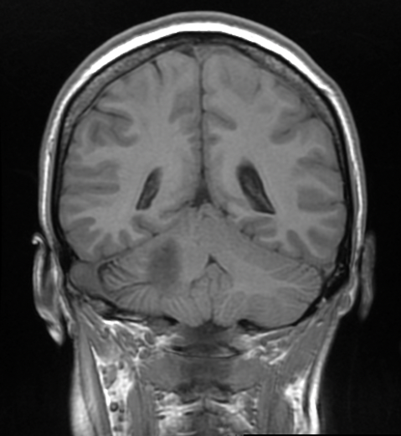
Brain age
1) Model training
Training model
Predicting chronological age with that model
Differences between brain age and chronological age
Individuals of different ages
Trained model
2) Predictions
Model applied to individual data
Brain age:
27 years old
Example individual.
Chronological age:
22 years
Difference / Brain age gap: 5 years
Notes:
Besides classical age-associations, one can use brain age
For that one trains a model, usually using machine learning on magnetic resonance images
This model is then used to make individual predictions, “a best guess” about the age of a person based on their brain
This can be done using different brain features and scales, from the voxel/pixel level to reconstructed features such as grey matter thickness in a brain region
Multiple studies indicate that the difference between chronological and brain age (the brain age gap) indicates multiple health outcomes and diseases

