Slide 1
Ever Wider World
Turf.js Intro

Slide 2
Outline
Review
Discussion (from Friday)
Turf.js ‘Activity’

Slide 3

Considerations of map design?
Medium
Audience
Purpose
Anyone want to critique this?
Notes:
What’s missing? So much.
One level would be ‘worthiness’ or ‘appropriateness’ to map. We’ll discuss that more soon.
The other would be the whole conception of an unidirectional flow from creator to viewer - that if we just get the design right, they’ll realize … blah blah.

Slide 4
Static Visual Stories
“Static visual stories rely on conventional news maps that supplement journalistic reporting. These maps often provide spatial reference or support reporting with data-driven analysis. Much like the addition of photos, news maps provide visual interruptions in the body of text-based stories”
Examples include:
Spring is springing earlier and earlier - Washington Post
See Maps Showing Where FBI Planes Are Watching From Above (buzzfeednews.com)

Slide 5
Longform Infographics
“Longform infographics rely on underlying maps as the primary mode of visual storytelling. Most suited for online and mobile environments, readers vertically scroll through the map to understand the story. Resembling traditional strip maps, longform infographics constrain the reader to a particular map extent and scale to guide the reader through a story and landscape.”
Examples include:
A Rogue State Along Two Rivers - The New York Times (nytimes.com)
The Conflicts Along 1,172 Miles of the Dakota Access Pipeline - The New York Times (nytimes.com)
https://somethingaboutmaps.wordpress.com/2015/09/28/a-matter-of-perspective/

Slide 6
Multimedia Visual Experiences
“Multimedia visual experiences combines maps, both static and dynamic, with photos, graphics, audio, and video to create a multifaceted storytelling experience. This genre relies on web-technologies and the readers ability to scroll and pace themselves through the story. “Snowfall” is often considered the first multimedia visual experience in the news. This genre has become increasingly utilized as web-technologies and templates become more accessible”
Examples include:
Devoured: How China’s Poyang lake was decimated by dredging and sand mining (reuters.com)
What the 1921 Tulsa Race Massacre Destroyed - The New York Times (nytimes.com)

Slide 7
Undergirded by a heap of interlinked technologies emerging in the late 90s to mid-2000s

Slide 8
What can’t you do in slippy maps?
Is it a you problem or a technology one?

Slide 9
That Wider World
We’re going to spend the rest little bit of the term introducing some powerful, fun alternatives to and extensions of leaflet.
This will help build a more robust set of tools for you to rely upon.
These are only introductory, but it’s meant to show how now that you know the basics, you can quickly pick up the rest!

Slide 10
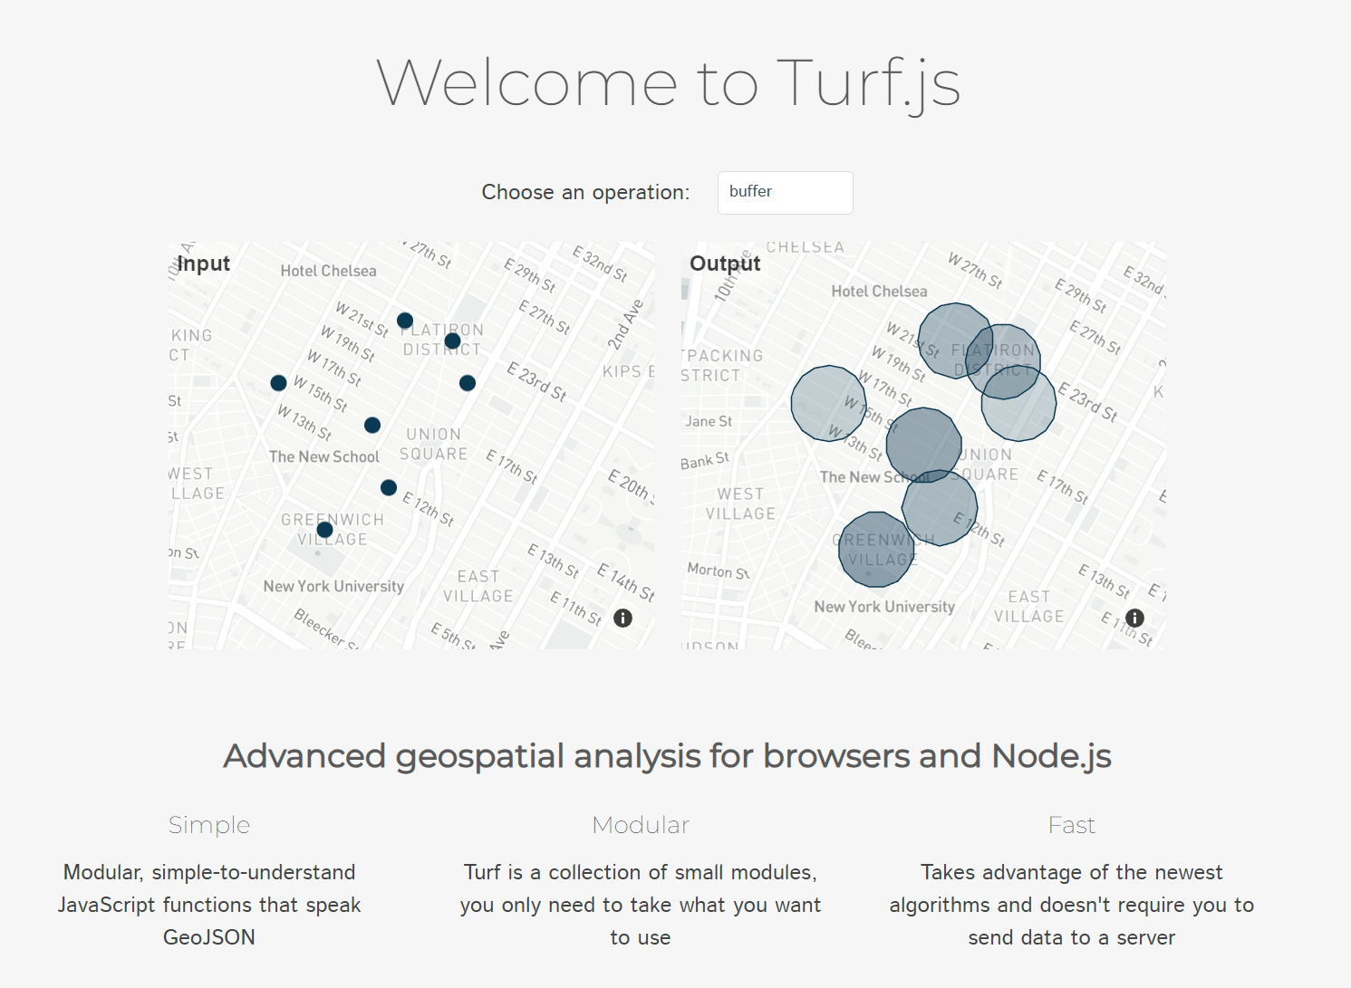

Slide 11

A little history…
Project started and managed by Morgan Herlocker
Morgan was then hired by… Mapbox!
Although, according to his github, he’s now at SpaceX

Slide 12
Let’s head on over to our trusty (terrible) demo map…
Bear in mind, Turf literally tells you not to do this as it loads the full 500+kb file. There are directions on the site as to how to ‘minify’ it; but, for this demo… we can go slow.

Slide 13
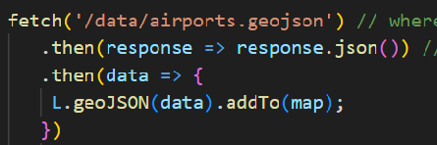
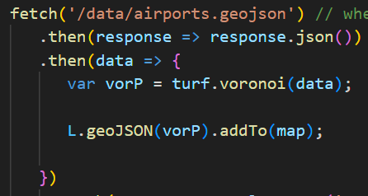
Let’s modify what we have…

Slide 14
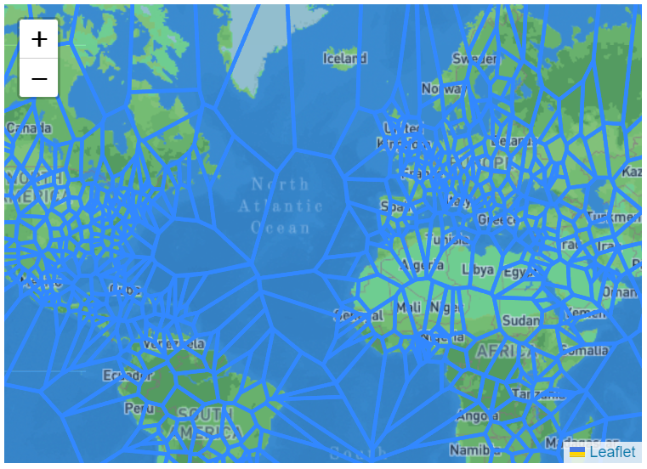
Boom!

Slide 15
Now let’s fancy it up!
(we’ll do more of this on Wednesday)

Slide 16
