Slide 1
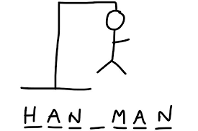
„HANGMAN”
Michał Jarmołowicz
Max Rogowski

Slide 2
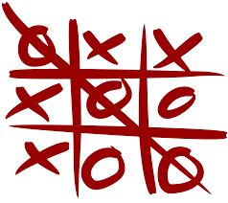
„Tic Tac Toe”
Krzysztof Moszyński
Michał Jarmołowicz
Max Rogowski

Slide 3
Presentation plan
Description of working method and planning
Problems encountered
Introduction to the rules
What has been done
An additional feature
Summary and contact details

Slide 4
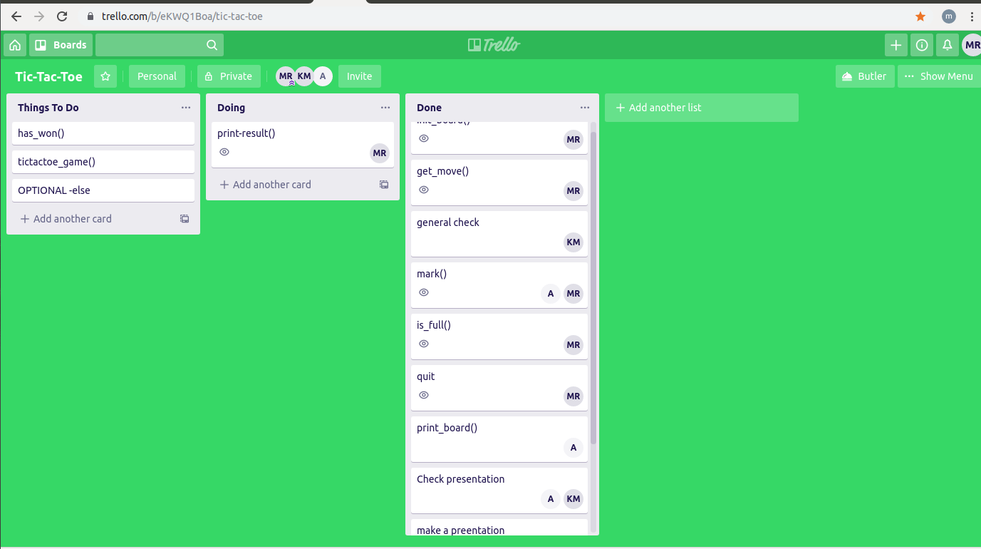
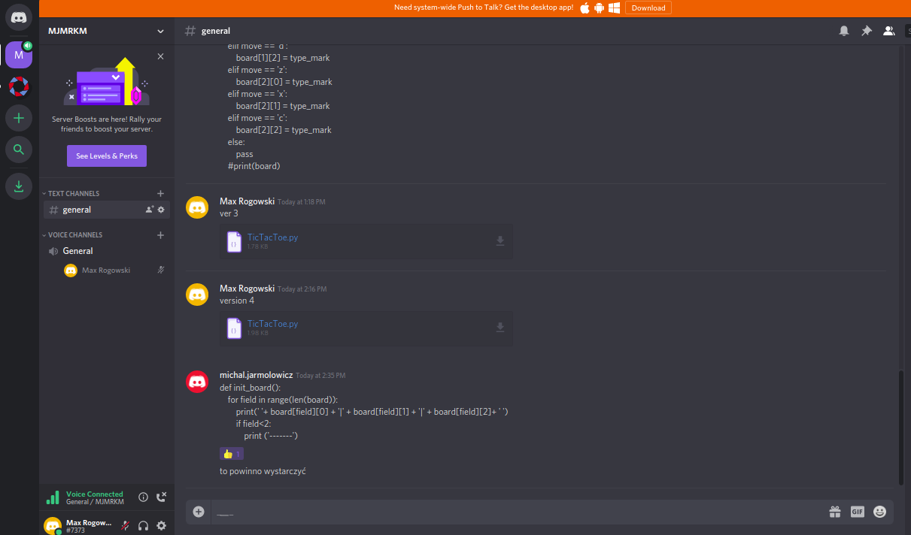
Description of working method and planning
Planing- https://trello.com/b/eKWQ1Boa/tic-tac-toeVersion control + comunication https://discordapp.com/

Slide 5

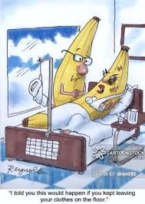
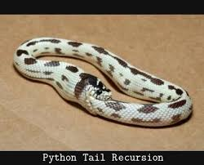
Problems encountered
Time ticking - 1.5 day for everything
Flu season
Python anger

Slide 6
Introduction to the rules
Tic-tac-toe (American English), noughts and crosses (British English), or Xs and Os is a paper-and-pencil game for two players, X and O, who take turns marking the spaces in a 3×3 grid. The player who succeeds in placing three of their marks in a horizontal, vertical, or diagonal row is the winner.
https://en.wikipedia.org/wiki/Tic-tac-toe

Slide 7
What has been done
All functionalities have been implemented for egzample:
two-player game,
writing messages about who won
automatic player changes
https://learn.code.cool/codecool-graph/#/../projects/tic-tac-toe

Slide 8

An additional feature
Exit at any time by entering 'exit', 'wyjscie', 'wyjście' or 'quit'
Use of more intuitive keys:
qwe, asd, zxc
instead of a1, a2, etc.
Let’s play :)

Slide 9
Summary and contact details
THANK YOU FOR YOUR ATTENTION!
Contact - Discord:
Michal- michal.jarmolowicz #1469
Krzysiek- NonVideri #4599
Max- Max Rogowski #7373
Github:
https://github.com/MaxKuzaj13/Hangman

