Slide 1
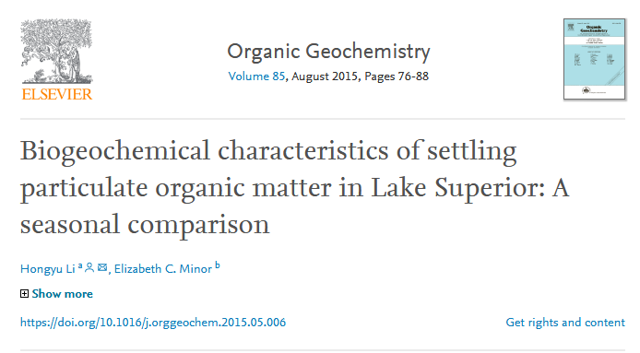
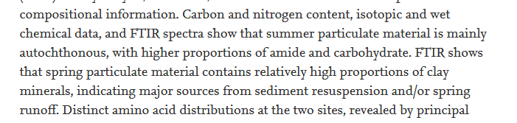
Due to sediment resuspension events and an oxic water column, organic matter eventually buried in Lake Superior’s sediments has probably experienced extensive alteration due to several cycles through the water column and the bacterially-active sediment-water interface.

Slide 2
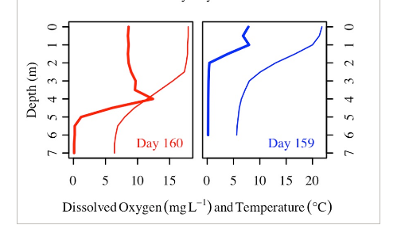
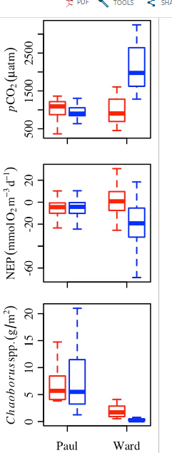
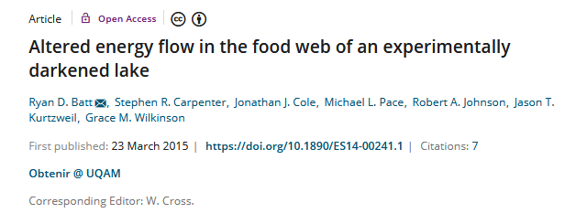
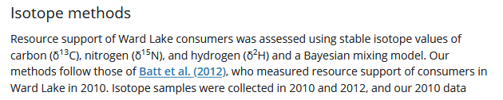
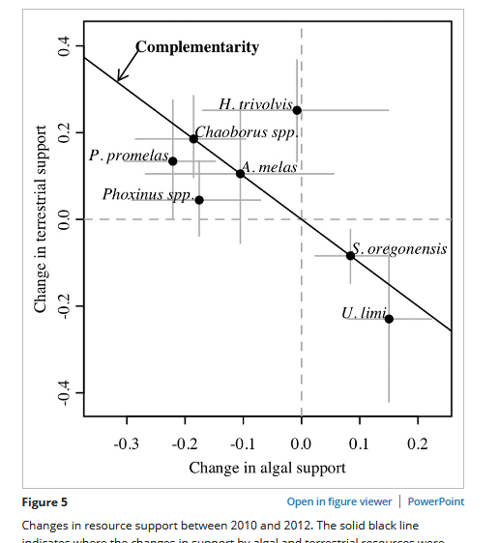
In wirklichkeit: anoxia studie!
Thus ongoing effort is needed to understand other drivers of temporal change in resource support, and how resource support changes over longer time scales. Our study challenges a perspective that holds resources as unimportant if they currently support a small fraction of consumer biomass, and embraces a view of such resources serving food webs as insurance that may mitigate the adverse effects of constricted energy pathways.
Therefore, our results and those of previous studies suggest that zooplankton may become increasingly allochthonous as phytoplankton become less available, but taxon‐specific feeding habits may impose a limit on the extent of change.

