Slide 1
HYPOO 2020

Slide 2
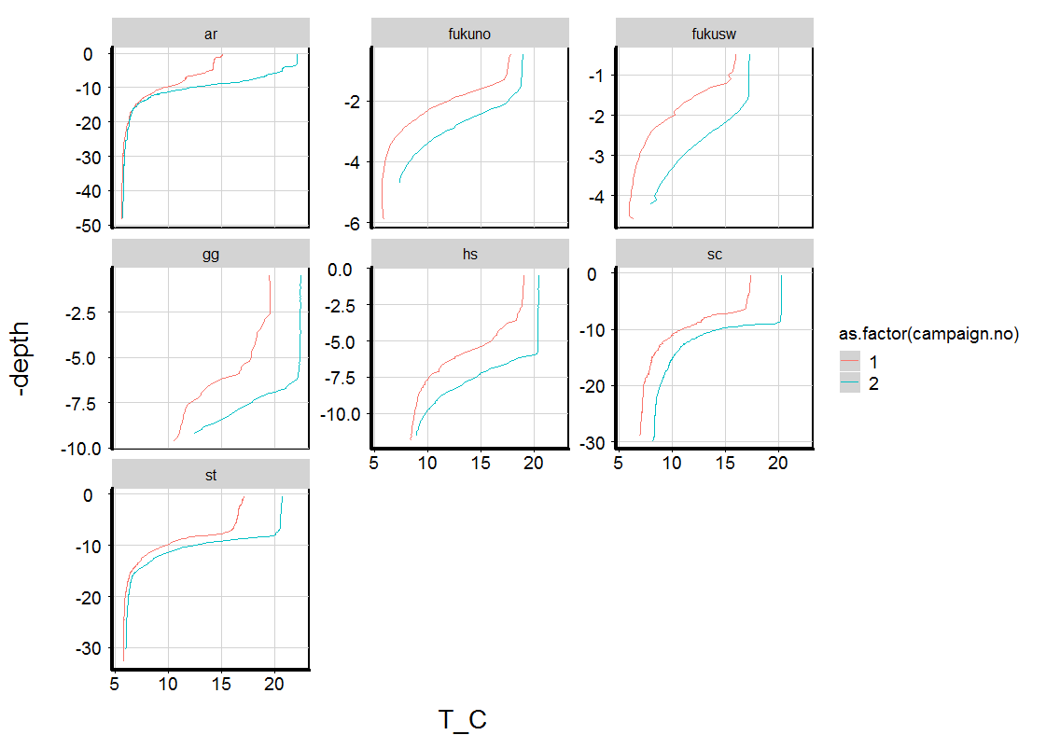

Slide 3
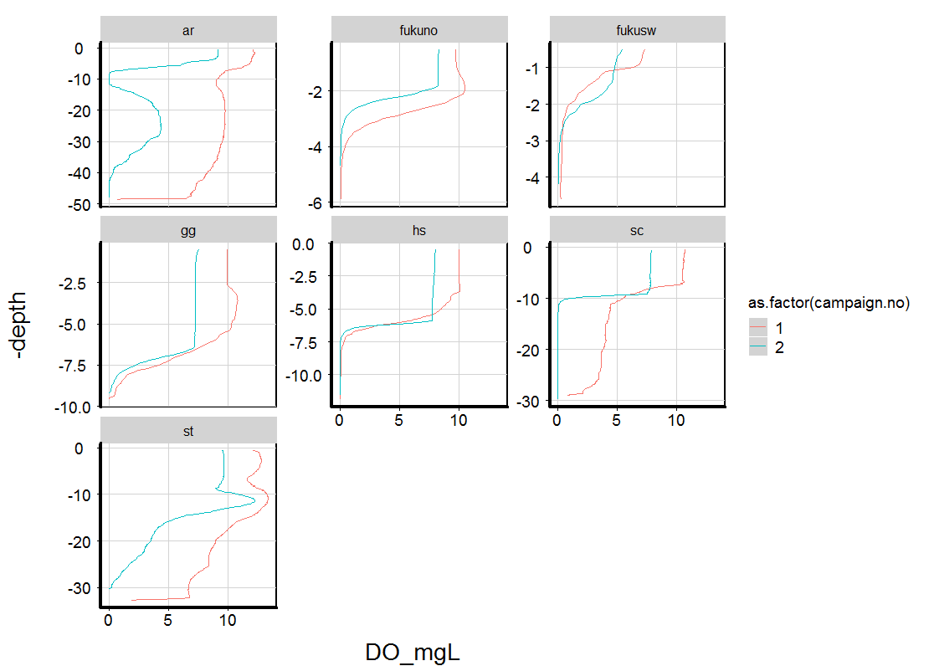

Slide 4
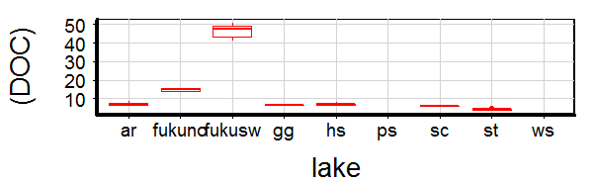
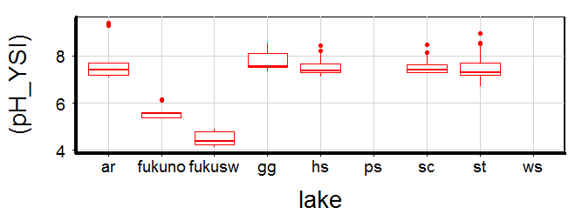
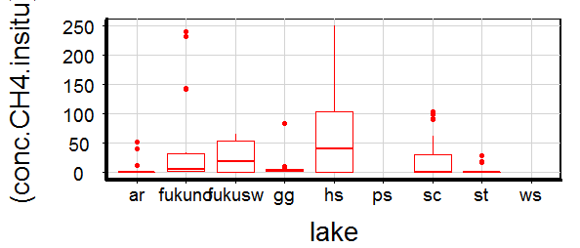
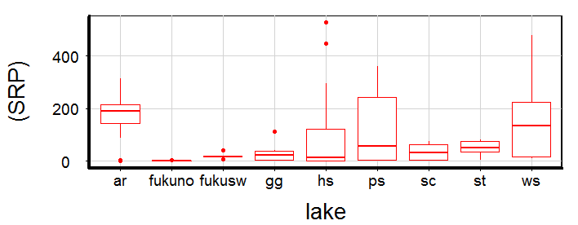
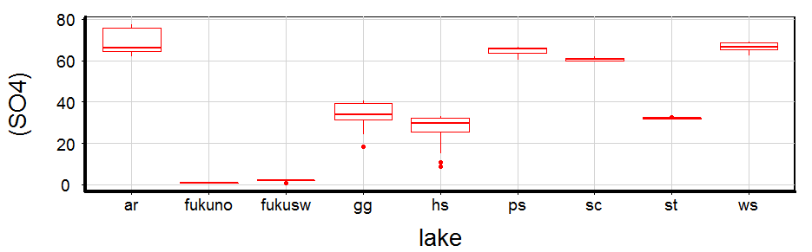

Slide 5
profiles

Slide 6
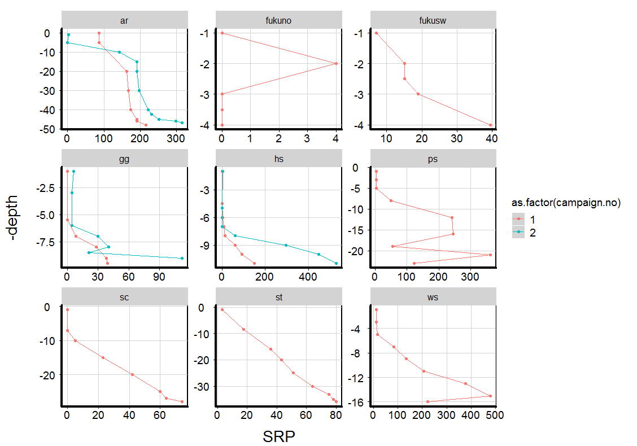

Slide 7
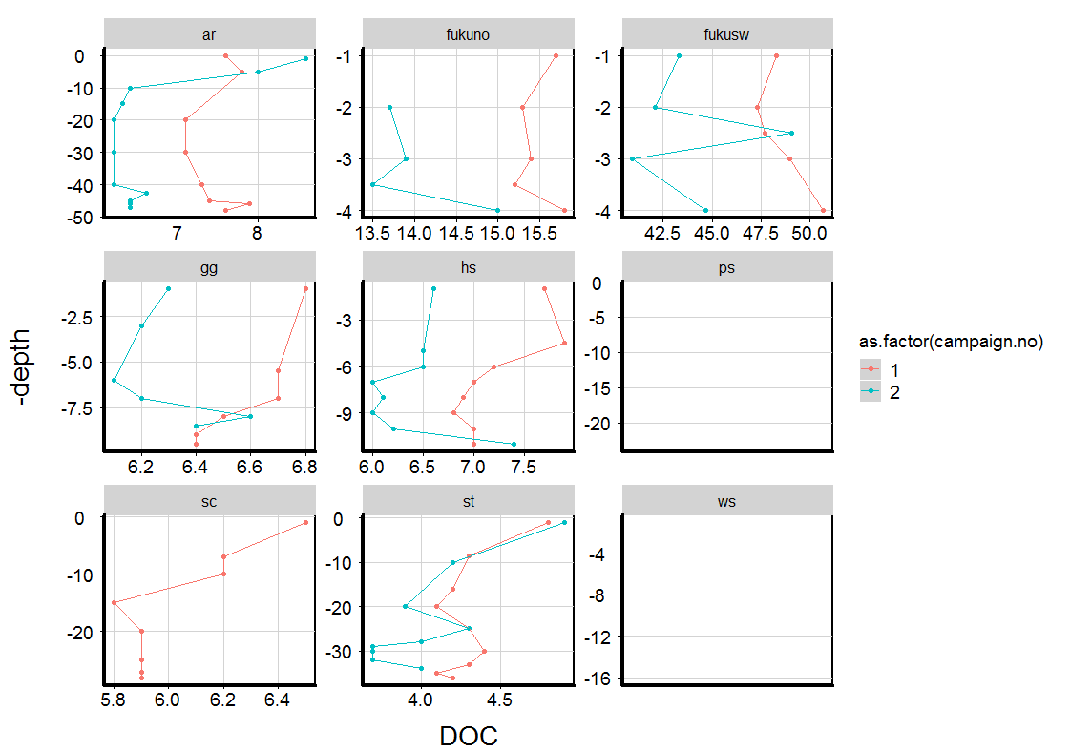

Slide 8
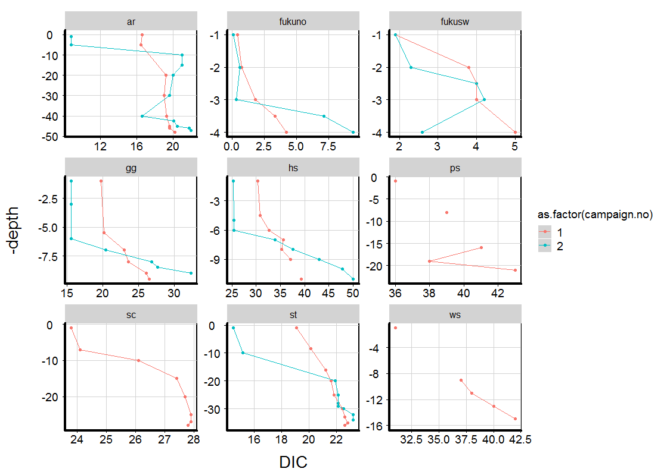

Slide 9
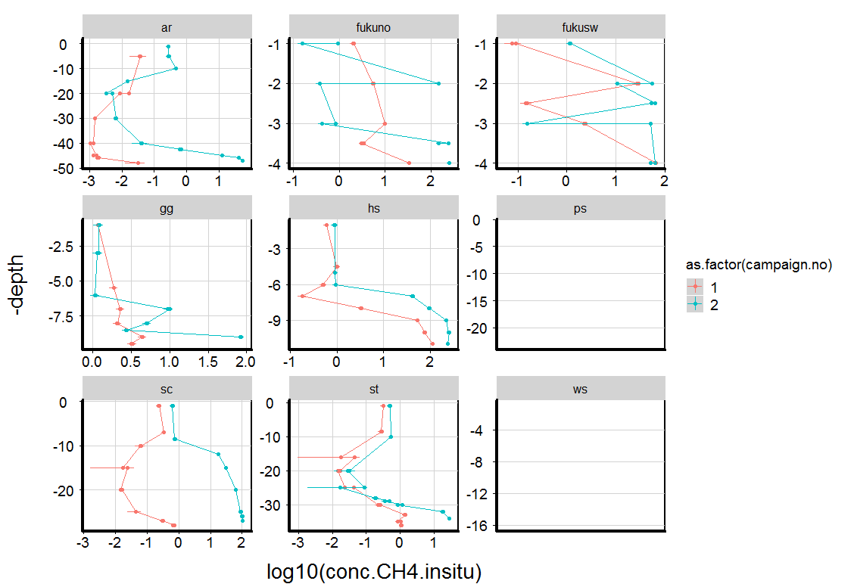

Slide 10
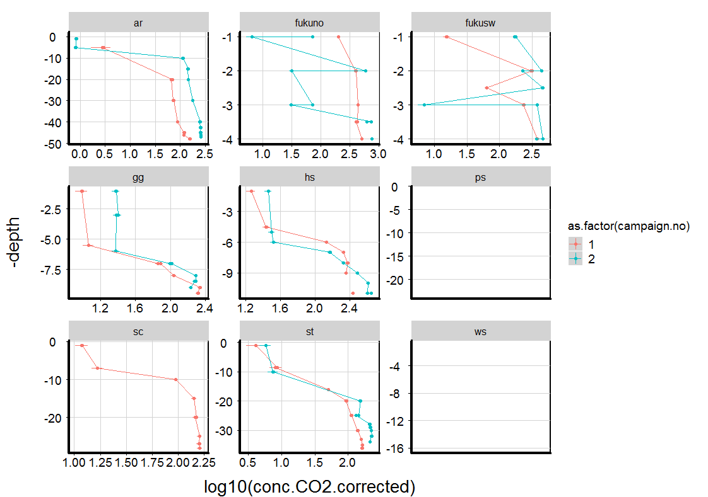

Slide 11
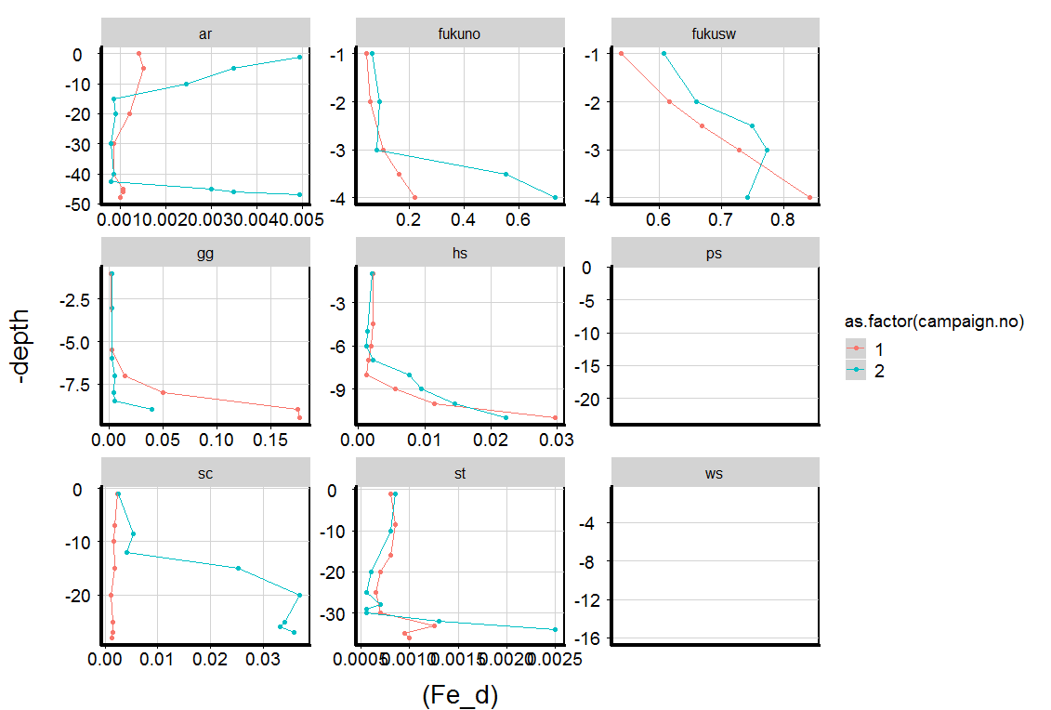

Slide 12
C, DIC, Calcit

Slide 13
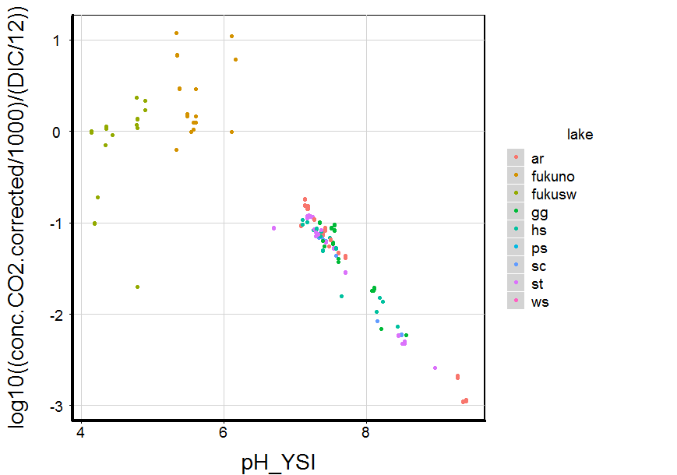
Mehr CO2 als DIC?
CO2:DIC=1:1, alles CO2
C-GGW

Slide 14
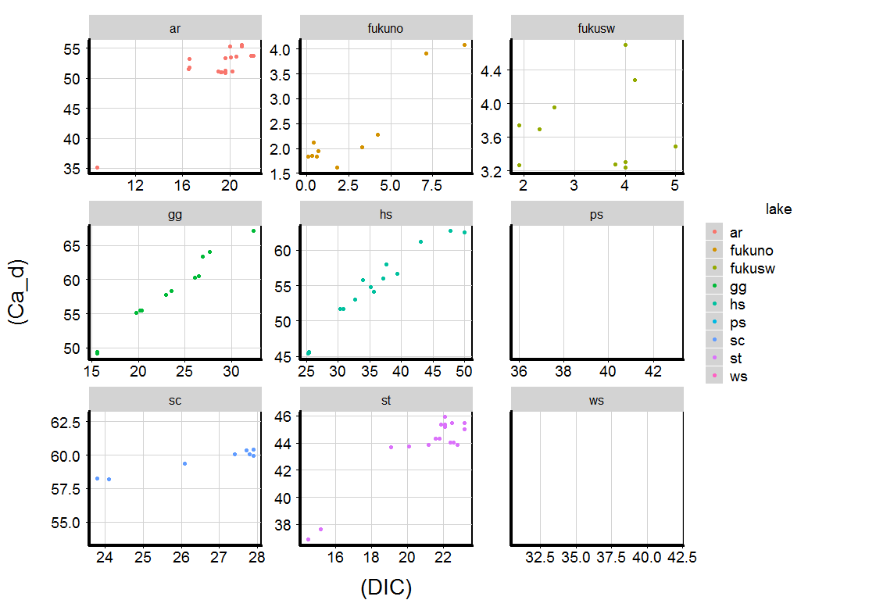

Slide 15
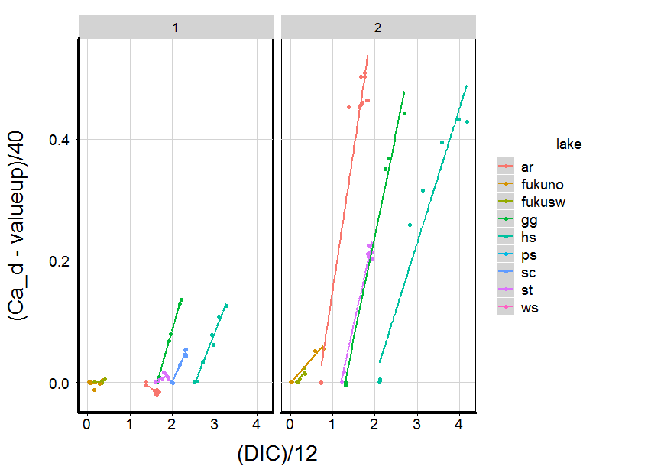
Corrected for background Ca, all DIC-CA relationships have similar slopes (2C per 1Ca freed)

Slide 16
Lability

Slide 17
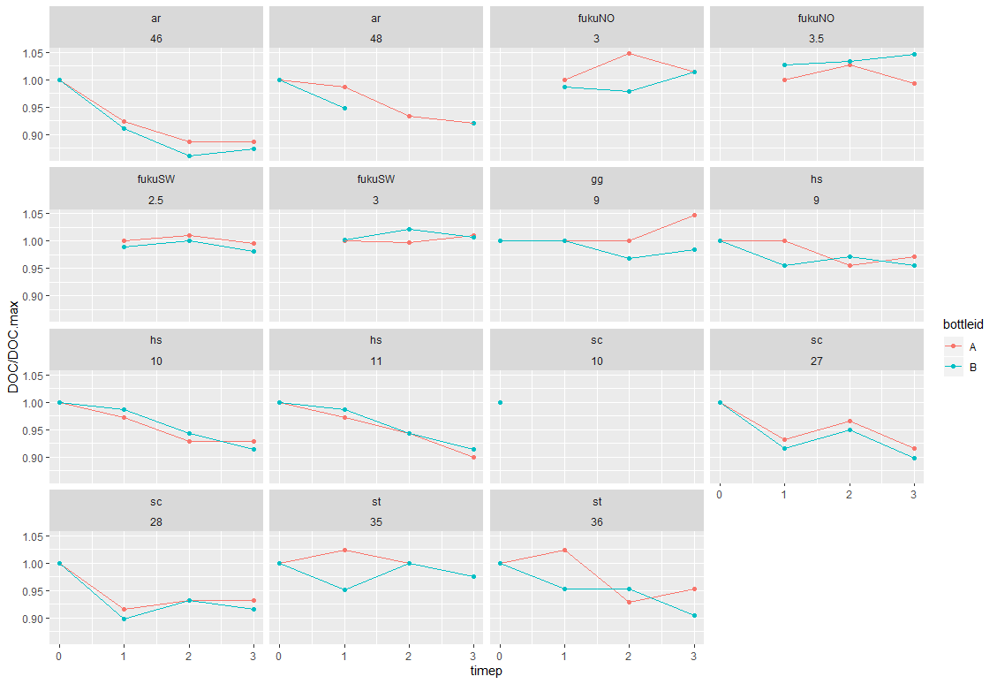

Slide 18
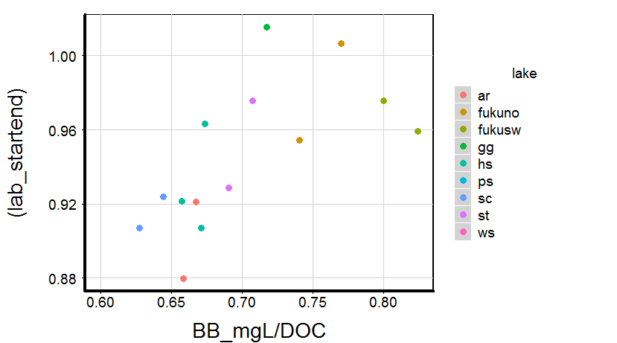
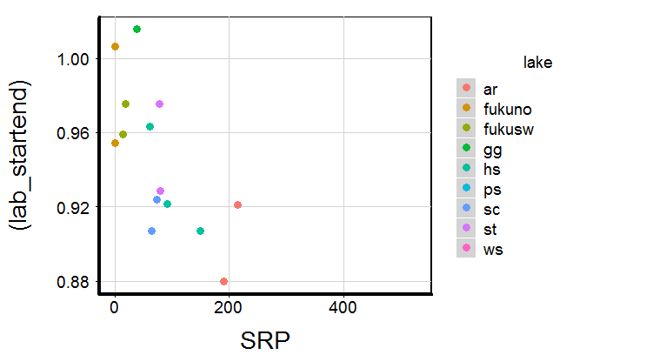
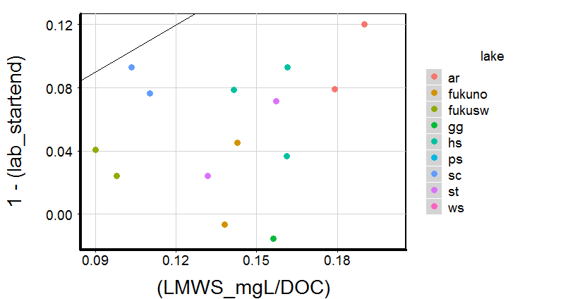
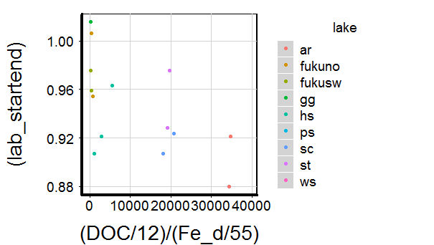
#je mehr unabbaubarer DOC (building blocs), desto
weniger wird umgesetzt in 14 tagen
SRP hat Einfluß?
Mol-Verhältnis C:Fe niedrig
wenn recalcitrant

Slide 19
“Anoxic Age”

Slide 20
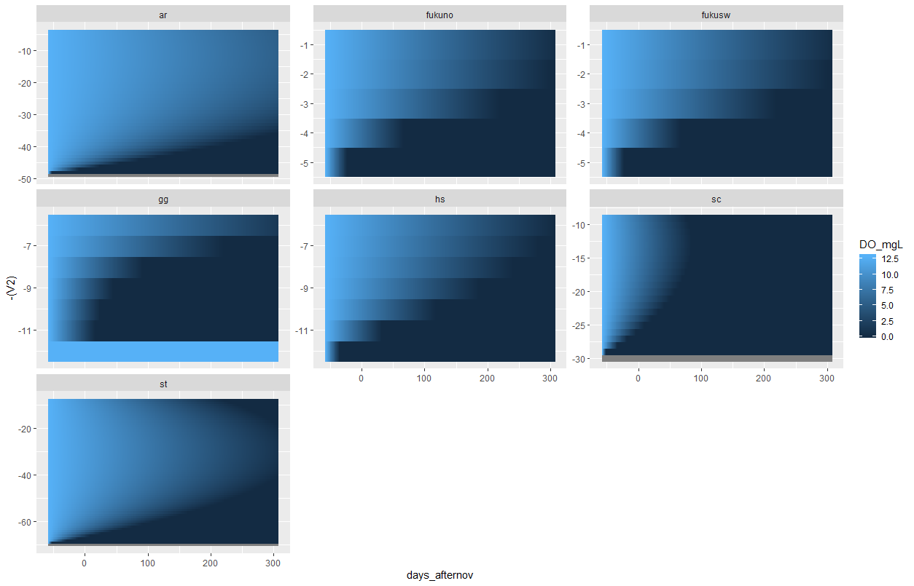
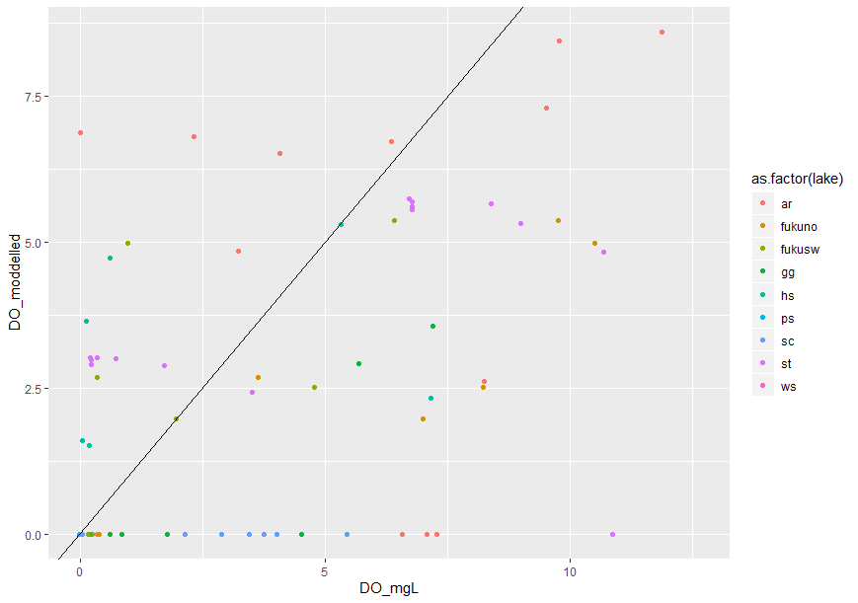
Last overturn 1.11.
Kampagne 1
Kampagne 2
anoxicx age
of sample

Slide 21
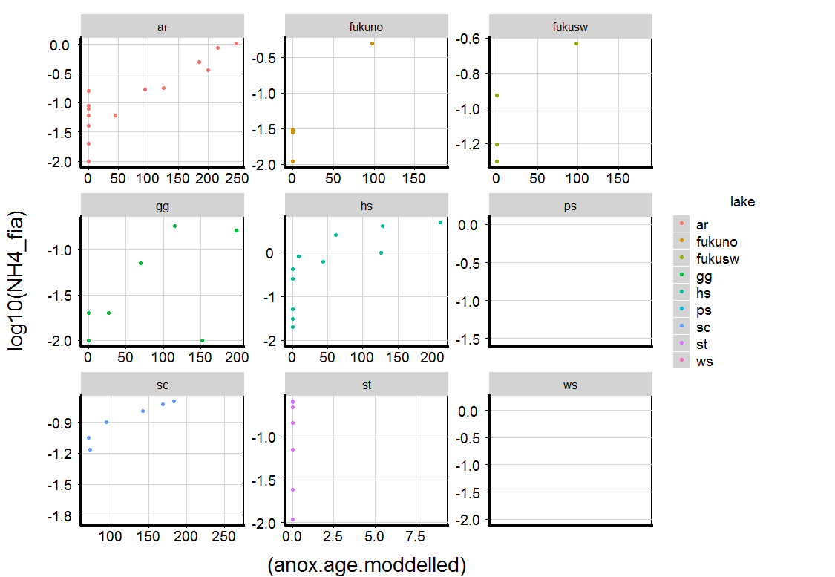

Slide 22
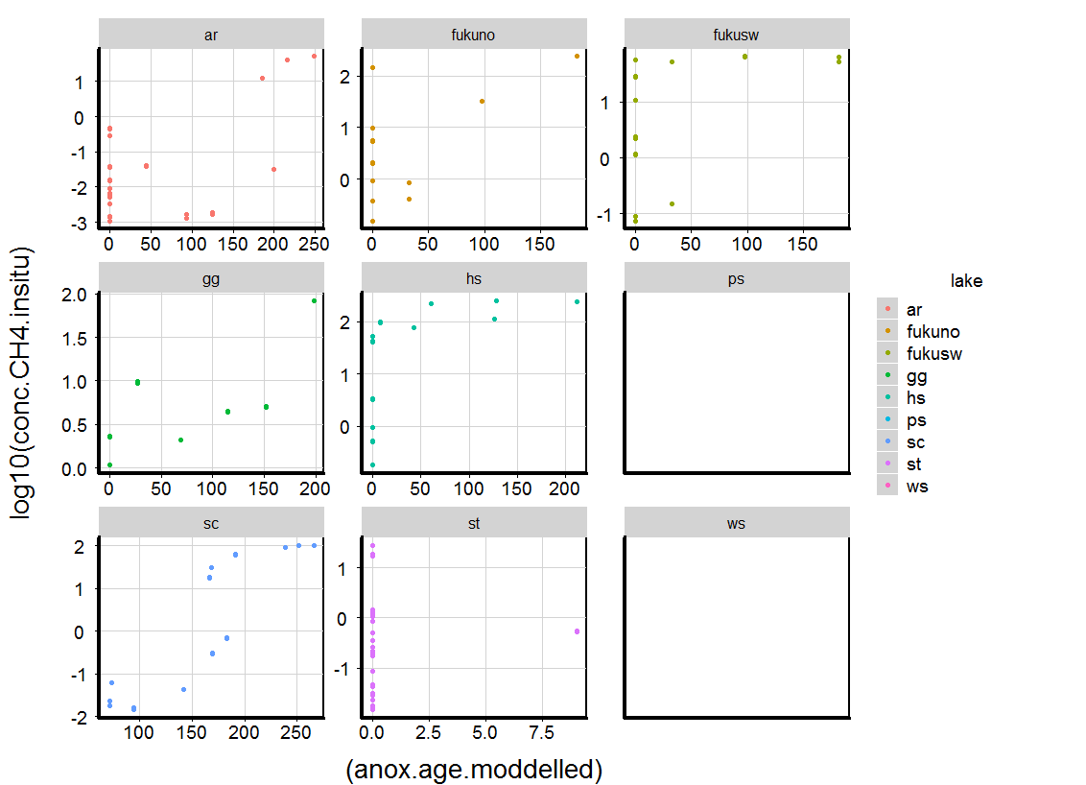

Slide 23
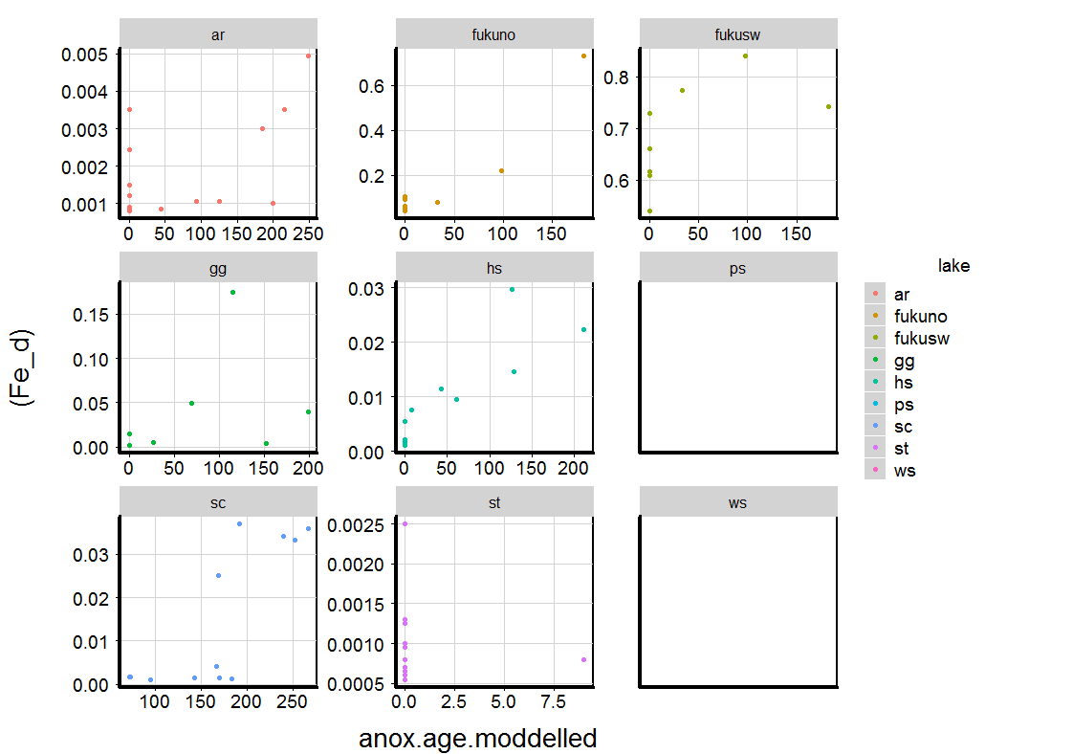
works less well with Fe and DOC

Slide 24
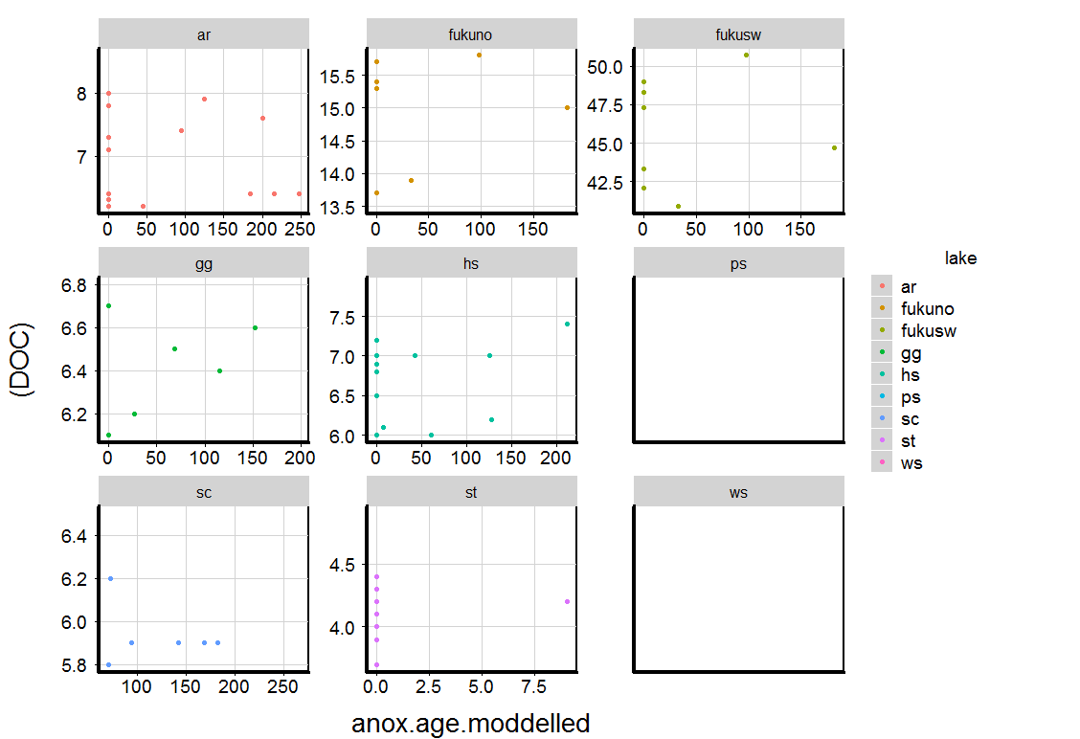

Slide 25
Anaerobe heterotrophe Respiration

Slide 26
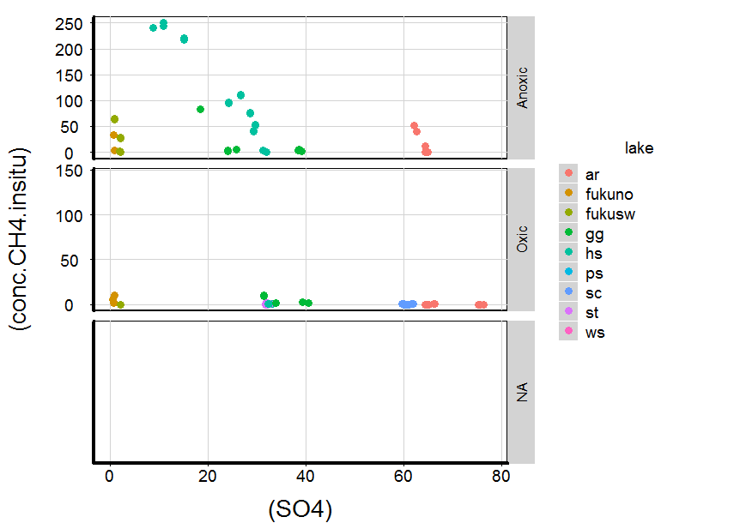

Slide 27
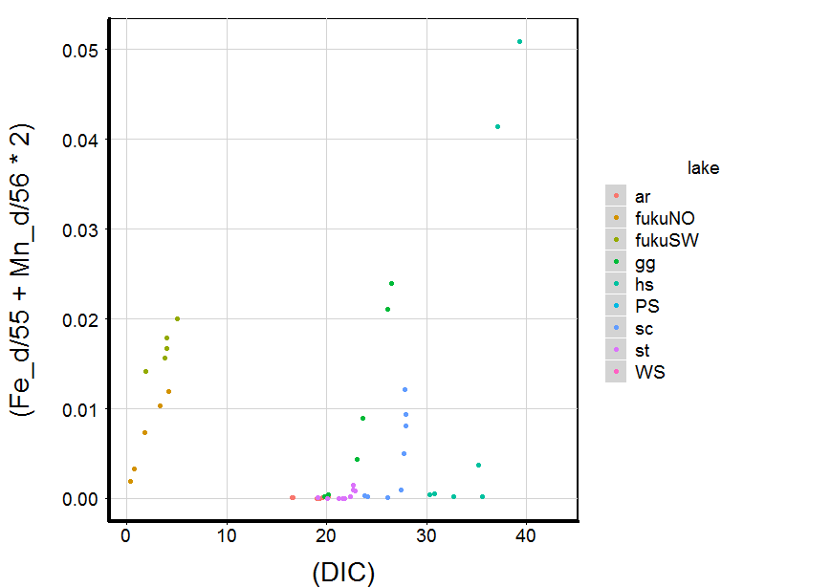
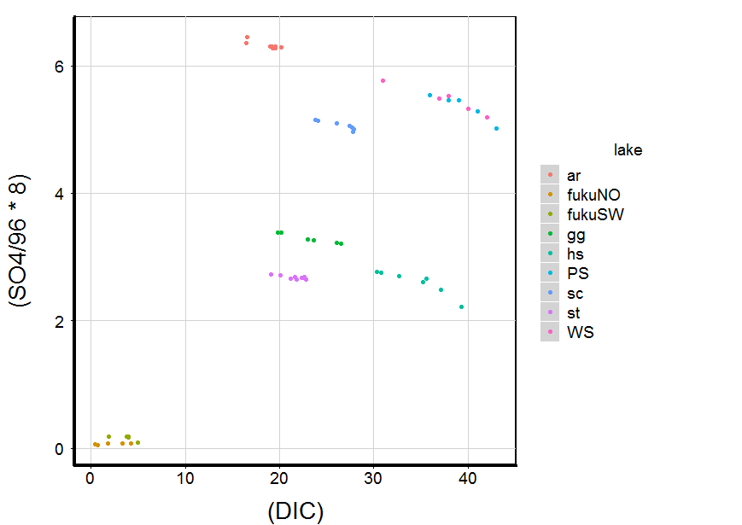

Slide 28
Bathymetry, Sed-Water-Ratios

Slide 29
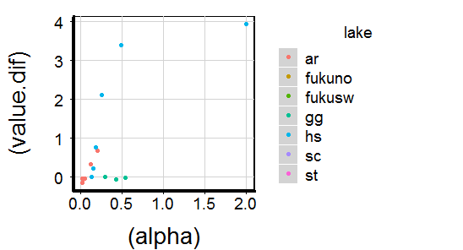
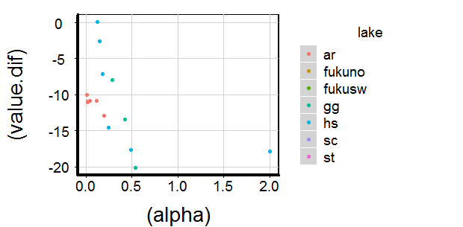
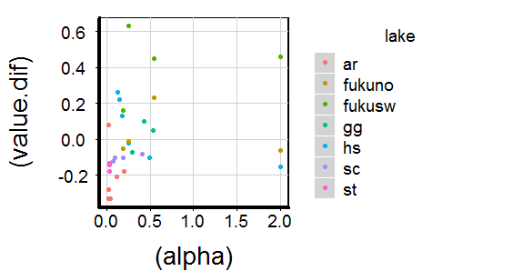
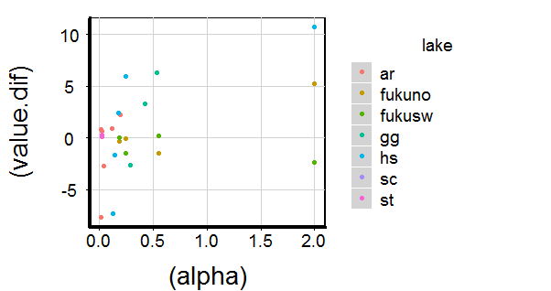
NH4 increase (dif time2-time1)
higher where more sediment
SO4 decreases
Faster where more sediment
DIC increases
faster where more sediment
pH less acidic where more sediment

Slide 30
Finish analysis, esspeciall second run bioassay
Improve “anoxic age” calculation by using real data
Disentangle drivers of biological lability in anoxic waters: nutrient abundance, DOM composition (size fractions, fluorescent components)
Understand DIC dynamics in deep waters: Calcite dissolution, Methanogenesis, Mineralization
(Turbulent-) Diffusive exchange between deep layers: use heat as a tracer (to derive k_{z})

Slide 32
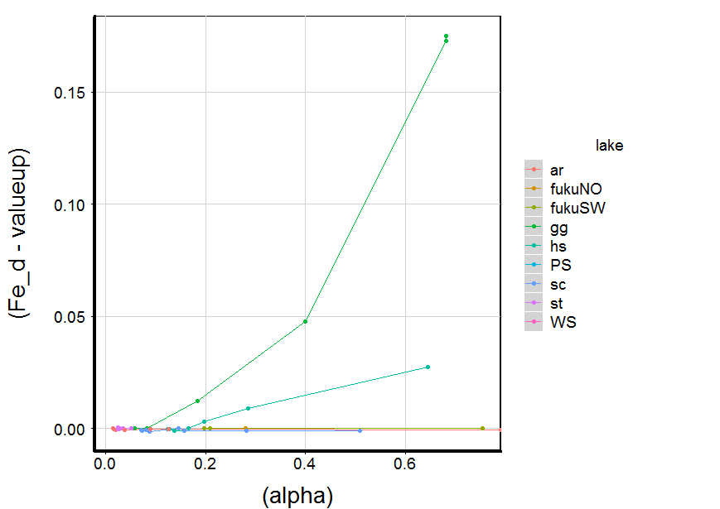
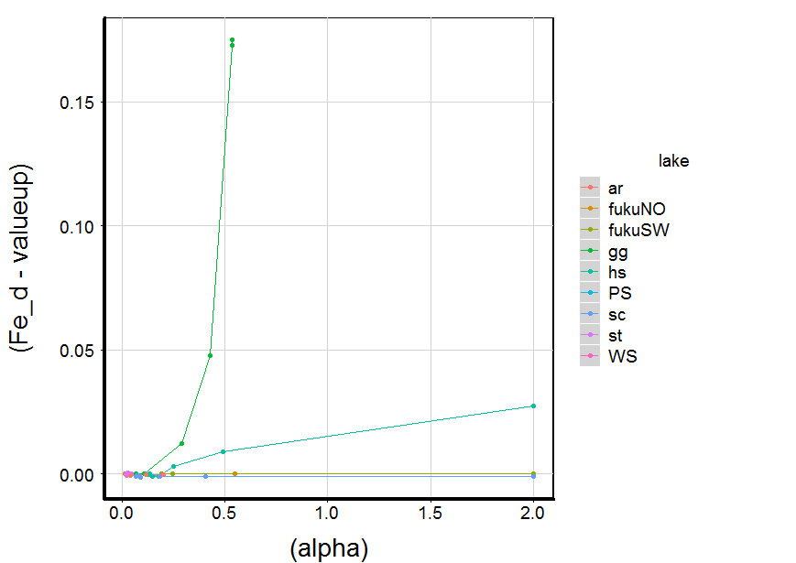
Differenz aus Konzentration an Oberfläche und in der Tiefe, in Abhängigkeit von Sediment:Wasser Verhältnis, hier für Fe

