Slide 1
Паттерны проектирования
Команда

Slide 2
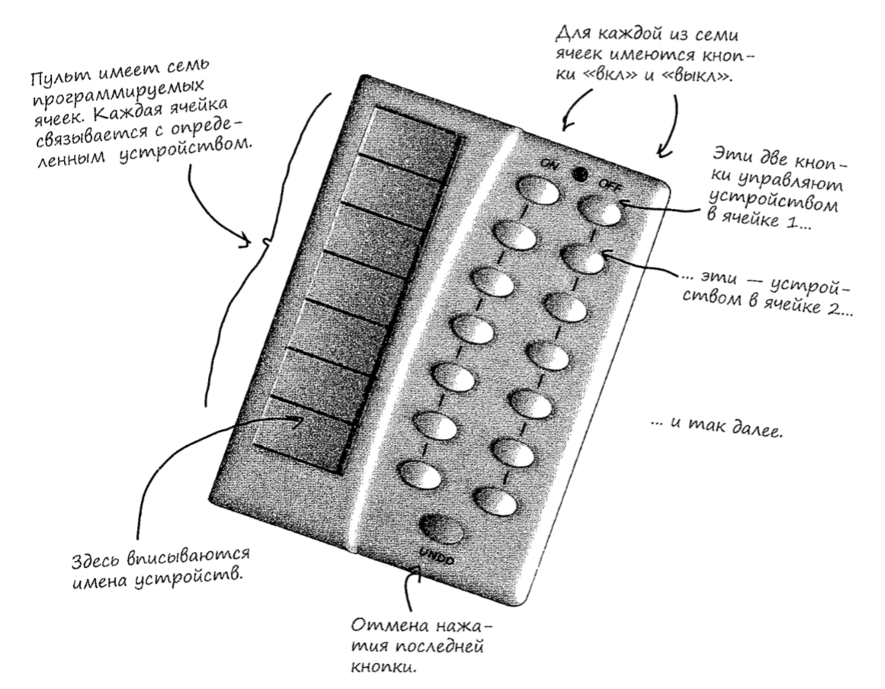
Программирование пульта управления

Slide 3
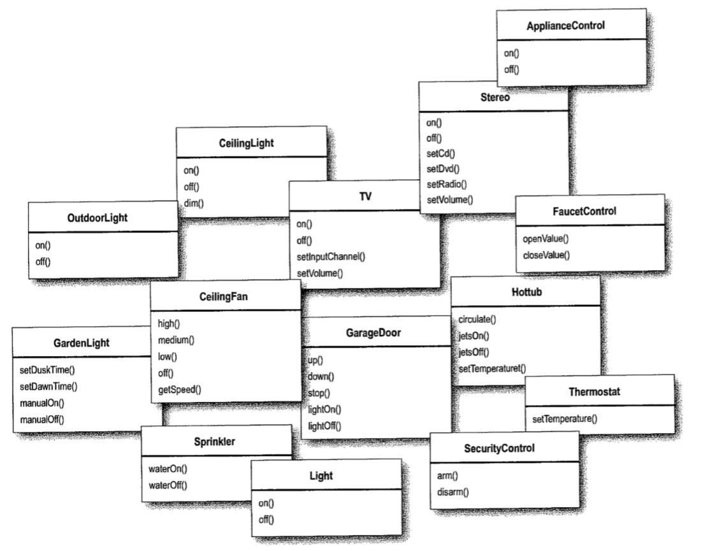
Классы управления устройствами

Slide 4
Реализация интерфейса Command. Реализация команды для включения света
public interface Command { public void execute(); }
public class LigthOnCommand implements Command { Ligth ligth; public LigthOnCommand(Ligth ligth){ this.ligth = ligth; } public void execute(){ ligth.on(); } }

Slide 5
Использование объекта команды
public class SimpleRemoteControl { Command slot; public SimpleRemoteControl(){} public void setCommand(Command command){ slot = command; } public void buttonWathPressed(){ slot.execute(); } }

Slide 6
Тестирование
public class Ligth { public void on(){ System.out.println("Light is on"); } public void off(){ System.out.println("Light is off"); } }
public class SimpleRemoteControl { Command slot; public SimpleRemoteControl(){} public void setCommand(Command command){ slot = command; } public void buttonWathPressed(){ slot.execute(); } }
public interface Command { public void execute(); }
public class Solution { public static void main(String[] args) { SimpleRemoteControl remoteControl = new SimpleRemoteControl(); Ligth ligth = new Ligth(); LigthOnCommand ligthOn = new LigthOnCommand(ligth); remoteControl.setCommand(ligthOn); remoteControl.buttonWathPressed(); } }
public class LigthOnCommand implements Command { Ligth ligth; public LigthOnCommand(Ligth ligth){ this.ligth = ligth; } public void execute(){ ligth.on(); } }
Light is on

Slide 7
Добавление еще одного устройства
public class GarageDoor { public void up(){ System.out.println("The door is up"); } public void down(){ System.out.println("The door is down"); } public void stop(){ System.out.println("The door is stopped"); } public void lightOn(){ System.out.println("The light in garage is on"); } public void lightOff(){ System.out.println("The light in garage is off"); } }
public class Solution { public static void main(String[] args) { SimpleRemoteControl remoteControl = new SimpleRemoteControl(); Ligth ligth = new Ligth(); LigthOnCommand ligthOn = new LigthOnCommand(ligth); GarageDoor garageDoor = new GarageDoor(); GarageDoorOpenCommand garageOpen = new GarageDoorOpenCommand(garageDoor); remoteControl.setCommand(ligthOn); remoteControl.buttonWasPressed(); remoteControl.setCommand(garageOpen); remoteControl.buttonWasPressed(); } }
public class GarageDoorOpenCommand implements Command { GarageDoor garageDoor; GarageDoorOpenCommand(GarageDoor garageDoor){ this.garageDoor = garageDoor; } public void execute(){ garageDoor.up(); } }
Light is on
The door is up

Slide 8

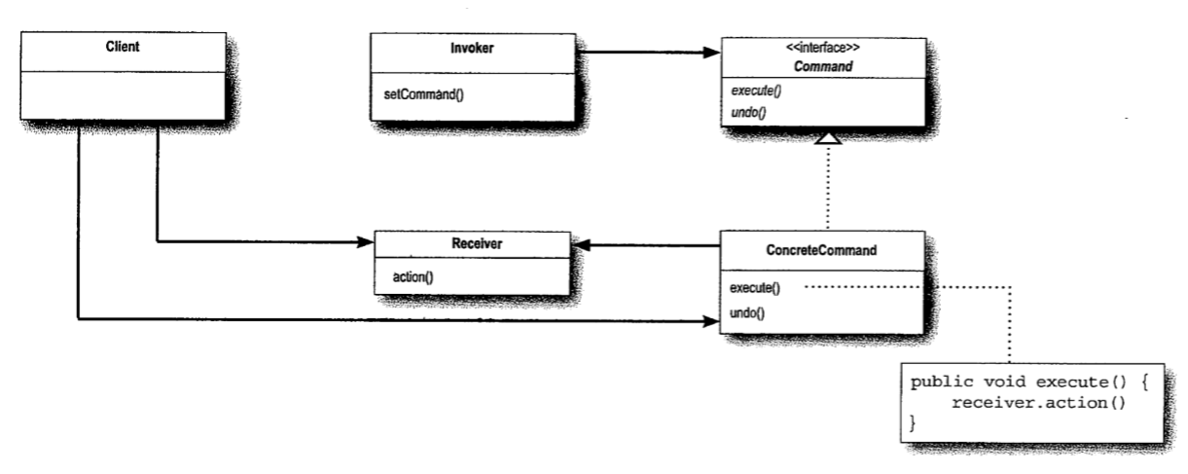
Определение паттерна

Slide 9
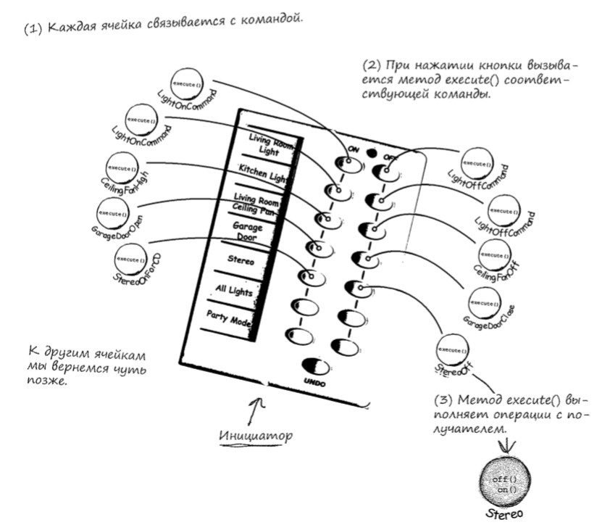
Связывание команд с ячейками

Slide 10
Реализация пульта
public class RemoteControl { Command [] onCommands; Command [] offcommands; public RemoteControl(){ onCommands = new Command[7]; offcommands = new Command[7]; Command noCommand = new NoCommand(); for (int i = 0; i < 7; i++){ onCommands[i] = noCommand; offcommands[i] = noCommand; } } public void setCommand(int slot, Command onCommand, Command offCommmand){ onCommands[slot] = onCommand; offcommands[slot] = offCommmand; } public void onButtonWasPushed(int slot){ onCommands[slot].execute(); } public void offButtonWasPushed(int slot){ offcommands[slot].execute(); } public String toString(){ StringBuffer stringBuffer = new StringBuffer(); stringBuffer.append("\n------ Remote Control ------\n"); for (int i = 0; i < onCommands.length; i++){ stringBuffer.append("[slot " + i + "] " + onCommands[i].getClass().getName() + " " + offcommands[i].getClass().getName() + "\n"); } return stringBuffer.toString(); } }

Slide 11
Реализация команд для класса Light
public class Light { private String location; public Light(String location){ this.location = location; } public void on(){ System.out.println(location + " Light is on"); } public void off(){ System.out.println(location + " Light is off"); } }
public class LightOnCommand implements Command { Light light; public LightOnCommand(Light light){ this.light = light; } public void execute(){ light.on(); } }
public class LightOffCommand implements Command{ Light light; public LightOffCommand(Light light){ this.light = light; } public void execute(){ light.off(); } }

Slide 12
Реализация команд для класса Stereo
public class Stereo { private String location; public Stereo(String location){ this.location = location; } public void on(){ System.out.println(location + " Stereo is on"); } public void off(){ System.out.println(location + " Stereo is off"); } public void setSD(){ System.out.println(location + " stereo is set for CD input"); } public void setDVD(){ System.out.println(location + " stereo is set for DVD input"); } public void setRadio(){ System.out.println(location + " Radio is set"); } public void setVolume(int volume){ System.out.println(location + " stereo volume set to " + volume); } }
public class StereoOnWihtCDCommand implements Command { Stereo stereo; public StereoOnWihtCDCommand(Stereo stereo){ this.stereo = stereo; } public void execute(){ stereo.on();; stereo.setSD();; stereo.setVolume(10); } }
public class StereoOffCommand implements Command { Stereo stereo; public StereoOffCommand(Stereo stereo){ this.stereo = stereo; } public void execute(){ stereo.off(); } }

Slide 13
Тестирование кода
public class RemoteLoader { public static void main(String[] args) { RemoteControl remoteControl = new RemoteControl(); Light livingRoomLight = new Light("Living Room"); Light kitchenLight = new Light("Kitchen"); GarageDoor garageDoor = new GarageDoor(); Stereo stereo = new Stereo("Living Room"); LightOnCommand livingRoomLightOn = new LightOnCommand(livingRoomLight); LightOnCommand kitchenLightOn = new LightOnCommand(kitchenLight); LightOffCommand livingRoomLightOff = new LightOffCommand(livingRoomLight); LightOffCommand kitchenLightOff = new LightOffCommand(kitchenLight); GarageDoorOpenCommand garageDoorOpen = new GarageDoorOpenCommand(garageDoor); GarageDoorCloseCommand garageDoorClose = new GarageDoorCloseCommand(garageDoor); StereoOnWihtCDCommand stereoOnWihtCD = new StereoOnWihtCDCommand(stereo); StereoOffCommand stereoOff = new StereoOffCommand(stereo); remoteControl.setCommand(0, livingRoomLightOn, livingRoomLightOff); remoteControl.setCommand(1, kitchenLightOn, kitchenLightOff); remoteControl.setCommand(2, garageDoorOpen, garageDoorClose); remoteControl.setCommand(3, stereoOnWihtCD, stereoOff); System.out.println(remoteControl); remoteControl.onButtonWasPushed(0); remoteControl.onButtonWasPushed(3); remoteControl.offButtonWasPushed(3); remoteControl.offButtonWasPushed(0); remoteControl.onButtonWasPushed(1); remoteControl.offButtonWasPushed(1); remoteControl.onButtonWasPushed(2); remoteControl.offButtonWasPushed(2); } }
------ Remote Control ------
[slot 0] LightOnCommand LightOffCommand
[slot 1] LightOnCommand LightOffCommand
[slot 2] GarageDoorOpenCommand GarageDoorCloseCommand
[slot 3] StereoOnWihtCDCommand StereoOffCommand
[slot 4] NoCommand NoCommand
[slot 5] NoCommand NoCommand
[slot 6] NoCommand NoCommand
Living Room Light is on
Living Room Stereo is on
Living Room stereo is set for CD input
Living Room stereo volume set to 10
Living Room Stereo is off
Living Room Light is off
Kitchen Light is on
Kitchen Light is off
The garage door is up
The garage door is down

Slide 14

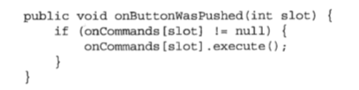
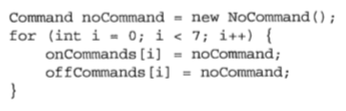
Объект noCommand

Slide 15
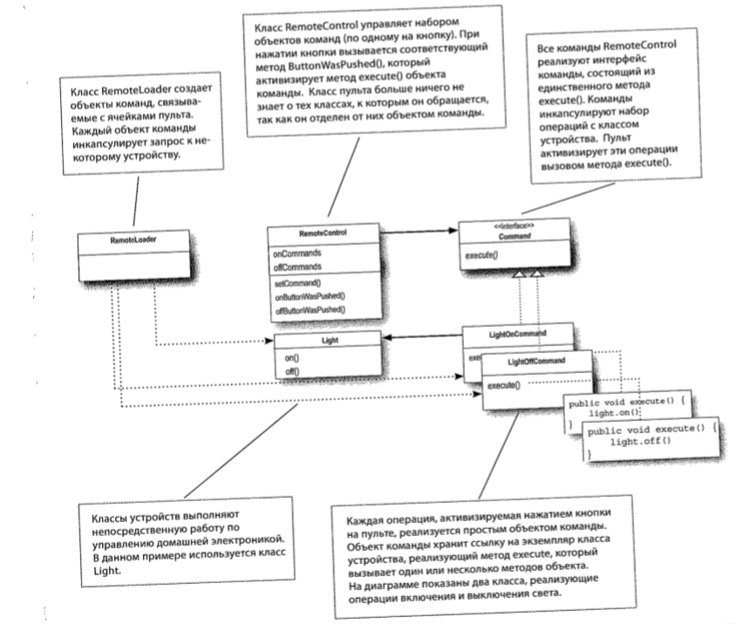
Архитектура

Slide 16
Механизм отмены
public interface Command { public void execute(); public void undo(); }
public class LightOnCommand implements Command { Light light; public LightOnCommand(Light light){ this.light = light; } public void execute(){ light.on(); } public void undo(){ light.off(); } }
public class LightOffCommand implements Command{ Light light; public LightOffCommand(Light light){ this.light = light; } public void execute(){ light.off(); } public void undo(){ light.on(); } }

Slide 17
Изменения в RemoteControl
public class RemoteControl { Command [] onCommands; Command [] offcommands; Command undoCommand; public RemoteControl(){ onCommands = new Command[7]; offcommands = new Command[7]; Command noCommand = new NoCommand(); for (int i = 0; i < 7; i++){ onCommands[i] = noCommand; offcommands[i] = noCommand; } undoCommand = noCommand; } public void setCommand(int slot, Command onCommand, Command offCommmand){ onCommands[slot] = onCommand; offcommands[slot] = offCommmand; } public void onButtonWasPushed(int slot){ onCommands[slot].execute(); undoCommand = onCommands[slot]; } public void offButtonWasPushed(int slot){ offcommands[slot].execute(); undoCommand = offcommands[slot]; } public void undoButtonWasPushed(){ undoCommand.undo(); } public String toString(){ ……… } }

Slide 18
Тестирование кнопки отмены
------ Remote Control ------
[slot 0] LightOnCommand LightOffCommand
[slot 1] NoCommand NoCommand
[slot 2] NoCommand NoCommand
[slot 3] NoCommand NoCommand
[slot 4] NoCommand NoCommand
[slot 5] NoCommand NoCommand
[slot 6] NoCommand NoCommand
[undoCommand] NoCommand
Living Room Light is on
Living Room Light is off
------ Remote Control ------
[slot 0] LightOnCommand LightOffCommand
[slot 1] NoCommand NoCommand
[slot 2] NoCommand NoCommand
[slot 3] NoCommand NoCommand
[slot 4] NoCommand NoCommand
[slot 5] NoCommand NoCommand
[slot 6] NoCommand NoCommand
[undoCommand] LightOffCommand
Living Room Light is on
Living Room Light is off
Living Room Light is on
------ Remote Control ------
[slot 0] LightOnCommand LightOffCommand
[slot 1] NoCommand NoCommand
[slot 2] NoCommand NoCommand
[slot 3] NoCommand NoCommand
[slot 4] NoCommand NoCommand
[slot 5] NoCommand NoCommand
[slot 6] NoCommand NoCommand
[undoCommand] LightOnCommand
Living Room Light is off
public class RemoteLoaderWithUndo { public static void main(String[] args) { RemoteControlWithUndo remoteControl = new RemoteControlWithUndo(); Light livingRoomLight = new Light("Living Room"); LightOnCommand livingRoomLightOn = new LightOnCommand(livingRoomLight); LightOffCommand livingRoomLightOff = new LightOffCommand(livingRoomLight); remoteControl.setCommand(0, livingRoomLightOn, livingRoomLightOff); System.out.println(remoteControl); remoteControl.onButtonWasPushed(0); remoteControl.offButtonWasPushed(0); System.out.println(remoteControl); remoteControl.undoButtonWasPushed(); remoteControl.offButtonWasPushed(0); remoteControl.onButtonWasPushed(0); System.out.println(remoteControl); remoteControl.undoButtonWasPushed(); } }

Slide 19
Реализация отмены с состоянием
public class CeilingFan { public static final int HIGH = 3; public static final int MEDIUM = 2; public static final int LOW = 1; public static final int OFF = 0; String location; int speed; public CeilingFan(String location){ this.location = location; speed = OFF; } public void high(){ speed = HIGH; System.out.println(location + " ceiling fan is on high"); } public void medium(){ speed = MEDIUM; System.out.println(location + " ceiling fan is on medium"); } public void low(){ speed = LOW; System.out.println(location + " ceiling fan is on low"); } public void off(){ speed = OFF; System.out.println(location + " ceiling fan is off"); } public int getSpeed(){ return speed; } }
public class CeilingFanHighCommand implements Command{ CeilingFan ceilingFan; int prevSpeed;
public CeilingFanHighCommand(CeilingFan ceilingFan){ this.ceilingFan = ceilingFan; } public void execute(){ prevSpeed = ceilingFan.getSpeed(); ceilingFan.high(); } public void undo(){ if (prevSpeed == CeilingFan.HIGH){ ceilingFan.high(); } else if (prevSpeed == CeilingFan.MEDIUM){ ceilingFan.medium(); } else if (prevSpeed == CeilingFan.LOW){ ceilingFan.low(); } else if (prevSpeed == CeilingFan.OFF){ ceilingFan.off(); } } }

Slide 20
Тестирование
public class RemoteLoaderWithFan { public static void main(String[] args) { RemoteControlWithUndo remoteControl = new RemoteControlWithUndo(); CeilingFan ceilingFan = new CeilingFan("Living room"); CeilingFanHighCommand ceilingFanHigh = new CeilingFanHighCommand(ceilingFan); CeilingFanLowCommand ceilingFanLow = new CeilingFanLowCommand(ceilingFan); CeilingFanMediumCommand ceilingFanMedium = new CeilingFanMediumCommand(ceilingFan); CeilingFanOffCommand ceilingFanOff = new CeilingFanOffCommand(ceilingFan); remoteControl.setCommand(0, ceilingFanLow, ceilingFanOff); remoteControl.setCommand(1, ceilingFanMedium, ceilingFanOff); remoteControl.setCommand(2, ceilingFanHigh, ceilingFanOff); remoteControl.onButtonWasPushed(1); remoteControl.offButtonWasPushed(1); System.out.println(remoteControl); remoteControl.undoButtonWasPushed(); remoteControl.onButtonWasPushed(2); System.out.println(remoteControl); remoteControl.undoButtonWasPushed(); } }
Living room ceiling fan is on medium
Living room ceiling fan is off
------ Remote Control ------
[slot 0] CeilingFanLowCommand CeilingFanOffCommand
[slot 1] CeilingFanMediumCommand CeilingFanOffCommand
[slot 2] CeilingFanHighCommand CeilingFanOffCommand
[slot 3] NoCommand NoCommand
[slot 4] NoCommand NoCommand
[slot 5] NoCommand NoCommand
[slot 6] NoCommand NoCommand
[undoCommand] CeilingFanOffCommand
Living room ceiling fan is on medium
Living room ceiling fan is on high
------ Remote Control ------
[slot 0] CeilingFanLowCommand CeilingFanOffCommand
[slot 1] CeilingFanMediumCommand CeilingFanOffCommand
[slot 2] CeilingFanHighCommand CeilingFanOffCommand
[slot 3] NoCommand NoCommand
[slot 4] NoCommand NoCommand
[slot 5] NoCommand NoCommand
[slot 6] NoCommand NoCommand
[undoCommand] CeilingFanHighCommand
Living room ceiling fan is on medium

