Slide 1
Паттерны проектирования
Адаптер

Slide 2
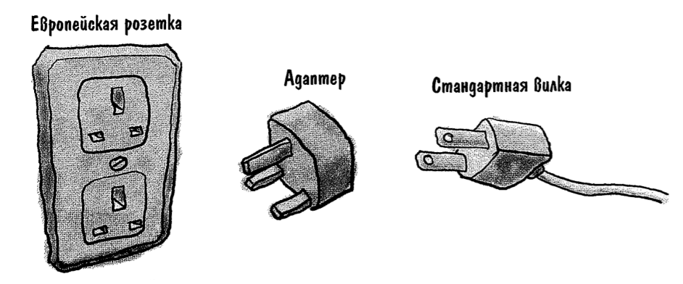
Пример адаптера

Slide 3
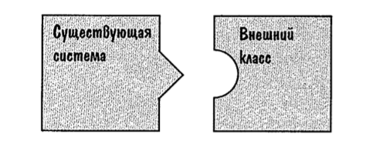
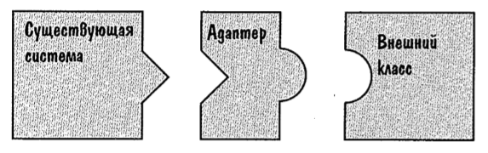
Объектно-ориентированные адаптеры

Slide 4
Утки - индюки
public interface Duck { public void quack(); public void fly(); }
public interface Turkey { public void goggle(); public void fly(); }
public class MallardDuck implements Duck { @Override public void quack() { System.out.println("Quack"); } @Override public void fly() { System.out.println("I'm flying"); } }
public class WildTurkey implements Turkey { @Override public void goggle() { System.out.println("Gobble gobble"); } @Override public void fly() { System.out.println("I'm flying a short distance"); } }

Slide 5
Адаптер индюка к утке
public class TurkeyAdapter implements Duck { Turkey turkey; public TurkeyAdapter(Turkey turkey){ this.turkey = turkey; } @Override public void quack() { turkey.goggle(); } @Override public void fly() { for (int i = 0; i < 5; i++){ turkey.fly(); } } }

Slide 6
Тестирование
public class Solution { public static void main(String[] args) { MallardDuck duck = new MallardDuck(); WildTurkey turkey = new WildTurkey(); Duck turkeyAdapter = new TurkeyAdapter(turkey); System.out.println("The turkey says..."); turkey.goggle();; turkey.fly(); System.out.println("\nThe Duck says..."); testDuck(duck); System.out.println("\nThe TurkeyAdapter says..."); testDuck(turkeyAdapter); } static void testDuck(Duck duck){ duck.quack();; duck.fly(); } }
The turkey says...
Gobble gobble
I'm flying a short distance
The Duck says...
Quack
I'm flying
The TurkeyAdapter says...
Gobble gobble
I'm flying a short distance
I'm flying a short distance
I'm flying a short distance
I'm flying a short distance
I'm flying a short distance

Slide 7
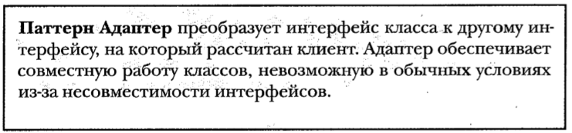
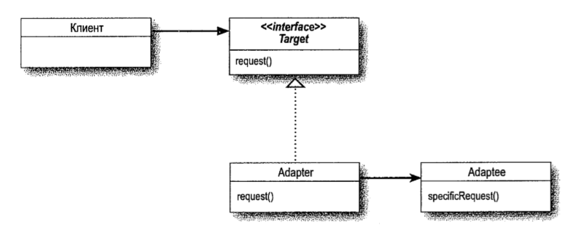
Определение паттерна

