Slide 1
Паттерны проектирования
Итератор

Slide 2
Реализация класса MenuItem
public class MenuItem { String name; String description; boolean vegeterian; double price; public MenuItem(String name, String description, boolean vegeterian, double price){ this.name = name; this.description = description; this.vegeterian = vegeterian; this.price = price; } public String getName() { return name; } public String getDescription() { return description; } public double getPrice() { return price; } public boolean isVegeterian() { return vegeterian; } }

Slide 3
Две реализации меню
public class DinerMenu { static final int MAX_ITEMS = 6; int numberOfItems = 0; MenuItem [] menuItems; public DinerMenu(){ menuItems = new MenuItem[MAX_ITEMS]; addItem("Soup of the day",
"Soup with a side of potato salad",
false,
3.29); addItem("Bacon",
"Bacon with tomato",
false,
2.99); addItem("Vegeterian Bacon",
"Soya becon with tomato",
true,
2.99); addItem("Hotdog",
"Hotdog with onions",
false,
3.05); } public void addItem(String name, String description,
boolean vegeterian, double price){ MenuItem menuItem = new MenuItem(name, description, vegeterian, price); if (numberOfItems >= MAX_ITEMS){ System.err.println("Sorry, menu is full"); } else { menuItems[numberOfItems] = menuItem; numberOfItems = numberOfItems + 1; } } public MenuItem[] getMenuItems(){ return menuItems; } }
public class PancakeHouseMenu { ArrayList menuItems; public PancakeHouseMenu(){ menuItems = new ArrayList(); addItem("Simple Breakfast",
"Pancakes with eggs, and toast",
true,
2.99); addItem("Regular Breakfast",
"Pancakes with fried eggs, sausage",
false,
2.99); addItem("Blueberry Pancakes",
"Pancakes made with fresh blueberries",
true,
3.49); addItem("Waffles",
"Waffles with strawberryes",
true,
3.59); } public void addItem(String name, String description,
boolean vegeterian, double price){ MenuItem menuItem = new MenuItem(name, description,
vegeterian, price); menuItems.add(menuItem); } public ArrayList getMenuItems(){ return menuItems; } }

Slide 4
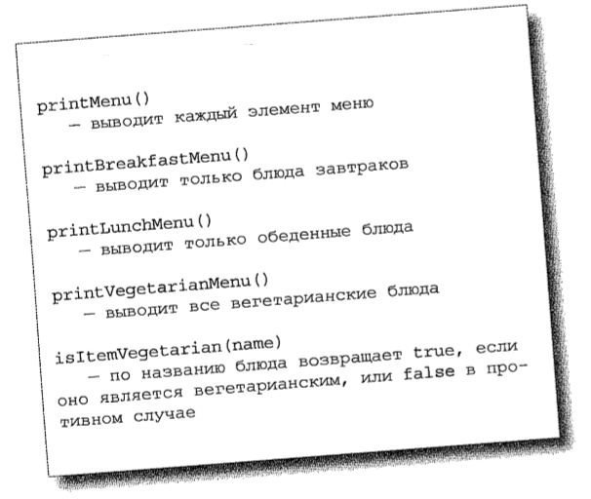
Спецификация клиента, использующего оба меню

Slide 5
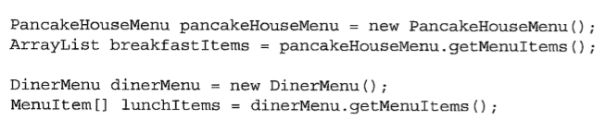
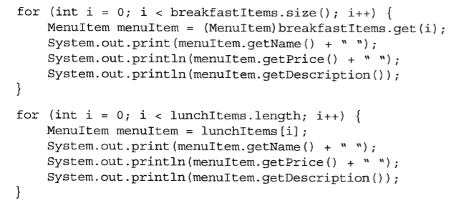
Реализация метода printMenu()

Slide 6
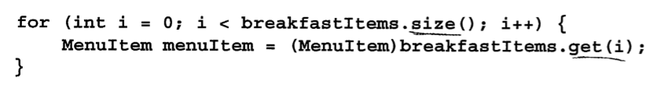
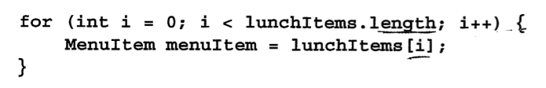
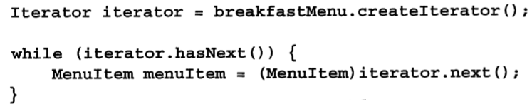
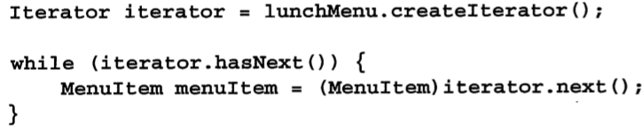
Инкапсуляция перебора элементов

Slide 7
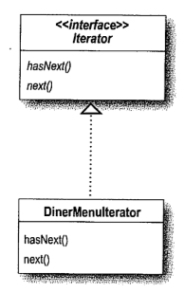
Паттерн итератор
public interface Iterator { boolean hasNext(); Object next(); }
public class DinerMenuIterator implements Iterator { MenuItem[] items; int position = 0; public DinerMenuIterator(MenuItem[] items){ this.items = items; } public Object next(){ MenuItem menuItem = items[position]; position = position + 1; return menuItem; } public boolean hasNext() { if (position >= items.length || items[position] == null){ return false; } else { return true; } } }

Slide 8
Изменения в DinerMenu
public class DinerMenu { static final int MAX_ITEMS = 6; int numberOfItems = 0; MenuItem [] menuItems; public DinerMenu(){ menuItems = new MenuItem[MAX_ITEMS]; addItem("Soup of the day", "Soup with a side of potato salad", false, 3.29); addItem("Bacon", "Bacon with tomato", false, 2.99); addItem("Vegeterian Bacon", "Soya becon with tomato", true, 2.99); addItem("Hotdog", "Hotdog with onions", false, 3.05); } public void addItem(String name, String description, boolean vegeterian, double price){ MenuItem menuItem = new MenuItem(name, description, vegeterian, price); if (numberOfItems >= MAX_ITEMS){ System.err.println("Sorry, menu is full"); } else { menuItems[numberOfItems] = menuItem; numberOfItems = numberOfItems + 1; } }
public MenuItem[] getMenuItems(){ return menuItems; } public Iterator createIterator(){ return new DinerMenuIterator(menuItems); } }

Slide 9
Изменения в PancakeHouseIterator
public class PancakeHouseIterator implements Iterator { ArrayList<MenuItem> items; int position = 0; public PancakeHouseIterator(ArrayList<MenuItem> items){ this.items = items; } public Object next(){ MenuItem menuItem = items.get(position); position = position + 1; return menuItem; } public boolean hasNext() { if (position >= items.size()){ return false; } else { return true; } } }

Slide 10
Изменение кода Waitress
public class Waitress { PancakeHouseMenu pancakeHouseMenu; DinerMenu dinerMenu; public Waitress(PancakeHouseMenu pancakeHouseMenu, DinerMenu dinerMenu){ this.pancakeHouseMenu = pancakeHouseMenu; this.dinerMenu = dinerMenu; } public void printMenu(){ Iterator pancakeIterator = pancakeHouseMenu.createIterator(); Iterator dinnerIterator = dinerMenu.createIterator(); System.out.println("MENU\n-----\nBREAKFAST"); printMenu(pancakeIterator); System.out.println("\nLUNCH"); printMenu(dinnerIterator); } private void printMenu(Iterator iterator){ while(iterator.hasNext()){ MenuItem menuItem = (MenuItem)iterator.next(); System.out.print(menuItem.getName() + ", "); System.out.print(menuItem.getPrice() + " __ "); System.out.println(menuItem.getDescription()); } } }

Slide 11
Тестирование
public class Solution { public static void main(String[] args) { PancakeHouseMenu pancakeHouseMenu = new PancakeHouseMenu(); DinerMenu dinerMenu = new DinerMenu(); Waitress waitress = new Waitress(pancakeHouseMenu, dinerMenu); waitress.printMenu(); } }
MENU
-----
BREAKFAST
Simple Breakfast, 2.99 __ Pancakes with eggs, and toast
Regular Breakfast, 2.99 __ Pancakes with fried eggs, sausage
Blueberry Pancakes, 3.49 __ Pancakes made with fresh blueberries
Waffles, 3.59 __ Waffles with strawberryes
LUNCH
Soup of the day, 3.29 __ Soup with a side of potato salad
Bacon, 2.99 __ Bacon with tomato
Vegeterian Bacon, 2.99 __ Soya becon with tomato
Hotdog, 3.05 __ Hotdog with onions

Slide 12
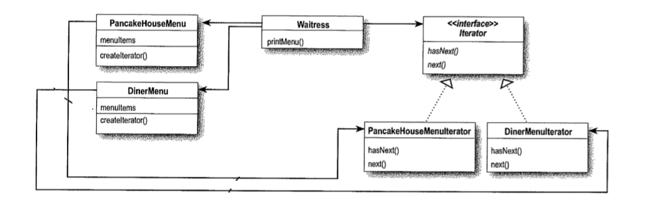
Диаграмма классов

Slide 13
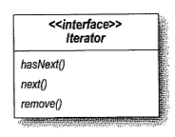
Интеграция с java.util.Iterator
import java.util.ArrayList; import java.util.Iterator; public class PancakeHouseMenu { ArrayList menuItems; public PancakeHouseMenu(){ menuItems = new ArrayList(); addItem("Simple Breakfast", "Pancakes with eggs, and toast", true, 2.99); addItem("Regular Breakfast", "Pancakes with fried eggs, sausage", false, 2.99); addItem("Blueberry Pancakes", "Pancakes made with fresh blueberries", true, 3.49); addItem("Waffles", "Waffles with strawberryes", true, 3.59); } public void addItem(String name, String description, boolean vegeterian, double price){ MenuItem menuItem = new MenuItem(name, description, vegeterian, price); menuItems.add(menuItem); } public Iterator createIterator(){ return menuItems.iterator(); } }

Slide 14
Изменения в DinerMenuIterator
import java.util.Iterator; public class DinerMenuIterator implements Iterator { MenuItem[] items; int position = 0; public DinerMenuIterator(MenuItem[] items){ this.items = items; } public Object next(){ MenuItem menuItem = items[position]; position = position + 1; return menuItem; } public boolean hasNext() { if (position >= items.length || items[position] == null){ return false; } else { return true; } } public void remove(){ if(position <= 0) { throw new IllegalStateException("You can't remove an item until you've done at least one next()"); } if (items[position - 1] != null){ for (int i = position - 1; i < (items.length - 1); i++){ items[i] = items[i + 1]; } items[items.length - 1] = null; } } }

Slide 15
Общий интерфейс Menu
import java.util.Iterator; public class Waitress { Menu pancakeHouseMenu; Menu dinerMenu; public Waitress(Menu pancakeHouseMenu, Menu dinerMenu){ this.pancakeHouseMenu = pancakeHouseMenu; this.dinerMenu = dinerMenu; } public void printMenu(){ Iterator pancakeIterator = pancakeHouseMenu.createIterator(); Iterator dinnerIterator = dinerMenu.createIterator(); System.out.println("MENU\n-----\nBREAKFAST"); printMenu(pancakeIterator); System.out.println("\nLUNCH"); printMenu(dinnerIterator); } private void printMenu(Iterator iterator){ while(iterator.hasNext()){ MenuItem menuItem = (MenuItem)iterator.next(); System.out.print(menuItem.getName() + ", "); System.out.print(menuItem.getPrice() + " __ "); System.out.println(menuItem.getDescription()); } } }
import java.util.Iterator; public interface Menu { public Iterator createIterator(); }
public class PancakeHouseMenu implements Menu{
…
}
public class DinerMenu implements Menu {
…
}

Slide 16
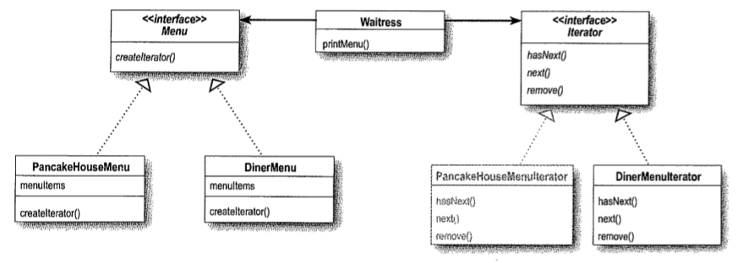
Итоговая диаграмма классов

Slide 17


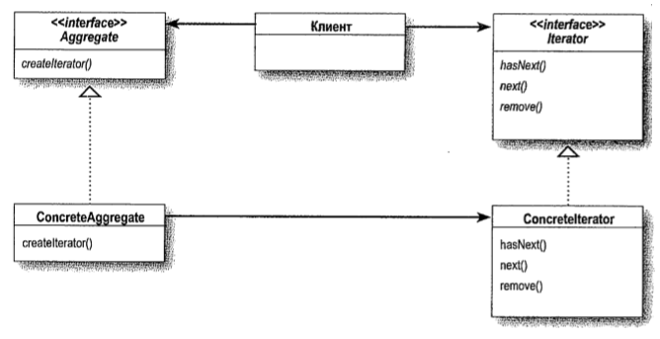
Определение паттерна Итератор

