Slide 1
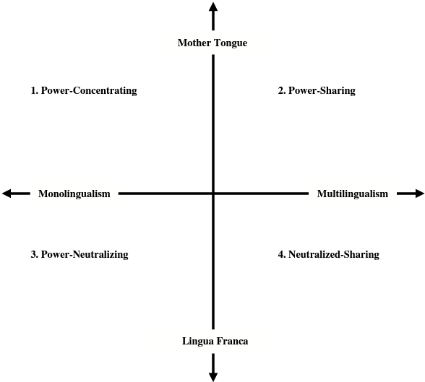
Source: Liu 2015

Slide 2
China
Taiwan(1945-2007)
Korea
Taiwan(2007-present)
Malaysia
Indonesia
Singapore
India
Philippines

Slide 3
China
Taiwan(1945-2007)
Taiwan(2007-present)
Singapore

