Slide 1
Chapter 1: Introduction
Software Engineering
WiSe 2018

Slide 2

software craftsman with heart and soul
computer science in Magdeburg
1 year VW
since then software developer in Braunschweig
Since 6 years
First version of these lectures in winter term 2018

Slide 3
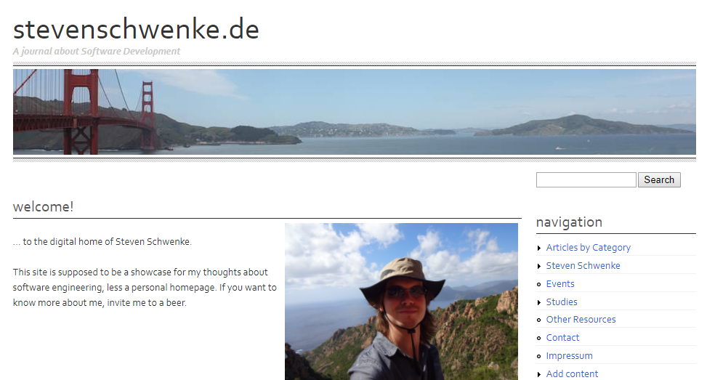
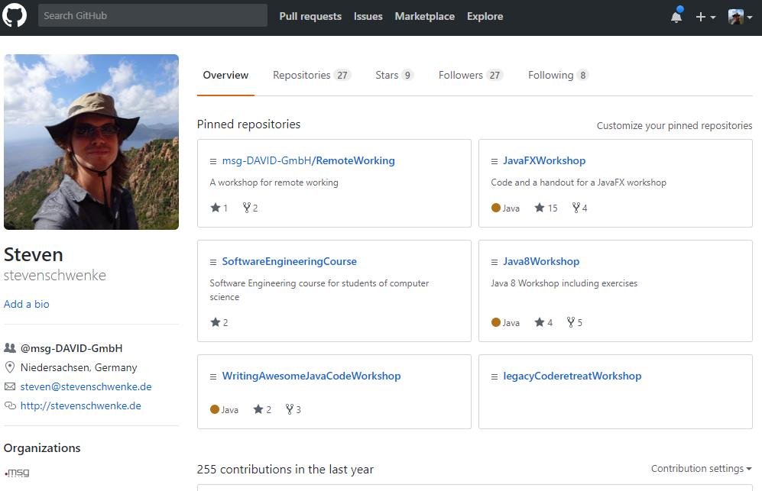
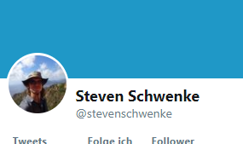

Slide 4
Who are you?
Computer Science?
Dream Job?
English? German?

Slide 5
Who are you?
Java?
TDD?
Junit?
Scrum?
Actual work experience?

Slide 6
Who are you?
Whishes & suggestions for the course?
- Enter here -

Slide 7
Goals

Slide 8
What it‘s NOT about

Slide 9
Requirements

Slide 10
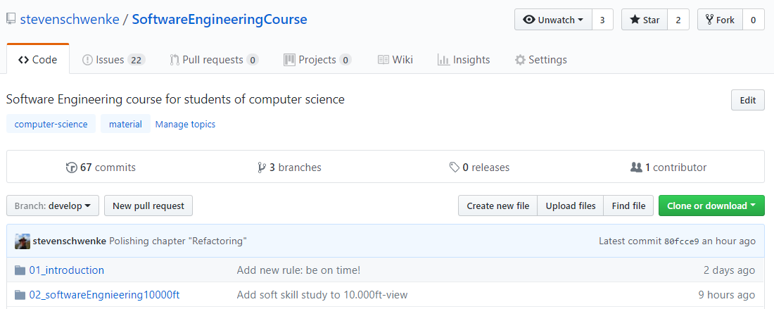
Material

Slide 11
Time Table – Weekend Sessions?
Notes:
Klären, zu welchen Uhrzeiten die Wochenendseminare sein sollen. Mittag? Hat was auf?

Slide 12
Rules

