Slide 1
Chapter 1: Introduction
Software Engineering
SoSe 2018

Slide 2

software craftsman with heart and soul
computer science in Magdeburg
1 year VW
since then software developer in Braunschweig
Since 5 years

Slide 3
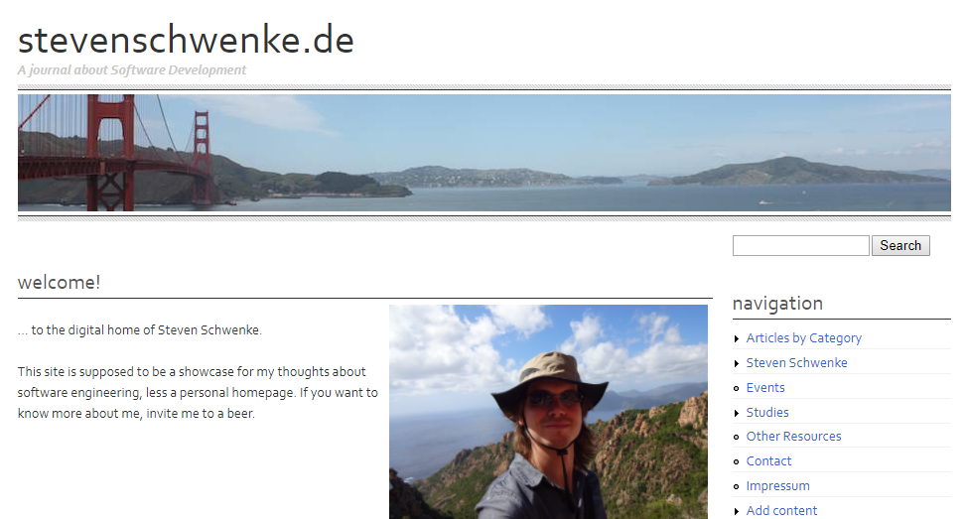
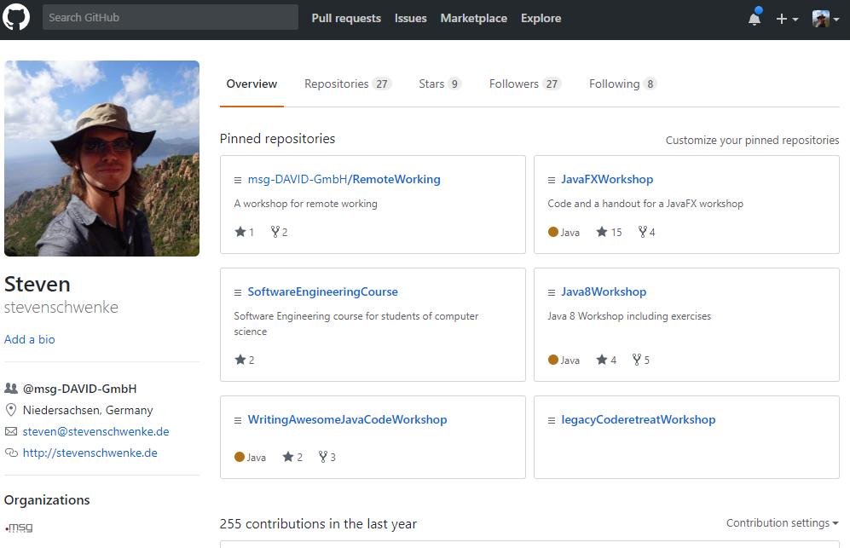
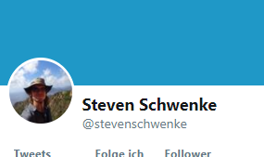

Slide 4
Who are you?
Computer Science?
Dream Job?
English? German?

Slide 5
Who are you?
Java?
TDD?
Junit?
Scrum?
Actual work experience?

Slide 6
Who are you?
Whishes & suggestions for the course?
- Enter here -

Slide 7
Goals

Slide 8
What it‘s NOT about

Slide 9
Requirements

Slide 10
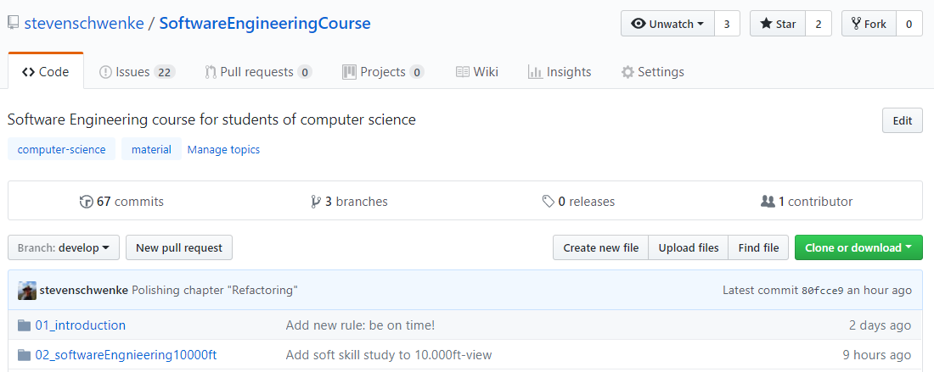
Material

Slide 11
Rules

