Slide 1
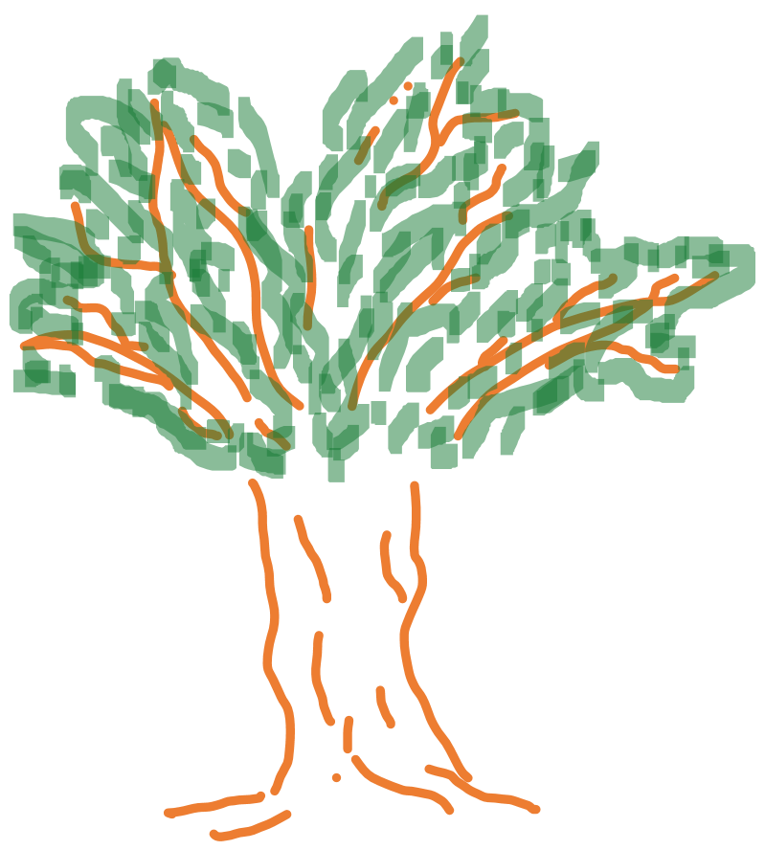
Chapter 2:
Software Engineering 10.000ft view

Slide 2
Biological Approach
Software is grown …

Slide 3
Biological Approach
… not built.

Slide 4
Models and
Best Practices
Code
Community
Elements of
Software Engineering
Tools
Soft Skills
Processes

