Slide 1
Chapter 15:
Cloud + Microservices

Slide 2
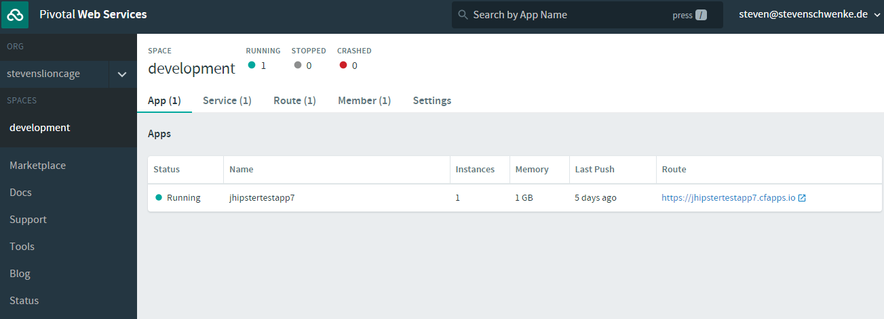
Accessibility

Slide 3
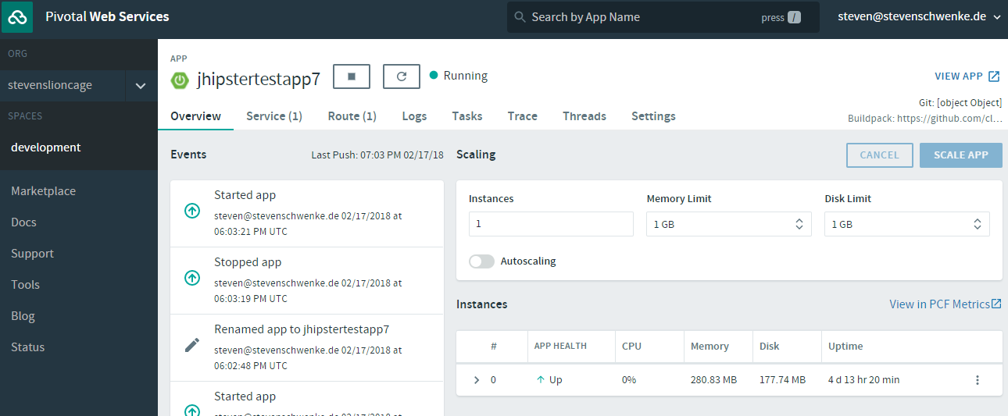
„Hyper-Scale“

Slide 4
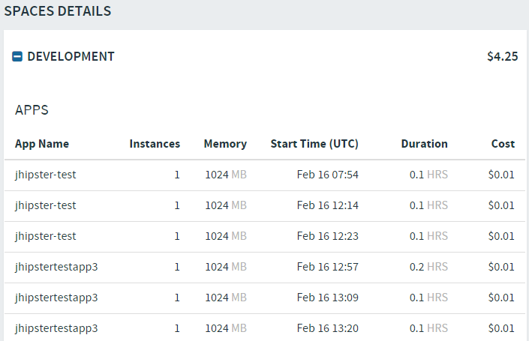
Efficiency

Slide 5
Pyramid of Layers
SaaS
PaaS
IaaS

Slide 6





Pyramid of Layers

Slide 7


Slide 8
History-Lesson

Slide 9

History-Lesson

Slide 10
History-Lesson

Slide 11

History-Lesson

Slide 12
You are not Google!

