Slide 1

Chapter 18
Ethics in Software Engineering

Slide 2
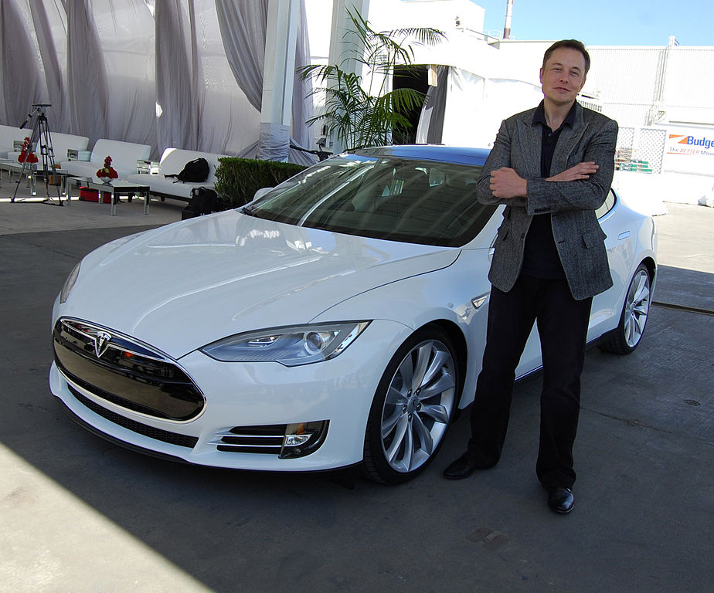

Slide 3
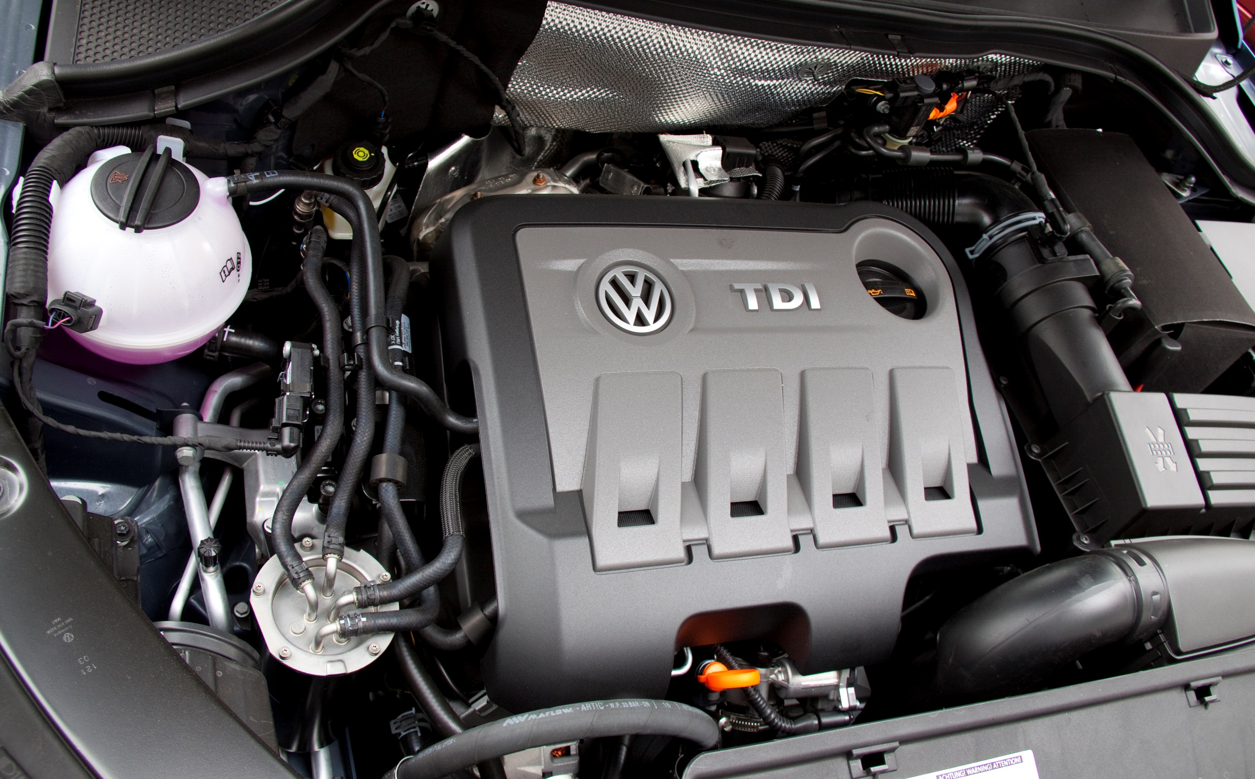

Slide 4
Data
Licensing
Aspects of Ethics
in Software Engineering
Algorithms and
Functionality
Plain Security

Slide 5
Who is responsible?

Slide 6
Who is responsible?
YOU ARE

Slide 7
Who is responsible?
YOU ARE
If you f*ck up,
people will die.

