Slide 1
DESIGN FOR SCREENS · ASSIGNMENT 3 — WEEK 1
UX RESEARCH & PROCESS
Research
& Discovery
Dieter Rams Portfolio Website
Max McDonough
Emily Carr University of Art + Design
March 2026
PERSONA · EMPATHY MAP · JOURNEY · USER FLOW · SITE MAP · MOOD BOARD · PRECEDENT · WIREFRAMES

Slide 2
01 — DESIGNER PERSONA
Dieter Rams
Architect of Quiet Objects
Dieter Rams is one of the most influential industrial designers of the twentieth century. Trained as an architect and carpenter, he joined Braun in 1955 and rose to become Head of Design — a role he held for over three decades, producing some of the most enduring objects in design history.
His grandfather, a master carpenter, instilled a belief in craftsmanship and honest materials. This early influence shaped a philosophy centered on restraint and purpose — the conviction that good design should serve the user without demanding attention.
DR
"I believe designers should eliminate the unnecessary. That means products should be neither more nor less than what they need to be."
BORN 20 May 1932
EDUCATION Architecture
BRAUN 1955–1997
VITSOE 1959–Present

Slide 3
01 — DESIGNER PERSONA
Profile & Motivations
MOTIVATION
PHILOSOPHY
Never commercial. Rams believed designers have a responsibility to reduce visual and physical pollution, to create things that last, and to resist the pressure of trends.
Design is an ethical practice, not a styling exercise. The best design is invisible — it serves the user without demanding attention or applause.
APPROACH
LEGACY
Mathematical precision in every element. A unified design language maintained across hundreds of products over decades. Form always follows function.
The Ten Principles became the closest thing industrial design has to a universal ethical framework. His work directly influenced Apple's design language under Jonathan Ive.
INDUSTRIAL DESIGN
FUNCTIONALISM
MINIMALISM
SUSTAINABILITY
BRAUN
VITSOE
ARCHITECTURE
SYSTEMS THINKING

Slide 4
02 — EMPATHY MAP
Inside the Mind of Dieter Rams
SAYS
THINKS
· "Less, but better."
· "Indifference towards people and the reality in which they live is actually the one and only cardinal sin in design."
· We are surrounded by too many things — too much visual noise, too many products that serve no real purpose.
· Designers have a moral responsibility to consider the environmental and social impact of what they create.
DOES
FEELS
· Designs with mathematical precision — every element in exact proportion.
· Maintains a consistent design language across hundreds of products spanning decades.
· Deep pride in work that has endured — products like the 606 shelf still manufactured unchanged.
· Genuine concern about overconsumption and the role design plays in environmental destruction.

Slide 5
02 — EMPATHY MAP
Pain Points & Goals
PAIN POINTS
GOALS
The disposability of modern products — things designed to be replaced rather than repaired. The commercialization of design as a styling exercise rather than an ethical practice. Seeing his own legacy at Braun eroded by market-driven aesthetics after his departure.
To leave behind a framework — the Ten Principles — that helps future designers make responsible choices. To prove that functionality and beauty are not in opposition. To ensure that objects like the 606 system continue to serve people for generations, not seasons.

Slide 6
03 — DESIGNER JOURNEY MAP
A Life in Design
01
02
03
Formation
Early Braun
Golden Era
1932–1955
1955–1961
1961–1976
Childhood, carpentry apprenticeship, architecture studies. Grandfather instills craftsmanship values.
Hired as architect, pivots to product design. Co-creates the SK4 'Snow White's Coffin.'
Head of Design at Braun. Creates T3, 606, ET 66. Establishes Braun's unified design system.
Purposeful
Breakthrough
Peak Output

Slide 7
03 — DESIGNER JOURNEY MAP
Philosophy to Legacy
04
05
06
Ten Principles
Departure
Legacy & Renewal
1976
1980s–1997
1997–Present
Codifies his philosophy into ten principles — the most enduring ethical framework in design. Taught in design schools globally.
Braun shifts to market-driven aesthetics. Rams watches his design language be abandoned. Retires after 42 years.
Ive cites Rams as primary influence. The 2018 documentary introduces his philosophy to a new generation. 606 remains in production.
Defining Moment
Bittersweet
Enduring

Slide 8
"Indifference towards people and the reality in which they live is actually the one and only cardinal sin in design."
— DIETER RAMS

Slide 9
04 — USER FLOW
Navigation Architecture
Land on Site
→
Hero
→
About
→
Principles
→
Work
↓
Filter Products?
Braun
All
Vitsoe
Legacy
→
Timeline
→
Contact
→
Submit Enquiry?
→
Confirmation
→
Exit

Slide 10
05 — SITE MAP
Content Architecture
Dieter Rams Portfolio Website
Hero
About
Principles
Work
Legacy
Timeline
Contact
Name, tagline
Scroll CTA
Portrait, bio
Metadata
10 principle
cards (2-col)
Filter buttons
8 product cards
6 influence
areas
1932–Present
10 key events
Enquiry form
Studio info

Slide 11
06 — MOOD BOARD
Visual Direction
COLOR PALETTE
PRIMARY TYPE
ACCENT TYPE
Aa
Aa
#1A1916
#2A2825
#6B6860
#B0ADA5
#E8E6E0
#F5F4F0
#C8442A
Calibri Light
Georgia Italic
TEXTURES
VISUAL KEYWORDS
RESTRAINED
FUNCTIONAL
HONEST
TIMELESS
PRECISE
QUIET
SYSTEMATIC
INDUSTRIAL
WARM NEUTRAL
PURPOSEFUL
Speaker Grille
Perforated
SPACING SCALE
8
16
24
32
48
64
80
120

Slide 12
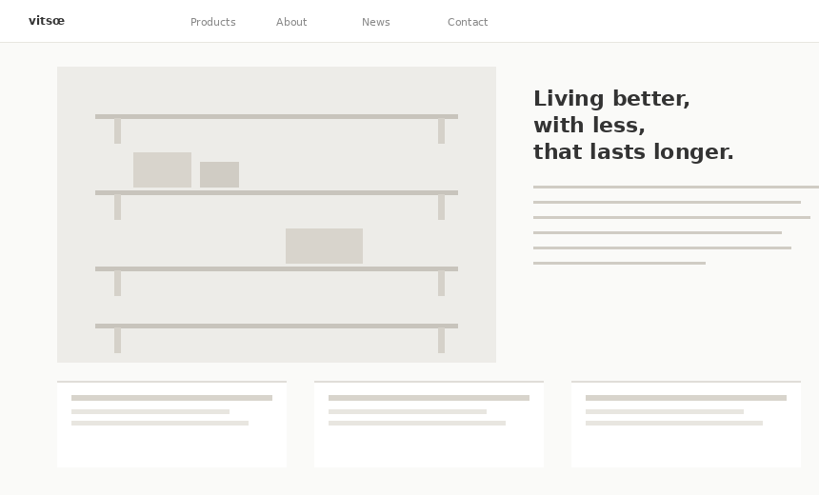
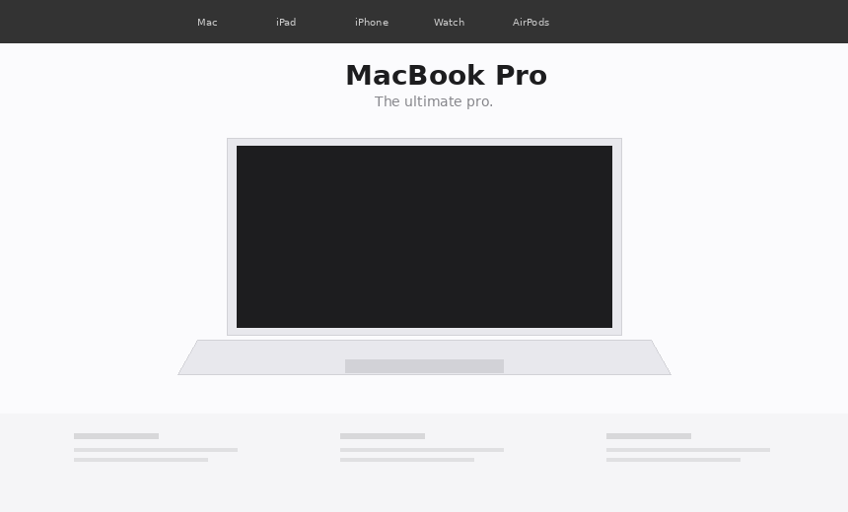
07 — PRECEDENT & INSPIRATION
Sites That Informed Mine
VITSOE.COM
APPLE.COM — PRODUCT PAGES
Design as Philosophy
Progressive Disclosure
Clean e-commerce meets editorial design. Extensive whitespace, restrained typography, photography that lets the furniture speak. The site embodies the Rams philosophy digitally.
The most direct digital descendant of Rams's approach. Large hero images, minimal text, progressive disclosure. Typography does the heavy lifting.
KEY TAKEAWAYS
KEY TAKEAWAYS
· Content-first hierarchy
· Editorial product storytelling
· Restrained warm-neutral palette
· Hero-centric layouts with dramatic negative space
· Progressive scroll storytelling
· Products as visual centerpiece

Slide 13
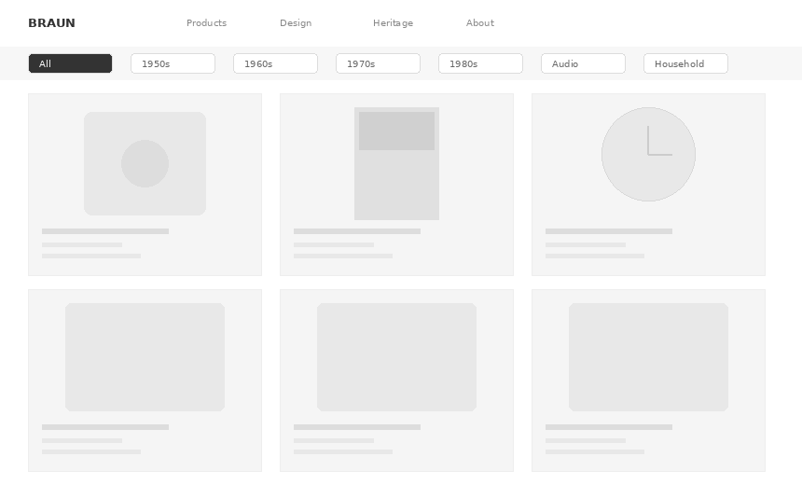
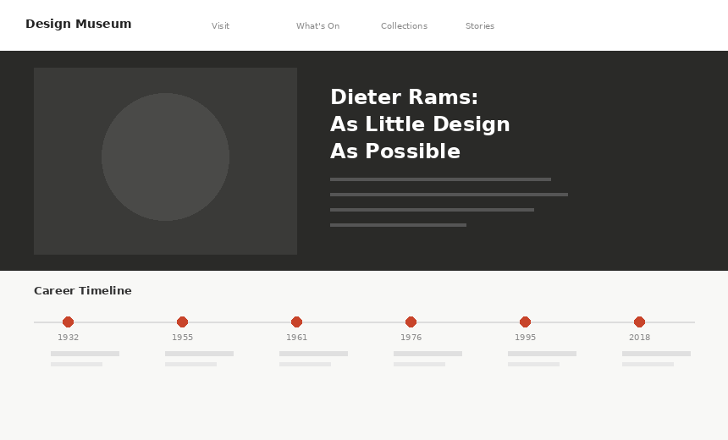
07 — PRECEDENT & INSPIRATION
Grid Curation & Editorial Approaches
BRAUN.COM — DESIGN COLLECTION
DESIGNMUSEUM.ORG
Grid-Based Curation
Editorial Biography
Clean grid of products with history and context. Filter-based navigation by decade and category allows intentional exploration.
Rich narrative text, timeline integration, contextual quotes. The reading experience mimics a well-designed magazine spread.
KEY TAKEAWAYS
KEY TAKEAWAYS
· Grid-based galleries with consistent card ratios
· Category filtering as primary navigation
· Timeline integration for context
· Editorial biography format with narrative flow
· Timeline as storytelling device
· Contextual quotes break up long-form content

Slide 14
07 — SYNTHESIS
Common Patterns & Application
Whitespace as Content
Typography Hierarchy
Scroll as Interaction
Every precedent treats negative space as a deliberate design element — reducing cognitive load and creating visual quiet.
Sans-serif for interface and body, with serif accents for editorial moments. Weight and size create structure.
Content reveals progressively. The viewport becomes a frame that moves through content rather than jumping between pages.
Grid Systems
Minimal Navigation
Content-First Design
Consistent grid structures — from product galleries to editorial layouts — create mathematical precision.
A thin fixed bar with essential links. The content itself guides the user, not the chrome around it.
The interface serves the content rather than competing with it. Design is unobtrusive.

Slide 15
08 — WIREFRAMES
Desktop Layouts
HERO
ABOUT
PRINCIPLES
WORK
TIMELINE
CONTACT

Slide 16
08 — WIREFRAMES
Mobile Responsive
HERO
ABOUT
PRINCIPLES
WORK
CONTACT

Slide 17
Dieter Rams
Weniger, aber besser.
Max McDonough
Design for Screens — Assignment 3, Week 1 Research
Emily Carr University of Art + Design
March 2026

