Slide 1
Reactjs Introduction

Slide 2
Overview
React is a CLIENT side framework
Uses Component architecture
Think custom HTML tags
Combines Model, View, and Controller in the same file
Usually creates a Single Page App (SPA)
Uses react-router module to navigate on the browser
Uses MVC (in the browser)
Uses new language, JSX (JavaScript with XML)
Must use a compiler to translate into JavaScript
Use babel to translate (trans-compiler)
Uses AJAX to communicate with server

Slide 3
Components
Each Component has
Model – stored in the this.state hash property
View – called by React via the render() method
Controller – called by the view when an event occurs
Actually, think View ➔ Controller ➔ Model
The View collects User Input (mouse clicks, etc), passes event to the Controller (methods in the Component)
The Controller calls the business logic, updates the Model
Uses this.setState( { name: value } );
React AUTOMATICALLY notices that the Model changed and renders() the View for changed Components ONLY.

Slide 4
Client Side Framework
It is a Client side framework
In the HTML
Use <script> tag to load modules
‘react’ – the main code
‘react-dom’ – accesses the browser’s DOM
‘react-router’ -- creates the page’s topology
‘babel/browser.js’ – converts the JSX to JS
‘components.js’ – my JSX code – transpiled
Contains the React application code

Slide 5
React Example 1 – fullPage.html
File ➔ javascripts/fullPage.js – contains the React app
<!DOCTYPE html> <html lang="en"> <head> <meta charset="UTF-8"> <title>TODO List</title> <link rel="stylesheet" href="stylesheets/style.css"> </head> <body> <div id="fullPage"></div> <script src="components/jquery/dist/jquery.js"></script> <script src="components/react/react.js"></script> <script src="components/react/react-dom.js"></script> <script src="components/babel/browser.js"></script> <script src="javascripts/fullPage.js" type="text/babel"></script> </body> </html>
Where to deploy the React app
The React source code

Slide 6
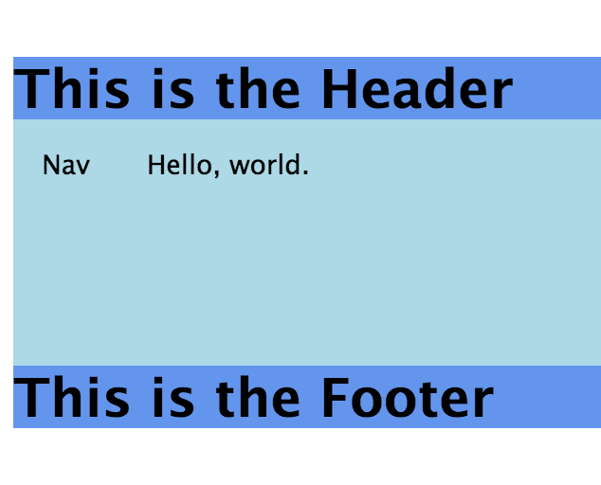
React Example 1:
The React app looks like this
Has multiple Components, <Header>, <Footer>, <Nav>, <Middle>
Parent passes text to the Children

Slide 7
React Example 1:
var Header = React.createClass( { render() { return ( <div className="header"><h1>{this.props.header}</h1></div> ); } }); var Footer = React.createClass( { render() { return ( <div className="footer"><h1>{this.props.footer}</h1></div> ); } }); var Nav = React.createClass( { render() { return ( <div className="nav">{this.props.nav}</div> ); } });
Access attribute: header
Access attribute: footer
Access attribute: nav

Slide 8
React Example 1:
The render() method is on the next page
var Middle = React.createClass( { render() { return ( <div className="middle">{this.props.text}</div> ); } }); var FullPage = React.createClass({ getInitialState() { return { header: 'This is the Header', footer: 'This is the Footer', nav: 'Nav' }; },
Access attribute: text
Model data
this.state.header, this.state.footer
Use this.setState( { name: value })

Slide 9
React Example 1:
render() { return ( <div className="fullPageBox"> <Header header={this.state.header}/> <div className="middle"> <div className="half"> <Nav nav={this.state.nav}/> </div> <div className="half"> <Middle text="Hello, world."/> </div> </div> <Footer footer={this.state.footer} /> </div> ); } }); ReactDOM.render( <FullPage />, document.getElementById('fullPage') );
Reference model data
Where to deploy

Slide 10
Model
Each Component has
Model – stored in the this.state hash property
View – called by React via the render() method
Controller – called by the view when an event occurs
Standard methods in the Component
constructor() – method to initialize the state data
Must call super() first thing – ES6 only
setState( { key; value } ) – changes the state variable
getInitialState() – returns initial state object – non-ES6
React re-renders the Component when
Page refreshed
State property changes -- use setState() method

Slide 11
Controller
The Controller handles events from the DOM
The Controller methods live in the Component
The render() method outputs the view
The HTML uses normal ‘on-’ properties to define the event handler
onClick, onSubmit, onMouseOver, etc.
Use { } to reference the Component methods
NOTICE: no quotes around it

Slide 12
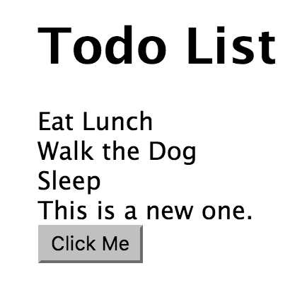
Controller Example
render() { var views = this.state.todos.map((item, idx) => <div key={idx}>{item}</div>); return ( <div className="todo-list-box"> <h1>Todo List</h1> {views} <button onClick={this.click} >Click Me</button> </div> ); }, click: function( event ) { event.preventDefault(); this.setState( {'todos': this.state.todos.concat('This is a new one.')}); }

Slide 13
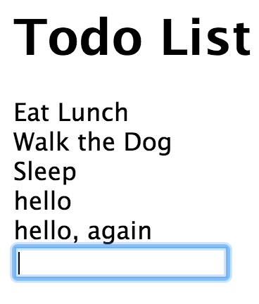
Controller Example 2 - <input>
render() { var views = this.state.todos.map((item, idx) => <div key={idx}>{item}</div>); return ( <div className="todo-list-box"> <h1>Todo List</h1> {views} <form onSubmit={this.addOne}> <input type="text" onChange={this.change} value={this.state.current}/> </form> </div> ); }, change: function (event) { event.preventDefault(); this.setState({'current': event.target.value}); }, addOne: function( event ) { event.preventDefault(); var item = this.state.current.trim(); if (item.length > 0) { this.setState( {'todos': this.state.todos.concat( item ), 'current': ''}); } },

Slide 14
Combining Components
Combine Components just like you would other HTML tags
Data is ALWAYS passed from the parent to the child tag
If the child MUST update some model property in the parent
Pass in an object or function that the child can call
In the parent render() method
Simply use a child component like any other HTML tag
Pass data as an ATTRIBUTE on the child tag
In the child component
Access attribute data using this.props.<attributeName>’
Data will be any type the parent passes.

Slide 15
React Example 1:
render() { return ( <div className="fullPageBox"> <Header header={this.state.header}/> <div className="middle"> <div className="half"> <Nav nav={this.state.nav}/> </div> <div className="half"> <Middle text="Hello, world."/> </div> </div> <Footer footer={this.state.footer} /> </div> ); } });
Reference model data

Slide 16
Virtual DOM
React notices the Model has changed (with setState())
React calls render() of the component
React puts the HTML into an in-memory copy of the DOM
Called the Virtual DOM
If it updated the DOM for each component, it is SLOW
After rendering ALL components (that changed)
It updates differences between the Virtual DOM and the DOM
MUCH faster
Many components have sub components that must change also

Slide 17
AJAX
The React app often uses AJAX to communicate with the server
One of the following sections describes this in great detail.
The most important point is that the AJAX updates the state variable and React automatically re-renders the Components

Slide 18
Summary
React is a Client (browser) framework.
It uses a Component Architecture
Each Component becomes a custom tag in HTML
Each Component has its own MVC (usually in the same file)
Uses a new language, JSX, which combines JavaScript with the view
React compiles the JSX file into JS using babel on the client side
NOTE: we did everything manually in the section
In the following sections, we will use Kraken and its build tools

Slide 19
Navigating Through Pages

Slide 20
Overview
Creating a Single Page App (SPA) requires:
All (most) pages load initially
Pages stored on browser
Data acquired from server
How does React know the topology of pages?
Use the React component, <Router>
Defines the routes (URI paths) present in the app
Path from the React component, <Route>
Defines the path TO component relationship, like Express
Show a React component, <Link>
Tells React to open a different page

Slide 21
Routes.jsx File
Defines the routes available to React
var routes = module.exports = ( <Router history={ReactRouter.browserHistory} > <Route path='/' component={Layout}> <IndexRoute component={Home} /> <Route path="/first" component={First} /> </Route> </Router> );
The outermost Route defines the basic HTML page
All the others are INSIDE the layout page
<IndexRoute> defines the default (initial) page layout
Path, /first, REPLACES the {Home} page with the {First} page
To go to a page, use the <Link> component

Slide 22
Routes.jsx - continued
Define the pages (Components)
var Layout = require('./public/views/layout.jsx'); var Home = require('./public/views/home.jsx'); var First = require('./public/views/first.jsx');
home.jsx has links to the other pages
Shown on the next page

Slide 23
/public/views/home.jsx
var React = require('react'); var Link = require('react-router/lib/Link'); module.exports = React.createClass({ displayName: 'home', render: function render() { return ( <div id='home'> <h1>This is the home page</h1> <h6>I am a React Router rendered view</h6> <Link to='/first'>Click to go to First</Link> <br /> <Link to='/second'>Click to go to Second</Link> <br /> <Link to='/third'>Click to go to Third</Link> <br /> <Link to='/fourth'>Click to go to Fourth</Link> <br /> </div> ); } });
<Link>s to a path
React renders that path
Looks in routes.jsx to see how
Renders the parents of the path

Slide 24
<Link> Component
<Link to='/first'>Click to go to First</Link>
Tells React to display the component whose path is /first
Path defined in routes.jsx previously
Creates the whole page
Renders ./public/views/layout.jsx
This contains the basic HTML page
Then renders ./publice/views/first.jsx
This renders as a child of layout.jsx
If layout.jsx is already rendered,
Renders only first.jsx part

Slide 25
Layout.jsx – Basic HTML Page
render: function render() { return ( <html> <head> <meta charSet='utf-8'/> <title> {this.props.title} </title> <link rel='stylesheet' href='/css/app.css' /> </head> <body> {this.props.children} <script src='/bundle.js'></script> </body> </html> ); }
{this.props.children} – set of components that might render inside layout.jsx
Defined in the routes.jsx
Insert current child of {Layout}
From routes.jsx
Default page is <IndexRoute>
Bundle created from ’grunt build’

Slide 26
Summary
‘react-route’
Uses the config file, ‘routes.jxs’ to defined all routes handled in the browser (as a SPA)
‘routes.jsx’ filename defined in config/config.json’
<Router> -- surrounds the routes available to React
<Route> -- defines the path / component relationshop
<IndexRoute> -- defines the default component for the parent <Route>
Uses <Link> to exchange components in the DOM
{this.props.<attributeName>} – available in the JSX file for children
{this.props.children} – set of components (and paths) defined in the ‘routes.jsx’ and used in the parent component
Makes it easy to define the interaction of components in React

Slide 27
React on Kraken

Slide 28
Overview
Configuring React on Kraken is fairly straight forward
Configure Kraken to use React
For Server Side Rendering (SSR)
For Client Side Rendering (Single Page App)
Configure Kraken routes to start the application
Use /controllers/index.js – path ‘/’ to index file
Configure React routes
/routes.jsx – Define React path to components
Configure the initial /index.js to translate JSX code to plain JS code (transpiler)
Uses babel

Slide 29
Configure Kraken’s view-engine
Server side routing ➔ /config/config.json
"express": { "view engine": "jsx", "view": "require:anemone-machina/lib/expressView", "view cache": false, "views": "path:./public/views" }, "view engines": { "jsx": { "module": "anemone-machina/lib/server", "renderer": { "method": "create", "arguments": [ { "routes": "require:./routes.jsx", "routesFilePath": "path:./routes.jsx" } ] } } },
Where the views are
Where the routes.jsx is

Slide 30
Kraken routes
File /controllers/index.js ➔ Defines path
Renders path = ‘/’
Renders the PATH, not the page name, looks it up in the routes.jsx file
router.get('/', function (req, res) { // res.send('<code><pre>' + JSON.stringify(model, null, 2) + '</pre></code>'); res.render( req.url, model ); });

Slide 31
Routes.jsx File
File routes.jsx → Defines the routes for React and Kraken
var React = require('react'); var ReactRouter = require('react-router'); var Router = ReactRouter.Router; var Route = ReactRouter.Route; var IndexRoute = ReactRouter.IndexRoute; var Layout = require('./public/views/layout.jsx'); var Home = require('./public/views/home.jsx'); var First = require('./public/views/first.jsx'); var routes = module.exports = ( <Router> <Route path='/' component={Layout}> <IndexRoute component={Home} /> <Route path="/first" component={First} /> </Route> </Router> );

Slide 32
Routes.jsx File
Defines the routes available to React and Kraken
var routes = module.exports = ( <Router history={ReactRouter.browserHistory} > <Route path='/' component={Layout}> <IndexRoute component={Home} /> <Route path="/first" component={First} /> </Route> </Router> );
The outermost Route defines the basic HTML page
All the others are INSIDE the layout page
<IndexRoute> defines the default (initial) page layout
Path, /first, REPLACES the {Home} page with the {First} page
To go to a page, use the <Link> component

Slide 33
Render Layout Page
File is /public/views/layout.jsx ➔ HTML page
'use strict'; var React = require('react'); module.exports = React.createClass({ render: function render() { return ( <html> <head> <meta charSet='utf-8' /> <title> {this.props.title} </title> </head> <body> { this.props.children } <script src='/bundle.js'></script> </body> </html> ); } });
DOM location of current child of {Layout}
Client side – combined JS

Slide 34
Babel – Transpiling JSX to JS
File /index.js ➔ main Node program
'use strict'; require('babel-register')({ presets: ['react'] }); var express = require('express'); var kraken = require('kraken-js');
And more…
Babel expects react JSX files

Slide 35
Kraken Ready
Kraken is ready for Server Side Rendering (SSR)
For a SPA, must have Client Side Rendering and Navigation
As shown before, there are a LOT of JS frameworks required
For the build process, let’s combine them into one
Save network time to load them individually
Essentially catenated JS files
Kraken uses browserify
Can also use webpack
Has config file, webpack.config.js

Slide 36
Summary
React is a Client (browser) framework.
Kraken is a Server framework
Kraken with React does Server Side Rendering
Uses routes.jsx to define path → Component relationship
Kraken build (with browserify) creates bundle.js with
All the frameworks, react, jquery, react-dom, babel, etc.
The main.js program (loaded last so it runs after everything is loaded)
Uses a new language, JSX, which combines JavaScript with the view
Both client and server must understand the language
React compiles the JSX file into JS using babel

Slide 37
Lab 1 Exercise
Review the lab instructions in the /instructions/react-kraken.docx file
Use the /lab-kraken folder
Create a new Kraken app
Configure the Kraken app to use React

Slide 38
Lab 2 Exercise
Refer to /instructions/react-routing.docx for the lab
Use the same /lab folder, or the /solution-kraken folder
Create four pages, ‘/public/views/first.jsx – fourth.jsx’
Each page should have two <Link>s
One to point to ‘/’ – the root of the app
One to point to the next page in sequence
The Home component should have links to ALL of the other 4 components.

