Slide 1
Creating Pages with Angular.js

Slide 2
Overview
Angular is a client-side JavaScript Framework for adding interactivity to HTML
Plays well with Jquery
Easy to test
Integrated with Kraken
Is a middleware component
Configure as a new view engine
I18n
Expression Language
Model access
Loops, etc.

Slide 3
Responsive Pages
Traditional Page Refresh Cycle
Click on link, go to next page, click on link, go to next page
Each page loaded from the server
** sequence diagram of browser and server with a link clicked
Response with webpage and assets
To ramp up, angular uses ajax to get only the data that changed.
Click on link, server responds with JSON data
Ajax is hidden from the developer

Slide 4
Directives
Angular uses directive (markers) on an HTML tag to tell it to run some JavaScript code.
<html ng-app=“hello-world”>
<body ng-controller=“HelloWorld”>
<h1>How y’all doin?</h1>
</body></html>
function HelloWorld() {
alert(“Hello World… is ready.”);
}

Slide 5
Modules
NOT THE SAME AS A NODE MODULE!!!!
Where we keep pieces of the Angular application
Make code more maintainable, testable, readable.
Where we define dependencies for the app
Each module can use other Modules
var app = angular.module(‘store’, [ ]);
Array is a list of dependencies (in other files)
Code lives in ‘app.js’ file and included in the HTML page.

Slide 6
Expressions
Insert the dynamic parts into the HTML
<p> ten = {{4 + 6 }} </p>
evaluates to ➔ <p> ten = 10 </p>
<p>{{“Hello” + “ World!!”}} </p>
evaluates to ➔ <p> Hello World! </p>

Slide 7
Directives
<html ng-app=“store”> // module name
<body ng-controller=“StoreController as store”>
Controller as <alias> - used in block
<h1 ng-show=“name”>
Evaluates expression, if true, then shows the element
<h1 ng-hide=“noName”>
Evaluates expression, if true, then hides the element
<div ng-repeat=“product in store.products”>
Repeats the element with ‘product’ as alias in block

Slide 8
Filters
{{ data | filter: options }}
Date
Currency – adds the currency symbol and handle decimal
Uppercase and lowercase
Number
orderBy:
<li ng-repeat=“produce in store.products | orderBy:’-price’”>
Order by property, ‘price’, descending (notice the ‘-’ sign)

Slide 9
Images
<img src=“{{store.image}}” />
Won’t work because it tries to download the image before the expression is evaluated.
<img ng-src=“{{store.image}}”>
The image must be loaded after the javascript has run.

Slide 10
Data Binding
<a ng-click=“tab = 1”>Description</a>
“tab = 1” defines a var tab and assigns it the value, 1
{{tab}} - re-evaluated each time ‘tab’ changes
<div class=“panel” ng-show=“tab === 1”>
….
</div>
<div class=“panel” ng-show=“tab === 2”> …. </div>
<div class=“panel” ng-show=“tab === 3”> … </div>

Slide 11
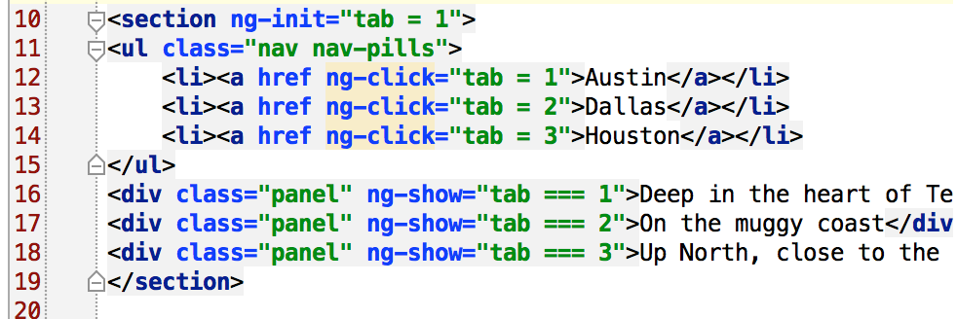
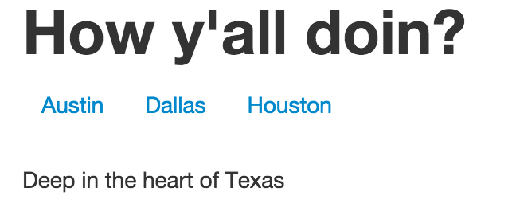
Initialize variables
Initialize the variable so page refresh has a value.

Slide 12
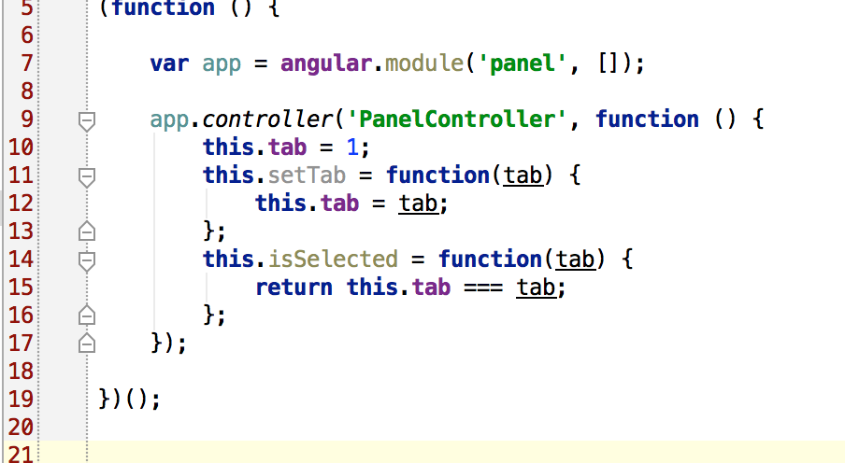
Panel Controller
Move logic to a controller.

Slide 13
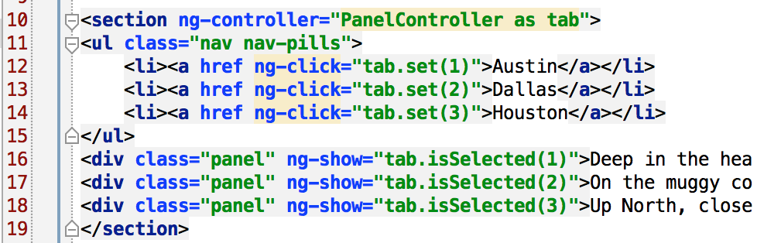
Panel Controller
Move logic to a controller.

Slide 14
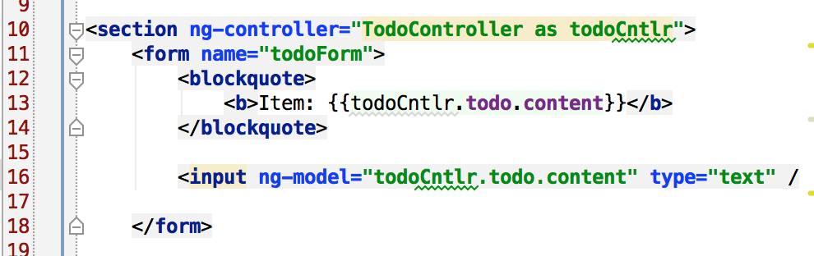
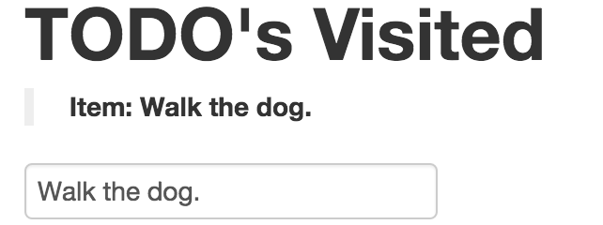
Form element Binding
Bind the input field to the todo.content property on the controller.

Slide 15
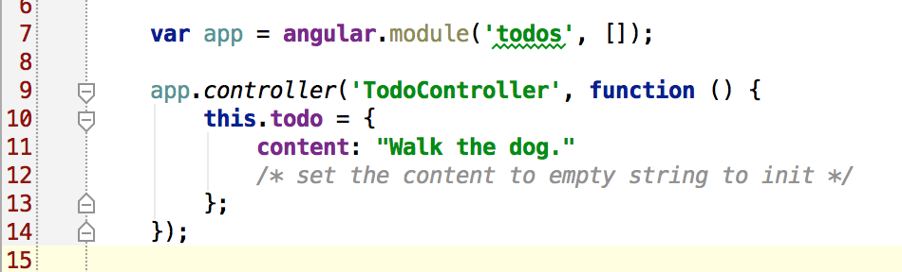
Form element Binding
Access the todo content with:
<controller-variable>.todo.content

Slide 16
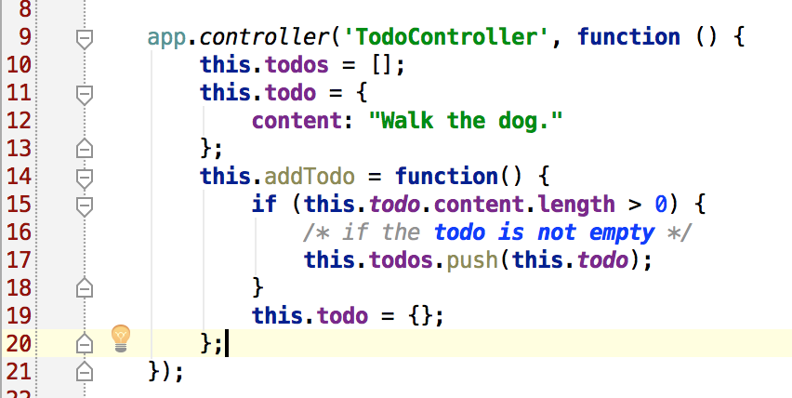
Submitting a form
Create an array of todo items.
Create the addTodo() method – the todo object is already set

Slide 17
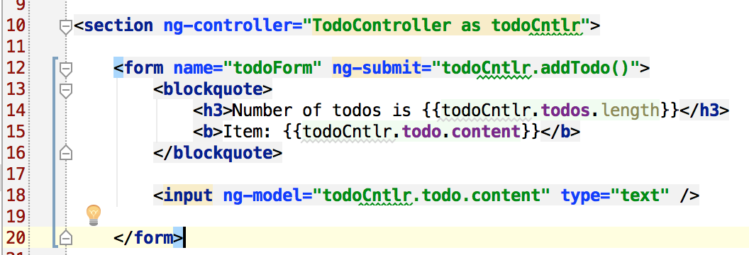
Submitting a form
On the submit, it calls the addTodo() method on the controller
It binds the input field to the todo.content property on the controller.

Slide 18
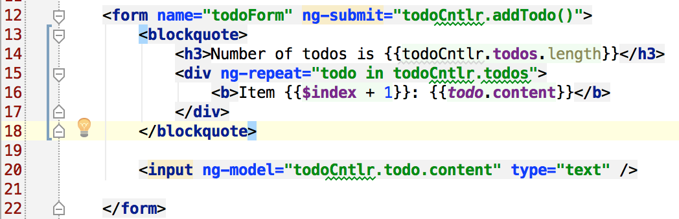
Render a List
Use ng-repeat=“alias as array”
Use alias in the block
Repeat the block for each element in the array

Slide 19
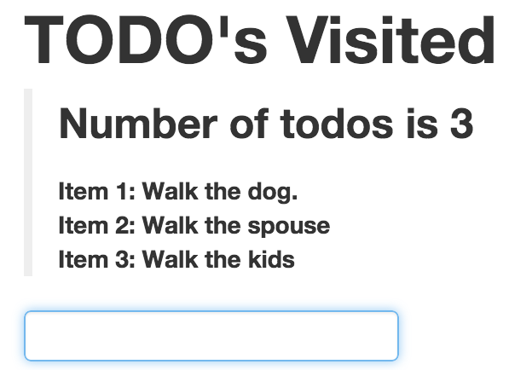
Render a List

Slide 20
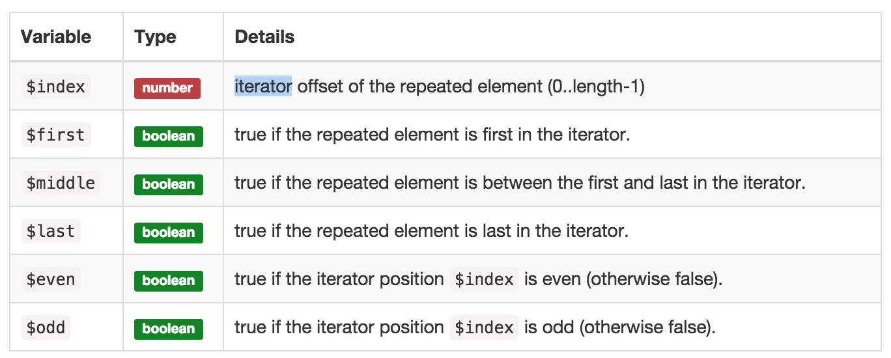
Ng-repeat Properties
From the Angular docs
https://docs.angularjs.org/api/ng/directive/ngRepeat

Slide 21
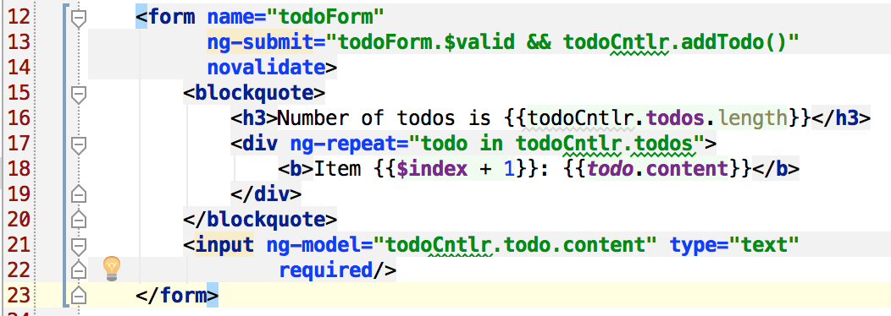
Validations
Input field is now required
Form, todoForm, had property, $valid, set before the submit
Only calls addTodo() if the form fields are valid
Form attribute, novalidate, mean no HTML5 validation

Slide 22
Validation Input Classes
Default Angular validation CSS classes
Source before typing
<input name=“author” ng-model=“….” type=“email” required />
Source after typing, with invalid email
<input name=“author” … class=‘ng-pristine ng-invalid” />
Source after typing, with VALID email
<input name=“author” … class=“ng-dirty ng-valid” />

Slide 23
Validation Types
Angular built-in validations
<input type=“email” name=“email” />
<input type=“url” name=“homepage” />
<input type=“number” name=“quantity” />
optional: min=“1” max=“5”

Slide 24
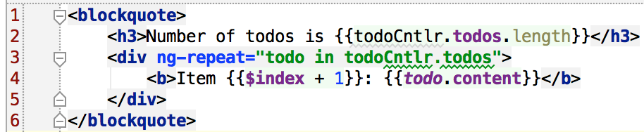
HTML Snippets
Reuse source code with ng-include
todoArray.html
todoSnippets.html
Results
What we started with!!!

Slide 25
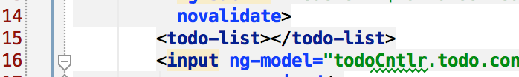
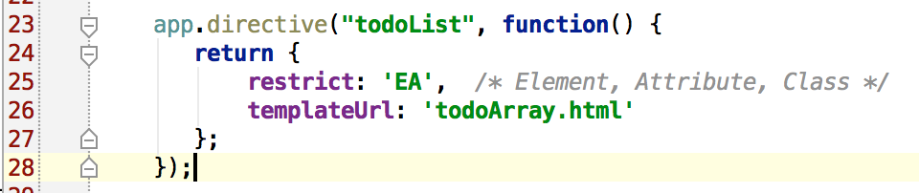
Custom Directives
Directive for Element, Attribute, and/or Class
Allows you to extend HTML tags and attributes
More powerful than ng-include

Slide 26
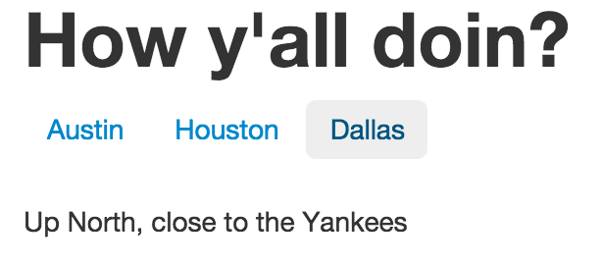
Custom Directives with Controllers
Define the Controller in the Custom Directive
Instead of in the HTML markup
Also define the Controller alias
Can use the same HTML markup with different controllers
Example: Tabs anyone?

Slide 27
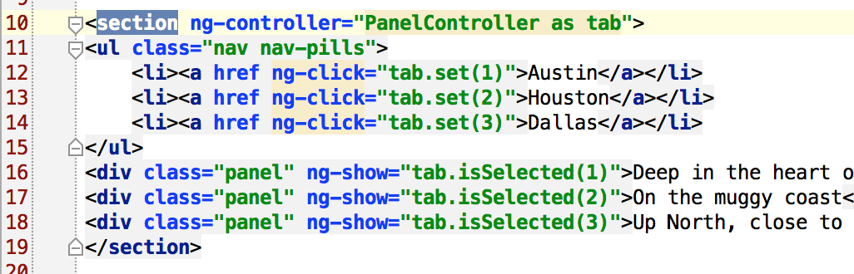
Directives with a Controller
Refactor to a file (city-panels.html)
➔ city-panels.html
<section> ⬅ remove ng-controller attribute
…
</section>

Slide 28
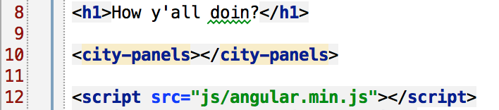
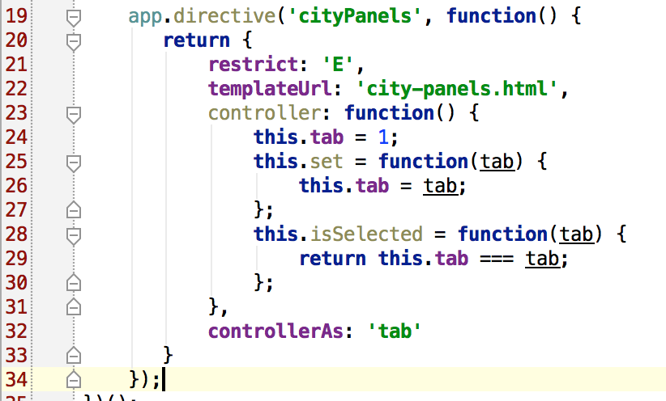
Directives with a Controller

Slide 29
Organizing your App
Best to split Modules around functionality:
App.js – top level
Product.js – all functionality for products
User.js – all functionality for users
ShoppingCart.js –
Identify the dependencies in the array. Not the name of the js files, but the name of the other modules.
var app = angular.module(‘store’, [‘store-products’, ‘users’, ‘shoppingCart’]);

Slide 30
Services
Angular services provide more functionality
Fetch JSON data from a web service with $http
$http({method:’GET’, url=‘/products.json’});
OR $http.get(‘/products.json’, {param1: ‘hello’});
Returns a Promise object with .success() and .error() callbacks.
Log messages with $log – to the js console
Filter an array with $filter

Slide 31
Controller with Service
Load service with injection, (eg. ‘$http’)
app.controller(‘MyController’, [‘$http’, function($http) {
// use the service inside here
var store = this;
store.products = [ ]; // initialize because it renders
// before the data is ready
$http.get(‘/products.json’).success(function(data) {
store.products = data;
}]);
});

Slide 32
$http Functionality
Additional $http methods
Can do get(), post(), delete(), put()
Or any other method using the $http({method: ‘OPTIONS’…
$http.post(‘/path/to/resource.json’, {param1:’hi’, p2: ‘lo’});
$http.delete(‘/user/4754’);
$http.put(‘/user/4754’, {name:’clay’});

Slide 33
Localization
Not a part of Angular, we use Kraken

Slide 34
Summary
Angular is a client-side JavaScript framework
Uses ‘Directives’ to create new Elements and Attributes
Application uses HTML markup to handle events
Application uses AJAX to get data from server
Server looks like a RESTful server
Creates reusable markup
Simplifies HTML
Reuse common parts
Reuse common client code

