Slide 1
Kraken Shopping Cart Example
Building a shopping cart using Kraken

Slide 2
Overview
This section examines an existing app, the Kraken shopping cart.
The app functions are:
Create / delete items in inventory
Add / remove items to the shopping cart
Display the shopping cart
Pay for the items
Use Paypal API
Use testing ID for Paypal
Use testing ID for credit card information

Slide 3
Demo of the Shopping Cart
Demo of the shopping cart.
Make sure mongod is started
Go to the solution folder
npm install
npm start
Browse to http://localhost:8000

Slide 4
What is the Application?
A set of Pages?
A set of functions?
Database tables?

Slide 5
The Answer is YES
From the user perspective
The application is a set of pages
The application goes through those pages under user command
Mouse gestures
From the server perspective
The application is a set of functions
The user provide input data through the browser
The server performs the business logic
From the database perspective
The application is a set of tables
The data is manipulated by the server

Slide 6
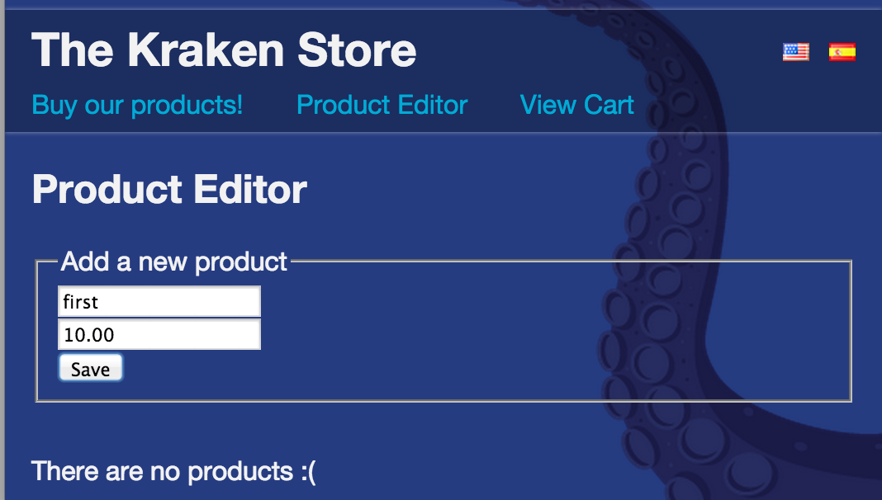
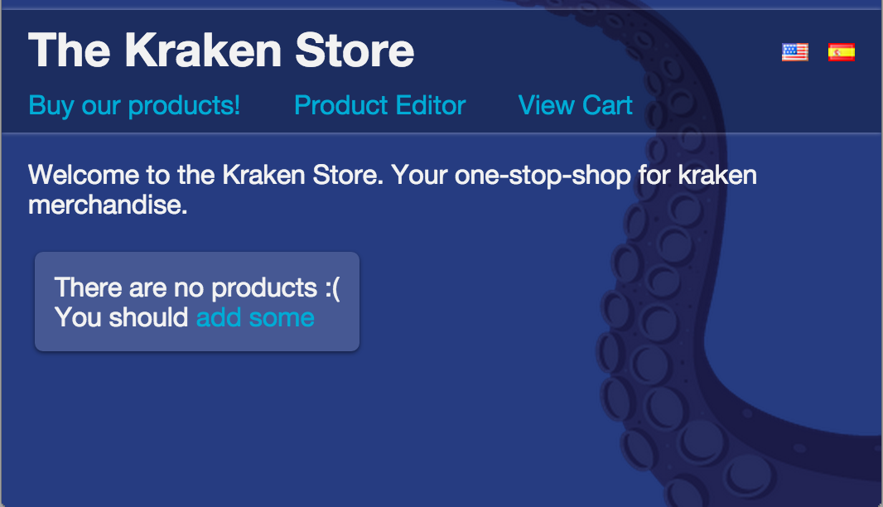
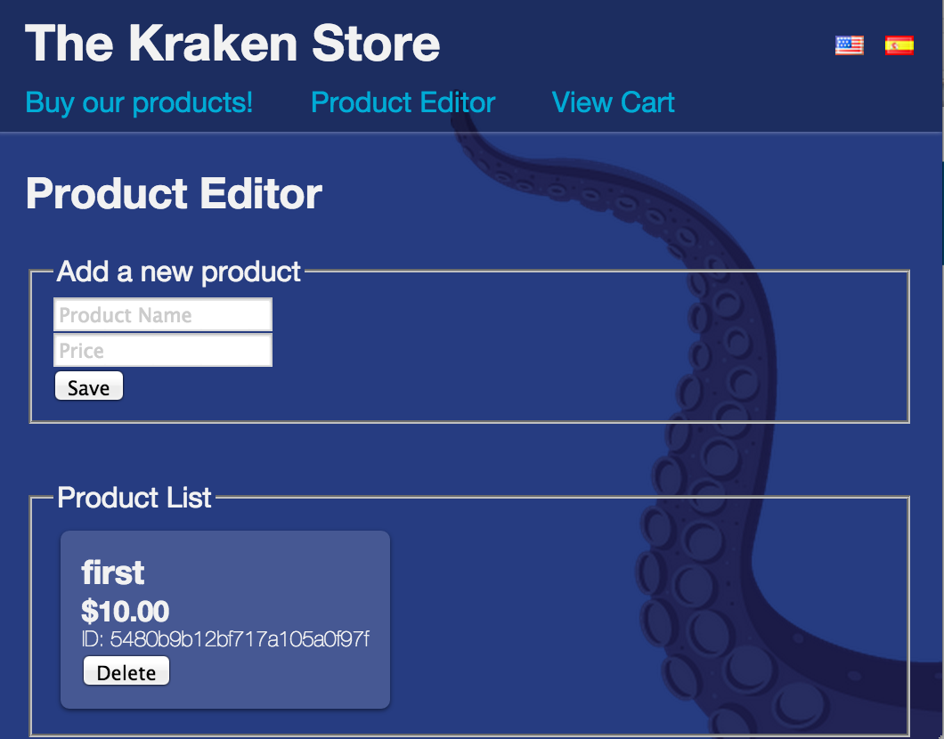
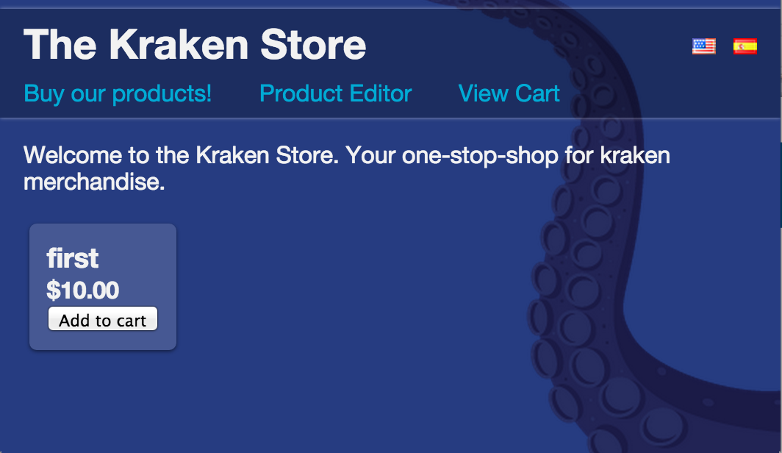
The User Perspective

Slide 7
Kraken and the View
Pages are stored as templates
May contain EL (Expression Language) parts to indicate where the dynamic parts go.
Separates pages into header, footer, body, etc.
Header (master.template) contains 5 of the links
Shows up on all pages

Slide 8
The Server Perspective
Functions:
addToCart( itemId )
removeFromCart( itemId )
createItem( name, price )
removeItem( itemId )
checkOut( ….. )
Each function does (a part) of the functional requirements.
Functional Requirements?
What does the application do?

Slide 9
Database Perspective
The application is a FORMs based application
The user enters data in a series of forms
The application:
Provides a user interface for the db CRUD operations
Most web applications are forms based applications
Amazon, Costco, Walmart, etc.
Very few are algorithmic
Paypal, Google, Google Analytics

Slide 10
Database Perspective
This is the applications memory
The ProductModel schema, for example:
product : {
name: String,
price: Number
}
ProductModel methods (provided by mongoose)
save({}, callback);
update({}, callback);
findById( id, callback(err, product))

Slide 11
What does Node do?
Node wires it all together
Node accepts input from the page (mouse gesture)
It analyses the input to determine which server function(s) it should call
Node calls the server function
Server function gets input from the user, converts to internal representation, calls the business logic
Server defines the next page
Node renders the next page
Page inserts dynamic parts in the page

Slide 12
Summary
The Kraken Shopping Cart
A web application
A forms based application
Simple views
Simple controllers
Simple data base structures

