Slide 1
What is node.js?
And why do I want to use it?

Slide 2

What is node.js?
Node.js applications are written in JavaScript, and can be run within the Node.js runtime on Windows, Mac OS X and Linux with no changes.
-Wikipedia
Node.js is a software platform for scalable server-side and networking applications.

Slide 3
History of node.js
2009
2009
2009
2011
2011
2011
2013
Inspired by a progress bar on Flickr, Ryan Dahl begins developing node.js
Dahl demos node.js at JSConf in Berlin
Joyent becomes node.js sponsor
First stable release of node.js – 0.4.8
Walmart moves node.js into production
Linked-in launches mobile app on node.js
PayPal begins move to node.js

Slide 4
Why is node.js Important?
Scalability
Shorter development cycle

Slide 5
IBM Extreme Blue Team—Passes
...Node led to 40% reduction in time to value while allowing us to double the traffic served with half the servers (in comparison to Java implementation).
Thus, Node was able to deliver the same functionalities as Java, and it outperformed Java in terms of rapid development and better hardware utilization.
http://www.ibm.com/developerworks/java/library/mo-nodejs-1/

Slide 6
LinkedIn Moved From Rails To Node
After evaluation, some of the advantages of Node.js were:
Much better performance and lower memory overhead than other tested options, running up to 20x faster in some scenarios
Frontend and backend mobile teams could be combined into a single unit.
Servers were cut to 3 from 30. Enough headroom remains to handle 10x current levels of resource utilization.
http://highscalability.com/blog/2012/10/4/linkedin-moved-from-rails-to-node-27-servers-cut-and-up-to-2.html
Notes:
Some reduction was the result of client-side rendering--not just node.

Slide 7
Node.js at PayPal
Built almost twice as fast with fewer people
Written in 33% fewer lines of code
Constructed with 40% fewer files
Double the requests per second vs. the Java application…using a single core for the node.js application compared to five cores in Java.
35% decrease in the average response time for the same page.
https://www.paypal-engineering.com/2013/11/22/node-js-at-paypal/

Slide 8
How node.js Does It
Non-blocking I/O package
An underlying event-driven I/O package
Event-driven, asynchronous operations
Events from I/O streams drive the flow of the application
Good language choice
May not be perfect, but advantageous
Package management
Robust package and dependency management to simplify development and deployment

Slide 9
Other Asynchronous Web Frameworks
Vert.x
Eclipse Foundation
Java-based with bindings for JavaScript, Ruby, ….
Spring Reactor
Spring
Java-based with bindings for other JVM-based languages
Akka
Scala with binding for Java
Actor model
Notes:
All Apache 2.0 licensed.

Slide 10
Components of node.js
I/O library – libuv
Multiplatform asynchronous I/O library
https://github.com/joyent/libuv
V8
Google's open-source JavaScript engine
https://code.google.com/p/v8/
npm
Package/dependency management for node
https://www.npmjs.org
node.js API

Slide 11
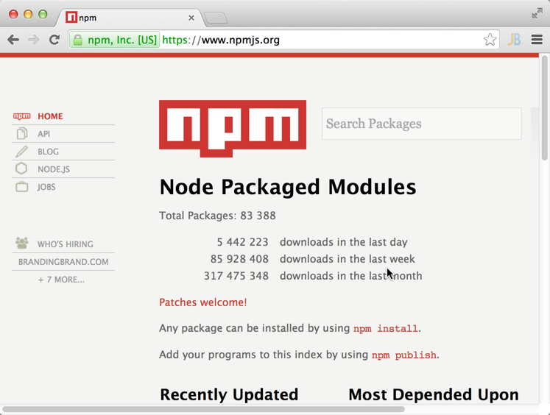
Core and Userland
Node "Core"
Very small
Bare essentials
Userland
Includes npm
Very large
Easy to publish modules
Vibrant community
Caution: maturity of packages varies

Slide 12
What Does it Mean to be Event-Driven?
Similar to UI programming
Event sources are typically streams instead of user actions
Single thread waits for events and calls handler when when an event is received.
Event Loop
Event Queue
Event Handlers

Slide 13
Synchronous Model
One thread is dedicated for the lifecycle of the request/response.
Thread spends most of its time blocked on I/O.
Notes:
Imagine one server per customer at a restaurant—from IBM article.

Slide 14
Blocking and Non-Blocking I/O
Reading two files in blocking and non-blocking way
Blocking:
file1
file2
time
Non-Blocking:
file2
file1
time

Slide 15
What Not to do in node.js
Handlers are executed synchronously.
Long-running handlers can kill responsiveness.
Event Loop
Event Queue
Event Handlers
Notes:
Decompose handler into a series of callbacks that chain.

Slide 16
V8 and JavaScript
Robust engine
This is what makes JavaScript viable server-side
Closures well-suited to event-driven model
Not a specialized language, but a good fit
Ease inter-team communications
Server- and client-side teams speak the same language.
Code can move between client and server
Not a drop-in, but the potential is there

Slide 17
Node.js Webserver
Loads the “http” module.
var http = require('http');
var server = http.createServer( function (request, response) { response.writeHead(200, {'Content-Type': 'text/plain'}); response.end('Hello World\n'); } ); server.listen(8000); console.log('Server running at http://localhost:8000/');
Create the http server.
Create the listener for “request” events.
Start the server.
Print an info message to the console.

Slide 18
node.js Echoserver
Loads the “net” module.
var net = require('net'); var server = net.createServer( function (socket) { socket.write('Echo server\r\n'); socket.pipe(socket); } ); server.listen(3000, '127.0.0.1');
Create a generic server.
Create a listener for the “connection” event.
Start the server.

Slide 19
Improving Concurrency: Clustering and Workers
"Cluster"
Experimental module that makes advantage of multi-core systems
Parent process fork workers
Workers are separate processes
Workers can be killed or respawned without affecting other workers
There is no shared state
Workers can share server ports
Programmer is responsible for managing the workers
Feature of this module may change!
http://nodejs.org/api/cluster.html

Slide 20
Summary
Non-blocking I/O and event-driven architecture provide very efficient I/O.
JavaScript as the primary language enhances communications between large development teams.
Simple, effective package management simplifies development and deployment.
Very active community with a supportive core team provides many open-source solutions.
Modeling the applications as a set of event handlers results in leaner designs.

