Slide 1
Debugging node Applications

Slide 2
Overview
Embedded debugging code
Node.js' debugging client
Debugging with IDEs
Node Inspector

Slide 3
Printing With util
Synchronous output to stdout and stderr
util.log(string)
Prints string to stdout
Prefixed with timestamp
util.debug(string)
Prints string to stdout
Prefixed with “DEBUG”
util.error([...])
Prints arguments to stderr
Arguments printed on separate lines

Slide 4
Formatting Strings
util.format(format, […])
Returns a formatted string
Uses printf()-like syntax
%s -- string
%d -- number
%j -- JSON
% -- %, no need to escape
Extra arguments are printed using util.inspect()
Extra placeholders are ignored

Slide 5
Printing Objects
util.inspect(object, [options])
Decomposes object into a formatted string
Options object controls formatting
showHidden – lists object’s non-enumerable properties
depth – recursion depth
colors – use ANSI color codes
customInspect – use custom inspect() functions
For example:
util.inspect(util, { showHidden: true, colors: true });

Slide 6
Printing With Console
Corollary to console object in browsers
Same formatting syntax as util.format()
Print arguments to stdout
console.log([data], [...]) console.info([data], [...])
Print arguments to stderr
console.error([data], [...]) console.warn([data], [...])
Notes:
Asynchronous when in a pipeline.

Slide 7
Other Useful Console Functions
console.dir(obj)
Calls util.inspect() on obj and prints the result to stdout
console.time(label) / console.timeEnd(label)
Prints elapsed time for label to stdout
console.trace(label)
Prints a stacktrace to stderr
console.assert(expression, [message])
Throws an AssertionError with message if expression is false.

Slide 8
Node.js' Debugging Client
Terminal-based debugger
Similar to gdb
Supports
breakpoints
watched variables
remote evaluation
Can be useful to know how to navigate with it

Slide 9
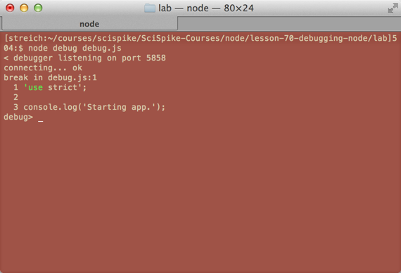
Node.js' Debugging Client Screenshot

Slide 10
Node Debugger Cheat Sheet
Stepping cont, c – Continue execution next, n – Step next step, s – Step in out, o – Step out pause – Pause running code Breakpoints— setBreakpoint([args]), sb([args]) no args – Current line line # – Specific line 'fn()' – First statement in function 'script.js', 1 – First line of script.js clearBreakpoint, cb(...) – Clear breakpoint | Info backtrace, bt – Print backtrace list(n) – List with n-line context watch(expr) – Add watchpoint unwatch(expr) – Remove watchpoint watchers – List all watchers repl – Open debugger's repl Control run – Run script restart – Restart script kill – Kill script Info scripts – List all loaded scripts version – Display v8's version

Slide 11
Debugging with IDEs
Eclipse, WebStorm
Similar to other language debuggers
Solid support for debugging node.js applications

Slide 12
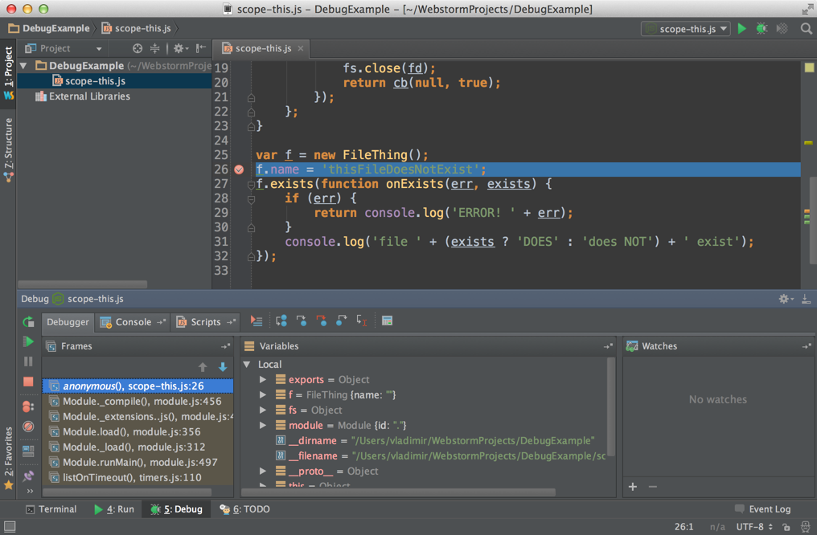
Debugging in IDE (WebStorm)

Slide 13
Node Inspector
https://github.com/node-inspector/node-inspector
Browser-based debugger for node.js applications (currently Chrome only)
Installed into node.js with npm: npm install -g node-inspector
Allows you to debug a remote instance of node.js
Start it with:
node-debug app.js
If that does not work:
Start you app as: node --debug-brk app.js
In another terminal: node-inspector
In Chrome, open: http://127.0.0.1:8080/debug?port=5858
Debugging guide: https://developers.google.com/chrome-developer-tools/docs/javascript-debugging
Notes:
A nice intro into the node-inspector:
http://www.youtube.com/watch?v=FMPk-KAPkEU
points to show:
breakpoints
running to a location (right click on the breakpoint and 'Continue to here')
set a watch on a variable (just type the variable name in the 'Watch Expressions')
set a condition on a breakpoint (right click on the breakpoint)

Slide 14
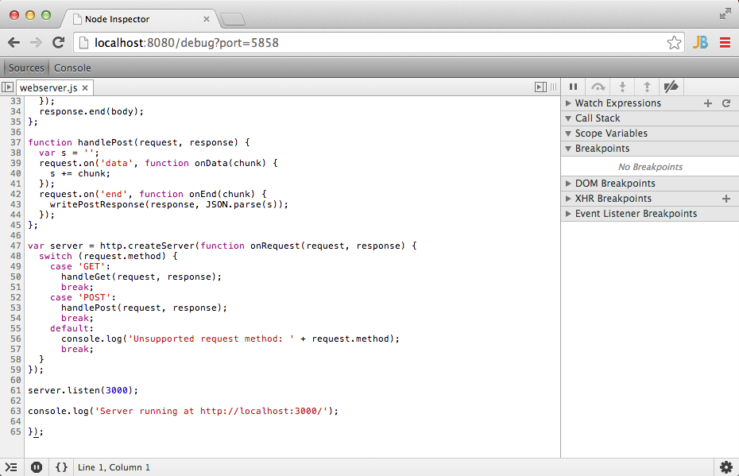
Node Inspector Screenshot

Slide 15
Good to know
Breakpoints can be added directly to your code by adding the debugger statement.
response.on('data', function onData(part) { debugger; s += part; });
A running node.js instance can be switched into debug mode:
kill -s USR1 <process id>

Slide 16
Summary
Node.js provides many built-in utilities for reporting to the console.
There are a number of excellent choices for debugging a node.js application
node-inspector
IDEs
Stepping through code only works in a limited context—breakpoints are essential
Remember that debugging is manual activity: automate validation through tests (coming next!)

