Slide 1
Yeoman

Slide 2
Overview
The Yeoman Workflow
yo: Scaffolding
bower: Front-End Package Management
grunt: Building

Slide 3
The Yeoman Workflow: Overview
Install
Scaffold
Run
Edit
Build

Slide 4
The Yeoman Workflow: Installation
Tool installation
npm install -g yo
Also installs bower & grunt
Also install any generators needed:
npm install -g generator-angular

Slide 5
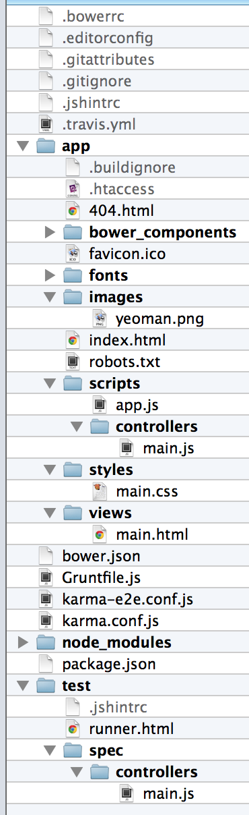
yo: Scaffolding
CLI for scaffolding generators
Scaffold initial web application
yo angular
Produces application based on current directory name

Slide 6
yo: Scaffolded Artifacts
Boilerplate config files
bower.json, Gruntfile.js, package.json, .gitignore, etc.
Single-page app (SAP)
app/index.html
Controller
app/scripts/controllers/main.js: Controller 'MainCtrl' populates model via $scope
Routes
app/scripts/app.js: URL '/' -> Controller 'MainCtrl' -> View 'views/main.html'

Slide 7
yo: Scaffolded Artifacts (Cont.)
View (Template)
app/views/main.html: Renders model
Tests
test/spec/controllers/main.js

Slide 8
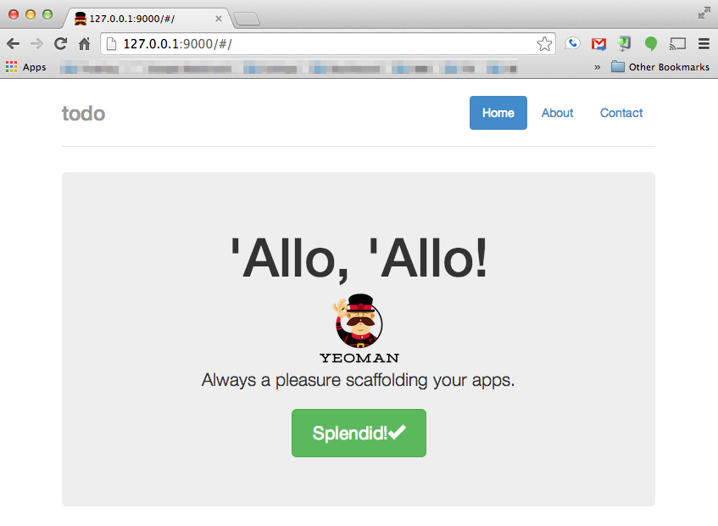
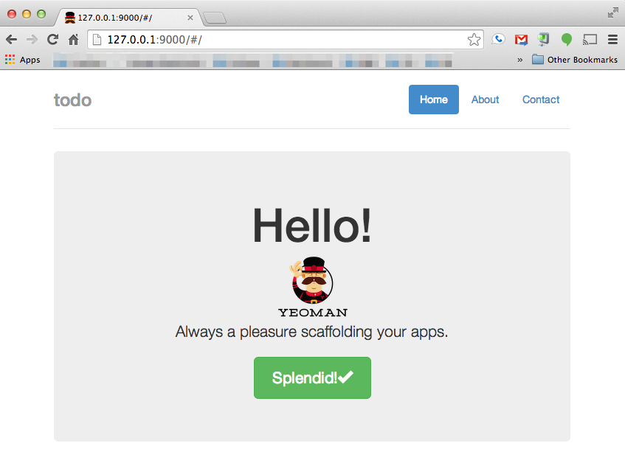
yo: Live Editing
Run application
grunt serve
Edits cause automatic reloading via LiveReload
Replace 'Allo, 'Allo with Hello in app/views/main.html

Slide 9
yo: Subgenerators
Generate a controller
yo angular:controller myController
Creates
app/scripts/controllers/mycontroller.js
test/spec/controllers/mycontroller.js
Generate a view
yo angular:view myView
Creates
app/views/myview.html

Slide 10
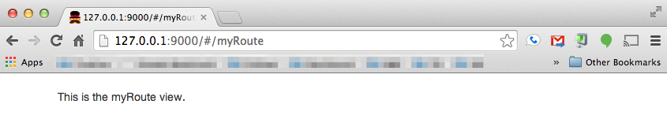
yo: Subgenerators
Generate a route: creates route, controller, & view!
yo angular:route myRoute
'/myRoute' -> 'MyrouteCtrl' -> app/views/myroute.html
app/scripts/controllers/myroute.js
app/views/myroute.html
/#/myRoute (invokes 'MyrouteCtrl')
app/views/myroute.html

Slide 11
bower: Front-end Package Management
Front-end/client-side package management
Updates html application page to include modules
Browser downloads dependencies
Flat dependency list
Modules are shared among dependents
Developer must resolve conflicting versions
Includes main & dev dependencies
Different from Node Package Manager (npm)
npm is server-side
npm dependencies form a tree & are not shared among dependents

Slide 12
grunt: Building
grunt is a general task runner
grunt uses plug-ins
Used for testing, building distributions, etc.
Web app scaffolded by yo includes custom "serve" task for development with LiveReload
Use grunt dist to build web app
Resultant build found in dist directory
Runs unit & end-to-end (automated-in-browser) tests
If tests pass, uglifies, minifies, processes images, etc.

Slide 13
Summary
Yeoman = yo + bower + grunt
Use yo to scaffold
Use bower to manage client-side dependencies
Use grunt to live-edit, test & build

