Slide 1
Dust.js
JavaScript Templating

Slide 2
Overview
Purpose of Template Engines
Rationale for Dust
Template basics
Retrieving values from the model
Contexts and how to use them
Using parameters
Template logic
Decomposing templates
Helpers
Based on the Dust Tutorial: https://github.com/linkedin/dustjs/wiki/Dust-Tutorial

Slide 3
What is a Template Engine?
A web template system uses a template processor to combine web templates to form finished web pages, possibly using some data source to customize the pages or present a large amount of content on similar-looking pages.
-Wikipedia

Slide 4
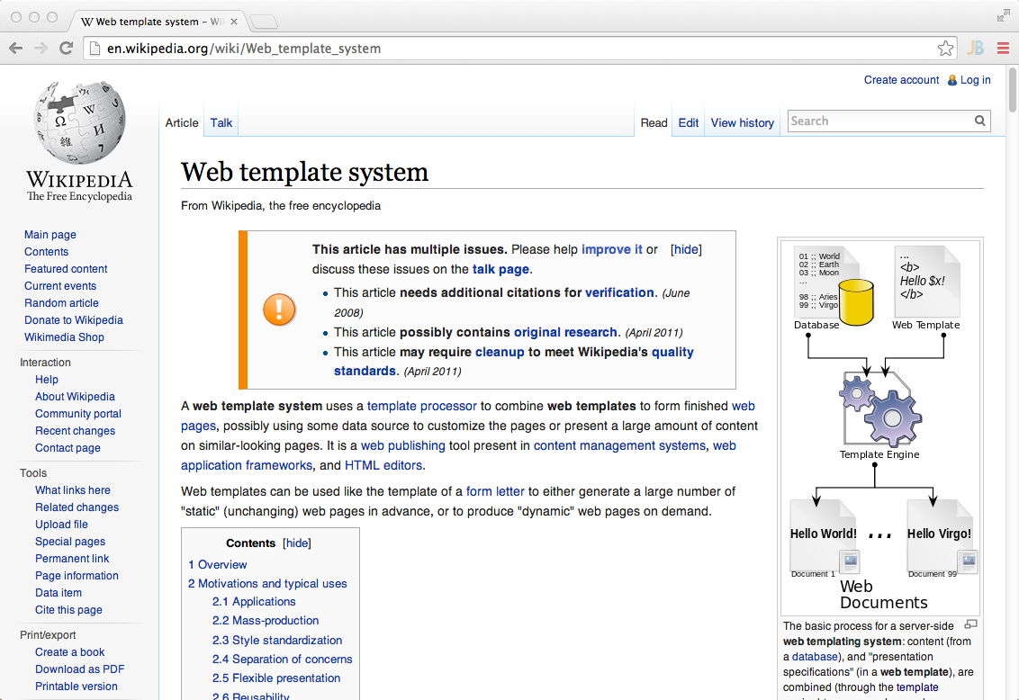
Consistency of Presentation

Slide 5
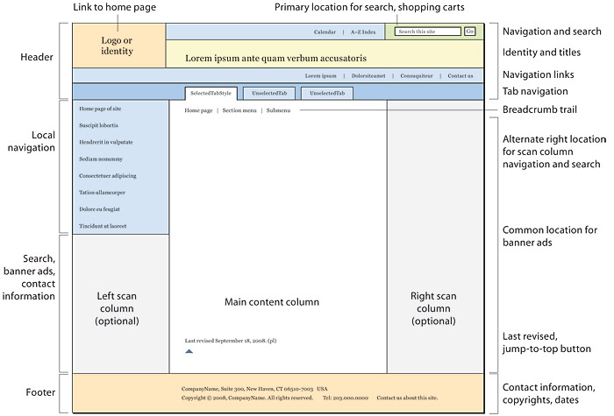
Decomposing a Web Page
http://webstyleguide.com/wsg3/6-page-structure/3-site-design.html

Slide 6
What is Dust.js?
Dust.js is a JavaScript templating engine designed to provide a clean separation between presentation and logic without sacrificing ease of use. It is particularly well-suited for asynchronous and streaming applications.
http://akdubya.github.io/dustjs/#dust

Slide 7
Why use Dust?
Compiled into JavaScript
Can run on server or client
Templates can be cached
Templates can be located on a content delivery network (CDN)
Eliminates the need for a server during UI development

Slide 8
Dust + Node: Beyond Technology
client
Single development stack
Client or server rendering
Move UI parts from one area to the other
Blended client + server team → rapid innovation
Prototype & production
{dust} JS Templates
server
node.js

Slide 9
Dust Example
Template
Newline
{title}{~n} <ul> {#names} <li>{name}</li>{~n} {/names} </ul>
Output
Famous People <ul> <li>Larry</li> <li>Curly</li> <li>Moe</li> </ul>
Model
{ 'title': 'Famous People', 'names': [{ 'name': 'Larry' }, { 'name': 'Curly' }, { 'name': 'Moe' }] }

Slide 10
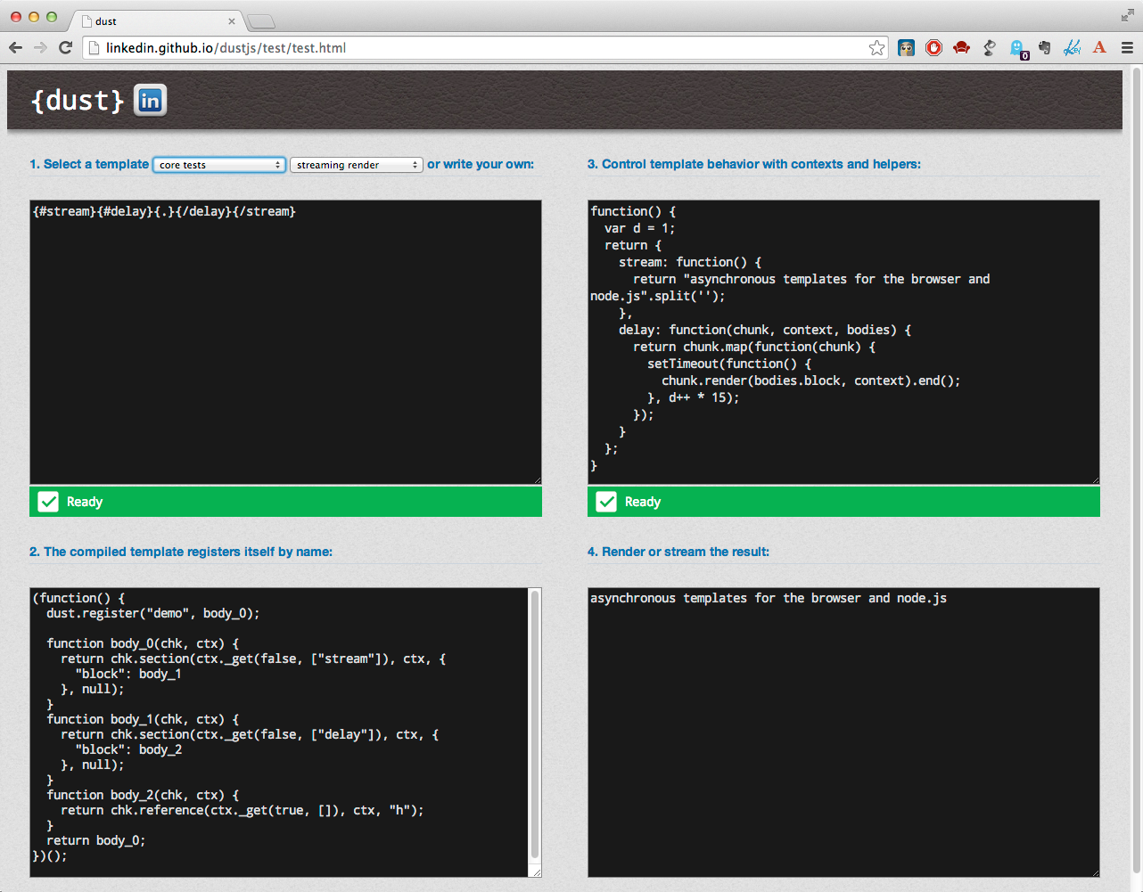
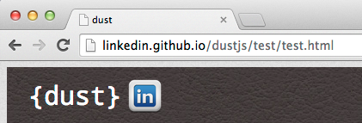
A Handy Dust Test Page
Check it out!

Slide 11
During the Course
All of the examples are in the lab directory in the examples.txt file
Open the test page at
http://linkedin.github.io/dustjs/test/test.html
and feel free to paste the template and model into the windows
For some examples, we will experiment with a few changes

Slide 12
Template Basics
Dust uses braces ({}) to identify its tags
Tags come in two different forms:
The key tag is used to reference a property in the model: {propertyName}
It is replaced by the value of the referenced property
All other dust operations use a start and an end tag:{XtagName}body{/tagName}
X is one of several symbols, '#' being the most common
The body typically contains other dust operations as in the previous example
Singletons—{XtagName/}—are also used

Slide 13
Inserting Property Values
Key tags are used to write the value of a scalar property to the output
Put the name of the property from the model in the tag. For example,
{name}
will be replaced in the output with the value of the name property found on the model
If the property is undefined, has no value, or is false, nothing is written to the output
If the property is on a descendant object, you can use the '.' path notation to reference it: {child.name}

Slide 14
Sections and Context
Dust sections set the context for the operations contained in the section body
{#propertyName} sets the template context to the referenced property
Tags in the body refer to the value of the property
If the property value is an array, the section will iterate over the elements in the array applying the operations in the body to each
If the property value is an object, the tags in the body can reference the properties of that object
If there is no matching property, the body is skipped

Slide 15
Context Example
Template
Model
root.name: {name}{~n} {#A} A.name: {name}{~n} {#B} B.name: {name}{~n} {/B} {/A}
{ 'name': 'root', 'A':{ 'name':'Albert', 'B':{ 'name':'Bob' } } }
Context Stack
B: name
Output
root.name: root
root.name: root A.name: Albert
root.name: root A.name: Albert B.name: Bob
A: name, B
root: name, A

Slide 16
Sections and Context, cont.
'.' path notation can be used to reference descendants. Using the previous example,
{#A.B}body{/A.B}
would change context directly to the B child of A.
The tag {.} refers to the value in the current context. If the value of the current context is a scalar
{#propertyName}{.}{/propertyName}
is equivalent to
{propertyName}
If the value is an array, {.} is the current element in the array

Slide 17
Array Values
When you change context to a property with an array for a value, Dust will iterate over the array and execute the body for every element.
If the array consists of scalar values, use {.} to reference the current element value
If the array consists of object values, property references apply to the current object element
Two new tags are available in the body
{$idx} is the zero-based index value of the current element
{$len} is the number of elements in the array

Slide 18
Array Iteration Example
Template
{title}{~n} {#names} {$idx}. {name}{~n} {/names}
Output
Famous People 0. Larry 1. Curly 2. Moe
Model
{ 'title': 'Famous People', 'names': [{ 'name': 'Larry' }, { 'name': 'Curly' }, { 'name': 'Moe' }] }
Notes:
Add callouts

Slide 19
Context Stack and Searching
Dust keeps contexts in a stack
The {#property} tag pushes a new context onto the context stack
If a property reference is not found in the current context, dust will search up the context stack to find it
If the property is not found anywhere, nothing gets written
Search is the same for properties referenced with a '.' path notation, but the search stops with a match on the root of the path
Prefix a '.' to the property to prevent a search

Slide 20
Searching Context Stack Example
Template
Model
root.name: {name}{~n} {#A} A.name: {name}{~n} {#B} B.name: {name}{~n} root.alt: {alt}{~n} {/B} {/A}
{ 'name': 'root', 'alt': 'root2', 'A':{ 'name':'Albert', 'B':{ 'name':'Bob' } } }
"alt" isn't in the current context
Stack
Output
B: name A: name root: name, alt, A
root.name: root A.name: Albert B.name: Bob root.alt: root2
root.name: root A.name: Albert B.name: Bob

Slide 21
Explicit Contexts
To explicitly set a parent context, append :parentName to your opening tag
{#context:parentContext}...{/context}
Limits the context stack to only the current and specified parent
Allows you to create an alternate search structure not available in the model
Unfortunately, you can only set the current and parent context with this notation

Slide 22
Explicit Contexts Example
Template
{#B:A} Aname: {Aname}{~n} Bname: {Bname}{~n} RootName: {rootName} {/B}
Output
Model
Aname: name of A
Bname: name of B
RootName:
{ 'rootName': 'name of root', 'Aname': 'alt name of root', 'A': { 'Aname': 'name of A' }, 'B': { 'Bname': 'name of B' } }
Notes:
Add callouts

Slide 23
Parameters
Parameters can also be added to the {#property} section tag
The name can be any valid JavaScript name
Adds a new context with the specified parameters to the context stack
Parameters will not hide any properties of the same name on the current model context, but will hide properties on parent contexts

Slide 24
Parameter Values
String values must be enclosed in double quotes
To reference a property in a parameter value:
Use the name of the property as the value
{#contextProperty param=propertyRef}...
Dust will resolve the reference before the parameter context is inserted into the context stack
Or enclose a key tag that references the property as a string
{#contextProperty param="{propertyRef}"}...
Dust will resolve the reference after the parameter context is inserted into the context stack

Slide 25
Parameter Example
Template
Model
{#person root="PropertyRoot" nameRef=root tagRef="{root}"} NameRef: {nameRef}, TagRef: {tagRef} {/person}
{ 'root': 'Subject', 'person': { 'name': 'Larry', 'age': 45 } }
Output
NameRef: Subject, TagRef: PropertyRoot

Slide 26
ParameterS on the Stack
Template
Model
{#person root="PropertyRoot" nameRef=root tagRef="{root}"} NameRef: {nameRef}, TagRef: {tagRef} {/person}
{ 'root': 'Subject', 'person': { 'name': 'Larry', 'age': 45 } }
Context Stack
name: "Larry"
age: 45
nameRef: "Subject"
tagRef: Function
root: "Subject"
person: Object

Slide 27
Output
Most whitespace is discarded
Use /*...*/ for comments in JavaScript code blocks
Use {`...`} to preserve whitespace and braces
Use {!...!} for comments in templates
Whitespace and braces can be inserted using:
{~n}—newline
{~r}—carriage return
{~s}—space
{~lb}—left brace ({)
{~rb}—right brace (})

Slide 28
Filters
All output is escaped to avoid cross-site scripting (XSS) unless filtered
Filters allow you to control escaping
To apply a filter, append |x after the tag where x is the filter. For example, to suppress all escaping in a section:
{#section|s}...{/section}
Filters can also be chained. For example, to have only HTML escaping applied:
{#section|s|h}...{/section}
A chain would typically begin with s to suppress filtering

Slide 29
Filters
s
Suppress auto escaping
h
Force HTML escaping
j
Force JavaScript escaping
u
uc
Encodes with JS native encodeURI
js
Encodes with JS native encodeURIcomponent
jp
Stringify JSON literal
Parse JSON string to object

Slide 30
:else
The {#propertyName} section can contain a conditional block by inserting an {:else} tag
Any body after the {:else} tag will be executed only if the value test evaluates to false
Within the {:else} body, the context will remain where it was originally
Parameter values will be present in the {:else} body

Slide 31
:else Example
Template
{#friends} {name}, {age}{~n} {:else} You have no friends! {/friends}
Output
Moe, 37
Larry, 39
Curly, 35
Model
If friends is empty
{ friends: [ { name: 'Moe', age: 37 }, { name: 'Larry', age: 39 }, { name: 'Curly', age: 35 } ] }
You have no friends!

Slide 32
Value Truth Test
The "truth" of the value test is determined as follows:
true | false
numeric 0 | undefined
string values "0", "null", etc. | null
empty object | empty string
non-empty object | empty array
 | boolean false

Slide 33
Logic Operators
Dust provides two tags that will execute their bodies conditionally
{?propertyName} will execute its body only if the value test returns true
{^propertyName} will execute its body only if the the value test returns false
Both sections can contain an {:else} tag

Slide 34
Logic Example—What If There Are No Names?
Template
{title}{~n} <ul> {#names} <li>{name}</li>{~n} {/names} </ul>
Output
Famous People <ul> <li>Larry</li> <li>Curly</li> <li>Moe</li> </ul>
Model
{ 'title': 'Famous People', 'names': [{ 'name': 'Larry' }, { 'name': 'Curly' }, { 'name': 'Moe' }] }

Slide 35
Logic Example—Protected Version
Template
{?names} {title}{~n} <ul> {#names} <li>{name}</li>{~n} {/names} </ul> {/names}
Output
Famous People <ul> <li>Larry</li> <li>Curly</li> <li>Moe</li> </ul>
Model
{ 'title': 'Famous People', 'names': [{ 'name': 'Larry' }, { 'name': 'Curly' }, { 'name': 'Moe' }] }

Slide 36
Partial Templates
Templates can be decomposed into partials, separate files that can be included where needed
Partials are loaded with the {>basename} tag
Partials run with the current context stack, but can take an explicit context also {>basename:context}
Partials can be referenced with a path but the name must be encosed in double quotes: {>"path/basename"}
Partials can also have parameters
Partial references can use Dust tags
Notes:
Bug when using dust tags with a specified context

Slide 37
Partial Example
Page Template
loginStatus Template
... {>loginStatus/} ...
{?user} Logged in as {user.name}.
{:else}
Not logged in. {/user}
Model
{ ... 'user': { 'name': 'Larry', 'memberSince': 'time began' }... }
Notes:
Consider presenting someone's login status on each page

Slide 38
Blocks and Inline Partials
Blocks and inline partials are tools for boilerplate content
Replacement tags for referencing values in the template instead of the model—the block is a reference to the inline partial
The block containing any default content is enclosed in {+blockName} tags
The block can be empty if no content is needed unless overriden: {+blockName/}
The inline partial is enclosed in {<blockName} tags
Inline partials can be defined in the same template as their reference

Slide 39
Block and Inline Partial Example
Base Template
<div class="footer"> {+pageFooter} <hr>
<a href="/">Initech Corp.</a> {/pageFooter} </div>
Page Template
{>baseTemplate/} {<pageFooter} <hr> <a href="/">Printers 'R Us</a>, a subsidiary of <a href="http://www.initech.com/">Initech Corp.</a> {/pageFooter}

Slide 40
Helpers
Helpers are extension to Dust that allow you to perform operations not provided in the base module.
Helpers are invoked in the following form:
{@helperName parameter=value}...{/helperName}
Requires another module: dustjs-helpers
Published modules includes helpers for logic, math, and a few other useful things
Additional helpers can be added

Slide 41
Logic Helpers: select
The select helper mimics a common switch statement
The body is a series of comparators with an optional default case
select takes one parameter—key—the value against which the comparators will operate
The first comparator to evaluate to true is selected
If no comparator evaluates to true, the default is selected
And, if there is no default, nothing is written

Slide 42
select Example
Template
{#people}{name}, {@select key=friends} {@lt value=1}poor soul{/lt}
{@lt value=3}get out more!{/lt}
{@default}you're lucky!{/default}
{/select}{~n}
{/people}
Output
Larry, you're lucky!
Curly, get out more!
Moe, poor soul
Model
{ 'people':
[{ 'name': 'Larry', 'friends': 5 },
{ 'name': 'Curly', 'friends': 2 }, { 'name': 'Moe', 'friends': 0 }] }

Slide 43
Caution: Side Effects Of Select
In the select body, there is a new context object that has property names of isSelect, selectKey, and isResolved
Watch out that you don't accidentally refer to those

Slide 44
Logic Helpers: comparators
Comparators allow you to compare two values
Used as the "cases" in the select helper
Can be used standalone also
When used standalone, a key parameter must be specified
An {:else} block may be used in the body of the comparator when standalone

Slide 45
Comparators, cont.
eq
Equality
ne
Inequality
gt
Greater than
lt
Less than
gte
Greater than or equals
lte
Less than or equals

Slide 46
Logic Helpers: if
The if helper provides an option for those cases that can't be solved with a select
if takes one parameter—cond—which contains a JavaScript expression
Dust tags can be used in the expression
The expression should account for the possibility that Dust tags may be empty
An {:else} block can be used in the if body
Notes:
Needs example

Slide 47
Math Helper
The math helper provides common arithmetic operations
math takes up to three parameters:
key (required) is the first operand
method (required) is the operation to be performed
operand (optional for unary operations) is the second operand
operation must be one of: add, subtract, multiply, divide, mod, abs, floor, and ceil
With no body, the result is written to the output.
With body, math acts exactly like select

Slide 48
math Example
Template
{title}{~n} {#names} {@math key=$idx method="add" operand=1}. {name}{~n}
{/names}
Output
Famous People 1. Larry 2. Curly 3. Moe
Model
{ 'title': 'Famous People', 'names': [{ 'name': 'Larry' }, { 'name': 'Curly' }, { 'name': 'Moe' }] }
Notes:
Fixes the 0-based value of $idx

Slide 49
Other Helpers: sep
The sep (separator) helper provides a very convenient way to add a separator between the elements of an array
Place whatever you want to separate the elements of the array in the body
{#names} {name}{@sep}, {/sep} {/names}
Nothing will be written for the last element in the array

Slide 50
sep Example
Template
Model
{title} here today: {#names} {name}{@sep}, {/sep} {/names}
{ 'title': 'Famous People', 'names': [{ 'name': 'Larry' }, { 'name': 'Curly' }, { 'name': 'Moe' }] }
Output
Famous People here today: Larry, Curly, Moe

Slide 51
Other Helpers: contextDump
The contextDump helper is a useful debugging aid
Writes the portion of the model in the current context
contextDump takes two parameters:
key can be current or full
to can be output or console
contextDump is only used as a singleton: {@contextDump/}

Slide 52
contextDump Example
Template
Output
{#A} {@contextDump key="full" to="output"/} {/A}
{ "tail": { "isObject": true, "head": { "name": "root", "A": { "name": "Albert" } } }, "isObject": true, "head": { "name": "Albert" } }
Model
{ 'name': 'root', 'A':{ 'name':'Albert' } }

Slide 53
Other Helpers: size
The size helper writes the size of the value
size takes one parameter: key
The result depends on the type of value:
Array: number of elements
String: string length
Object: number of properties
Number: value
Undefined, null, empty string: 0
Anything else: string length after conversion
Notes:
String length is in chars?
Add simplistic example

Slide 54
Running Dust
Templates are compiled into JavaScript using the dust.compile() function
The resulting string can be saved to a file
The compiled template is loaded and registered with the dust runtime by calling dust.loadSource()
The template is executed by calling dust.render() and passing in the model to use
If a value is undefined, nothing is written to the output

Slide 55
Running Dust in Node
'use strict'; var dust = require('dustjs-linkedin'); require('dustjs-helpers'); var templateString = '{@math key=addTo method="add" operand="2"/}'; var templateName = 'add2ToSomething'; var model = { 'addTo': 24 }; var template = dust.compile(templateString, templateName); dust.loadSource(template); dust.render(templateName, model, function errorHandler(err, out) { console.log(out); } );

Slide 56
Adding a Helper
You can add additional helpers to Dust
chunk is the accumulating output
context is the context stack
bodies is the X of bodies sections in the helper
parameters is an object with the specified parameters
dust.helpers.myHelper = function(chunk, context, bodies, params) { // code of the helper }

Slide 57
Summary
Dust.js is a powerful templating framework
Runs on client and on server
Mostly logicless
Clean separation of business logic from UI
Able to make sensible UI logic decisions through helpers
Partials
Helpers

