Slide 1
Node.js Resources

Slide 2
Node.js Resources
Books
Web sites
Notable technologies often used with Node

Slide 3
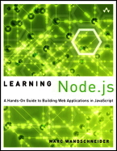

Books: The Beginnings
Learning Node.js: A Hands-On Guide to Building Web Applications in JavaScript
By: Marc Wandschneider
A very good first book on Node. A code oriented tour of building an app with node. Fast to read, stays at the high level.
Node.js in Action
By: Mike Cantelon, Marc Harter, T.J. Holowaychuk and Nathan Rajlich
Great as a second book on Node, by the creators of the Express. Goes into details and "why" questions.

Slide 4

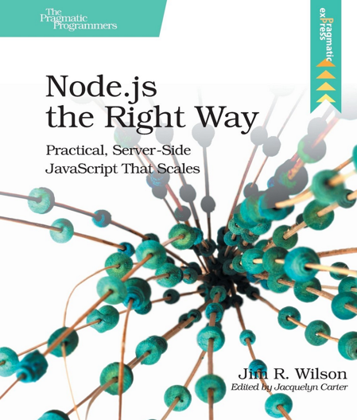
Books: Intermediate
Node.js Recipes: A Problem-Solution Approach
By: Cory Gackenheimer
A good reference, touches on common problems in Node development .
Node.js the Right Way: Practical, Server-Side JavaScript That Scales
By: Jim R. Wilson
A very different approach than other node books, this one shows integration with REST, ØMQ, Redis, CouchDB and more.

Slide 5
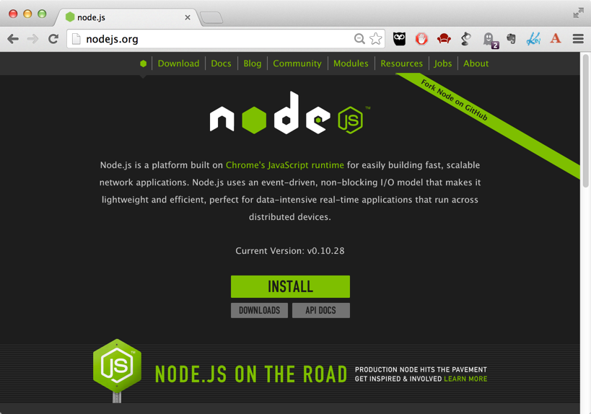
Node Web Sites: nodejs.org
The main resource for updates and documentation
It pays of to learn the core APIs

Slide 6
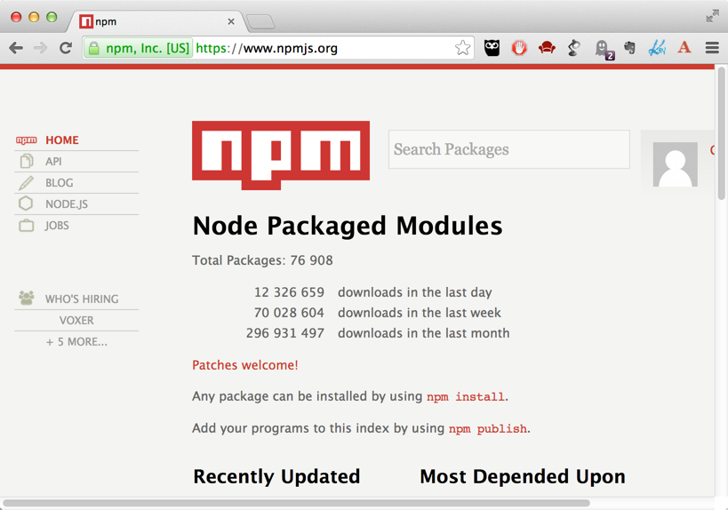
Node Web Sites: npmjs.org
The main resource for modules
Great community, watch out for maturity
Great resource for learning → visit projects on GitHub

Slide 7
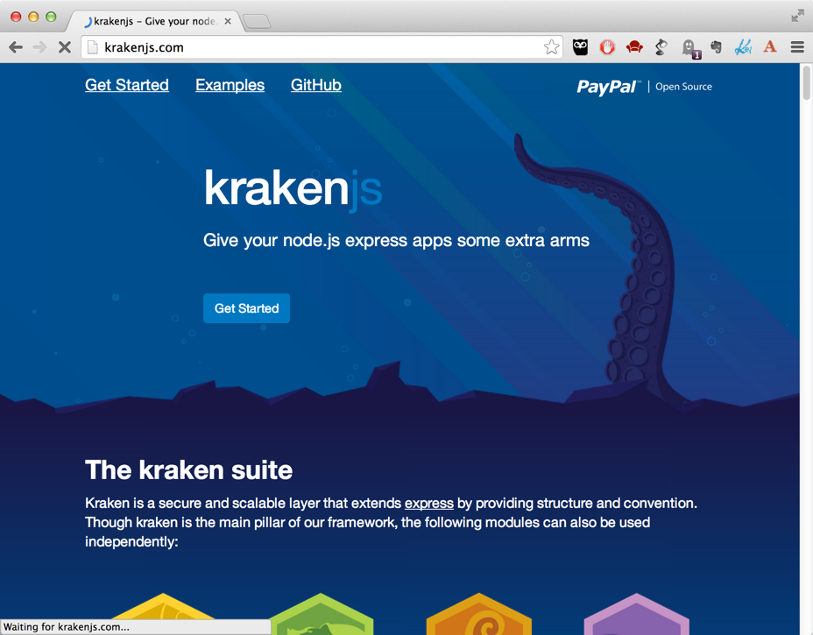
Node Web Sites: krakenjs.com
Check out the GitHub, look for examples
Also check PayPal internal references on Node and Kraken

Slide 8
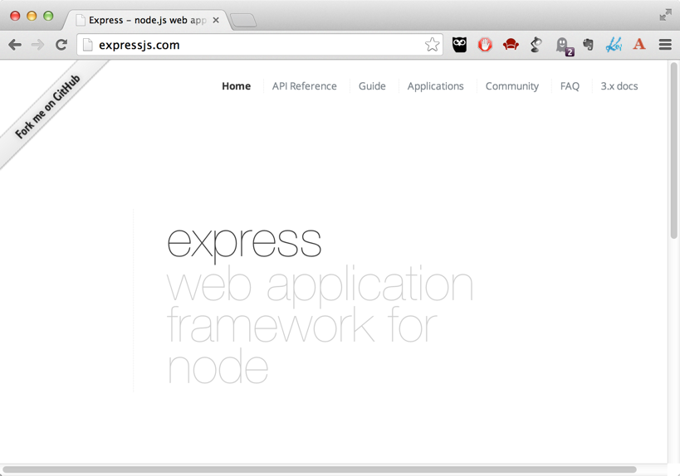
Node Web Sites: expressjs.com
The leading framework for Node
Guide and API reference are the important sections of the site

Slide 9
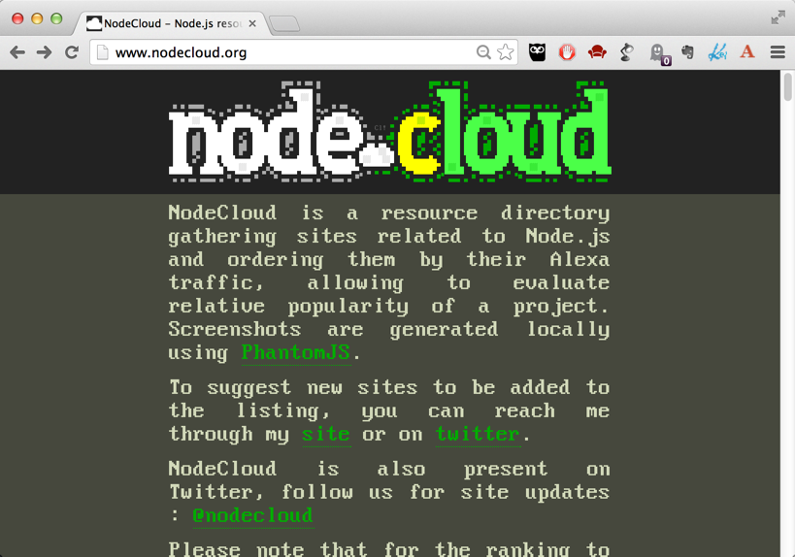
Node Web Sites: nodecloud.com
Aggregator of various Node sites and resources
Explore and learn!

Slide 10






Various Technologies often used with Node
A popular JavaScript UI framework
Common NoSQL stores used with Node.js
There are various drivers provided by the community

Slide 11




Various Technologies often used with Node
Messaging middleware
A fast library for building distributed applications
Automation for JavaScript tasks
Scaffolding for modern web applications.

Slide 12

Conclusion
Node is one of the most exciting technologies for modern applications
A large and vibrant ecosystem
Significant increase in productivity
Scale
Speed!
Learn – explore – deliver!

