Slide 1
Debugging React Components

Slide 2
Overview
Debugging JavaScript using Chrome
Debugging React JavaScript code
Generated using ‘create-react-app’
Uses webpack to load the symbols as well as the code
Debugging React Components using ‘react-devtools’ plugin
Plugin (extension) of Chrome, Firefox, or stand-alone
Click on the React Component
Shows the props
Shows the state
User can modify either

Slide 3
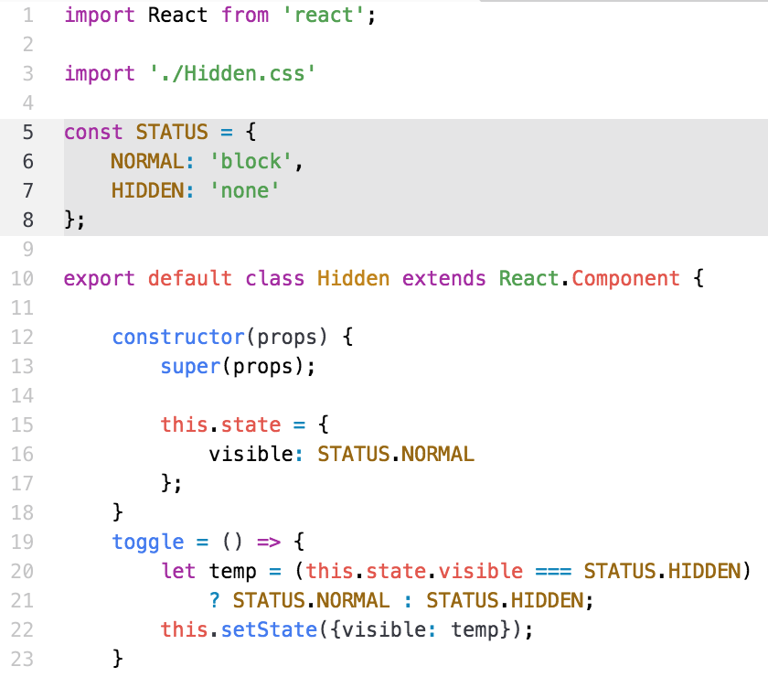
Example Component – Hidden.js
File → /src/components/Hidden.js

Slide 4
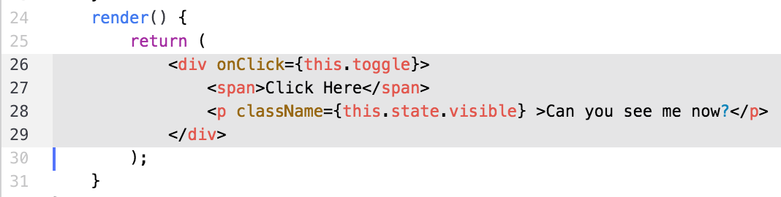
Example Component – Hidden.jsx
The className attribute should be either ‘none’ or ‘block’
The ‘click’ event should change the attribute value
Calls the toggle() function
Put a breakpoint on line 22 in the toggle() function

Slide 5
Build the app
Use the app in solutions/debugging
Start the app
Open the browser to
http://localhost:3000
Click on the ‘Click Here’
Watch the hidden text appear and disappear

Slide 6
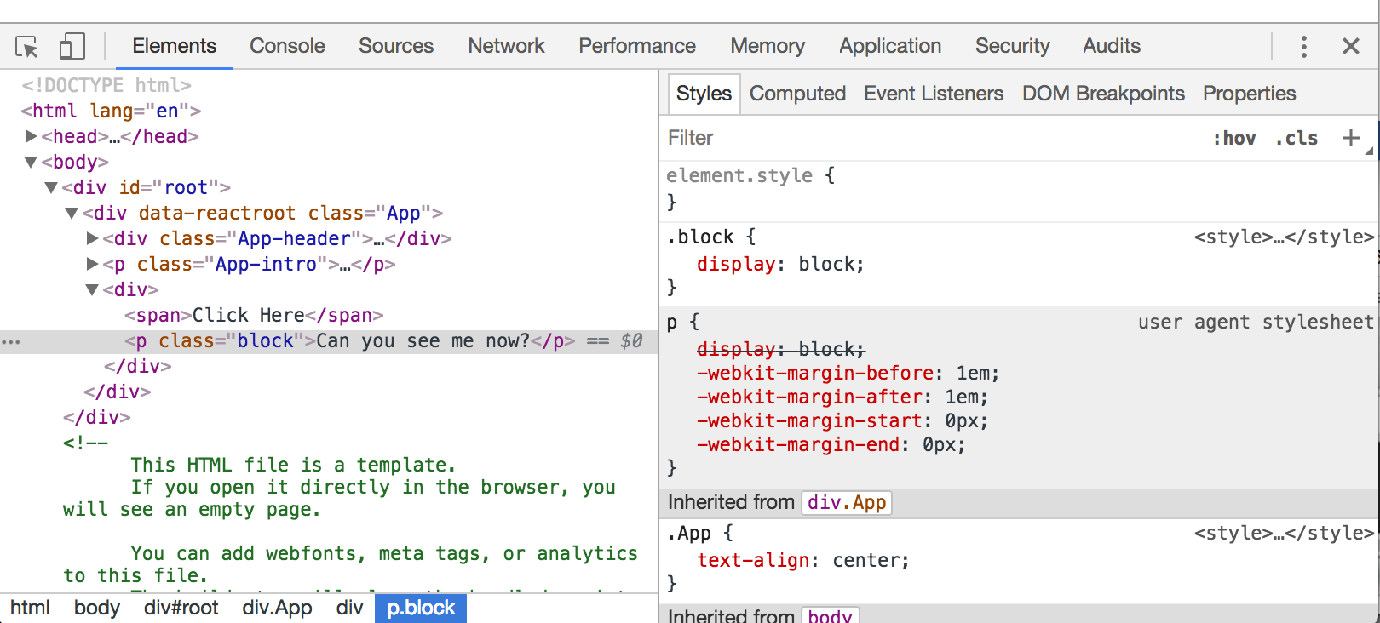
Use Chrome Debugger
In Chrome, open the debugger
Right click, then Inspect

Slide 7
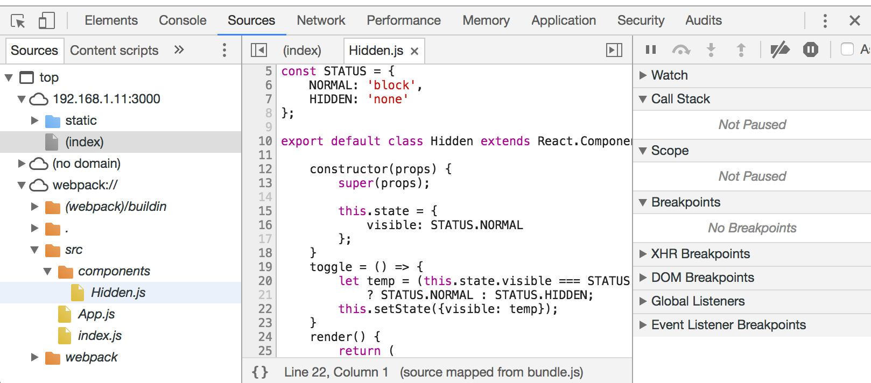
Debug with Chrome
Look in the Sources tab
Select the Hidden.js component

Slide 8
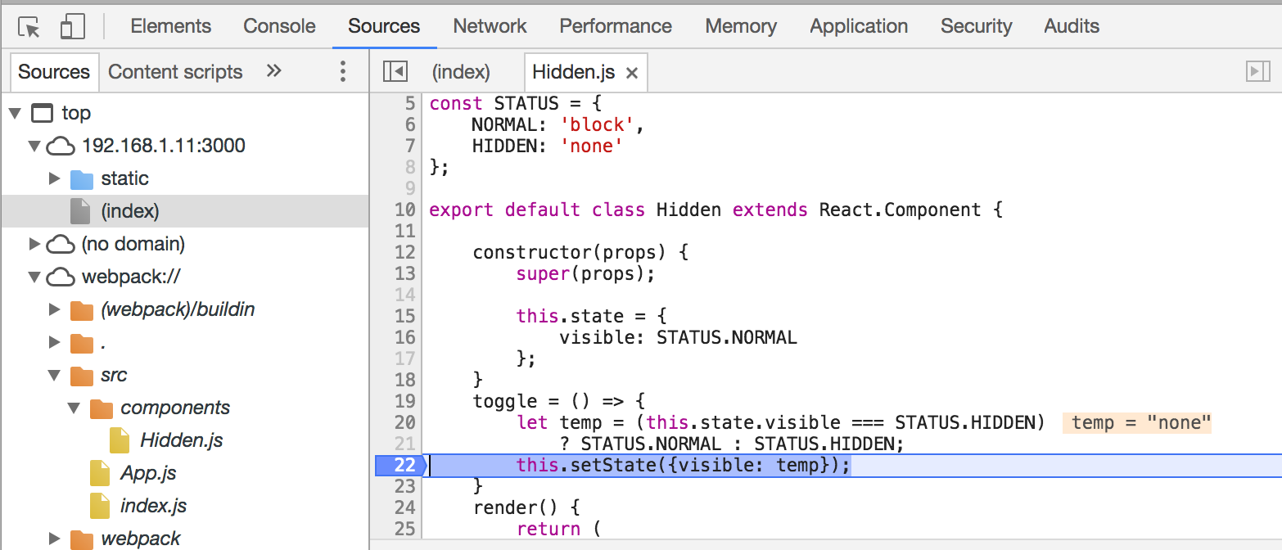
Debug with Chrome
Set a breakpoint at line 22
Refresh the page or click on the ‘Click Here’

Slide 9
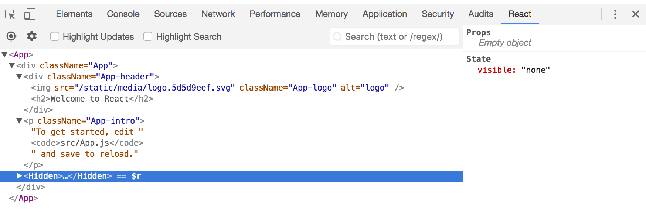
Debug with Chrome
Install ‘react-devtools’
Select the Hidden component

Slide 10
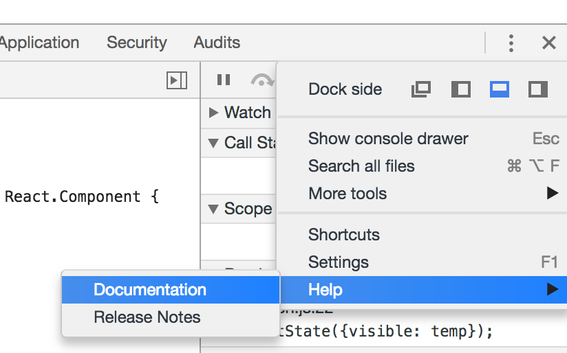
Debug with Chrome
Lots of help with Chrome
Can do profiling
Can do …

Slide 11
Lab Exercise
Use the instructions
Use the solutions/debugging folder
Install react-devtools
Perform breakpoints
View the <Hidden> props and state

