Slide 1
Reactjs Redux Async

Slide 2
Overview
Asynchronous code is more complex (of course)
The Action function handles it
Calls dispatch() multiple times
Usually the async Action should
Invoke a BEFORE action
To change the UI (like a spinner) by changing the state
Invoke the ASYNC code
Invoke the AFTER action with the data from Async
In the callback from the async call
Removes the spinner (by changing the state)

Slide 3
Async Actions
The reducer handles state change based on the action
It has the signature of ( state, action ) => state
We get the Async data and dispatch the reducer ourselves
The Async ACTION function does the following:
The function gets called by Redux via mapping
Signature is ( p1, p2 ) => null
The function invokes the async business logic – eg RESTful call
When the async part returns, the action calls:
dispatch( action_object )

Slide 4
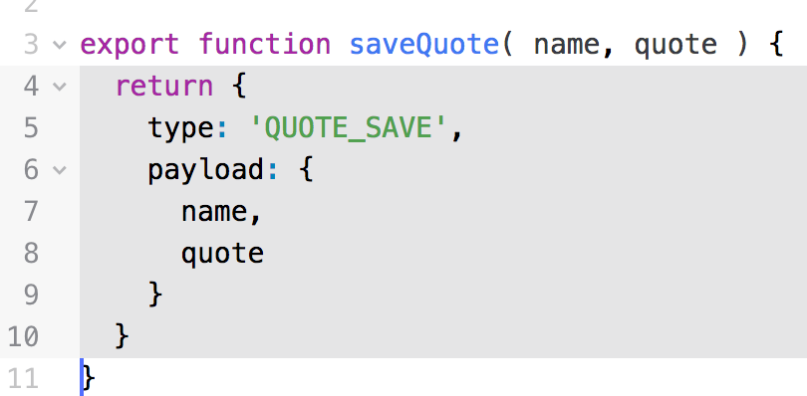
Redux Actions Revisited
In the last section, we defined an Action as a Command Object
Now, we put all the commands (whoops.. Actions) in a file
Then we call a method() which returns the Action
Easier to maintain – De-coupling
Can change the Action without changing the caller
Usually defined as a Constant
In a different file. Shared with
the reducer.

Slide 5
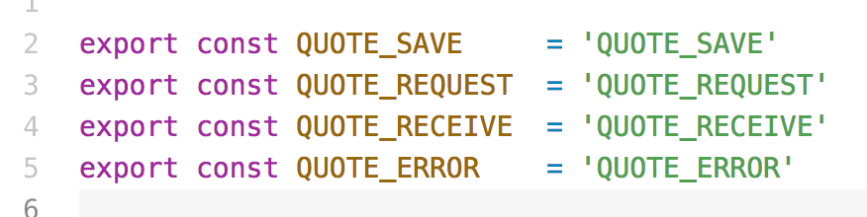
Action Constants
Defines all the strings shared by the Action and the Reducer
Action sends as the type
Reducer uses in the switch( action.type ) statement
Must be unique in the application
Convention is the Object first (e.g. QUOTE )
File → QuoteConstants.js

Slide 6
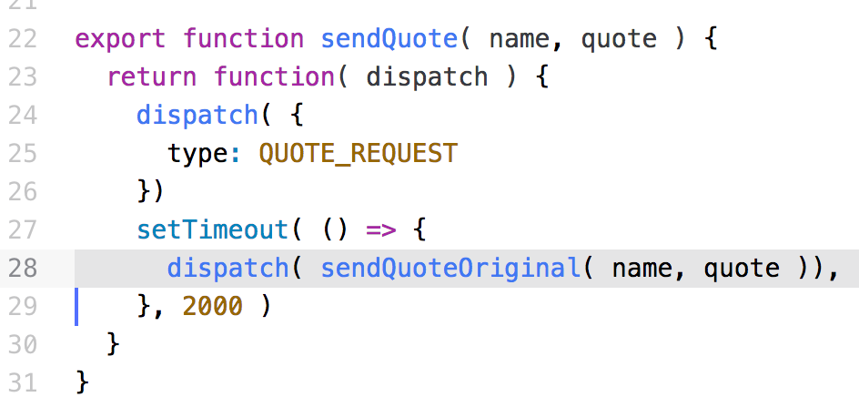
Redux Thunk
A THUNK is a function that returns a function
If we pass a Function to the dispatch() method
It calls the Function with dispatch as a parameter
This allows us to make multiple dispatch()es to React

Slide 7
UI Async Issues
In the UI, you probably want to use a spinner (or something)
Display during the Async operation
Hide after the Async finishes
Handle Async error messages
The component needs another property
Indicates in the middle of Async (using the property ‘isDelayed’)
So the saveQuote() action now becomes THREE actions
The saveQuote( name, quote )
Now dispatches the other two
The requestQuote( ) which sets a property ’isDelayed’ to TRUE
This is BEFORE the async call
The receiveQuote( name, quote ) which does the old save

Slide 8
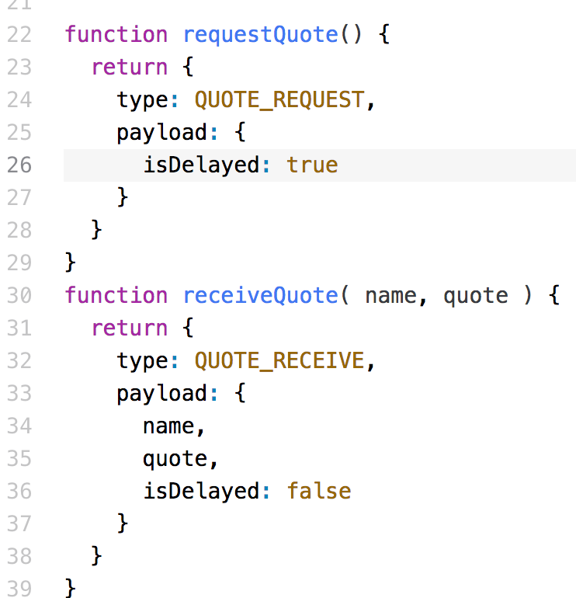
The New Actions
File → QuoteActions.js
Called BEFORE the async call
Sets the isDelayed property
Called AFTER the async call
Clears the isDelayed property

Slide 9
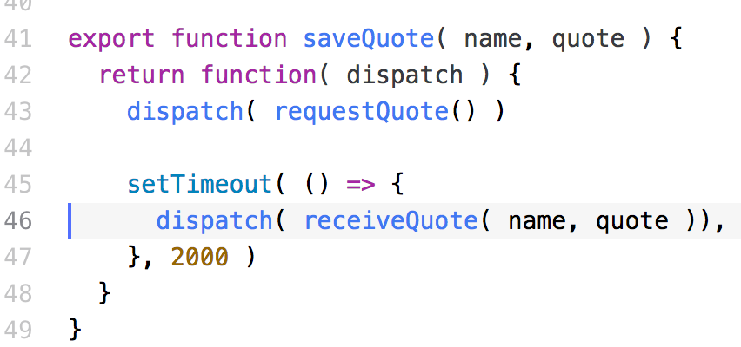
The New Actions with dispatch()
File → QuoteActions.js
Same action name !!!!!
Dispatched BEFORE the async call
Dispatched AFTER the async call

Slide 10
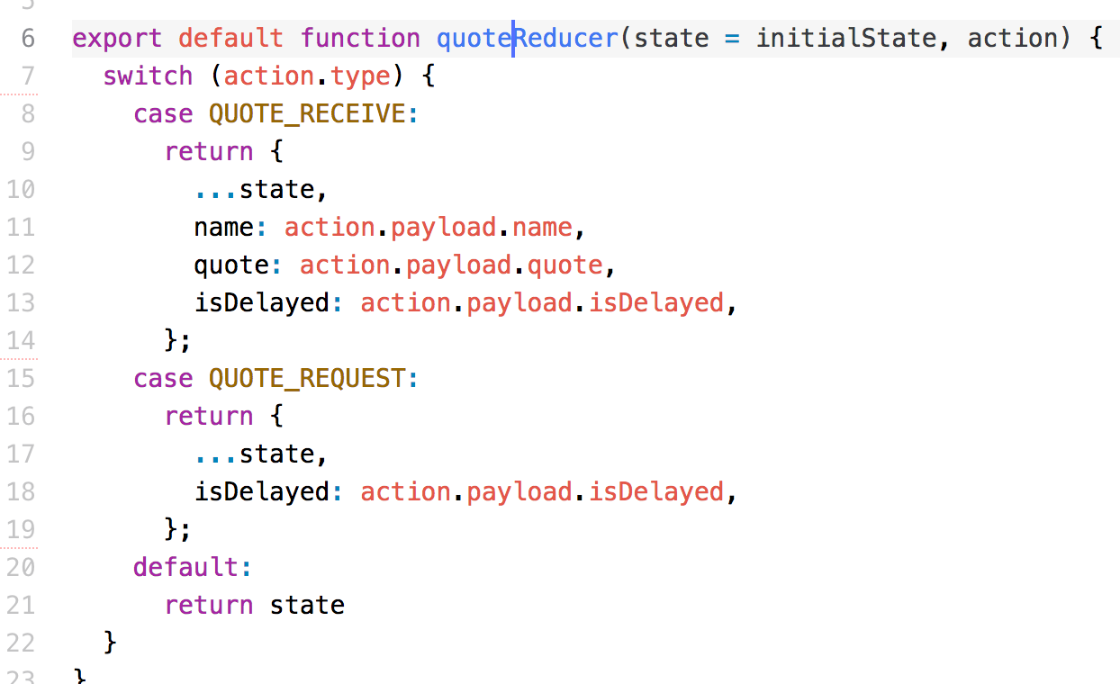
The New Reducer
File → QuoteReducer.js

Slide 11
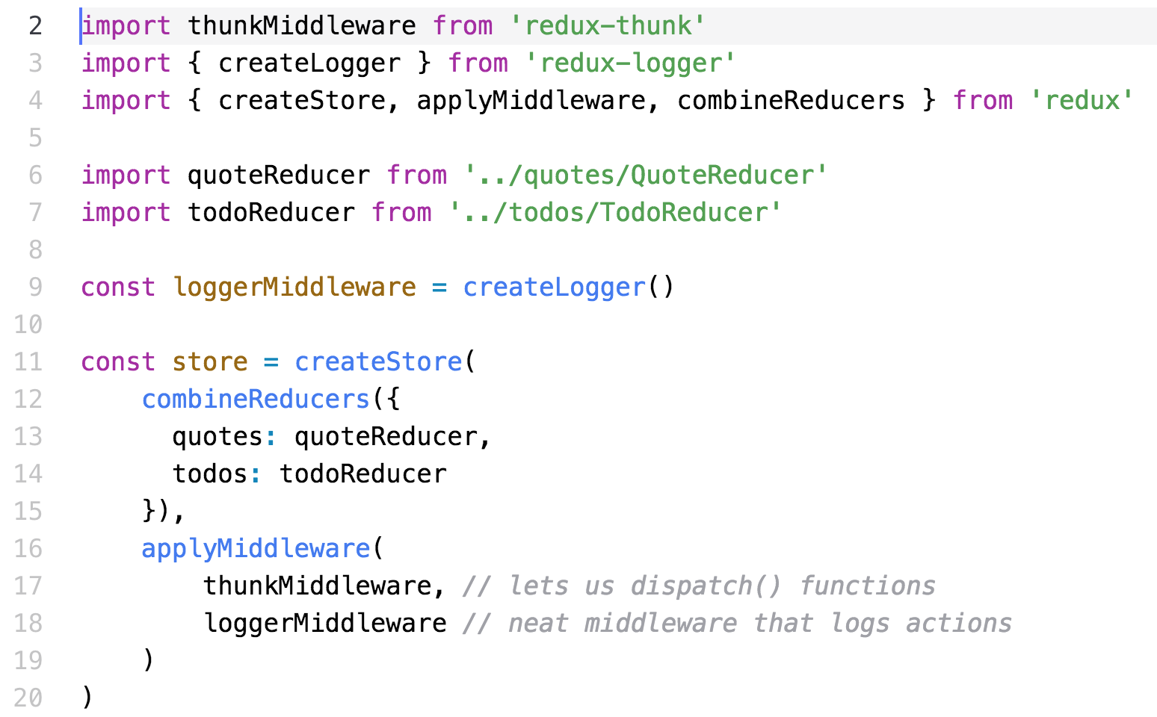
Configure the store – store.js
Configure the store to add the dispatch() function call

Slide 12
Summary
Async requires that the Action
Dispatches multiple Action Commands
The BEFORE action – spinners
The ASYNC call
The AFTER action
Save the data
Set the state for
Spinners
Errors

Slide 13
Lab Exercise
In this lab, you will:
Start with the Redux app
Modify the Actions and Reducers
To handle an async call
Configure the store
Watch it work!!!

