Slide 1
Reactjs User Input

Slide 2
Overview
Three ways to input user data in a React Component
All access the DOM elements
Elements inputs
On Submit, access the elements[ ] array on the <form>
Controlled input
Save current value in the state
Update current value with ‘onChange’ event handler
Un-controlled input
Use a ‘ref’ attribute to get a reference to the DOM <input> element
On Submit, access the value of the reference variable

Slide 3
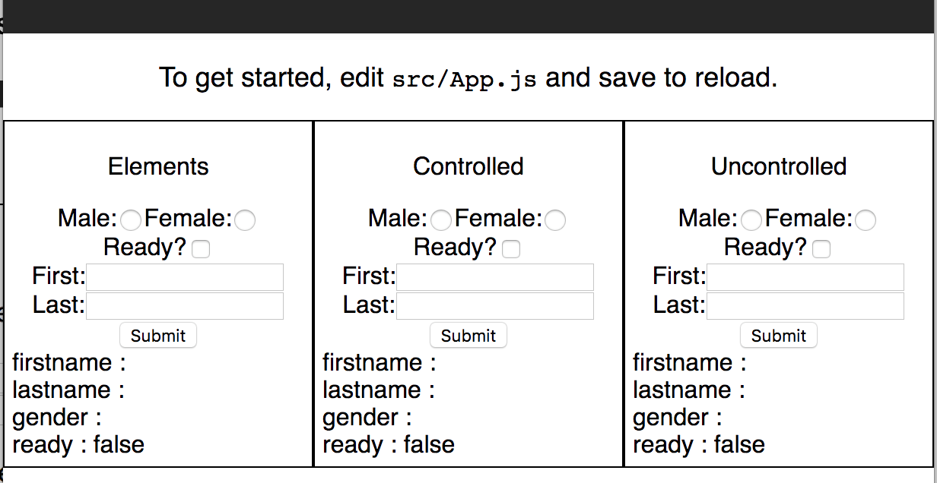
The App
This demonstrates the three methods
Inputs include Radio Buttons, Checkboxes, Text Input, etc.

Slide 4
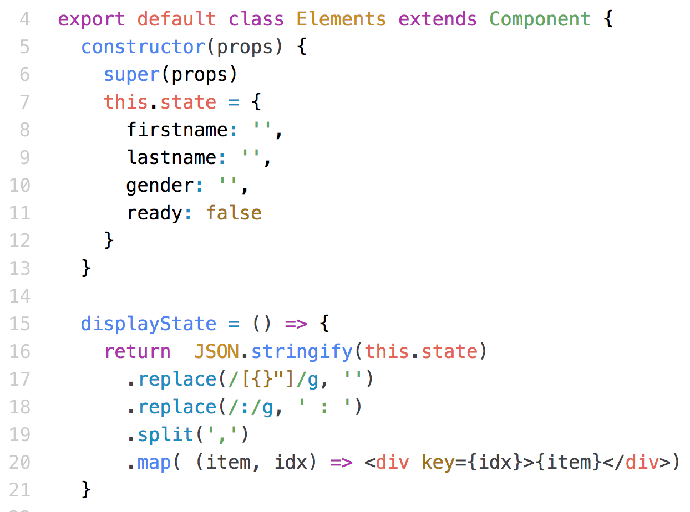
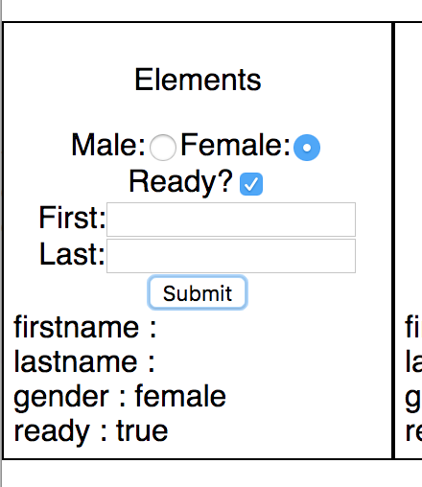
The Application
Is a React.Component
Notice the state and displayState() function

Slide 5
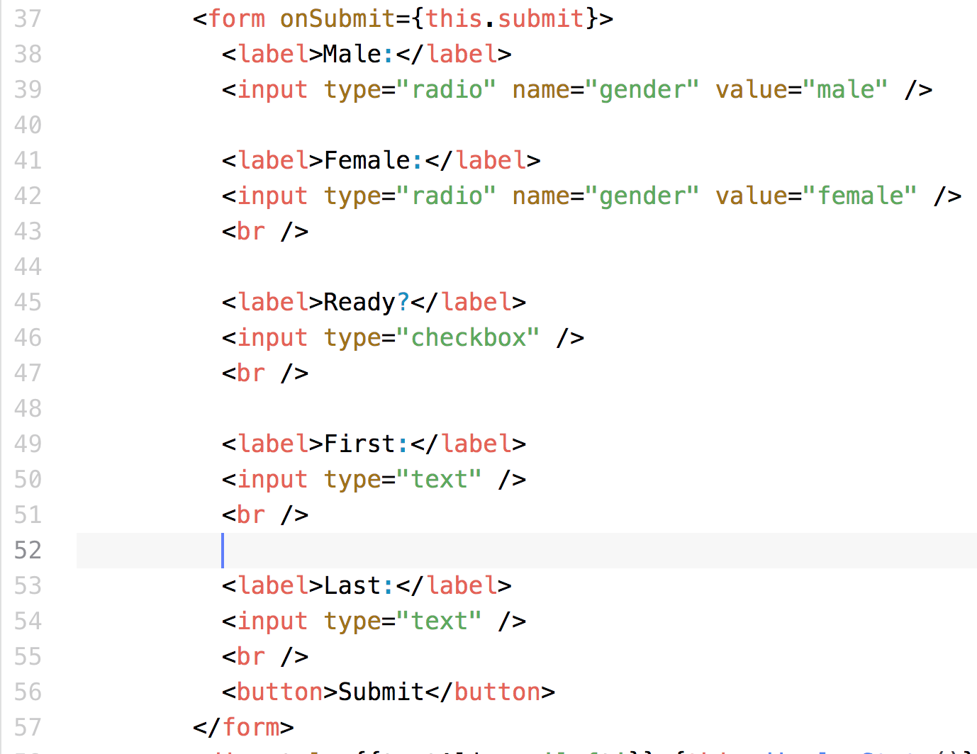
<form> Elements
Element 0
Element 1
Element 2
Element 3
Element 4

Slide 6
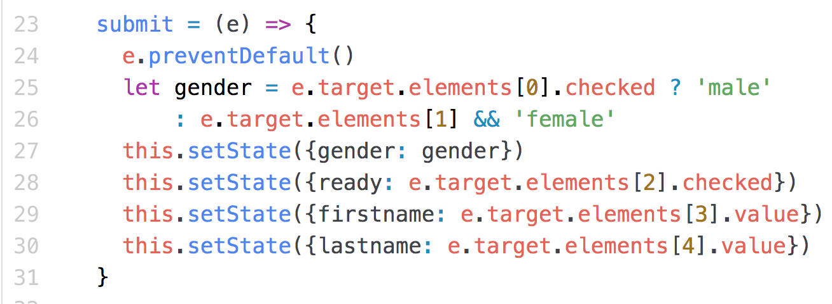
<form> Elements
On SUBMIT
Transfer user input to the State

Slide 7
<form> Elements
Advantages
Easy to build – JSX easy
Easy to understand
Disadvantages
Fragile – Adding an element changes the index values
Values only show up when the form is submitted

Slide 8
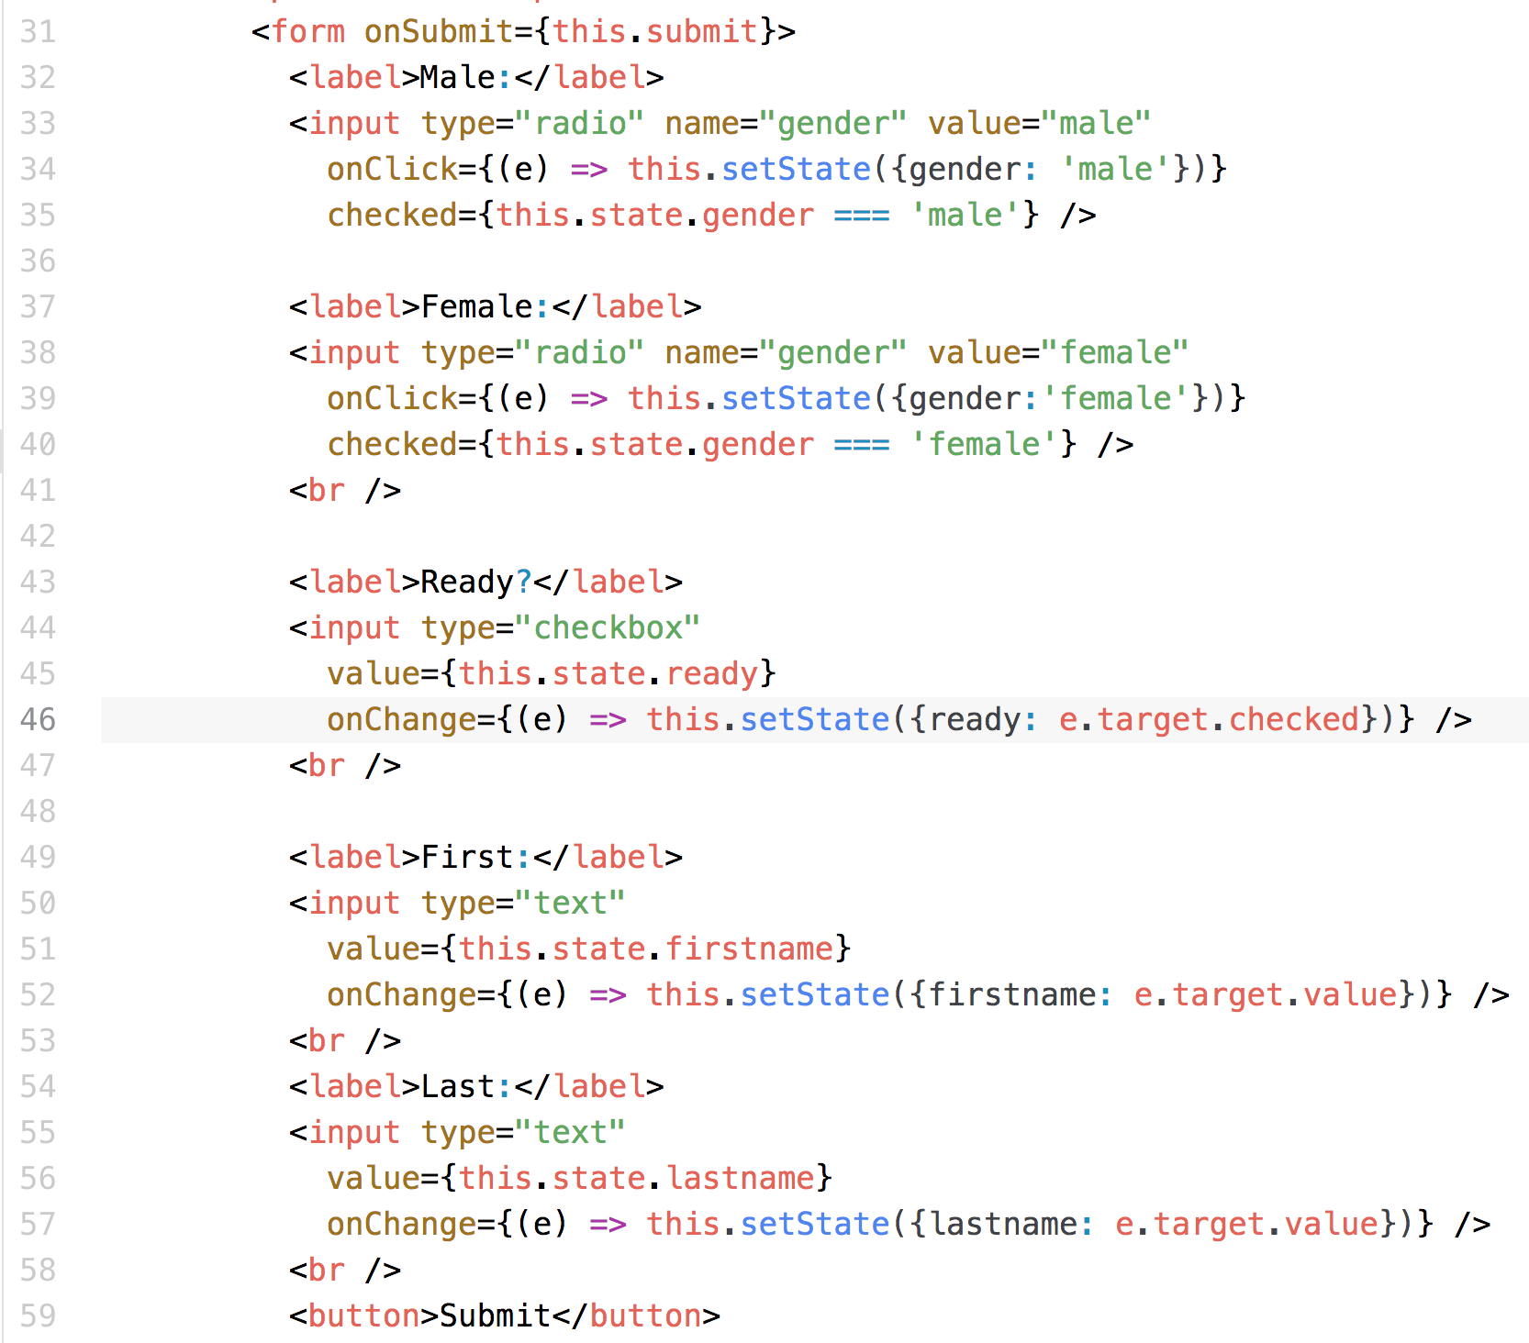
Controlled Inputs
Each input changes the state immediately, so re-render
‘onClick’ attribute
‘checked’ attribute
‘value’ attribute
‘checked’ property
‘value’ attribute
‘value’ property
‘value’ attribute
‘value’ property

Slide 9
Controlled Inputs
Advantages
Immediate update to the screen
Can use for immediate validation
Radio buttons easy
Robust – adding an element does not change existing elements
Disadvantages
More complex JSX

Slide 10
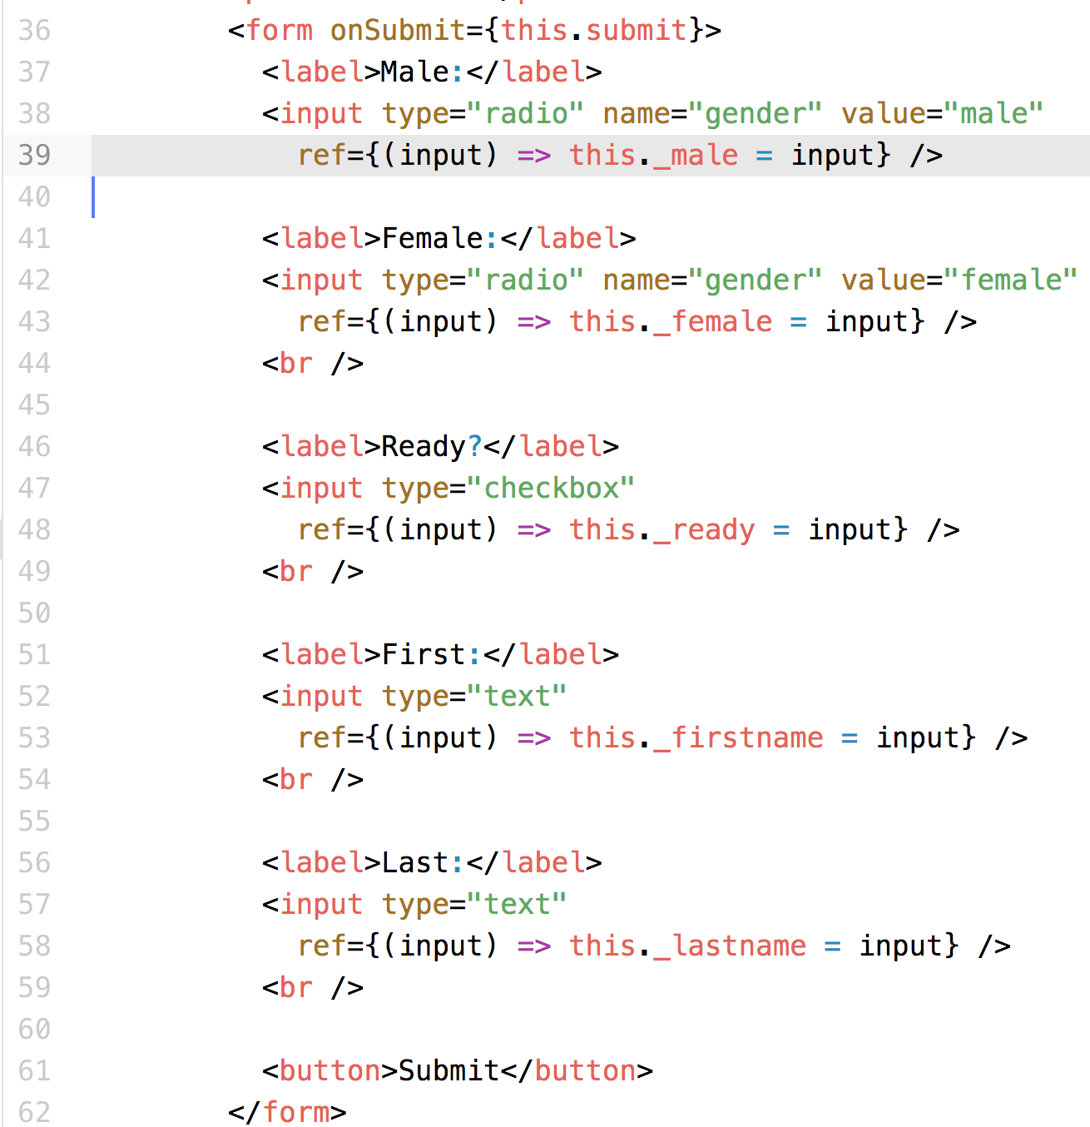
Uncontrolled ’ref’ Inputs
Creates a reference (ref) to the DOM <input> element
‘ref’ attribute
Assigns a DOM reference
To the instance variable,
this._male

Slide 11
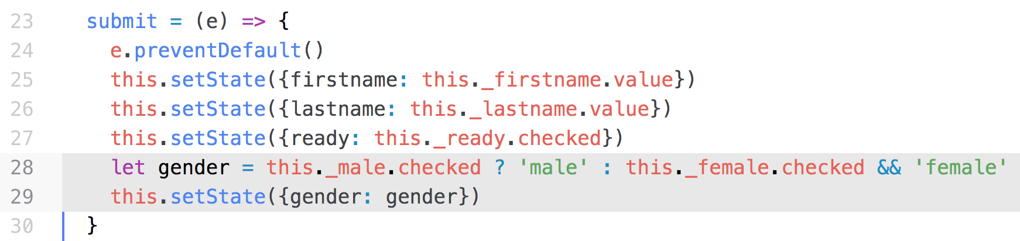
Uncontrolled ’ref’ Inputs
On Submit
Changes the state variables
Access the value from the DOM elements
Transfer user input to the State

Slide 12
Uncontrolled ’ref’ Inputs
Advantages
JSX intermediate (easier than Controlled, more complex than elements)
Disadvantages
State change only on Submit

Slide 13
Summary
Three ways to input user data in a React Component
All access the DOM elements
Elements inputs
On Submit, access the elements[ ] array on the <form>
Controlled input
Save current value in the state
Update current value with ‘onChange’ event handler
Un-controlled input
Use a ‘ref’ attribute to get a reference to the DOM <input> element
On Submit, access the value of the reference variable

Slide 14
Exercise
Existing React app, lab/react-app
Follow the TODO instructions to fix the app

Slide 15
Lab
File → /instructions/react-user-input.docx
Modify an existing project
Three components, Elements, Controlled, Uncontrolled
Turn the TODO’s into TO-DONEs

