Slide 1
React Mock Testing

Slide 2
Mock Functions
One of the problems with testing
The Unit Under Test (UUT) might (will) have dependencies
For example: a database, or a network site
It is difficult (or impossible) to:
Have a known state each time the test runs
Have custom data returned by the calls
Enter a Mock Server (or function)
It emulates the module called by the UUT
jest has built in support for Mock Function
Auto-mock → ALL modules are mocked

Slide 3
Mock the Callbacks
The Component under test
Pass it known data (via attributes)
Provide callbacks (via attributes)
Use a mocked function as the callback
Provide known data via the attributes, check the callback data
Good data for assurance that it works
Bad data for assurance that it detects errors, etc.
Simulate a click (or etc.)
Verify the mock was called correctly

Slide 4
What Happens?
These are the steps to use
Test Program → Create a MOCK function (callback) in the test program
Test Program →Pass the MOCK function as an attribute in the UUT
Test Program → Render the Component (the Unit Under Test)
Test Program → Simulate an Event (a click, submit, etc)
UUT → Event Handler invokes the callback (with data??)
Test Program → Verify the MOCK function was called.
Can also verify parameters
Can also return specific values from the MOCK function, to the Component

Slide 5
jest.fn()
jest.fn() returns a Mock Function which returns values
const myMock = jest.fn(); myMock('1'); myMock('a', 'b'); console.log(myMock.mock.calls); // > [ [1], ['a', 'b'] ]
All mock functions have the following API
.mock property → where the data for each call is stored
.mock.calls → array of parameters when it is called
.mock.calls.length → how many times it is called
Use the mock function as the CALLBACK in the UUT

Slide 6
Return Known Values
Mock Return Values
Allows the UUT to have pre-determined value
myMock.mockReturnValueOnce(10) .mockReturnValueOnce('x') .mockReturnValue(true); console.log(myMock(), myMock(), myMock(), myMock()); // > 10, 'x', true, true

Slide 7
Custom Mock Function
Create your own Mock Function
To return more than just the values
const myMockFn = jest.fn(cb => cb(null, true)); myMockFn((err, val) => console.log(val)); // > true myMockFn((err, val) => console.log(val)); // > true
How many parameters does the Mock Function have ???

Slide 8
Custom Mock Function
Create your own Mock Function
To return more than just the values
const myMockFn = jest.fn(cb => cb(null, true)); myMockFn((err, val) => console.log(val)); // > true myMockFn((err, val) => console.log(val)); // > true
How many parameters does the Mock Function have? ➔ one
It’s a function parameter

Slide 9
Change the Values
The mock function can change the values returned
const myMockFn = jest.fn(() => 'default') .mockImplementationOnce(() => 'first call') .mockImplementationOnce(() => 'second call'); console.log(myMockFn(), myMockFn(), myMockFn(), myMockFn()); // > 'first call', 'second call', 'default', 'default'

Slide 10
Custom Matchers
Jest has some custom matchers for validating the calls
// The mock function was called at least once expect(mockFunc).toBeCalled(); // The mock function was called at least once with the specified args expect(mockFunc).toBeCalledWith(arg1, arg2); // The last call to the mock function was called with the specified args expect(mockFunc).lastCalledWith(arg1, arg2);

Slide 11
Enzyme Testing
Caveats
When you use simulate(’event’, EventObject),
It calls onEvent( EventObject )
You must provide the EventObject if used in the handler
After simulate() is called, get another copy of the <input>, etc..
Use wrapper.find(‘input’) again… get new COPY of the object

Slide 12
Enzyme Testing Process
Enzyme Testing Steps
First, get a shallow rendered instance of the component
Next, convert to a JSON object and get a jest snapshot
Next, simulate some event
Input data, submit a form, click on something
Convert to JSON object and get a jest snapshot
Get a new copy of something interesting and compare the changed values
Repeat as needed
EXAMPLES FOLLOW

Slide 13
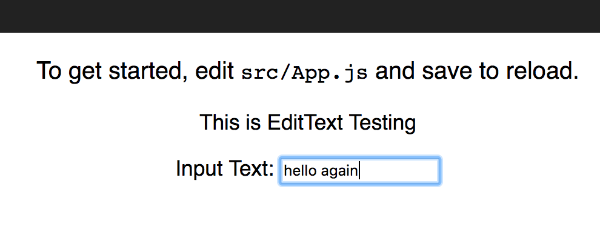
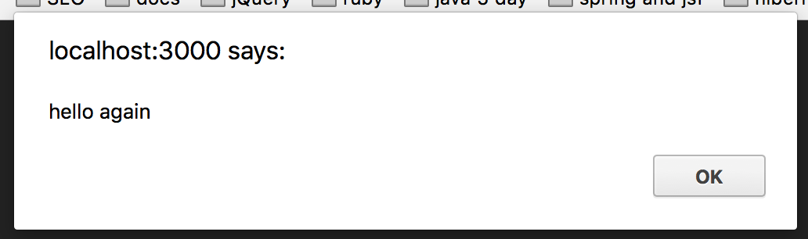
The Text Input field is ready

Slide 14
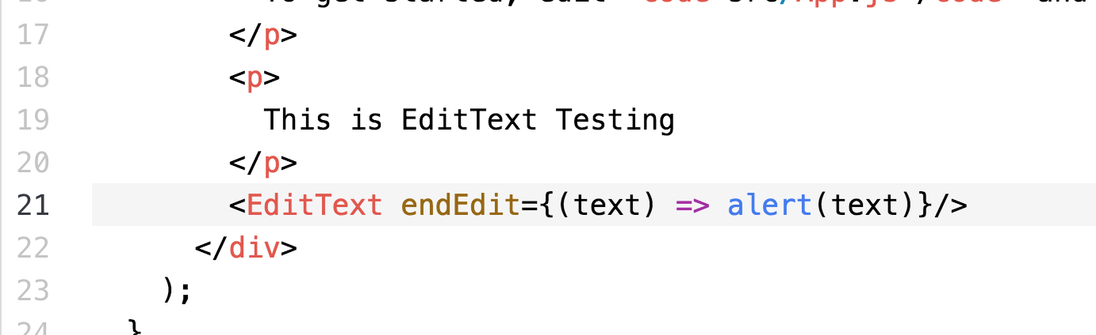
App.js Calls EditText.js
Callback puts the alert() on the screen
User enters data in EditText

Slide 15
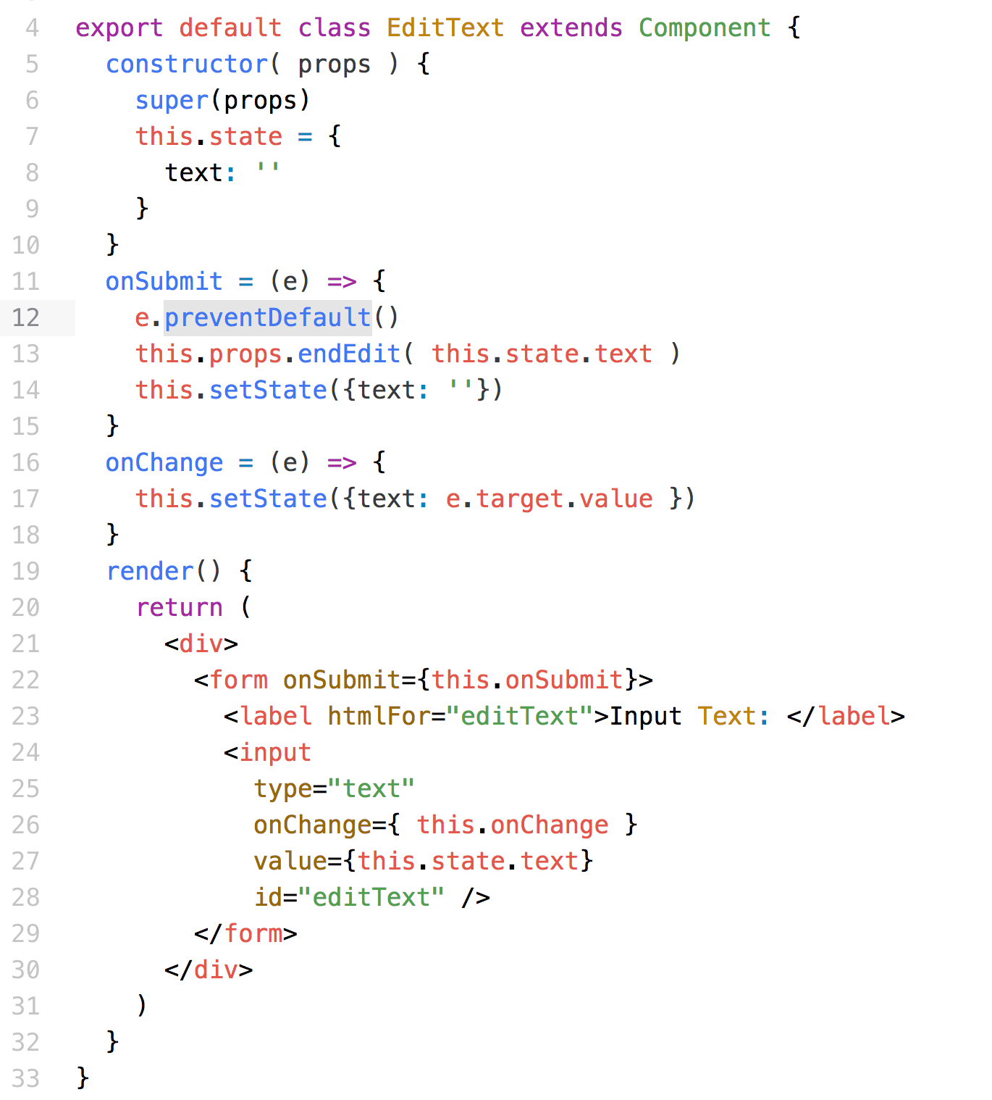
Test this component EditText.js
Callback to parent
User entered RETURN
Current Input

Slide 16
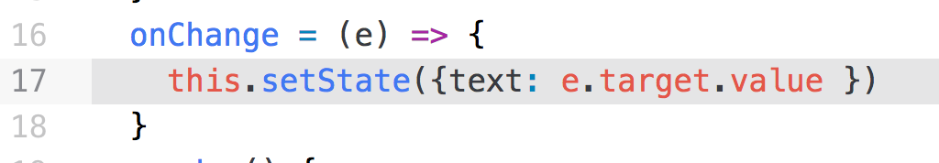
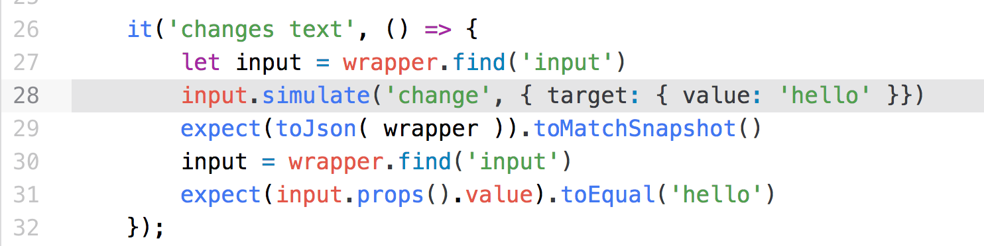
EditText.js Event Handlers
Event handlers have how many parameters?
Enzyme simulate( ‘event’, eventParameter)
What data type is the event parameter?

Slide 17
EditText.js Event Handlers
Event handlers have how many parameters? ➔ ONE
Enzyme simulate( ‘event’, eventParameter)
What data type is the event parameter?

Slide 18
EditText.js Event Handlers
Event handlers have how many parameters? ➔ ONE
Enzyme simulate( ‘event’, eventParameter)
What data type is the event parameter? ➔ an Event Object

Slide 19
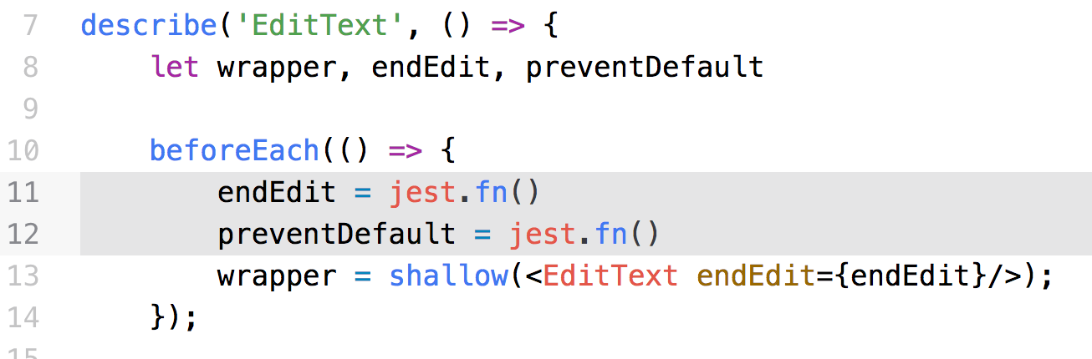
EditText-test.js – page 1
The mock function, endEdit

Slide 20
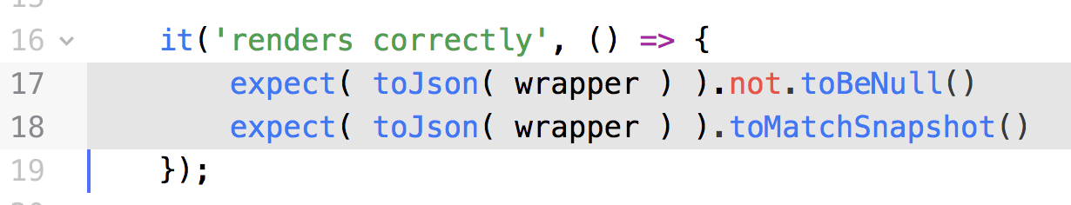
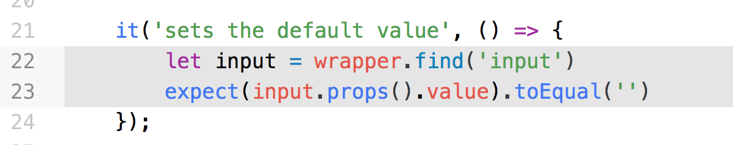
EditText-test.js – page 2
Make sure it matches the snapshot
Make sure it sets the default value from the state

Slide 21
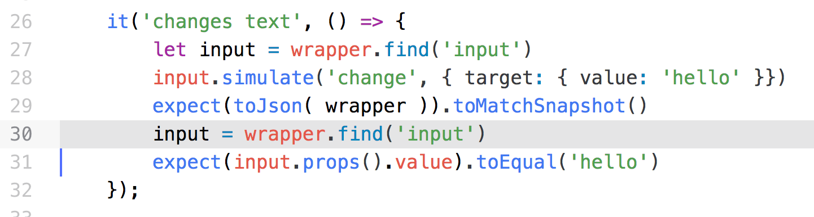
EditText-test.js – page 3
Simulate entering text
Notice, it must get a NEW copy of the <input> to see the changes!!!!
Copy of <input>
Event Object
Copy of <input>

Slide 22
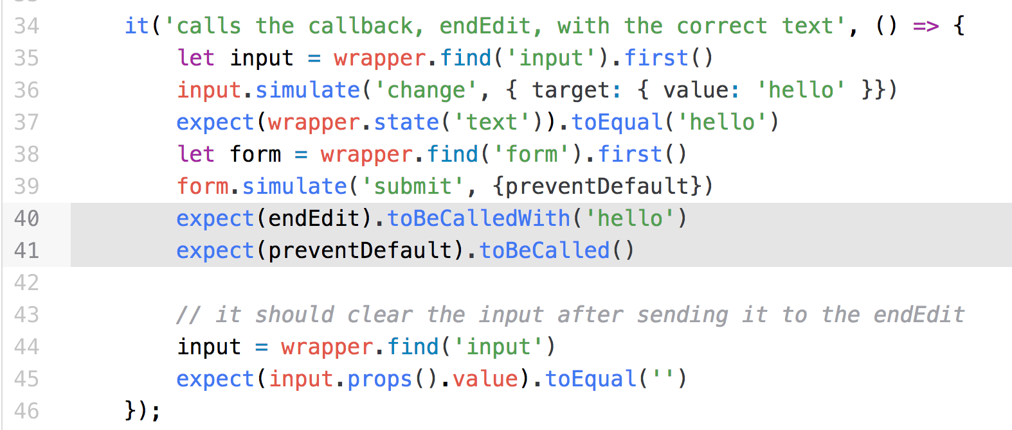
EditText-test.js – page 4
Make sure it calls the mock function
New copy of <input>, verify data is cleared
Event Object
Event Object
Data entry
is cleared

Slide 23
Summary
Difficult to test Components
Usually part of an environment
Have resources they call
Have callbacks they call
Have special data needed
Mock servers and functions
Provide known environments
Surround the Component Under Test with known environment

